Slide 1
Icelandic Communists 1918–1998
Hannes H. Gissurarson
22 September 2012

Slide 2
The Icelandic Movement
1918–1930 part of the Social Democratic Party
1930–1938 Communist Party, member of Comintern
Brynjolfur Bjarnason (1898–1989) leader
1938–1956 Socialist Unity Party, dominated by communists
Einar Olgeirsson (1902–1993) leader
1956–1968 Electoral alliance with left-wing groups
1968–1998 People’s Alliance, with no formal ties to the communist countries
Svavar Gestsson (b. 1944) one of leaders

Slide 3
Green Square, Copenhagen 1918

Slide 4
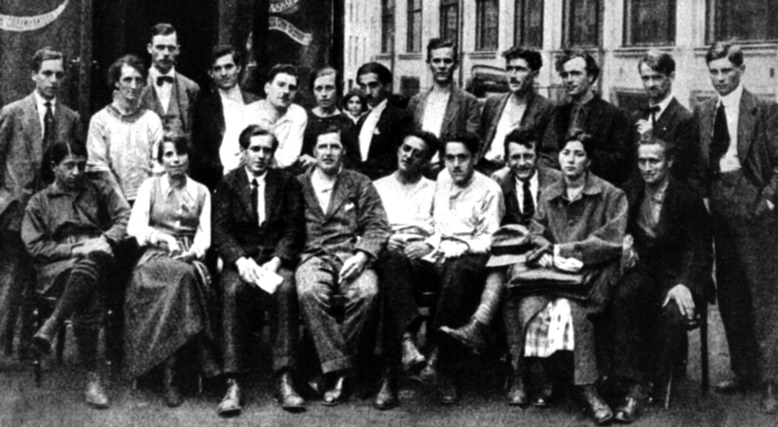
1920 Journey to Russia

Slide 5
The Revolutionary Dream
In Iceland the dream did not come true
Abroad, it became a nightmare, with 100 million victims
Conflict between social democrats and communists
21 Moscow theses
23 in Lenin School and Western University, Moscow
Arms hidden in Reykjavik
Repeated riots: “Drengsmalid” 1921, “Guttoslagurinn” 1932 (and three other assaults on the city council), assault on Conservative Party Headquarters 1946, assault on Parliament House 1949

Slide 6
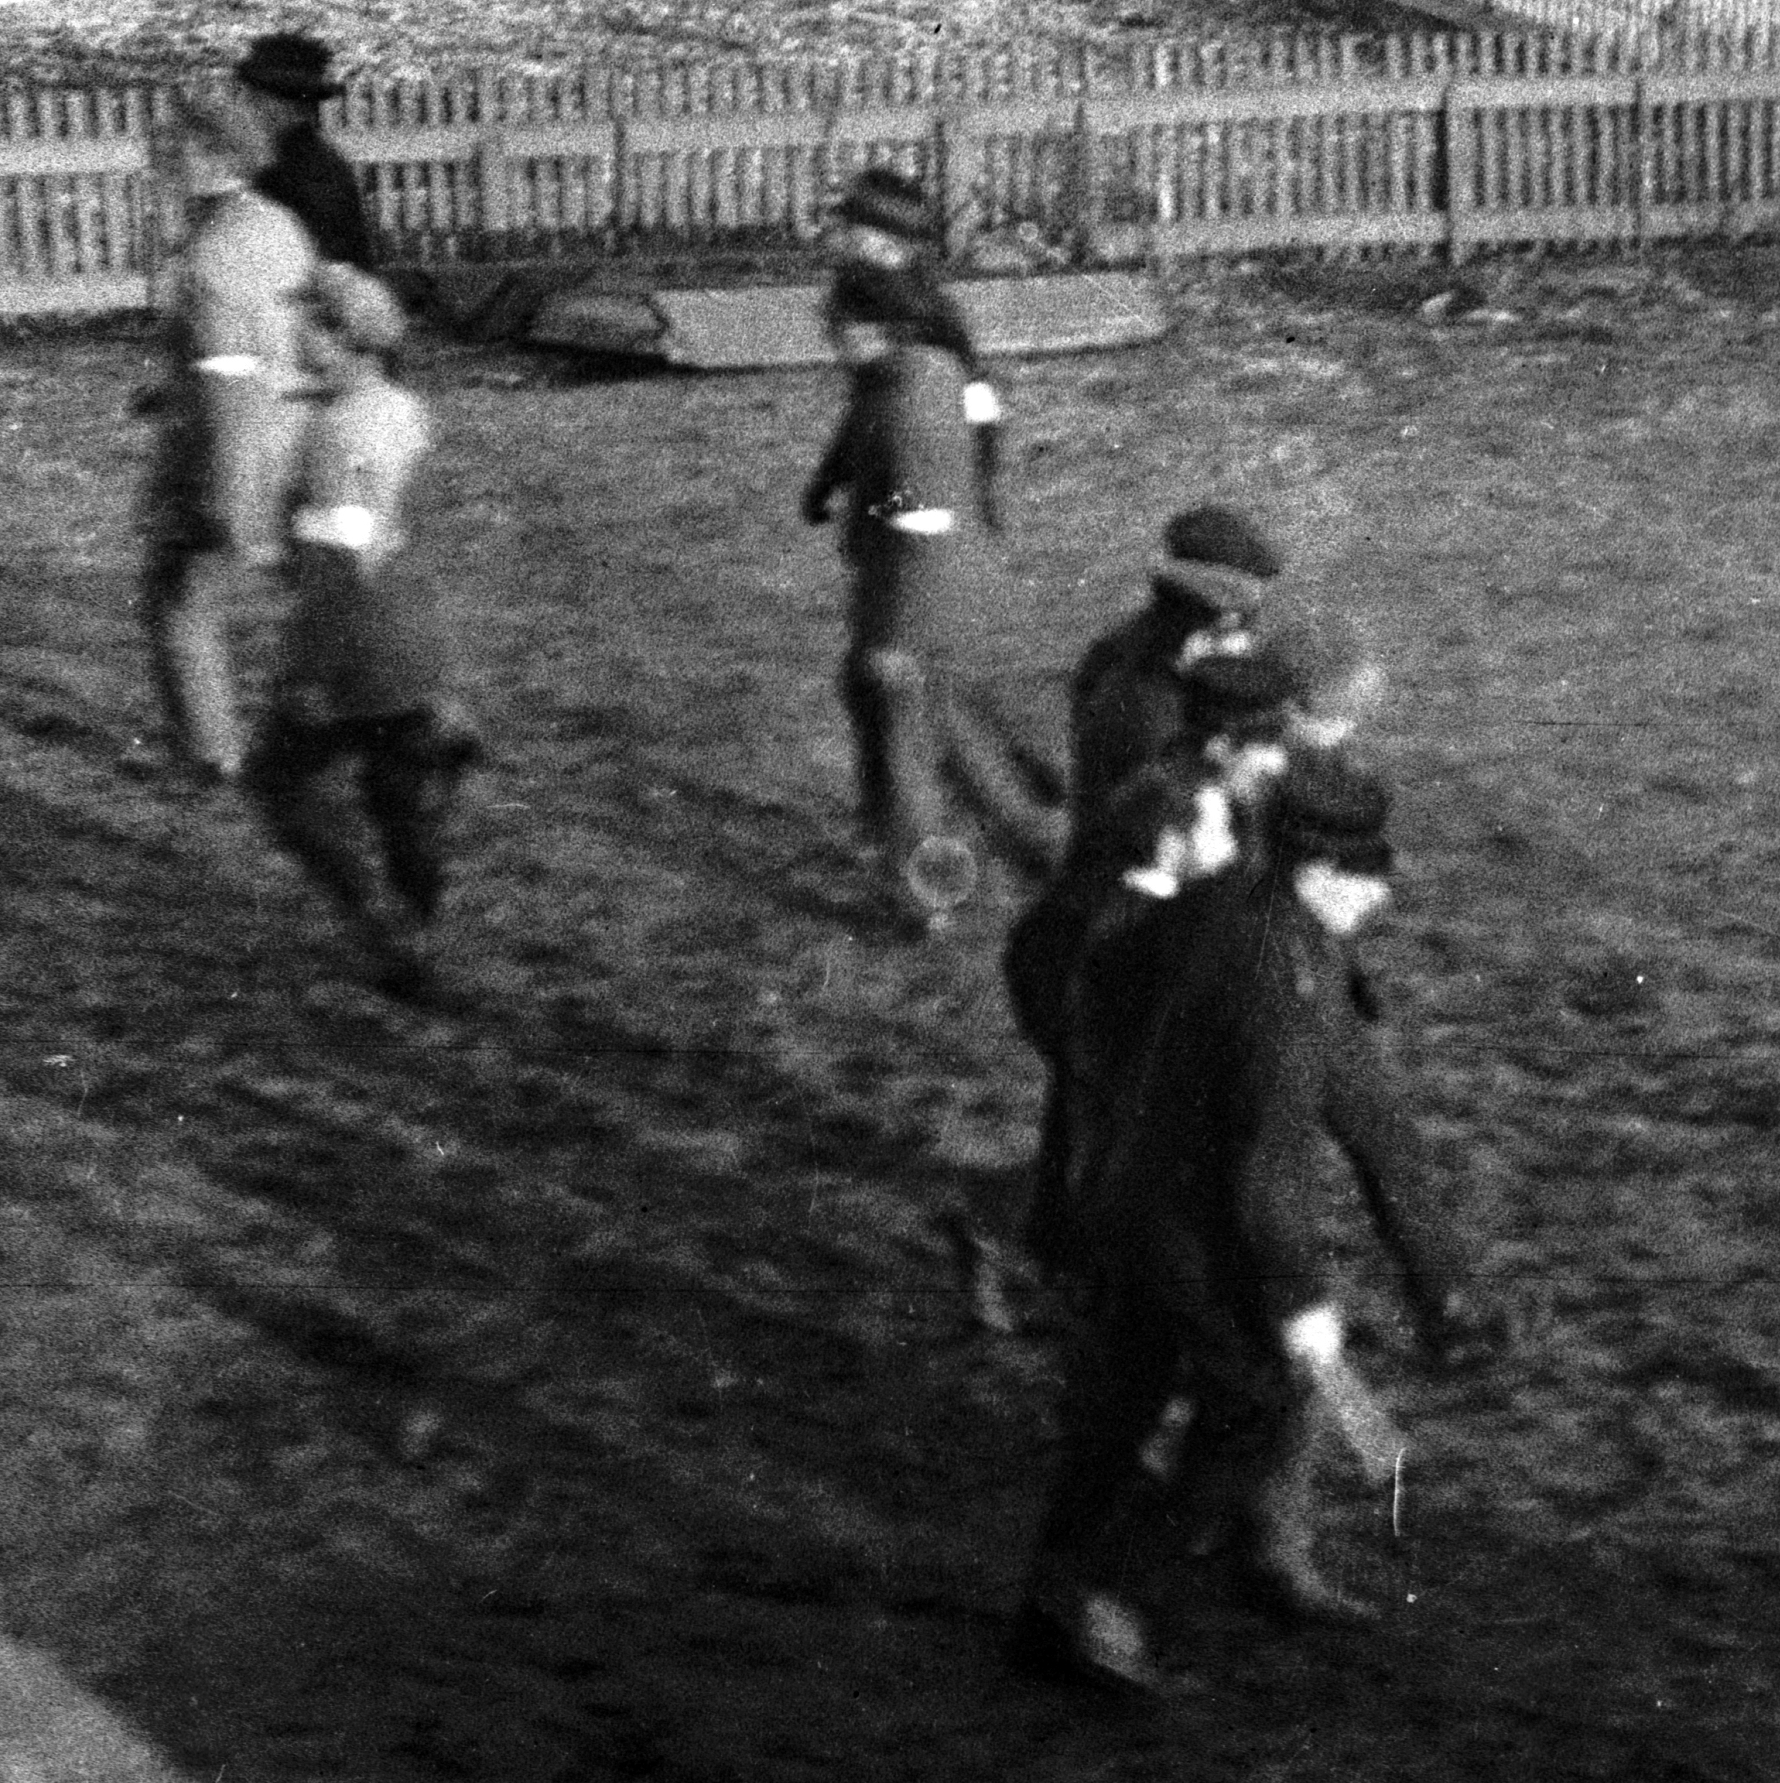
“Drengsmalid” 1921

Slide 7
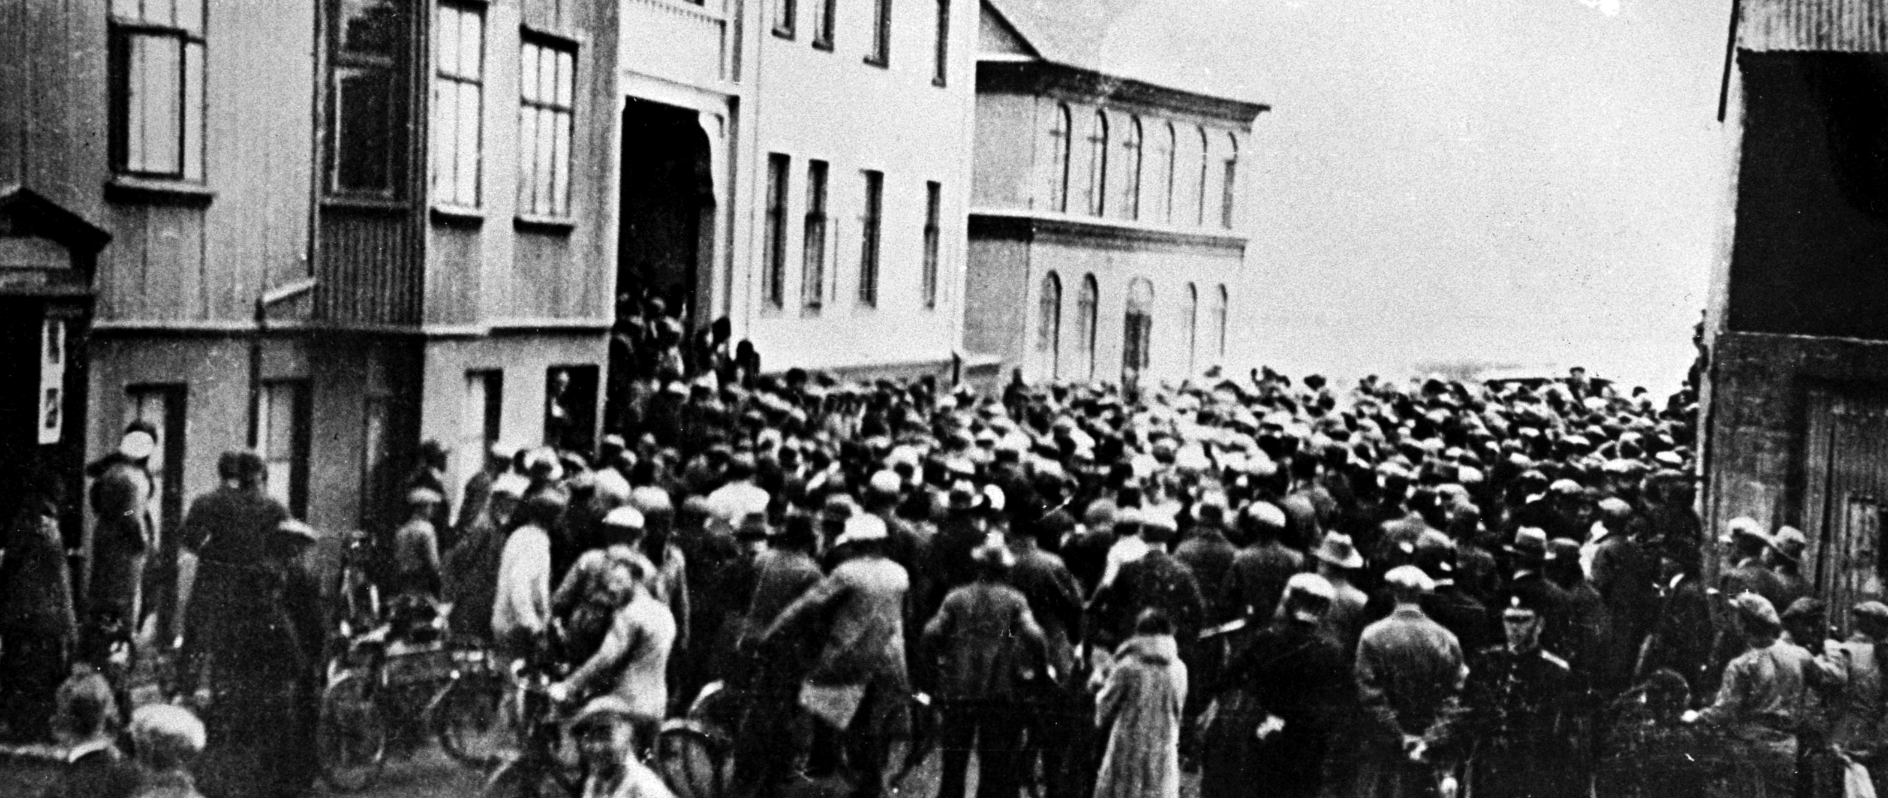
Gutto Assaults 1930–1932

Slide 8
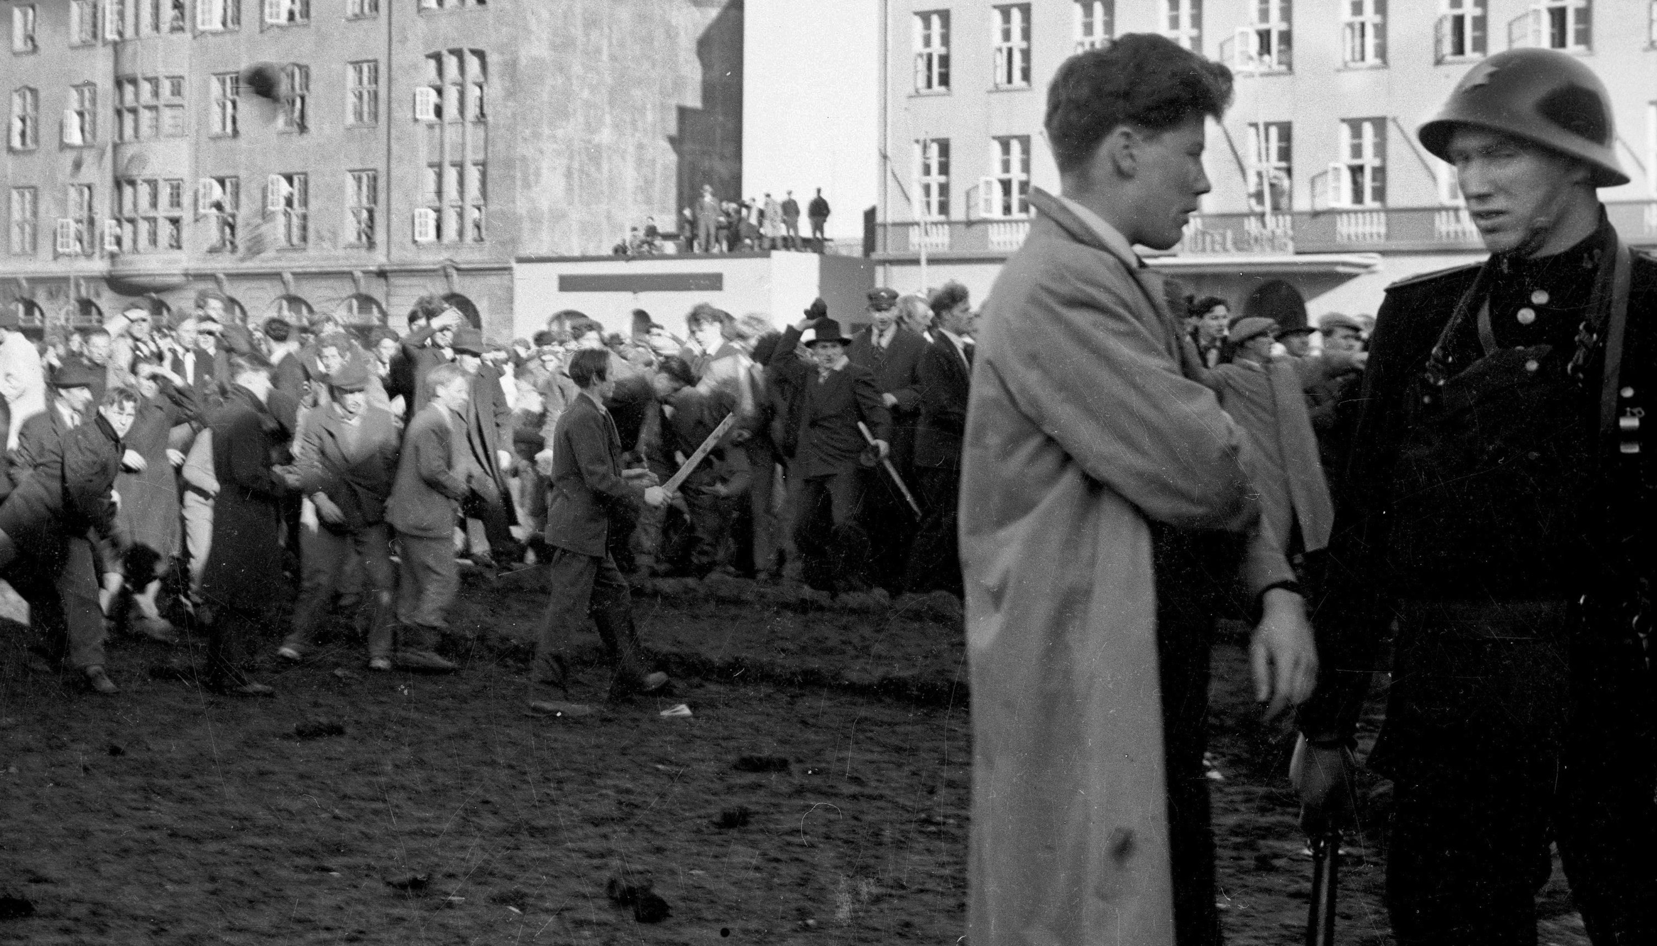
Parliamentary House 1949

Slide 9
Spying
MI5 deciphered telegrammes from Moscow in the mid-1930s, on obtaining passparts and providing information about individuals
Spies from the Soviet Naval Secret Service met Einar Olgeirsson in Summer of 1942
Spy from the Secret Service, Egorov, in the Embassy from 1944
Possible spy, Karl Sepp, 1946–1947
Vasily Mitrokhin here some time in 1952–1956
Spies or Agents: Arsaell Sigurdsson, Eggert Thorbjarnarson og Gudmundur Agustsson
Mostly GRU agents in Embassy, also KGB
Ragnar Gunnarsson Affair 1963

Slide 10
Gold from Russia
First transfer 1920
Swedish GRU agent Signe Sillén provided funds
Support 1931 and 1937 and 1940, possibly more often
Funds to Socialist Unity Party 1956, 1959, 1963 and 1966
Funds to MM Literary Society 1968 and 1970 and pension for Kristinn E. Andresson
Many tours to communist countries and two employees at friendship organisation
Many student grants to socialist countries, especially GDR
Many houses in Reykjavik

Slide 11
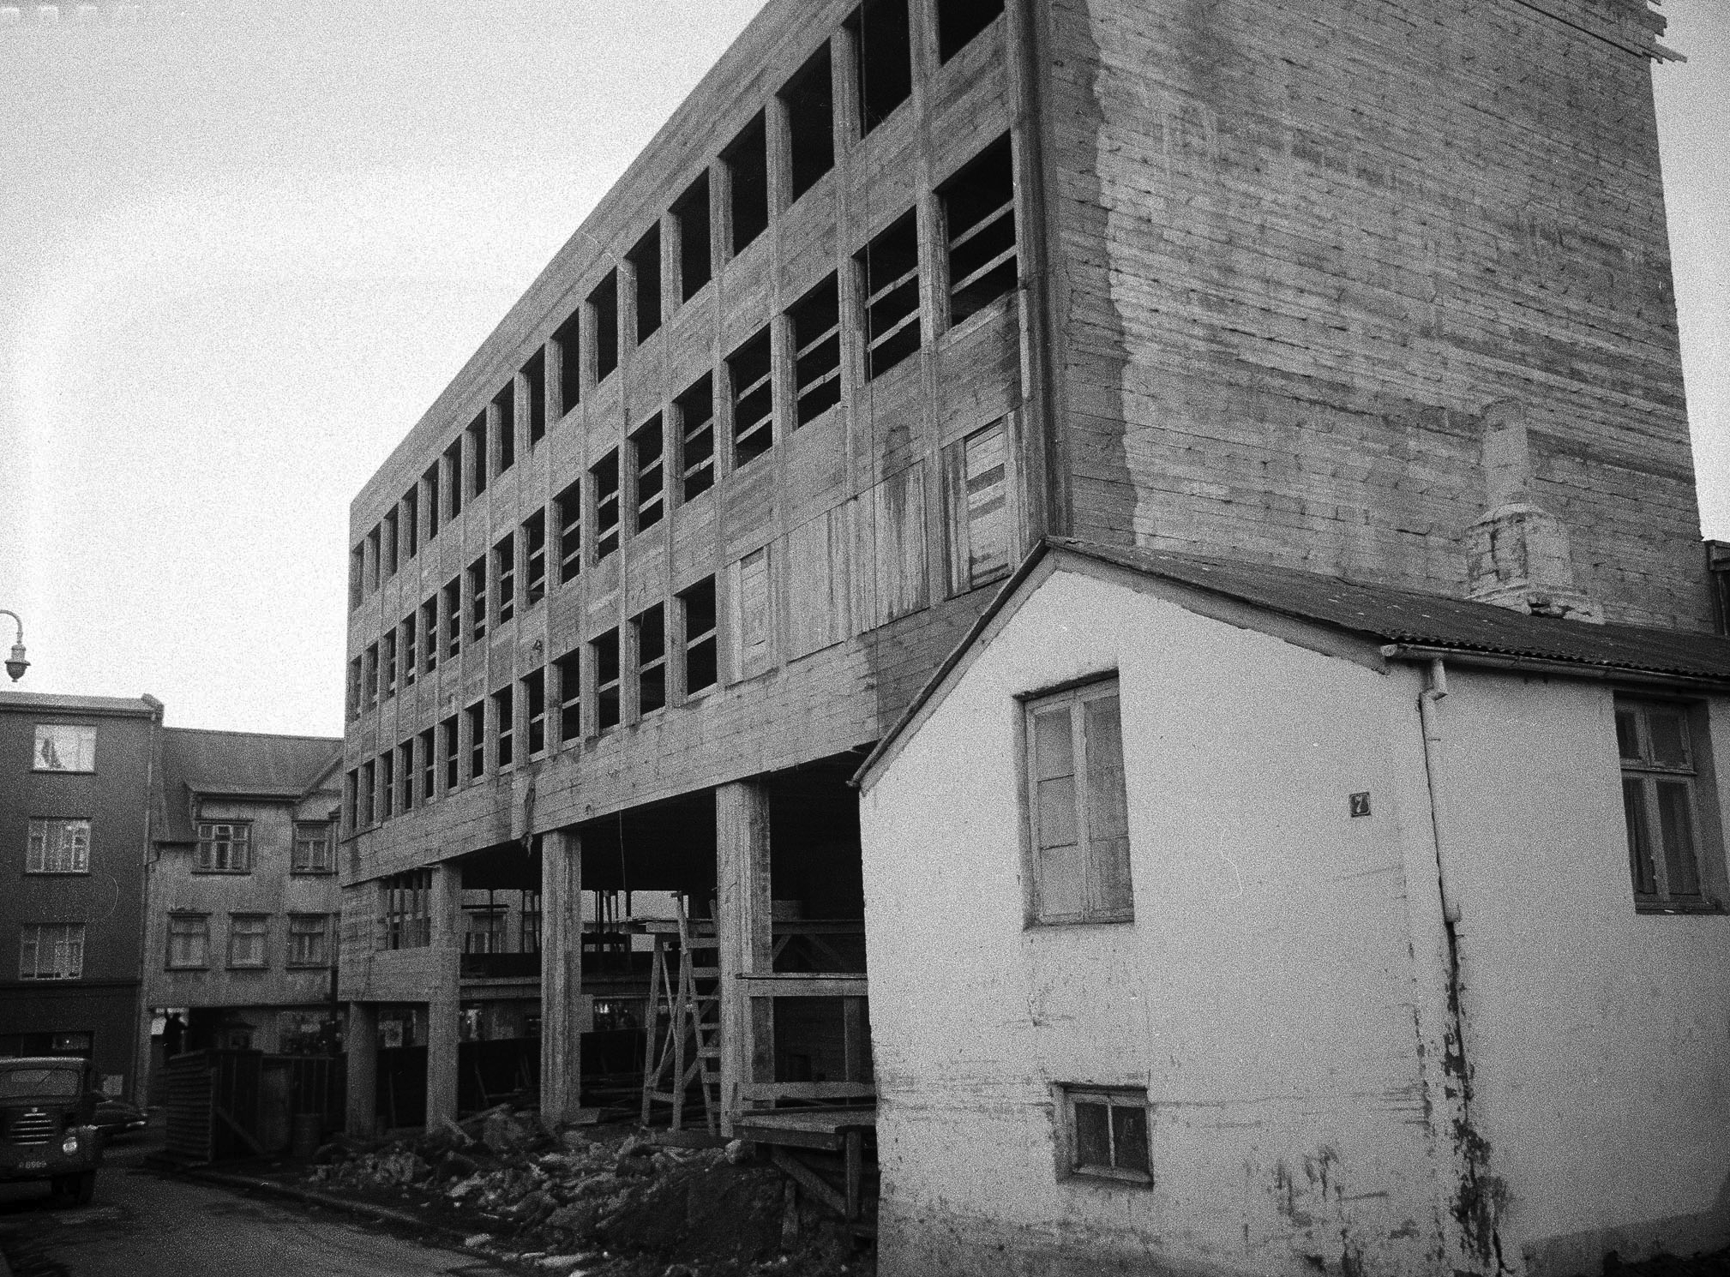
“The Rouble”

Slide 12
Threats and Persecution
Benjamin Eiriksson, “Go on writing! We won’t read it!”
Aki Jakobsson
Arnor Hannibalsson: Articles rejected
Gunnar Gunnarsson 1954: Thjodviljinn campaign
Jon Oskar 1964: Thjodviljinn campaign in 1964
Johann Hjalmarsson 1961: Thjodviljinn campaign
Steinn Steinarr 1956: Thjodviljinn leading article
Two explanations: Mad or Sell-Outs
Sverrir Kristjansson og Johannes ur Kotlum: Dared Not

Slide 13
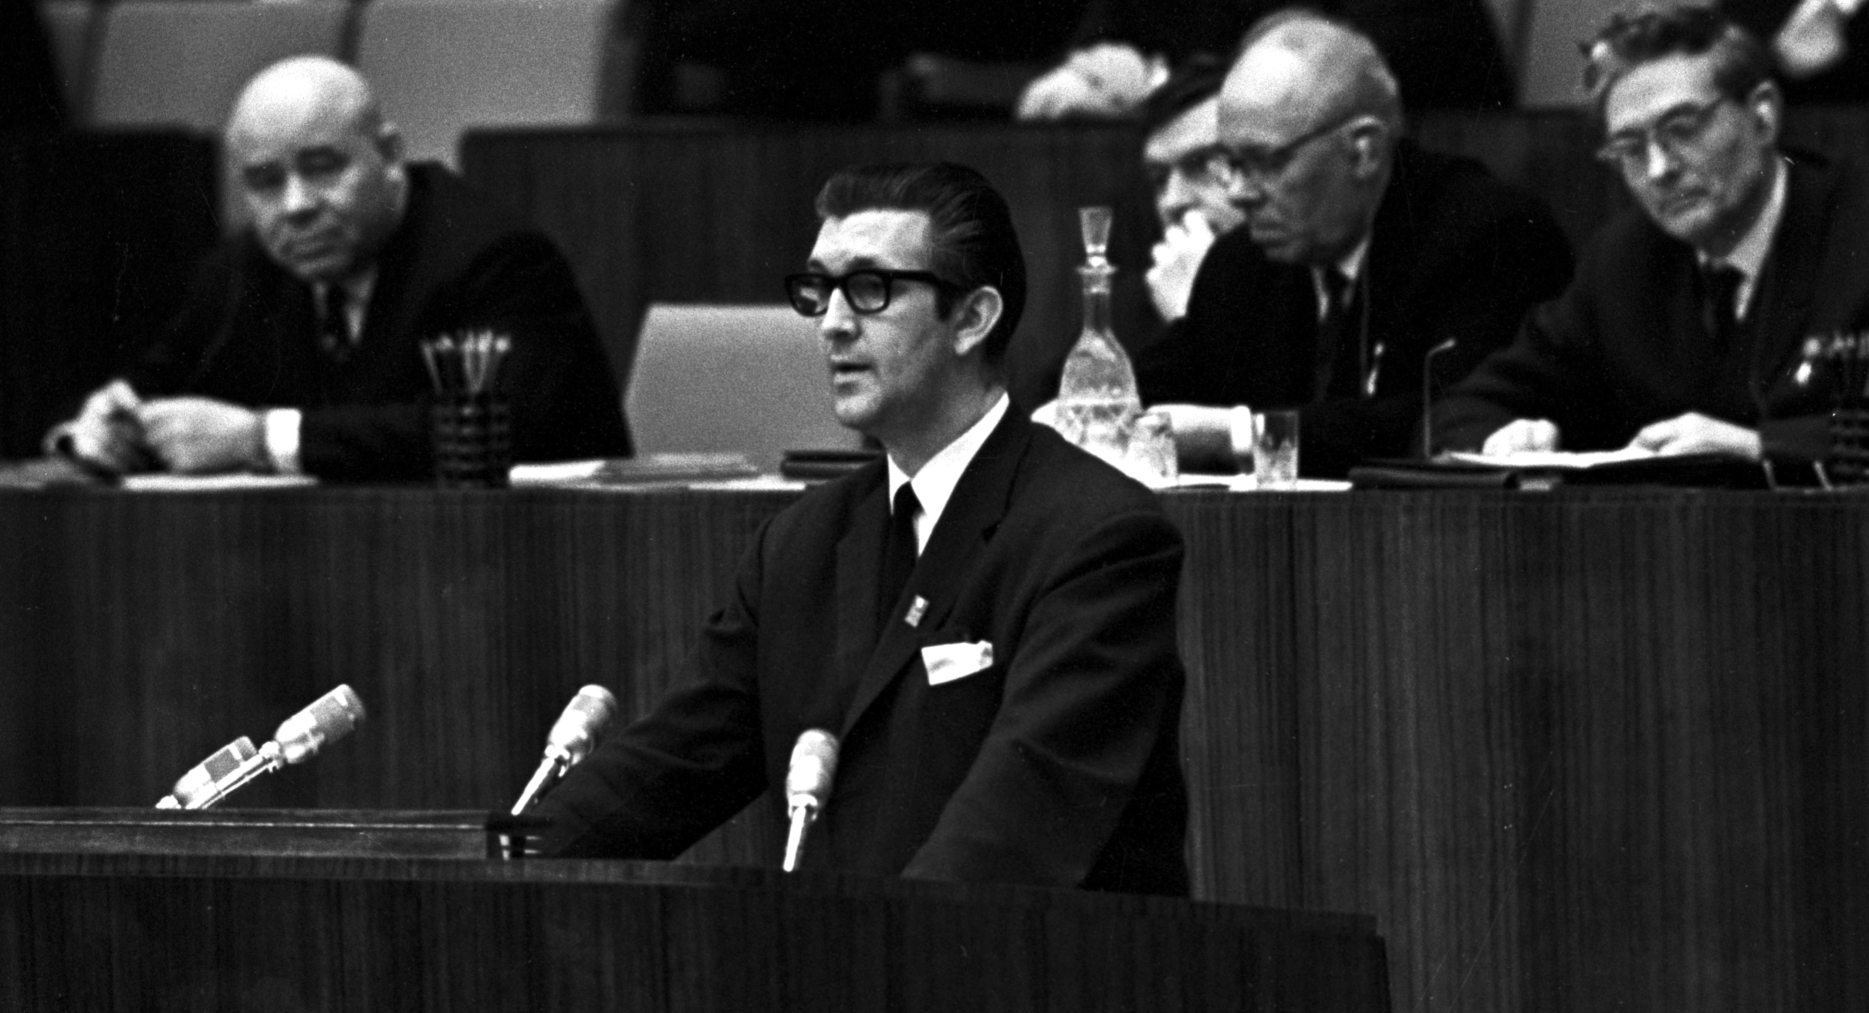
Close Ties

Slide 14
Sufficient information
Morgunbladid published Anton Karlgren 1924 and 1926
Translations of Malcolm Muggeridge and André Gide
Book by Aatami Kuortti 1938, same year as Russian Adventure by Laxness
Books by Orwell og Koestler
Victor Kravchenko’s book, reactions by Brynjolfur Bjarnason and Magnus Kjartansson
Books by Margarete Buber-Neumann, Ants Oras og Otto Larsen
Soviet Union apologetics abandoned 1968

Slide 15
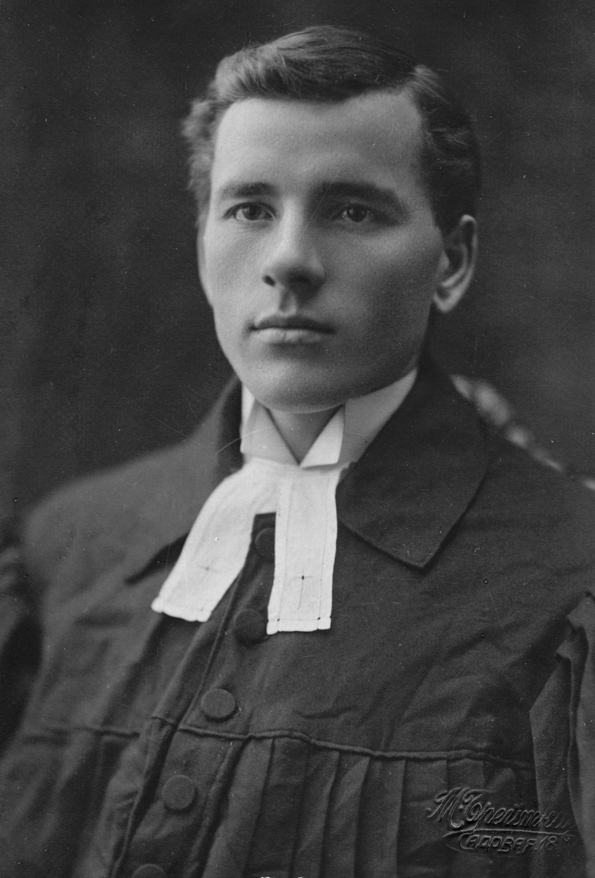
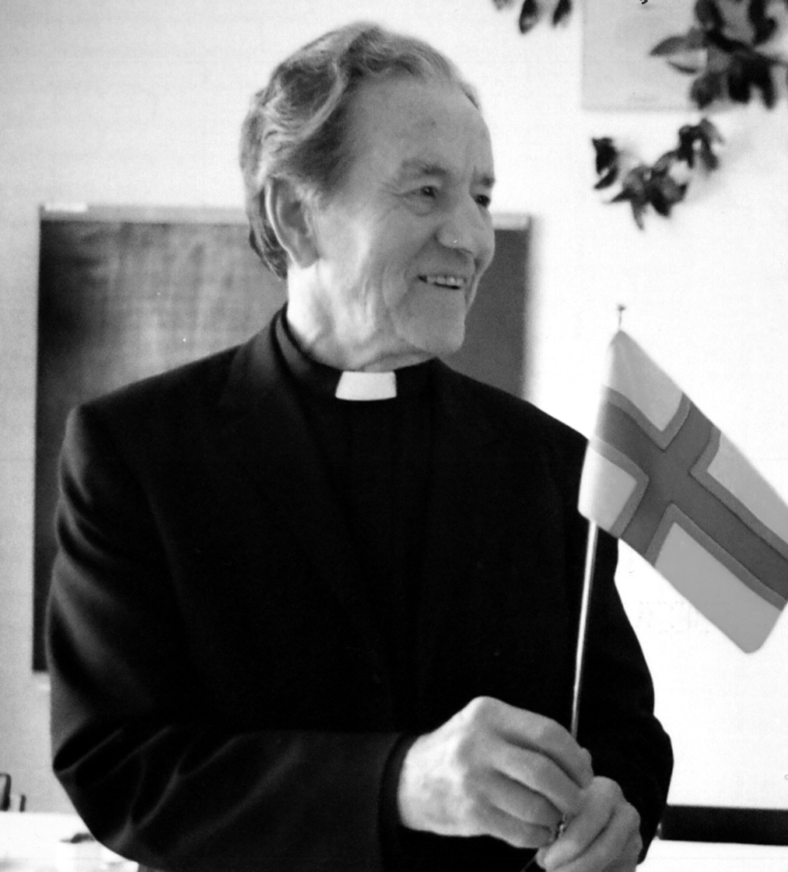
Aatami Kuortti

Slide 16
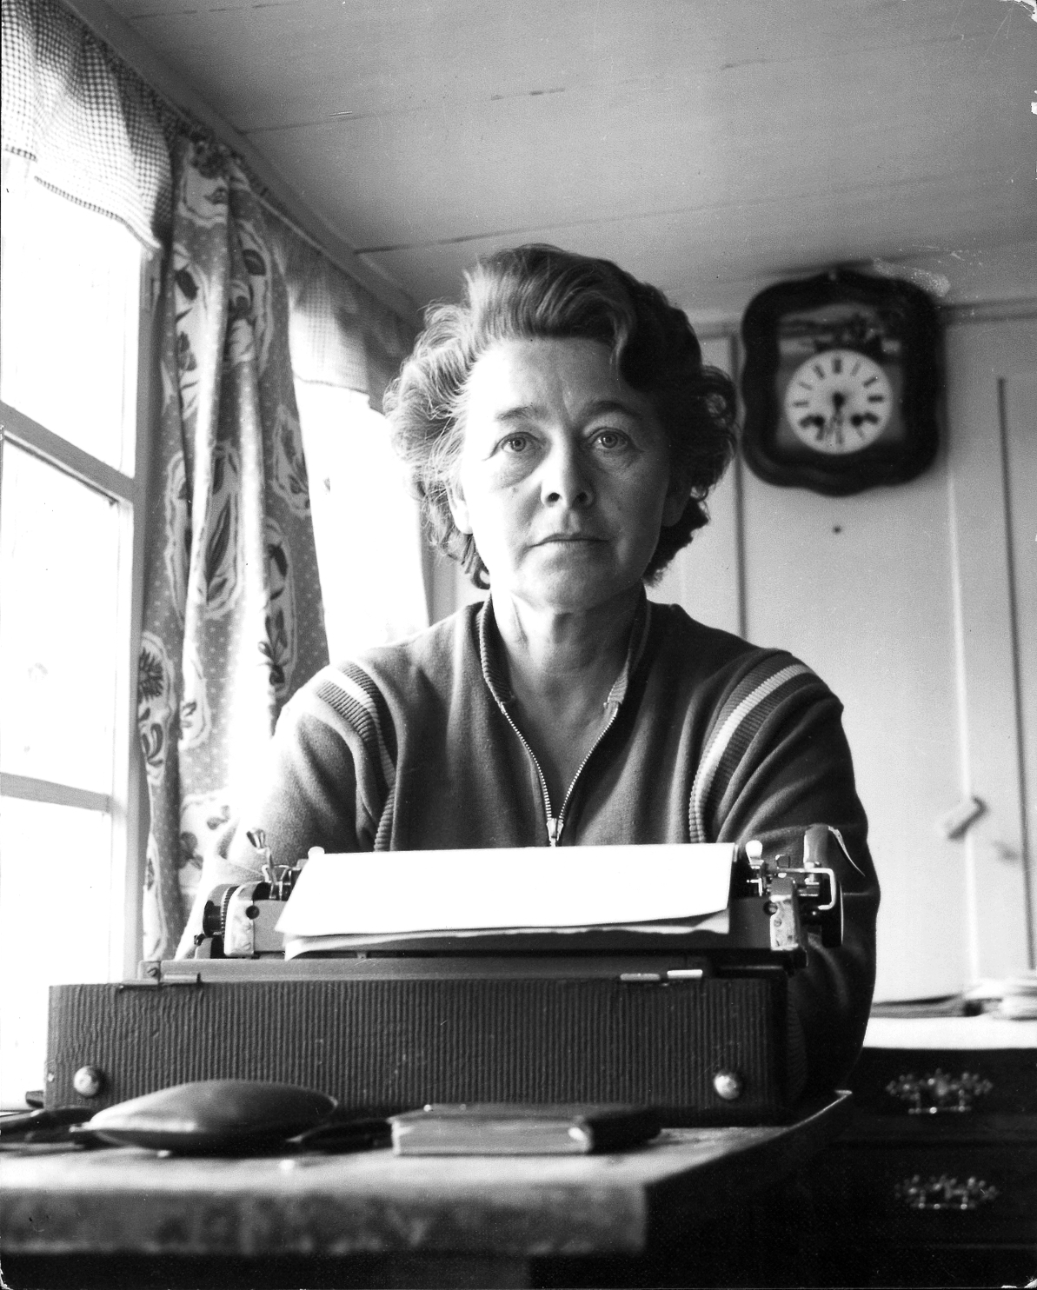
Margarete Buber-Neumann

Slide 17
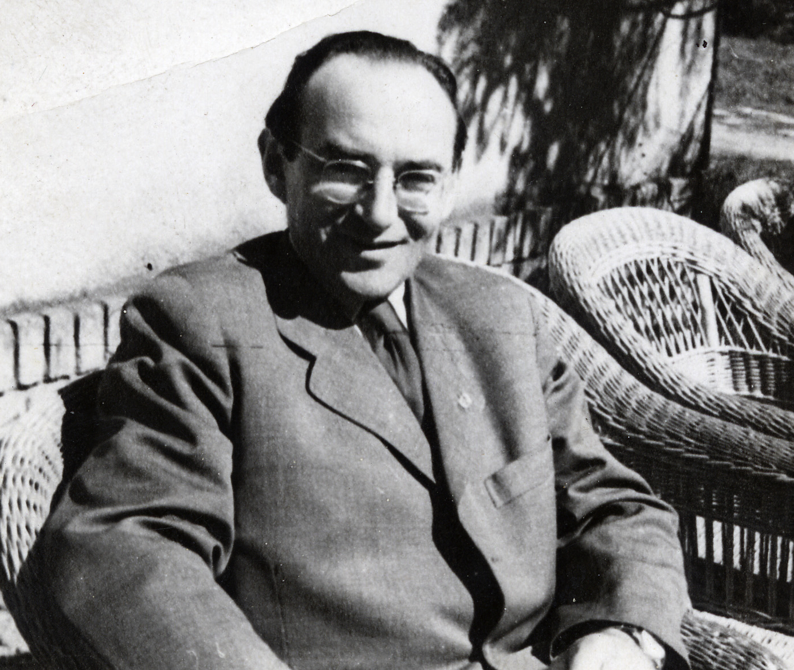
Rudolf Margolius

Slide 18
The Czech Connection
Otto Katz (André Simone) translated into Icelandic
Dr. Rudolf Margolius hanged for buying Icelandic fish
Thjodviljinn indignant over criticism of the trial
Ivan Olbracht’s Anna Proletarka strongly influenced Laxness’ The Atom Station
Zdenek Nemecek, Ambassador to Denmark, visited Iceland in 1946, and met Laxness in Copenhagen in 1948
Dr. Emil Walter, Ambassador to Norway and Iceland, in 1954 protested against comments by Laxness
Events of 1948 and 1968 had significant impact in Iceland

Slide 19
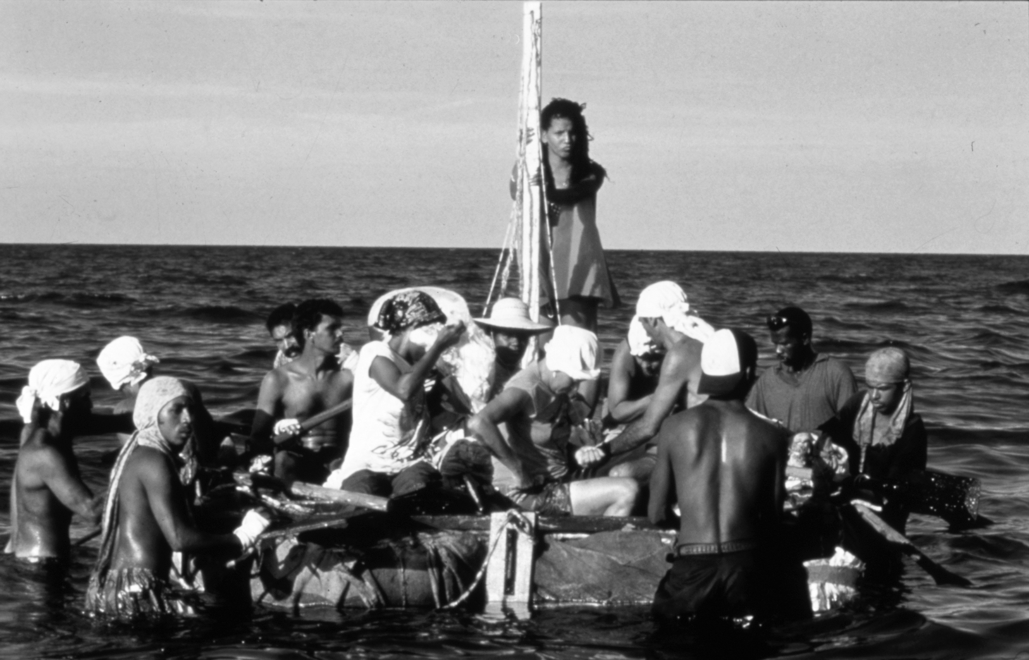
Story Ends in Havana 1998

Slide 20
Main Conclusions
Icelandic communists similar to communists elsewhere, no more undemocratic, no less
They were more successful in building alliances, mainly because social democrats were weak (without strong roots)
Ties to communist countries began earlier, were stronger and lasted longer than hitherto held
Controversy about history: Thor Whitehead and Jon Olafsson
Criticisms of my book, November 2011 meeting of Historians’ Association
Historians not impartial between executioneers and victims

