Slide 1

Making the Invisible Hand Visible:
Reflections on the Political Economy of Freedom
Professor Hannes H. Gissurarson
Porto Alegre 9 April 2013

Slide 2
Role of Political Economy
To make the invisible hand visible, in other words to explain:
How one man’s gain needn’t be another man’s loss
How order can emerge without anyone issuing orders; spontaneous coordination
Also to explain the state, especially unintended consequences of government actions

Slide 3
Parable of Good Samaritan
Four overlooked lessons from the parable:
We need government to protect us from highwaymen
We cannot trust the intellectuals, the priest and the Levite
The Samaritan was a man of means; he could afford to help
He did good at his own expense, not that of his neighbours

Slide 4
Nature of the State
Hegel: State is “March of God through History”
Totalitarian 20th Century: “March of the Devil through History”
The fantasy of the benevolent despot
Process, not end-of-state: power tends to corrupt, and absolute power corrupts absolutely
Process: people react to costs, produce less or more, depending on system

Slide 5
Invisible Victims of Totalitarian State
Notes:
Sources: On victims of communism, Black Book of Communism 1997, introduction by Stéphane Courtois. Icelandic translation 2009 by Hannes H. Gissurarson. Reykjavik: Haskolautgafan. On victims of Nazism, Rummel, R.J., 1992. Democide: Nazi Genocide and Mass Murder, Chapter 1. New Brunswick, NJ: Transaction Publishers.

Slide 6
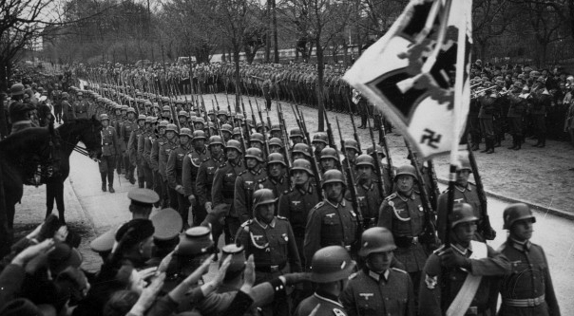
37 Million Soldiers Killed in Wars
Notes:
German Soldiers marching into Stalingrad. Source: Walther Günther.

Slide 7
The Big News: 21st Century Capitalism
Not the financial crisis since 2008
The big news: BRIC countries, comprising almost half the earth’s population, joined the world economy, participating in international capitalism
With economic growth, hundreds of millions migrating into middle class
Economic freedom has on average not decreased, after a rapid earlier increase

Slide 8
News of Capitalism’s Death Exaggerated
Notes:
Source: Economic Freedom of the World: 2012 Annual Report (2012). Internet page: freetheworld.com

Slide 9
Economic Freedom in the BRICs
Notes:
Source: Source: Economic Freedom of the World: 2012 Annual Report (2012). Internet page: freetheworld.com

Slide 10
The Four Chinese Economies 2011
Notes:
Heimild: World Economic Outlook Database, October 2012. Heimasíða Alþjóðagjaldeyrissjóðsins: www.imf.org

Slide 11
Seven Nordic economies 2010
Notes:
Sourcesr: Canadian data (Table A.34 gross domestic product per capita, provinces and territories, in current dollars) from Canada Statistics for 2009–2010. The data are in C$ which was then almost equal to US$. See www.statcan.gc.ca Data on Nordic countries from CIA World Factbook (GDP per Capita, PPP, USD) 2010. Data on states in the US frrom Avery, J.E., Siebeneck, T.P., og Tate, R.P. 2011. Gross Domestic Product by State. Advance Statistics for 2010 and Revised Statistics for 2007–2009. Price level 2010. Bureau of Economic Analysis. See www.bea.gov

Slide 12
Swedes in Different Economies
Notes:
Sources: Data on the US and Sweden, OECD 2009. GDP per capita: US$, using current PPPs, in OECD in Figures. Paris: OECD Publishing. Data on Swedish-Americans, Sanandaj, Nima 2012. The surprising ingredients of Swedish success — free markets and social cohesion. London: Institute of Economic Affairs, 21.

Slide 13
Capitalism still alive and kicking!
International financial crisis reminded us that capitalism is subject to fluctuations, such as credit bubbles which inevitably burst
But so is government: Lenin, Stalin, Hitler, Mao turned lives upside down
Government made matter worse: subprime loans in US; low interest rates in US; Basel rules underestimating risks from mortgages and government bonds
New financial techniques obscuring risks instead of spreading them

Slide 14
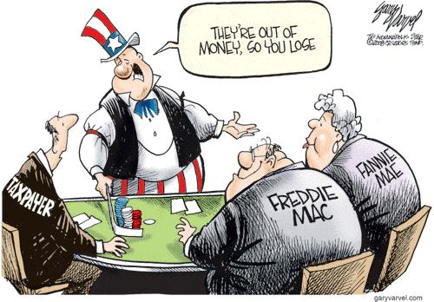
Moral Hazard of Banking

Slide 15
What is Unseen about Tax Revenue
Tax revenue does not necessarily increase with the tax rate (Laffer Curve)
With higher tax rates, people work less, switch over to untaxed activities, flee into the underground economy, invest less
By over-taxing, government loses revenue
Switzerland and Sweden: almost same tax revenue per capita, but different tax rates

Slide 16
Laffer Curve: Useful Simplification

Slide 17
Switzerland, Sweden: Laffer Curve
Notes:
Source: Revenue Statistics. OECD.

Slide 18
Will to Work Depends on Tax Rates
Notes:
Source: Edward C. Prescott 2007. The Modern Theory of Aggregate Labor Supply and the Consquences of Taxes. In Hannes H. Gissurarson and Tryggvi Thor Herbertsson eds., Cutting Taxes to Increase Prosperity. Reykjavik: RSE.

Slide 19
More Revenue with Lower Rate
Notes:
Source: Statistical Bureau of Iceland. Suggested by Edward Prescott.

Slide 20
What is Unseen in Progressive Tax
Sound philosophical and economic arguments against progressive incomes tax
Not a tax on being rich, but on becoming rich
With flat tax, the rich contribute more $: 36% of high income more than on low income
Net tax = Gross tax – Public services and transfers
Since public transfers and services more or less equal for all, net flat incomes tax indeed progressive (higher proportion paid by rich)

Slide 21
Flat Incomes Tax: Net and Gross
Notes:
Ragnar Arnason 2007. Gross versus Net Income Taxes and Progressivity. In Hannes H. Gissurarson and Tryggvi Þór Herbertsson eds., Cutting Taxes to Increase Prosperity (25–40). Reykjavik: RSE.

Slide 22
Net Flat Incomes Tax Is Progressive
Notes:
Ragnar Arnason 2007. Gross versus Net Income Taxes and Progressivity,. In Hannes H. Gissurarson og Tryggvi Þór Herbertsson eds., Cutting Taxes to Increase Prosperity (25–40). Reykjavik: RSE.

Slide 23
Tax Rates, the Rich, and Revenue
1980
1988
In 1980, there were 116,800 rich people in the US
Those rich people reported $36.2 billion of income to the IRS
They paid $19.0 billion of income tax to the federal government
By 1988, there were 723,700 rich people
Those rich people reported $353.0 billion of income to the IRS
They paid $99.7 billion of income tax to the federal government
Notes:
Source: Daniel Mitchell 2012. The Case for the Flat Tax. Lecture in Reykjavik 16 November. Mitchell Source: Internal Revenue Service. Rich people defined as those with over $200,000.

Slide 24
More Rich People, Higher Revenue
Notes:
Source: Daniel Mitchell 2012. The Case for the Flat Tax. Lecture in Reykjavik 16 November. Mitchell Source: Internal Revenue Service. Rich people defined as those with over $200,000.

Slide 25
Distribution of Tax Burden, US 2000
Notes:
Source: Department of the Treasury: Office of Tax Analysis Working Paper #85, "U.S. Treasury Distributional Methodology" by Julie-Anne Cronin (September 1999). See Tax Facts, http://www.taxpolicycenter.org from Brookings Institute.

Slide 26
The Unseen Challenge
Notes:
Heimild: International Monetary Fund, World Economic Outlook Database, October 2012.

Slide 27
Parting Ways: Australia and Argentina
Notes:
Source: Per Capita GDP Levels, 1 AD—2008 AD. Historical Statistics of the World Economy: 1–20008 AD. Copyright: Angus Maddison.

Slide 28
Slow Growth, Low Income

Slide 29
Maximize Growth, not Revenue

Slide 30
Final comments
Was the revival of economic freedom a return to the pre-1914 world?
Two causes for optimism: new technology repeatedly proves pessimists wrong; more world trade, with the BRICs, creates wealth
Two causes for pessimism: the pre-1914 world did’nt have extensive welfare obligations (to those who do not create or contribute), and it had sound money, based on the gold standard

