Slide 1
Estonia under the Occupation of Totalitarian States
Mart Nutt, PHD
Member of Parliament
Lecture 23.08.2013 Research Centre for Innovation and Economic Growth, Reykjavik, Iceland

Slide 2
I Why did Estonia lose it’s independence?
1. Germany attacked Poland on 1 September 1939 and the USSR attacked Poland on 17 September 1939
2. The USSR imposed a military bases agreement on the Baltic states (on Estonia on 28 September 1939)
3. The USSR attacked Finland on 30 November
4. On 15 June 1940, the USSR started an attack against the Baltic states and occupied them in two days
(A map of the borders of the spheres of influence).

Slide 3
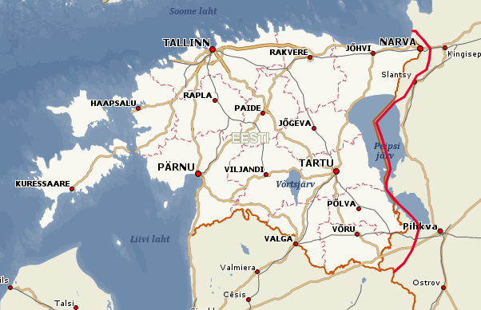
5. The “non-recognition policy” – the majority of the Western states do not recognise the Baltic states as part of the USSR.
6. On 22 June 1941, Germany attacked the USSR
7. In autumn 1944, the USSR reconquered the Baltic states.
8. In 1944-1945, the USSR unilaterally changed the Estonian-Russian border

Slide 4
II Resistance to occupation authorities
In June 1940, the Estonian Government saw no point in resistance to the USSR occupation
The guerrilla war (the Forest Brothers) continued in the occupied Estonia until 1956. The last Forest Brother was killed in 1978.
Throughout the occupation, non-violent resistance continued. The last Estonian dissidents were released in 1988.

Slide 5
III Sovietisation
The USSR occupation authorities started the Sovietisation at once, in summer 1940. The USSR legislation was enforced, the Estonian national symbols were prohibited and strict punishments were imposed for using them (especially the blue-black-and-white national flag).
Soviet reorganisations in the economy and social life:
nationalisation of enterprise and private property,
collectivisation of agriculture,
militarisation

Slide 6
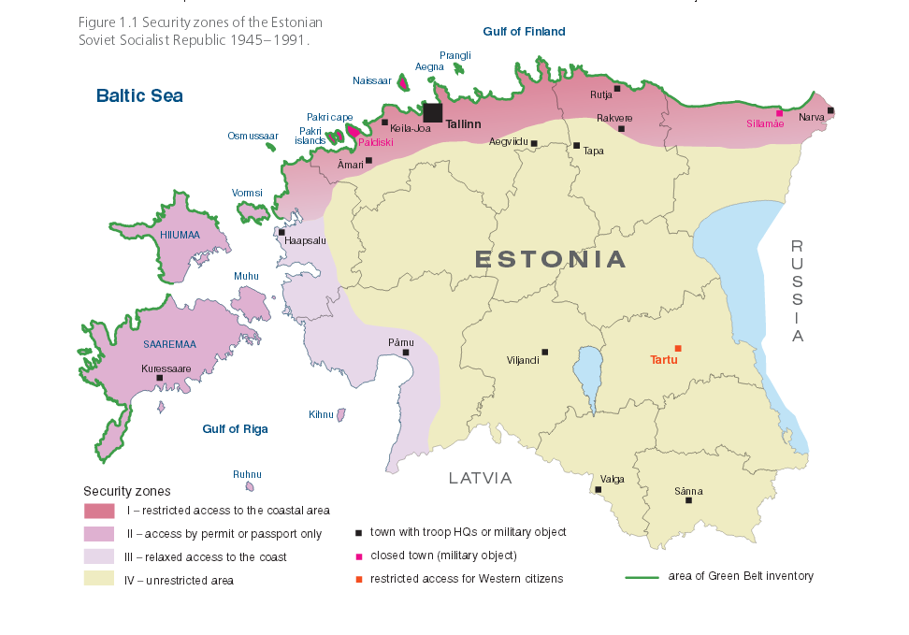

Slide 7
IV Crimes against humanity and demographic changes
Population census 1934 Estimation 1945 Population census 1989
Size of population: 1 126 413 850 000 1 565 662
Estonians : 89% 98% 62%
Indigenous minorities: 9% 1.5% 2%
Immigrant origin: 2% 0.5% 36%

Slide 8
1. In 1939-1941, ca 20 000 people (mostly Germans) left Estonia at Hitler’s invitation
2. On 14 June 1941, more than 10 000 people were deported from Estonia to the USSR
3. At the beginning of the German-USSR war, ca 3500 Jews left from Estonia to the USSR, and ca 1000 Jews who were Estonian citizens were murdered
4. In 1944, 70 000 Estonians left for Western countries, and 7500 Swedes fled from Estonia to Sweden in the fear of the Red Army.

Slide 9
5. In connection with the Estonian-Russian border changes made by the USSR in 1944-1945, ca 80 000 Estonian citizens of Russian origin remained on the territory of Russia.
6. In 1944-1989, 40 000 Estonian citizens were arrested for political reasons. The death penalty or 25+5 years forced labour were stricter punishments.
7. On 25 March 1949, more than 21 000 people were deported to the USSR in cattle wagons
8. In 1944-1989, half a million of USSR citizens were colonised to Estonia
9. Estonia lost ca 25% of its population during World War II and due to crimes against humanity which is one of the largest losses in Europe

Slide 10
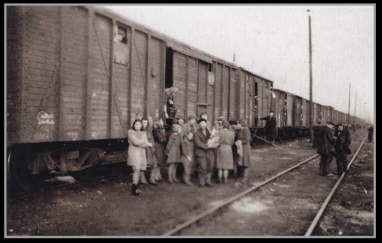

Slide 11
V Education and Russification
Education, including higher education, could be acquired in Estonian in Estonia throughout the whole period of the USSR annexation
At the same time, a systematic Russification was carried out
In 1978, the use of the Russian language was significantly extended in the Estonian schools and preparations to liquidate the Estonian schools were started
Communist education was carried out constantly. Children were forced to become Children of October, Pioneers and Young Communists (Komsomol)
Much to the distress of the occupation authorities, a number of foreign channels were available to Estonians

Slide 12
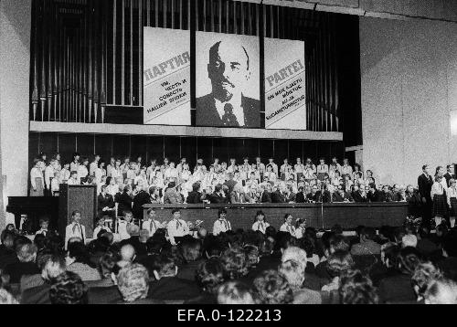

Slide 13
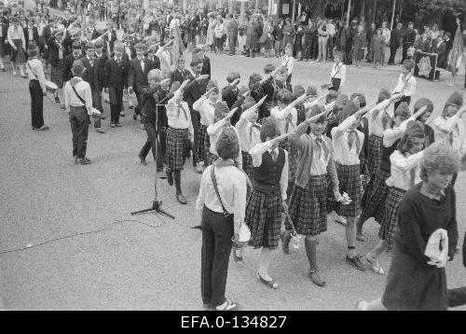

Slide 14
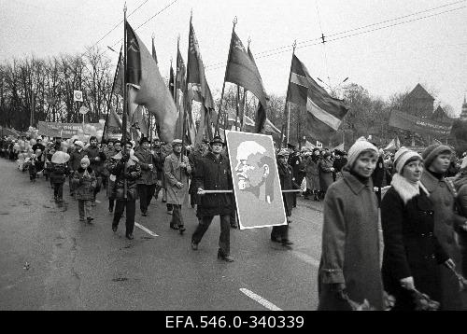

Slide 15
VI Living conditions
There was a constant deficit of consumer goods and foodstuffs in the USSR.
The Nomenclature had special shops, summer houses, hospitals, and official cars and flats which ordinary people could not use.
Bans on movement were established. If a person left home for a period of more than three days, registration at the militia and registration in the place of stay (“propiska”) was required.

Slide 16
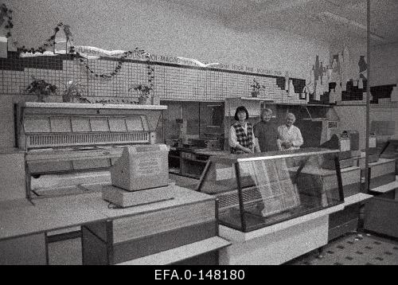

Slide 17
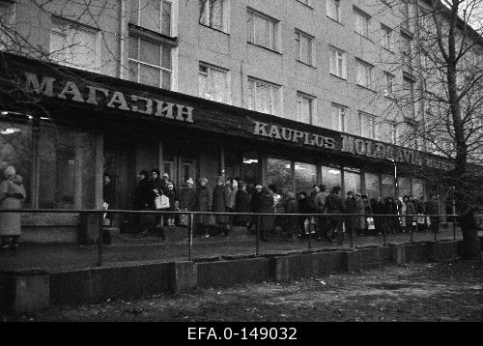

Slide 18
VII Collapse of the USSR and restoration of Estonia’s independence
The economy of the USSR was verging on collapse by mid-1980s; Mikhail Gorbachev’s perestroika, glasnost, uskorenie. Legalisation of small private enterprise.
The democratic movement soon develops into the independence movement in Estonia. Night song festivals (the Singing Revolution), the Baltic Way (Baltic Chain) on 23 August 1989. Circa 2 million people from the three Baltic states participated.
The coup attempt in Moscow on 19 August 1991.

Slide 19
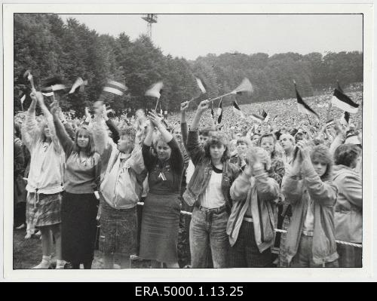

Slide 20
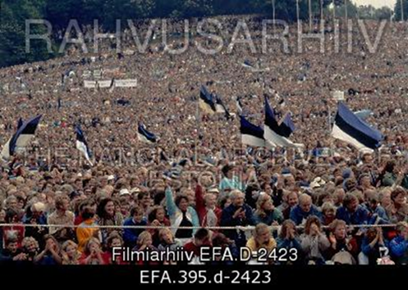

Slide 21
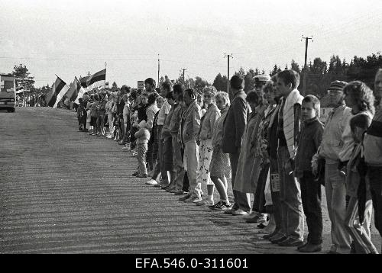

Slide 22
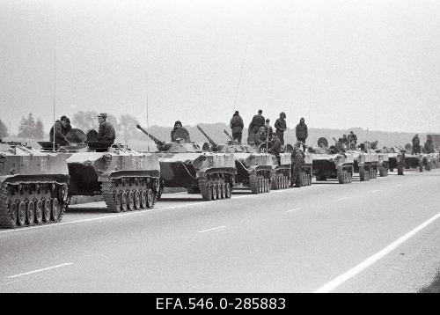

Slide 23
Thank You!

