Slide 1

Europe, Iceland and the Four Freedoms
Reflections after the 2008 Financial Crisis
Professor Hannes H. Gissurarson
Vilnius 12 September 2013

Slide 2
Topics to Be Discussed
The Big News in beginning of 21st Century
Causes of international financial crisis
Three fallacious explanations for Icelandic collapse: Overgrown banks; reckless bankers; failed neo-liberal experiment
More plausible explanations systemic and historic
Which model: Nordic or Anglo-Saxon?

Slide 3
What is the Big News?
Section 1

Slide 4
Capitalism Still Alive and Kicking!
Big News: not financial crisis since 2008
Rather: BRIC countries, comprising almost half the earth’s population, joined the world economy, participating in international capitalism
With economic growth, hundreds of millions migrating into middle class
Economic freedom on average not decreased, after a rapid earlier increase

Slide 5
Untimely Death Announcement
Notes:
Source: Economic Freedom of the World: 2012 Annual Report (2012). Internet page: freetheworld.com

Slide 6
Economic Freedom in China and India
Notes:
Source: Economic Freedom of the World: 2012 Annual Report (2012). Accessible on website: freetheworld.com

Slide 7
Four Chinese Economies 2011
Notes:
Source: World Economic Outlook Database, October 2012. IMF Website: www.imf.org

Slide 8
The Big Challenge
Notes:
Source: International Monetary Fund, World Economic Outlook Database, October 2012.

Slide 9
Main Causes of financial crisis
Section 2

Slide 10
Causes of Financial Crisis (1)
Capitalism not “depression-proof” (pace Friedman); subject to economic fluctuations
However, more stable, on the whole, than the political environment
Government made it worse: subprime loans in US; misguided monetary policy after 2002
Basel rules: risk harmonised; government bonds and real estate regarded as not risky

Slide 11
Causes of Financial Crisis (2)
Main cause: moral hazard of “Too Big to Fail”
In prosperity, bankers pocket the gain; in adversity, they pass the bill on to taxpayers
Recklessness systematic, rather than special to bankers
Moreover: new financial techniques were supposed to spread risk, but instead obscured it

Slide 12
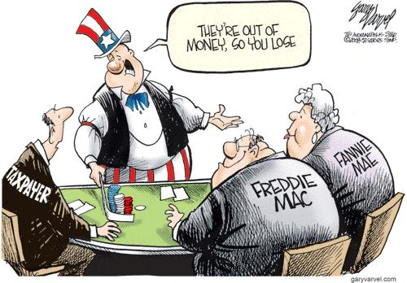
Moral Hazard of Banking

Slide 13
Seven EU Countries Hit Harder
Notes:
Source: Eurostat website. Real GDP growth, 2001–2010 (% change compared with the previous year; average 2001–2010).

Slide 14
Three fallacious explanations
Section 3

Slide 15
No more “Oversized” than others
Notes:
Norris, Floyd (2008). The World’s Banks Could Prove Too Big to Fail — or to Rescue, New York Times 10 October. His source is quoted as being Bridgewater Associates.

Slide 16
Size of Banking Sector, 1992–2007
Notes:
Sources: Thorvaldur Gylfason (2011); Union Bank of Switzerland.

Slide 17
Icelandic banks not too big
London banks would be too big for Coventry
But not too big for the UK, backed by Europe
Systemic error: fields of operations, under EEA agreement, whole of Europe, whereas field of insurance or back-up Iceland alone
When all refused to help, the banks collapsed
Banks not too big; Iceland alone too small

Slide 18
Bankers Elsewhere No Less Reckless
If Icelandic bankers reckless, why did they obtain credit abroad? Were their creditors then as reckless?
Danske Bank: biggest owner also biggest debtor (A.P. Møller); would have failed in 2008 without government aid; 1998–2008 balance sheet increased sixfold, equity only threefold
Royal Bank of Scotland 2007–2011, £256 billion in aid from British government
Notes:
Sources: Taxpayer support for UK banks. National Audit Office. Accessible on the Internet. Berlingske Tidende 12 November 2010. According to Danske Bank homepage, it received a government guarantee 6 October 2008, and a hybrid loan of 24+2 billion DKK in January 2009, and a government guarantee of a DKK 38 billion loan in June and July 2009.

Slide 19
Icelandic and Foreign Bankers
Barclays fined £290 million June 2012 for fixing libor rates; CEO and chairman resigned, nothing else happened
HSBC fined $1.9 billion, £1.2 billion, December 2012 for money laundering; CEO apologised, nothing else happened
Deutsche Bank under investigation for having manipulated books
Icelandic bankers arrested, and prosecuted for manipulating share prices
Notes:
Spiegel online, 11 December 2012. Whistleblower Accusations.

Slide 20
Greed and Self-love
Greed, or avarice, one of the seven deadly sins
Nothing however wrong with self-love, or the rational pursuit of self-chosen aims
It matters which self one loves
Also, to love one’s neighbour doesn’t mean that you have to love him as much as yourself
How is that love practised? By obeying the market signals, loss and profit, on how to serve others, satisfy their needs

Slide 21
Ha-Joon Chang:
“Between 1998 and 2003, the country [Iceland] privatized state-owned banks and investment funds, while abolishing even the most basic regulations on their activities, such as reserve requirements for the banks.”
23 Things They Don’t Tell You About Capitalism, p. 233

Slide 22
Chang is Wrong
Iceland joined EEA in 1994 and operated under the same financial regulation as other member-states (including the 27 EU countries)
Reserve requirements were the same as in the other EEA member-states; they were reduced, only to make them equal to those of competing European banks
Did not, anyway, make any difference about the collapse of the banks

Slide 23
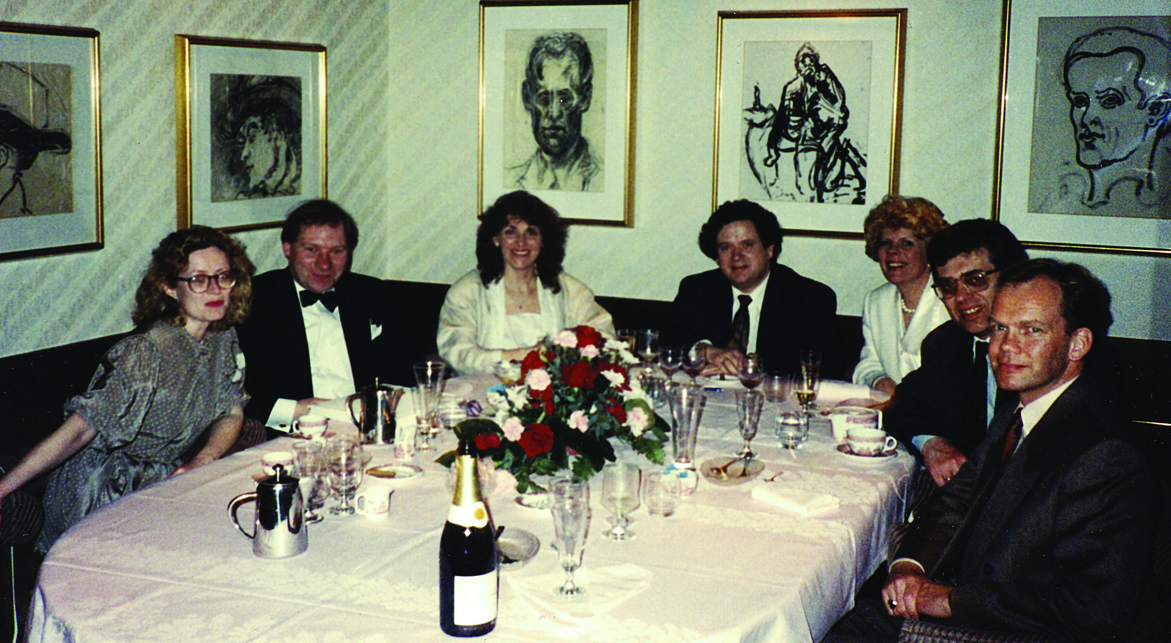
First day: 30 April 1991

Slide 24
Liberal Reforms 1991–2004
Not a “Neo-Liberal” experiment, but moving economy in the direction of neighbours
Member of EEA since 1994
Liberalisation and deregulation, adaptation of European legal framework
Privatisation and reduction of taxes
Successful system of fisheries management
Sustainable and strong pension system

Slide 25
Economic Freedom in Iceland
Notes:
Source: Economic Freedom of the World: 2012 Annual Report. Accessible at website freewtheworld.com

Slide 26
More Revenue with Lower Rate
Notes:
Source: Statistical Bureau of Iceland. Suggested by Edward Prescott.

Slide 27
Iceland in 2004
Relative poverty negligible (only Sweden with lower poverty rate)
Absolute poverty probably smallest in world
Unemployment much less than in other OECD countries; more opportunity to leave poverty
First on happiness index, one of highest on human development index
Fiscal and monetary stability

Slide 28
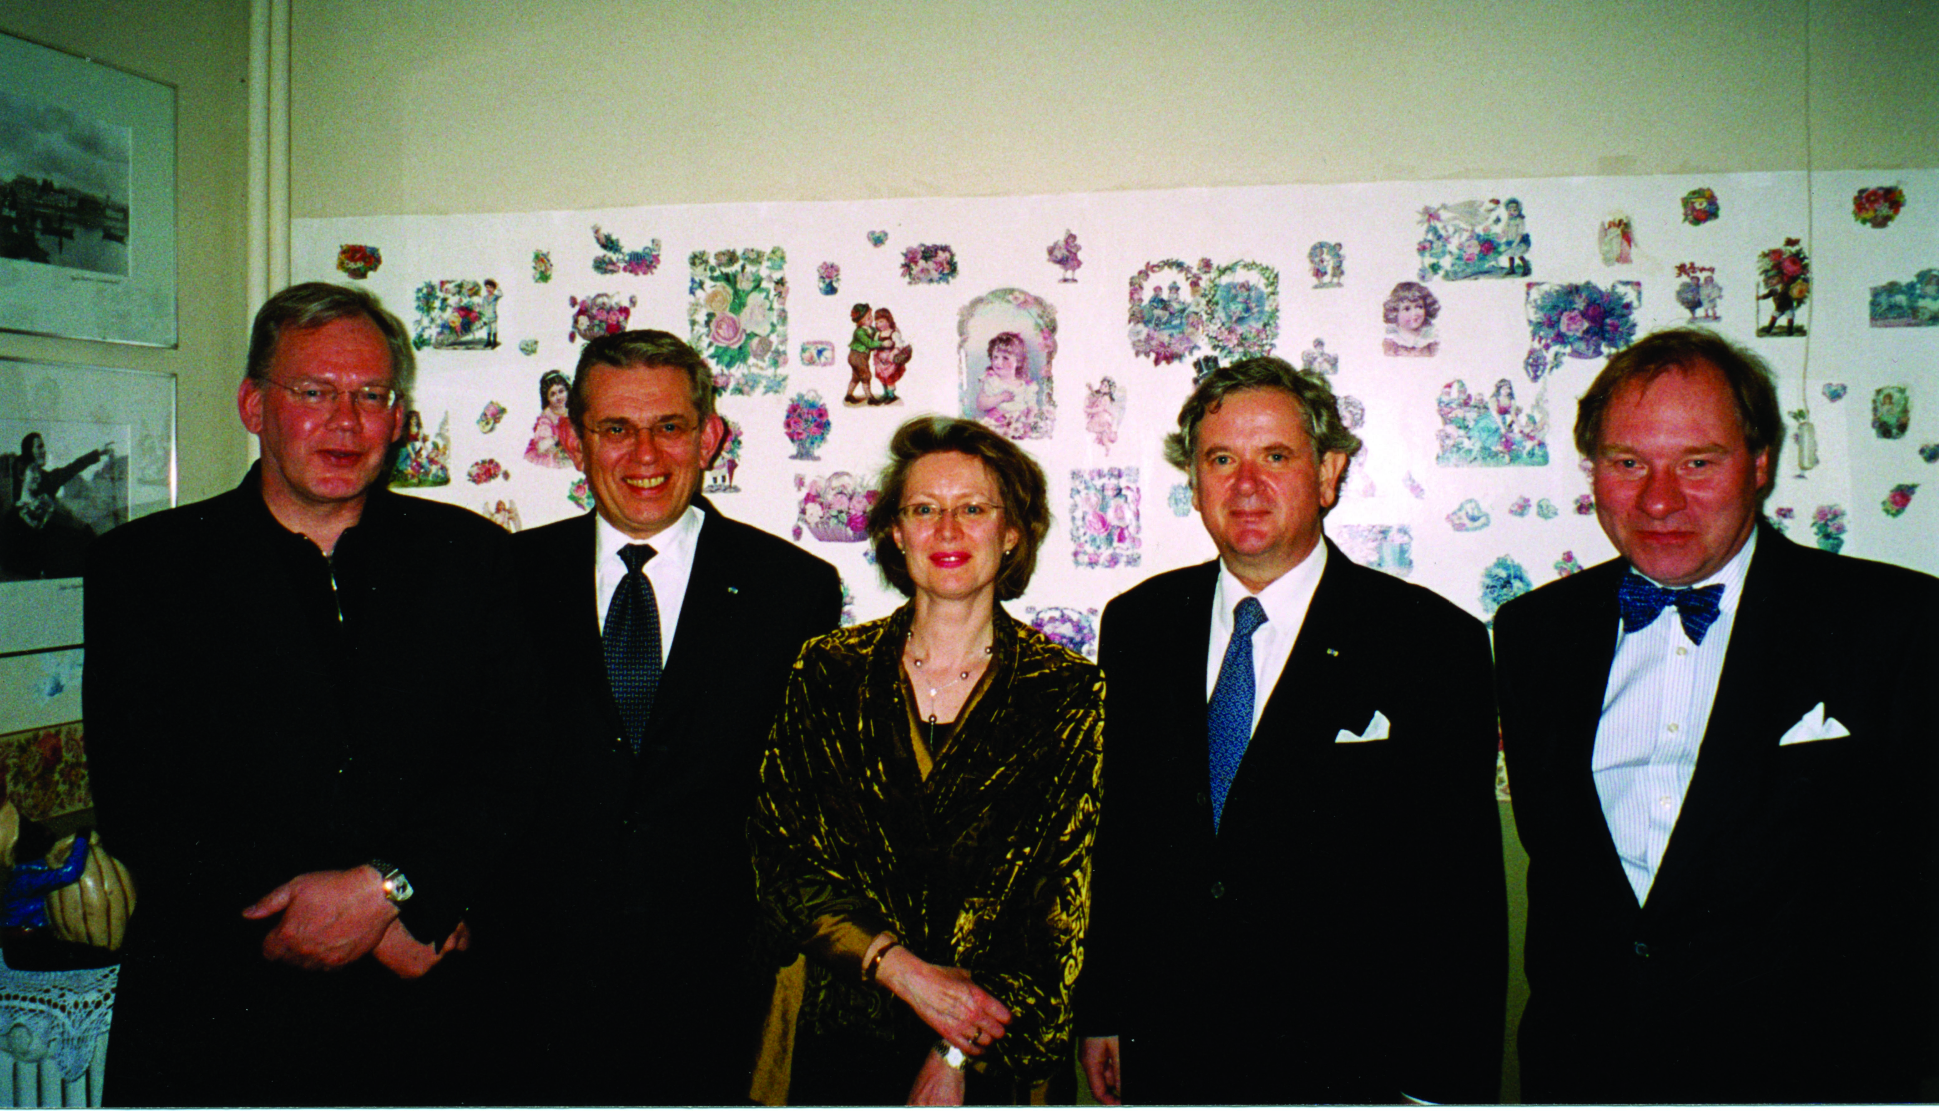
Last day: 15 September 2004

Slide 29
External Debt: After 2004
Notes:
Source: Central Bank, Statistics: http://statistics.cb.is/data/set/1wsf/#!display=line&ds=1wsf!1yuk=6 [accessed 4 August 2013].

Slide 30
From Market to Crony Capitalism
1991–2004 market capitalism: competition, independent judiciary, free media, economic power separate from political power
2004 David was beaten by Goliath, in the battle about media law
2004–2008 crony capitalism: oligopoly, oligarchs own media, supported by politicans (and supporting them), cooperative judiciary

Slide 31
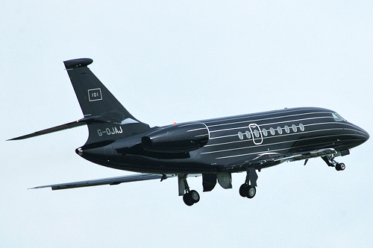
101: Private Jet of Main Oligarch

Slide 32
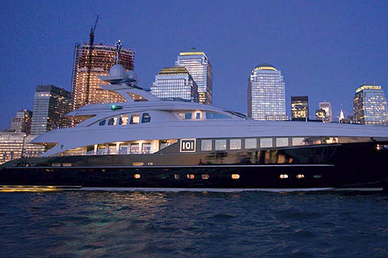
101: Private Yacht of Main Oligarch

Slide 33
It was a Baugur Bubble
Notes:
Source: Special Investigation Commission, Report, 2010, Vol. 7, Ch. 21, supplementary data.

Slide 34
Real explanations of Collapse
Section 4

Slide 35
Three Systemic Risks
The general international risk: moral hazard because of the “Too Big to Fail” idea
Additional risk for Iceland: field of operations all of EEA; field of institutional support Iceland alone
Additional risk for Iceland: too much cross-ownership, overvalued assets, Jon Asgeir Johannesson and his cronies

Slide 36
Three crucial decisions, historic
The Fed refused to make currency swap agreements with Iceland, at the same time as it did it with Nordic countries
The British Labour government closed the two Icelandic-owned banks in England, at the same time as it bailed out all others
The British Labour government used anti-terrorism law against Icelandic companies

Slide 37
The British as Bullies
FSA closed down Singer&Friedlander (Kaupthing) and Heritable Bank (Landsbanki) and froze Icelandic assets in the UK
Put Landsbanki, and Ministry of Finance and Central Bank on list of terrorist organisations
All transfers to and from Iceland stopped immediately, creating an emergency
As a result, bank assets fell in value, the situation became unmanageable

Slide 38
Why?
The British falsely thought that an illegitimate money transfer had been made from Kaupthing London to Kaupthing Iceland
They also confused different deposit accounts operated by Icelandic banks:
Kaupthing had affiliates, supervised by financial agencies in host countries
Landsbanki had branches, supervised by Icelandic Financial Supervisory Agency

Slide 39
Unnecessary losses
Asset management section of Singer & Friedlander sold for £5 million, real value sixfold (£30 million)
Glitnir Norway sold for NOK 300 million, had been bought year before for 3.1 billion
Finn Haugan, chairman of Norwegian Guarantee Fund, also leader of savings banks buying Glitnir Norway!
Glitnir Sweden sold for SEK 60 million, had been bought 4 years before for 380 million

Slide 40
Iceland Taken Down?
Icesave and Edge accounts could offer better rates, because cheaper to operate
Icelandic banks flexible and efficient, but reckless (even more than others)
New kids on the block, antipathy from old players, unpopular with other banks
Governments did not like the idea of tax competition: a new Luxembourg, Liechtenstein, Isle of Man or Guernsey

Slide 41
Others Helped: Currency swap lines
Aggregate transactions with CBs: $10,057 bn
ECB $8,011 (79.7% of total)
CB of the UK $919 bn
CB of Switzerland $466 bn
CB of Denmark $73 bn
CB of Sweden $67 bn
CB of Norway $30 bn
Also CBs of Japan, Korea and Mexico
Notes:
United States Government Accountability Office. Federal Reserve System. Report to Congressional Adressees. Washington: July 2011. Table 24. Online at: http://www.gao.gov/Products/GAO-11-696 Cf. Federal Reserve reveals trillions dished out to world banks to aid financial crisis... including $1.5trillion to British banks, Daily Mail 2 December 2010. Read more: http://www.dailymail.co.uk/news/article-1334929/Federal-Reserve-reveals-trillions-dished-world-banks-aid-financial-crisis.html#ixzz2bIMJWJRQ

Slide 42
Transactions, 2007–10, in $ billions
Citigroup 2,513
Morgan Stanley 2,041
Merrill Lynch 1,949
Bank of America 1,344
Barclays 868
Bear Stearns 853
Goldman Sachs 814
RBS 541
Deutsche Bank 354
UBS 287
JP Morgan Chase 391
Credit Suisse 262
Lehman Brothers 183
Bank of Scotland 181
BNP Paribas 175
Wells Fargo 159
Notes:
United States Government Accountability Office. Federal Reserve System. Report to Congressional Adressees. Washington: July 2011. Table 8. Online at: http://www.gao.gov/Products/GAO-11-696

Slide 43
Nordic or anglo-saxon?
Section 5

Slide 44
Challenges Facing the EU
EU a continental, rather than European, project
To be applauded: French and Germans abandon their wars; Central and Eastern Europeans enjoy increased security
But whither? Open market or closed state?
Challenges from North America and the BRICs
Two models: Nordic and Anglo-Saxon

Slide 45
Seven Nordic economies 2010
Notes:
Sources: Canadian data (Table A.34 gross domestic product per capita, provinces and territories, in current dollars) from Canada Statistics for 2009–2010. The data are in C$ which was then almost equal to US$. See www.statcan.gc.ca Data on Nordic countries from CIA World Factbook (GDP per Capita, PPP, USD) 2010. Data on states in the US frrom Avery, J.E., Siebeneck, T.P., og Tate, R.P. 2011. Gross Domestic Product by State. Advance Statistics for 2010 and Revised Statistics for 2007–2009. Price level 2010. Bureau of Economic Analysis. See www.bea.gov

Slide 46
Swedes in Different Economies
Notes:
Sources: Data on the US and Sweden, OECD 2009. GDP per capita: US$, using current PPPs, in OECD in Figures. Paris: OECD Publishing. Data on Swedish-Americans, Sanandaj, Nima 2012. The surprising ingredients of Swedish success — free markets and social cohesion. London: Institute of Economic Affairs, 21.

Slide 47
Less, Not More Regulation
Extensive regulation did not hinder the financial crisis
Regulation of financial markets create false security
Harmonisation of financial companies create an additional systemic risk, all eggs in the same basket
The only realistic strategy: economic growth

Slide 48
Parting Ways: Australia and Argentina
Notes:
Source: Per Capita GDP Levels, 1 AD—2008 AD. Historical Statistics of the World Economy: 1–20008 AD. Copyright: Angus Maddison.

Slide 49
Laffer Curve: Useful Simplification

Slide 50
Switzerland, Sweden: Laffer Curve
Notes:
Source: Revenue Statistics. OECD. 2011 Figures.

Slide 51
Slow Growth, Low Income

Slide 52
Maximize Growth, not Revenue

Slide 53
Final comments
Was the revival of economic freedom a return to the pre-1914 world?
Two causes for optimism: new technology repeatedly proves pessimists wrong; more world trade, with the BRICs, creates wealth
Two causes for pessimism: the pre-1914 world did’nt have extensive welfare obligations (to those who do not create or contribute), and it had sound money, based on the gold standard

Slide 54
