Slide 1

Three Liberal Thinkers:
Hayek, Popper and Friedman
Personal Recollections
Professor Hannes H. Gissurarson
Vilnius, 13 September 2013

Slide 2
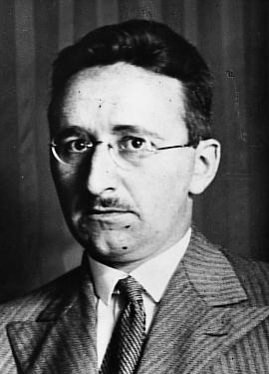
Friedrich A. von Hayek, 1899–1992
Born in Vienna, of Austrian nobility
Wittgenstein’s cousin
Professor LSE 1931–50
Professor Chicago 1950–62
Freiburg and Salzburg
Road to Serfdom 1944
„The Kiss of Death“

Slide 3
Hayek in Iceland, 1980
Influenced me with Road to Serfdom
Founded Libertarian Association on his 80th birthday, 8 May 1979, wrote to him
Responded: Could visit in April 1980
Lecture 2 April, Monetary Order
Lecture 5 April, The Muddle of the Middle
Interviewed by newspapers and television news

Slide 4
Social Life
Geir Haarde and I with him first evening
Liked Icelandic food, drank Burgundy
Reported his last discussion with Keynes:„Oh, they are just fools.“
Dinner with Central Bank governors and others
Reception at home of former Prime Minister Geir Hallgrimsson

Slide 5
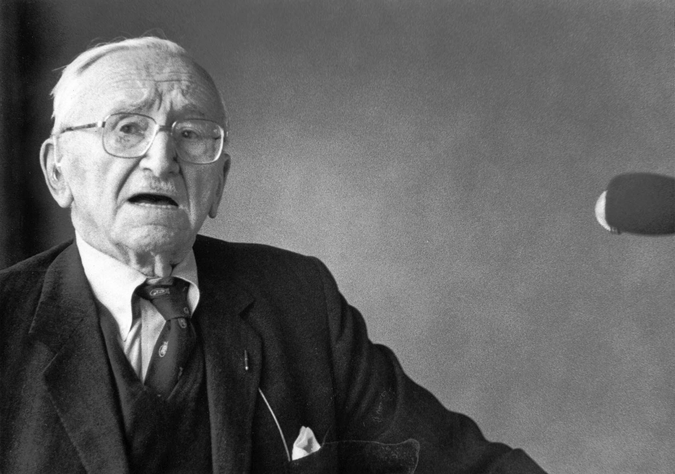
Muddle of the Middle, 5 April 1980

Slide 6
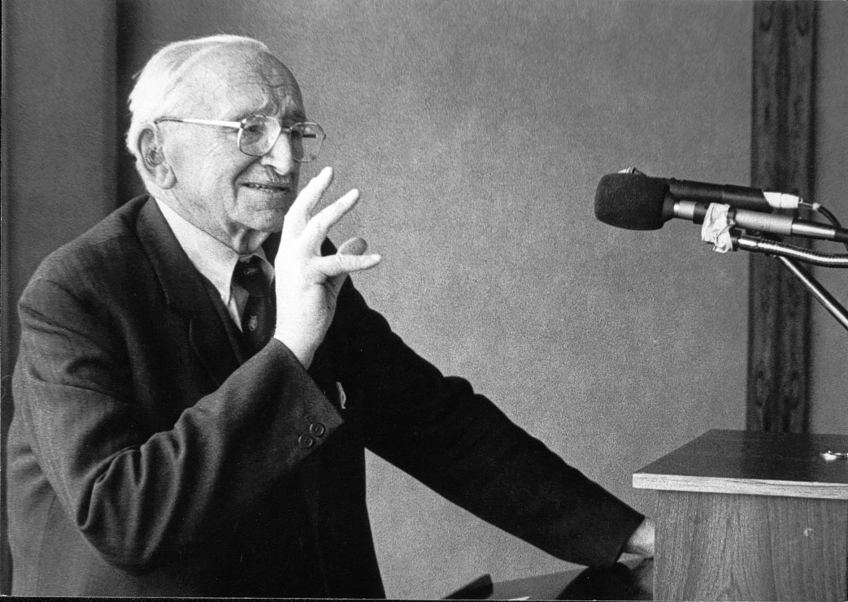
Erroneous Distinction by J.S. Mill

Slide 7
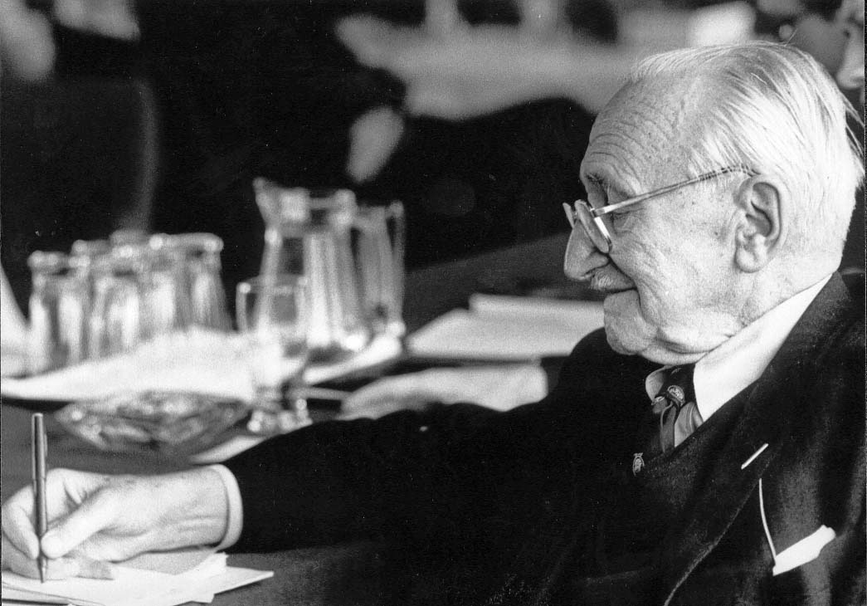
Socialism an Intellectual Error

Slide 8
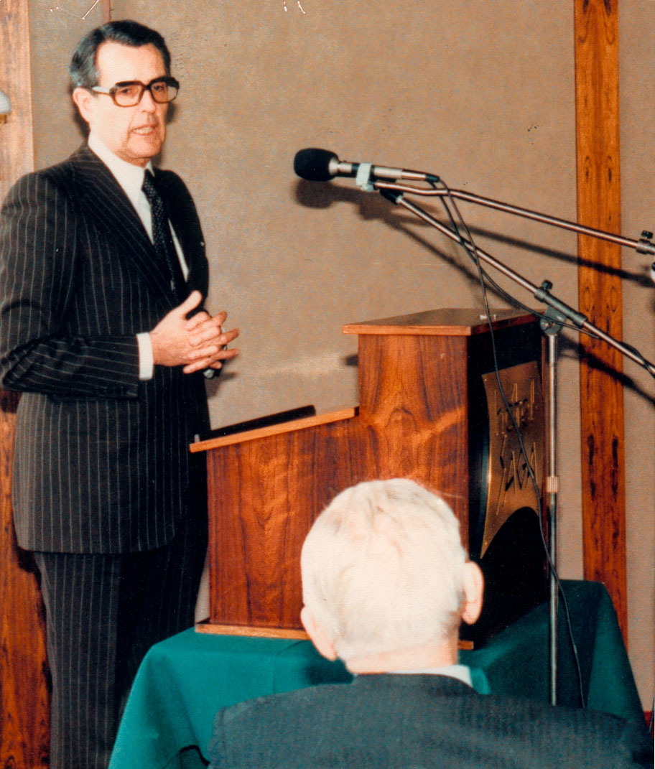
Lively Discussion in 1980
Hayek: Modern man brought up in institutions, not in the market
We must curb powers of the state and of labour unions
We must bring down nflation quickly
Government has to do less, and do it better, vital to cut government expenditure

Slide 9
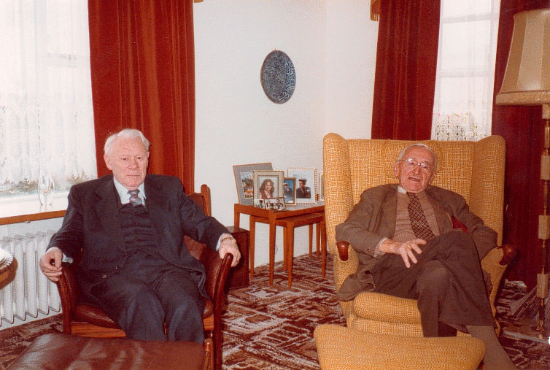
Hayek in the Western Fjords

Slide 10
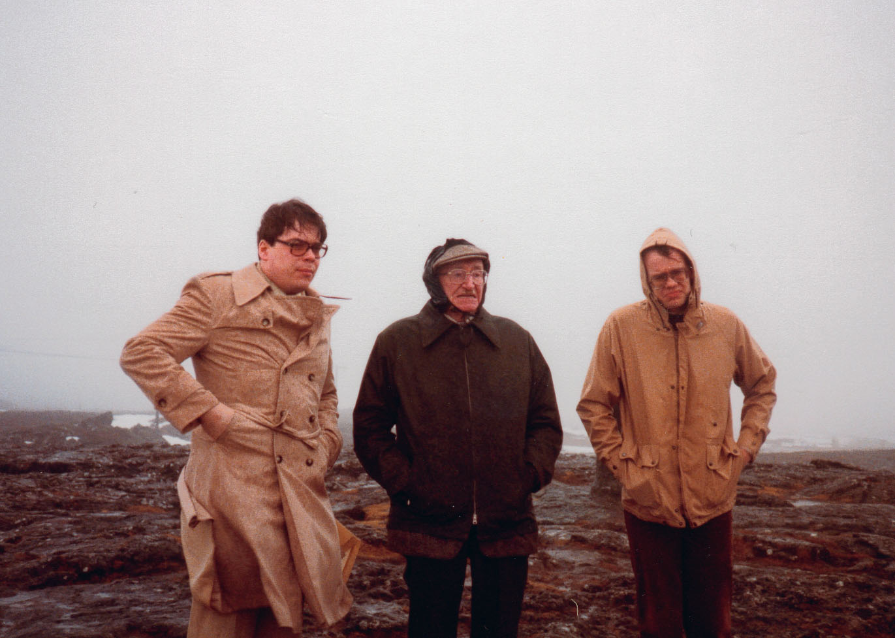
Enduring Rain at Thingvellir

Slide 11
Hayek looks at newspapers 1980

Slide 12
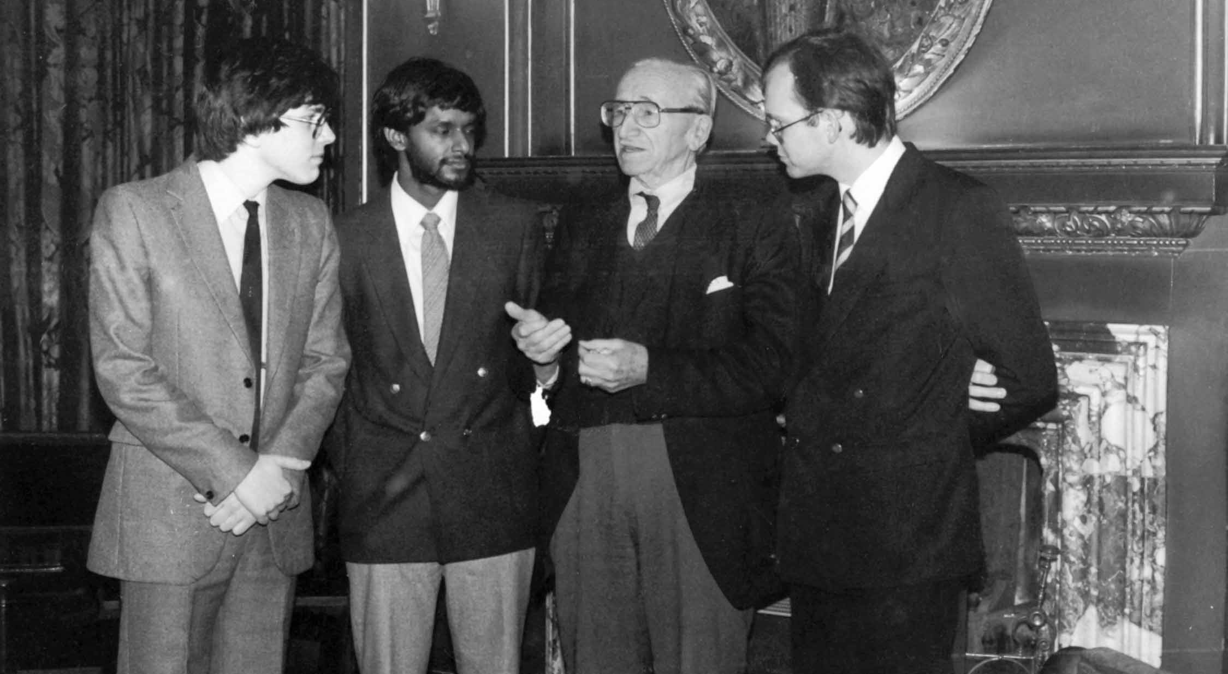
Hayek in Oxford in 1985

Slide 13
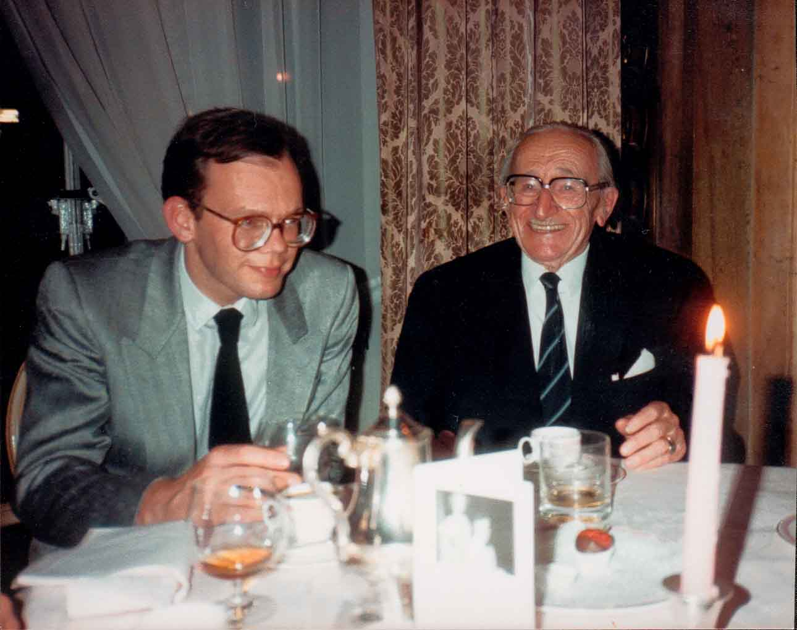
Hayek at the Ritz in 1985

Slide 14
Dinner in spring 1985
Collected him at the Reform Club in Pall Mall
Told us about four presidents: Coolidge, Hoover, Kennedy and Reagan
Told us how Thatcher disarmed him at the door of 10 Downing Street
Sang “City of the Dreams” with the musicians
Said: “Liberty” opposite of “Liberation”
Asked us not to become “Hayekians”

Slide 15
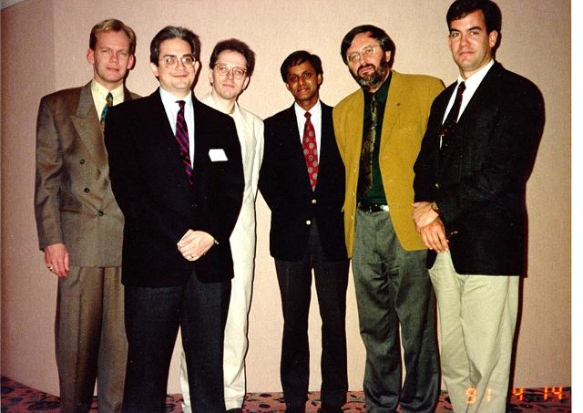
Hayek Society: Indianapolis 1986

Slide 16
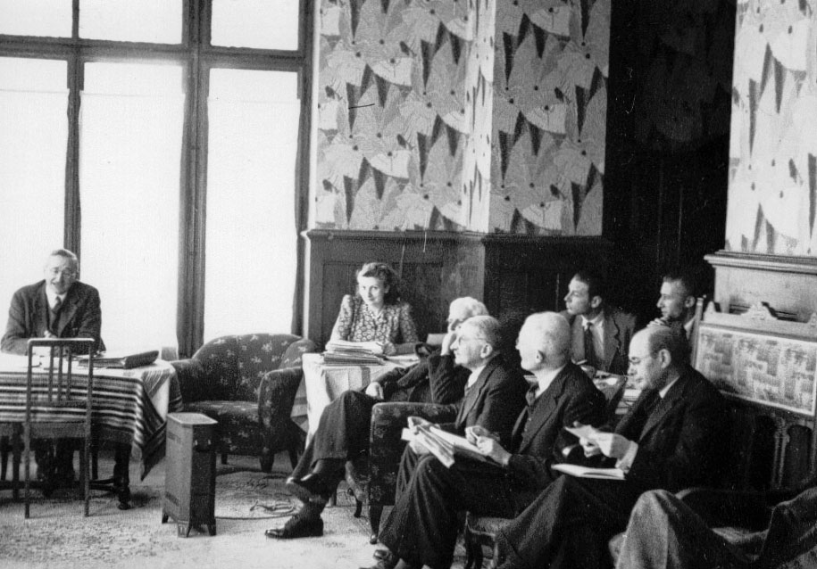
Mont Pelerin Society 1947

Slide 17
Hayek at the MPS 1947
President MPS 1947–1961
Nobel Prizes: Hayek, Friedman, Stigler, Coase, Becker, Allais, Smith (Vernon), Buchanan
President Einaudi of Italy, Chancellor Erhard, Otto von Habsburg, Vaclav Klaus, George Shultz, etc.

Slide 18
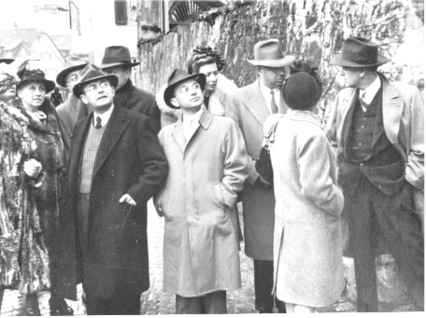
Friedman 1947

Slide 19
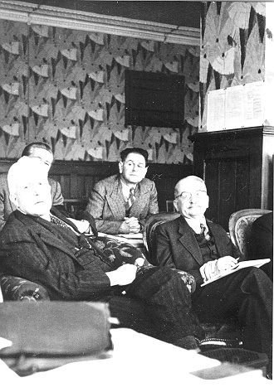
Popper and Mises 1947
Popper and Mises founding members MPS
When someone supported progressive taxation, Mises: “You are all a bunch of socialists!”
When Machlup doubted gold standard, Mises did not speak to him for three years

Slide 20
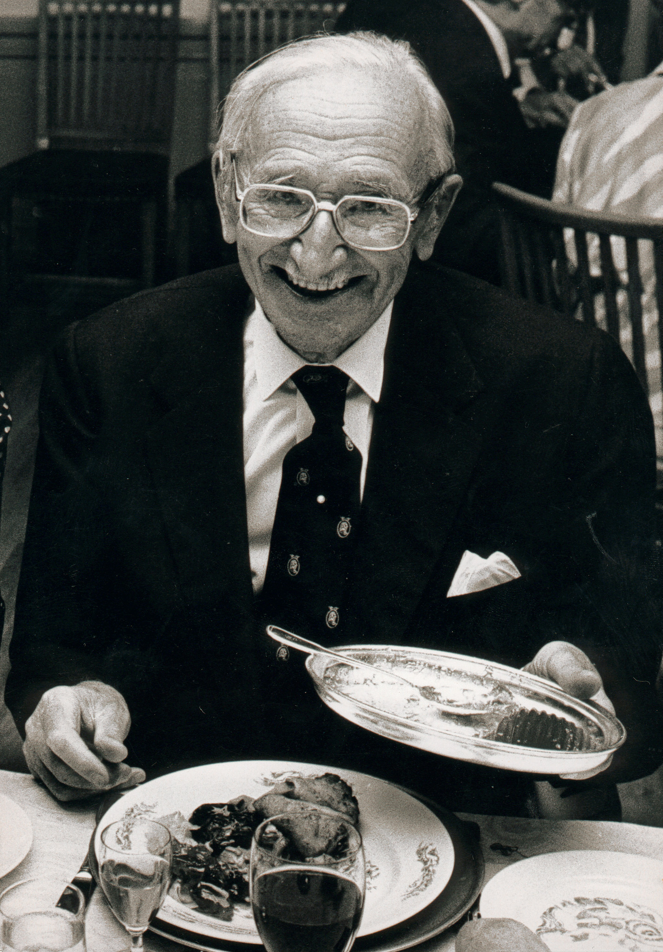
Stockholm 1981
Met Hayek in Stockholm 1981
West-Berlin 1982
Paris 1984
Last in Cambridge 1984
Spoke myself Sydney 1985 and St. Vincent (Italy) 1986, Hayek not there

Slide 21
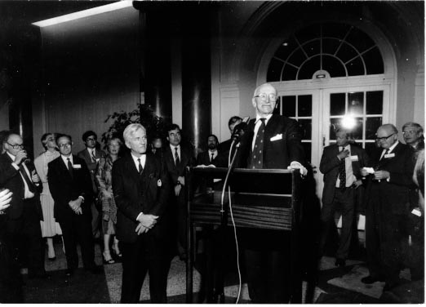
Hayek with von Weiszäcker 1982

Slide 22
Chirac, Lord Harris and Hayek 1984

Slide 23
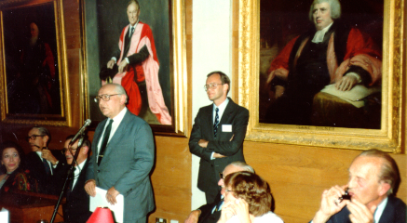
Cambridge 1984

Slide 24
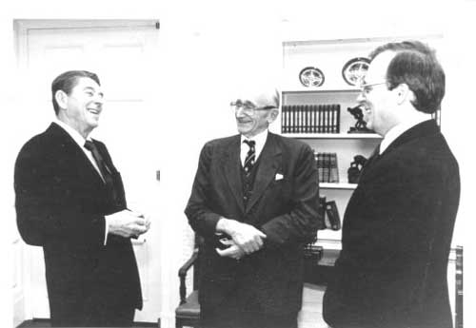
Reagan, Hayek and Ed Feulner

Slide 25
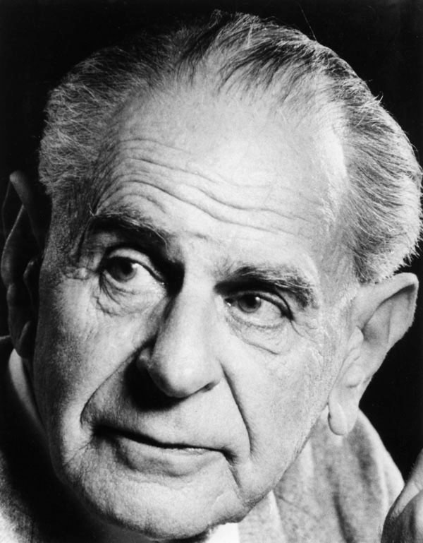
Karl Popper, 1902–1994
Born in Vienna, from a family of Jewish intellectuals
Logik der Forschung
Professor New Zealand 1937
LSE 1946
Hitler’s Anschluß of Austria: Wrote The Open Society and Its Enemies

Slide 26
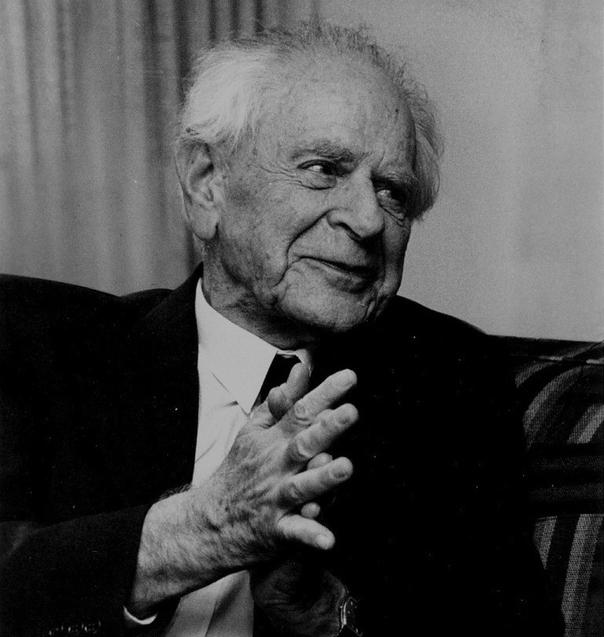
Popper and Wittgenstein 1946

Slide 27
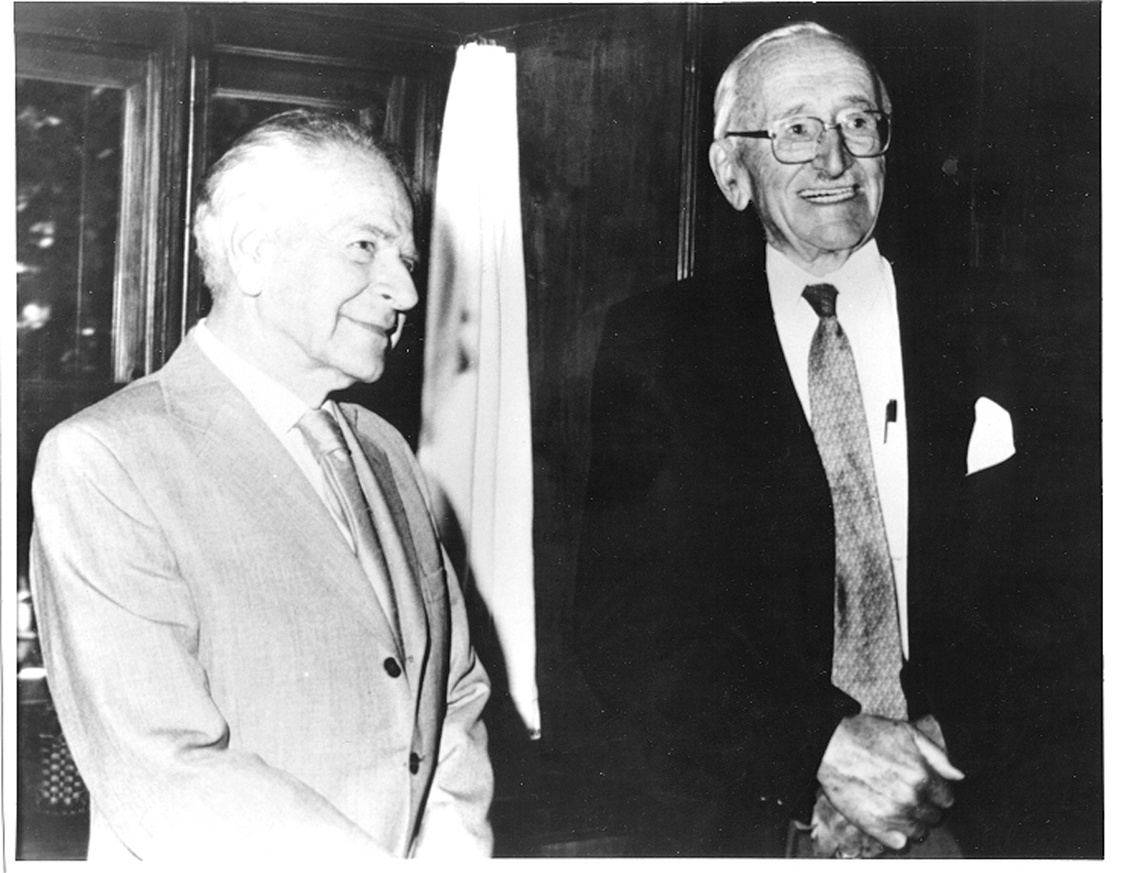
Popper and Hayek

Slide 28
Visited Popper 31 January 1985
Science and pseudo-science: Refutability
Enemies of open society: Plato, Marx, Hegel
Was Popper fair to Hegel?
Plamenatz: Popper on political technology, Hegel on moderate interventionism
Showed me photos from first MPS meeting
Liberalism endless struggle against identifiable problems
Tension or Paradox in Liberalism: Power

Slide 29
Iceland, Industrialisation, Churchill
Iceland the only nation state which Popper could think of of (but could not defend itself)
In Vienna, the Poppers read about Viking discoveries and Greenland settlement
Showed me books by Elizabeth Gaskell: Mary Barton and North and South
Admired Churchill and Thatcher

Slide 30
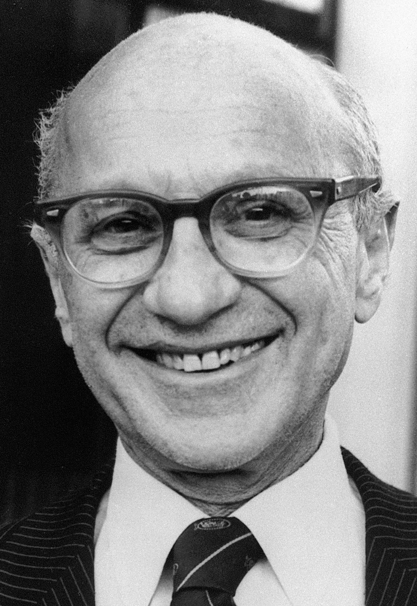
Milton Friedman, 1912–2006
Born in Brooklyn, son of poor immigrants from Ukraine
Doctorate from Columbia, NY
Disciple of Frank Knight
Professor at Chicago
Scholar at Hoover Institution at Stanford

Slide 31
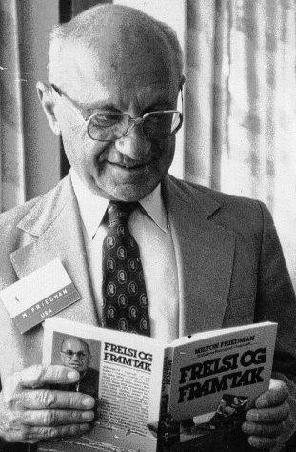
Friedman 1980 and 1982
1980: „Don’t defend me! Defend our ideas!“
On the way to China
Pointed to the model of Hong Kong
I translated Capitalism and Freedom
1982: Friedman in West Berlin

Slide 32
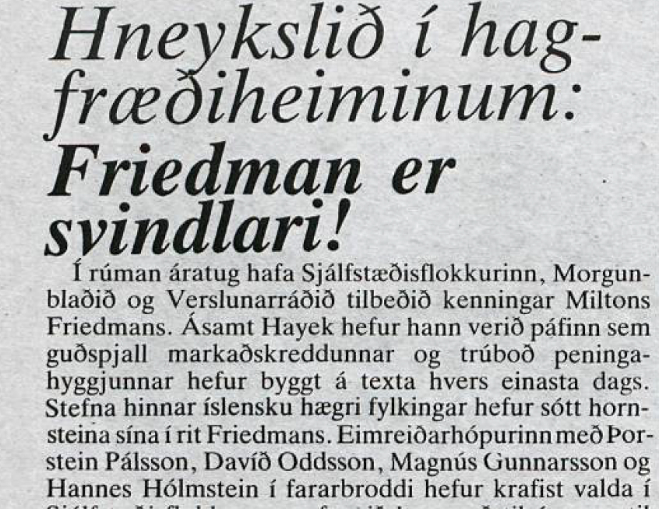
Socialists celebrating in 1984

Slide 33
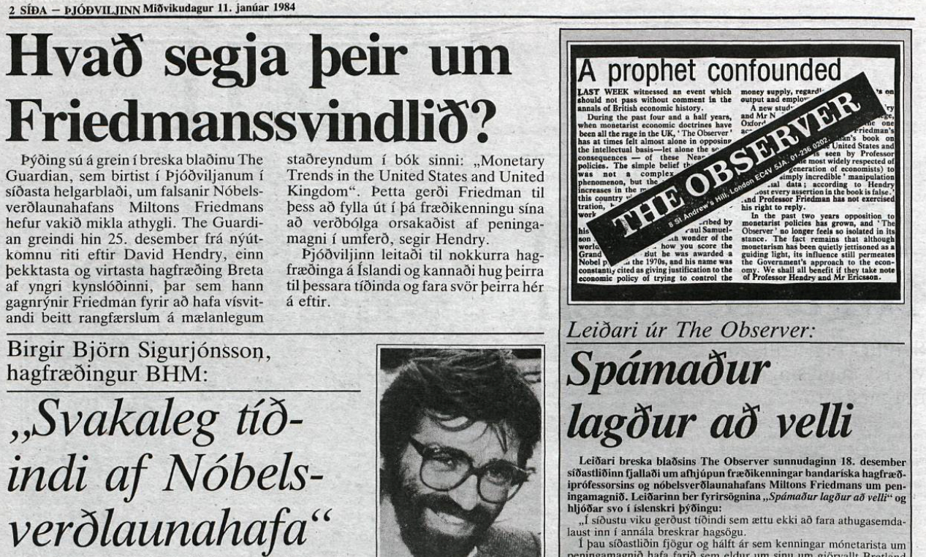
Specialists asked to comment …

Slide 34
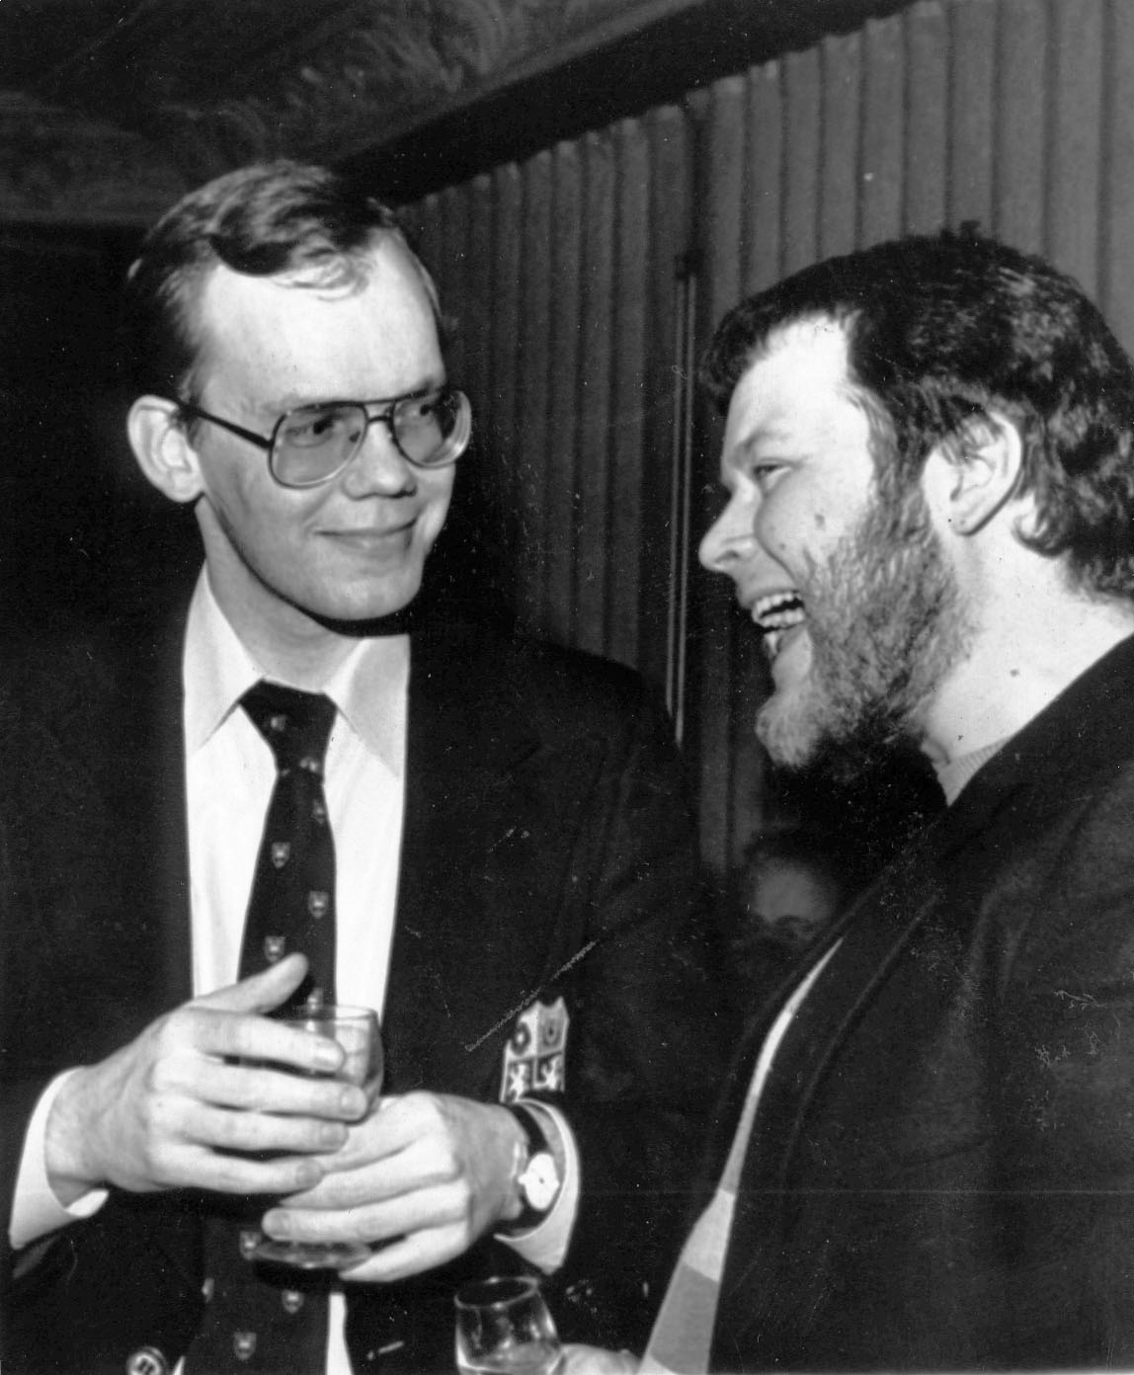
The socialists laughed …

Slide 35
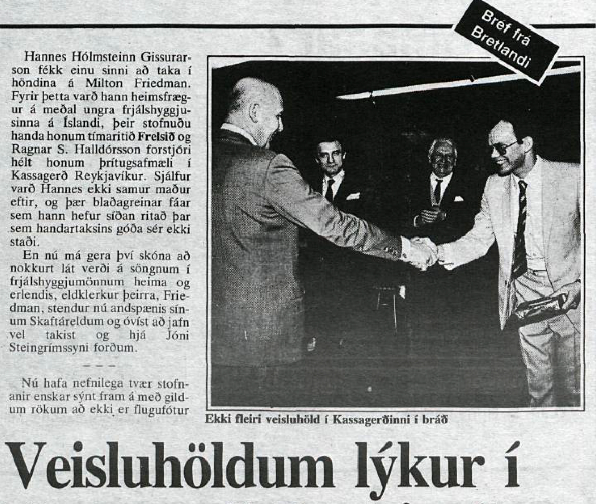
and declared the party over …

Slide 36
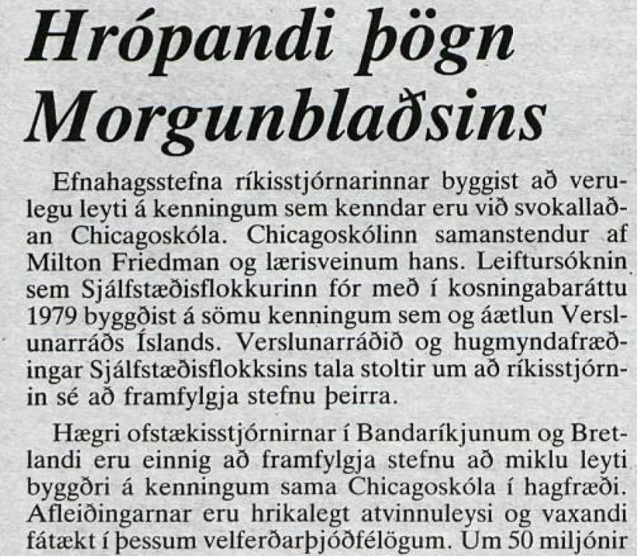
… and talked about screaming silence

Slide 37
It was all wrong!
Read Hendry’s paper, did not find any basis there for allegations in Guardian
Wrote to Hendry
He replied: Friedman honest scholar, only debate about statistical methods, e.g. time periods relevant and averages
Copied to Friedman; he sent a strongly worded letter to Hendry asking him why he had never corrected the media interpretation

Slide 38
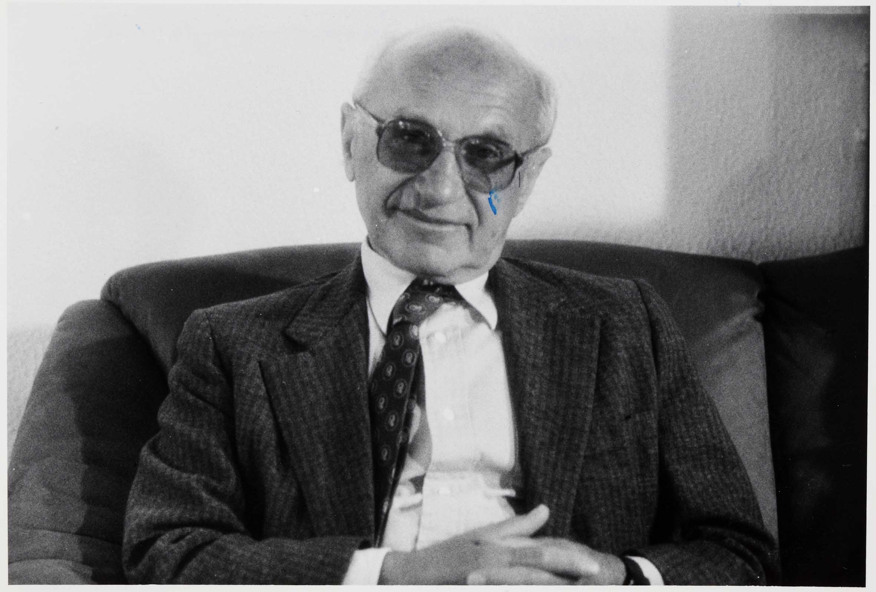
Do you have a solution in one word?

Slide 39
Lecture 1 September 1984

Slide 40
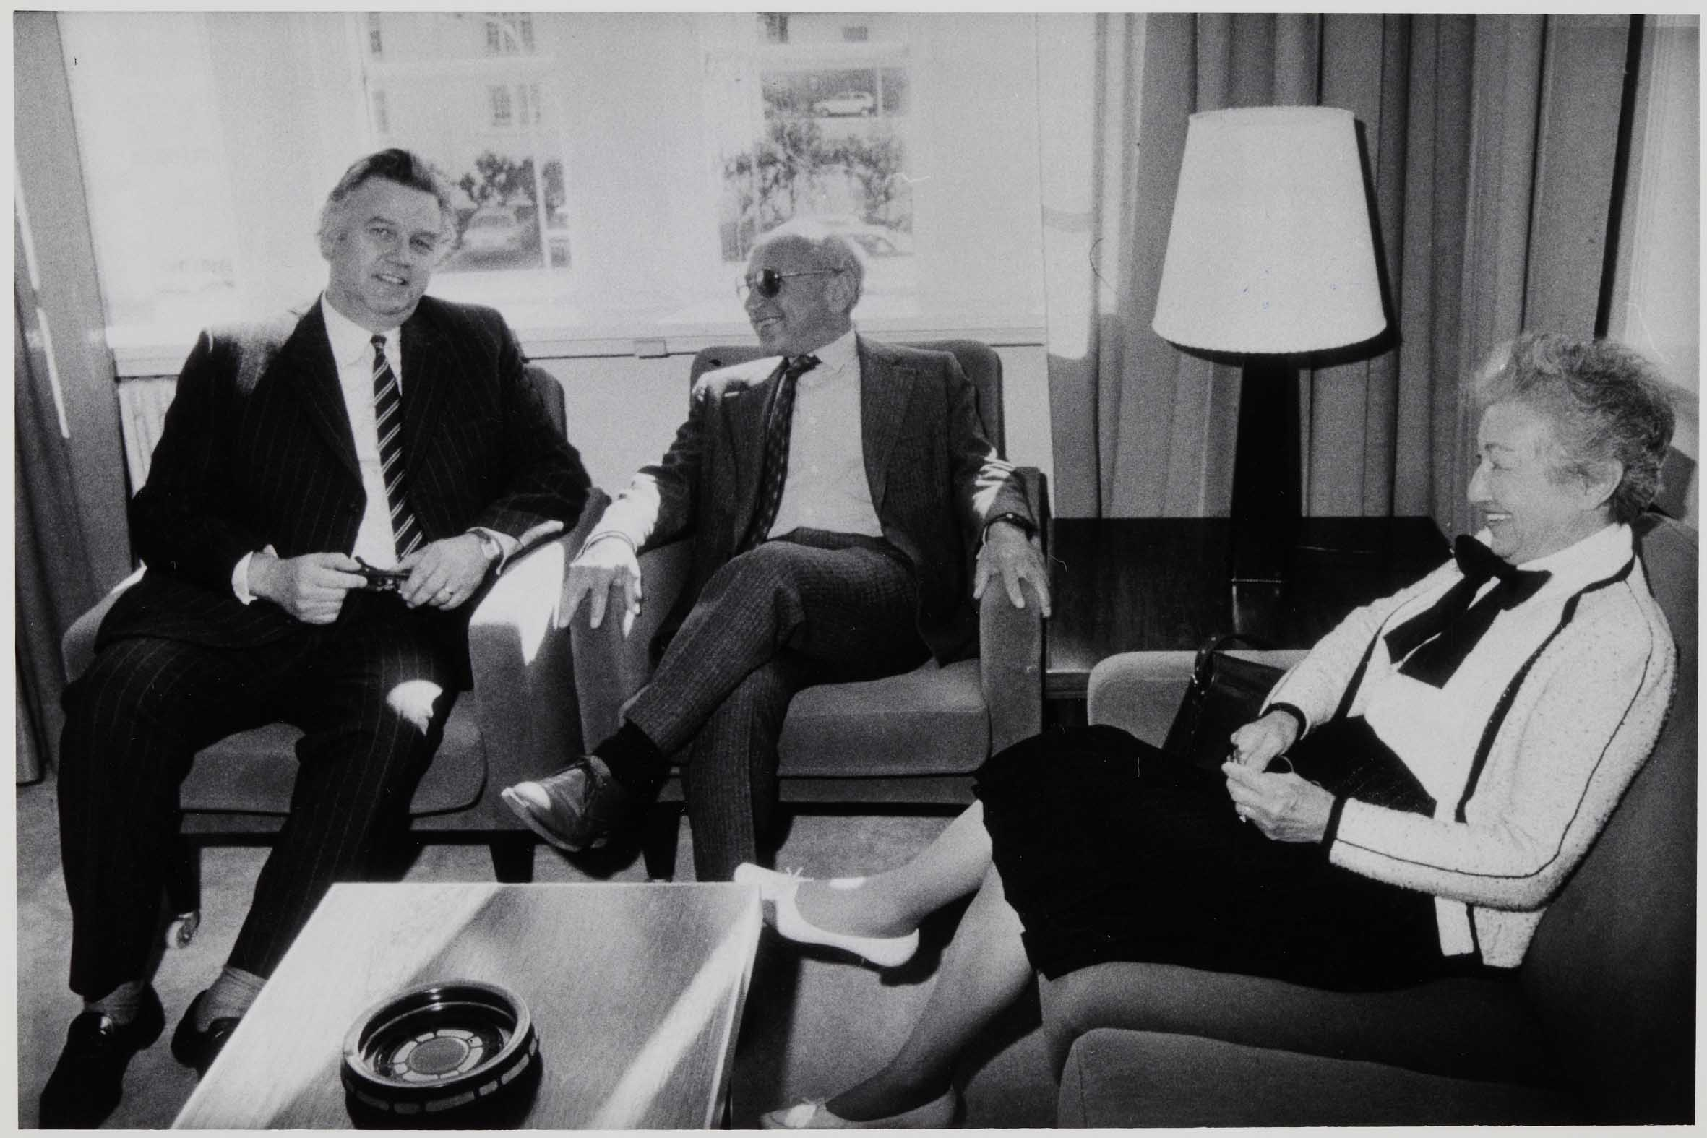
Lunch at the Government Mansion

Slide 41
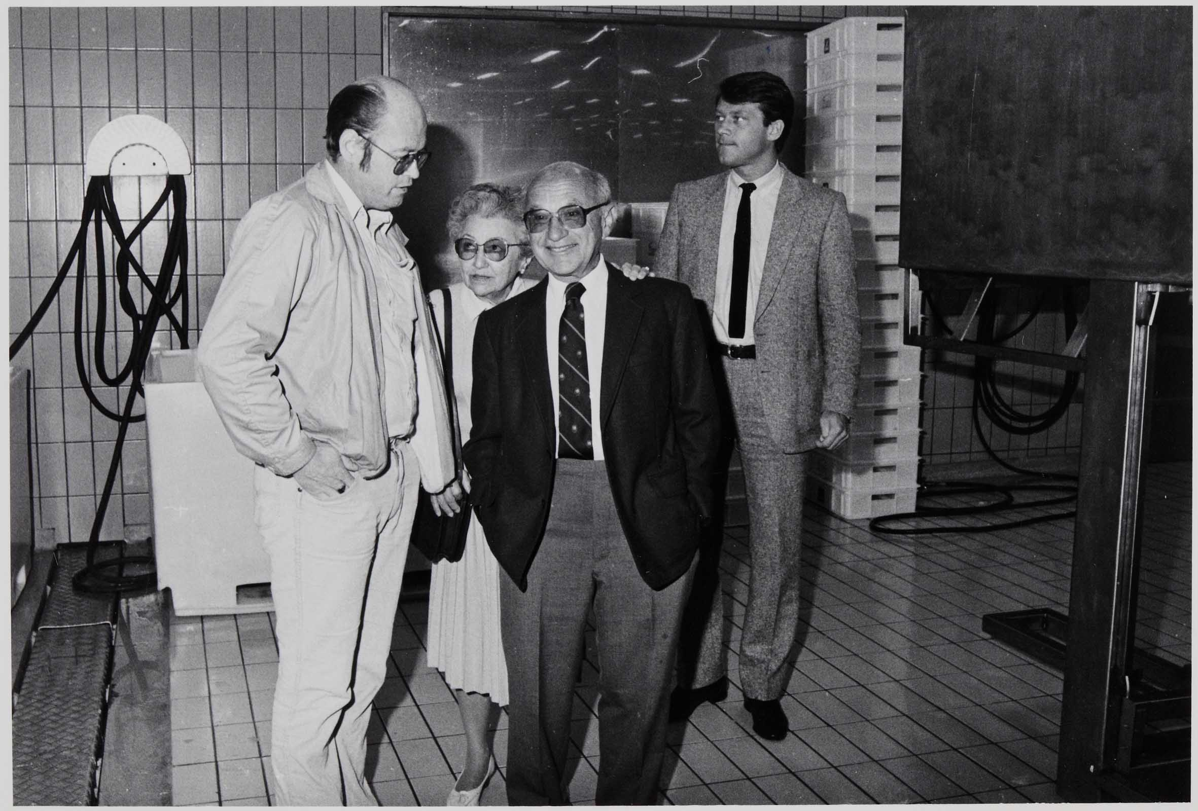
Visit to Fishing Firm Grandi

Slide 42
Social Life
Famous television debate with socialists Olafur R. Grimsson and S. Olafsson
Cocktail Party at home of P. Bjornsson
Dinner at home of I. Sigfusson
Lunch in Government Mansion, introduced him to Central Bank governor; Friedman’s response
Dinner at Chamber of Commerce: “Look into a mirror!”

Slide 43
Taylor Street and Sea Ranch
Lived in high-rise building 1750 Taylor Street, No. 1901, in San Francisco
Went out to dinner or had a pizza sent in
Summer house 2 hours north of San Francisco
Core of liberalism: tolerance, human fallibility, quoted Cromwell
Lent me the book about Ayn Rand by Barbara Branden, shook his head and laughed over her intolerance
Wondered what to say about Arthur Burns

Slide 44
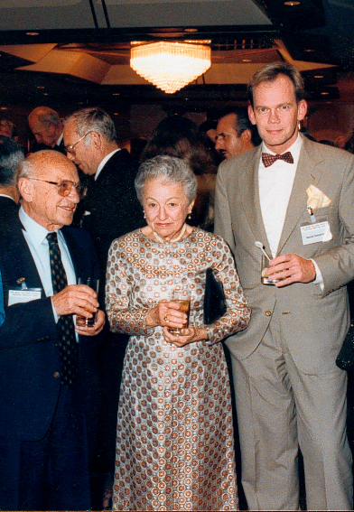
Tokyo 1988
Swedish economist: “Swedes do not know poverty”
Friedman: “Neither do Swedes in the US!”
Chinese minister of planning: “Who is my colleague in the US?”
Friedman: “The Free Market!”

Slide 45
Living standards in Nordic economies
Notes:
Sources: Figures from Canada (Table A.34 gross domestic product per capita, provinces and territories, in current dollars) from Canada Statistics for 2009–2010. In Canadian dollars which was then about the same as US dollars. Website www.statcan.gc.ca Figures from Nordic countries, CIA World Factbook (GDP per Capita, PPP, USD) for 2010. Figures from USA, Avery, J.E., Siebeneck, T.P., og Tate, R.P. 2011. Gross Domestic Product by State. Advance Statistics for 2010 and Revised Statistics for 2007–2009. Price level 2010. Bureau of Economic Analysis. Website www.bea.gov

Slide 46
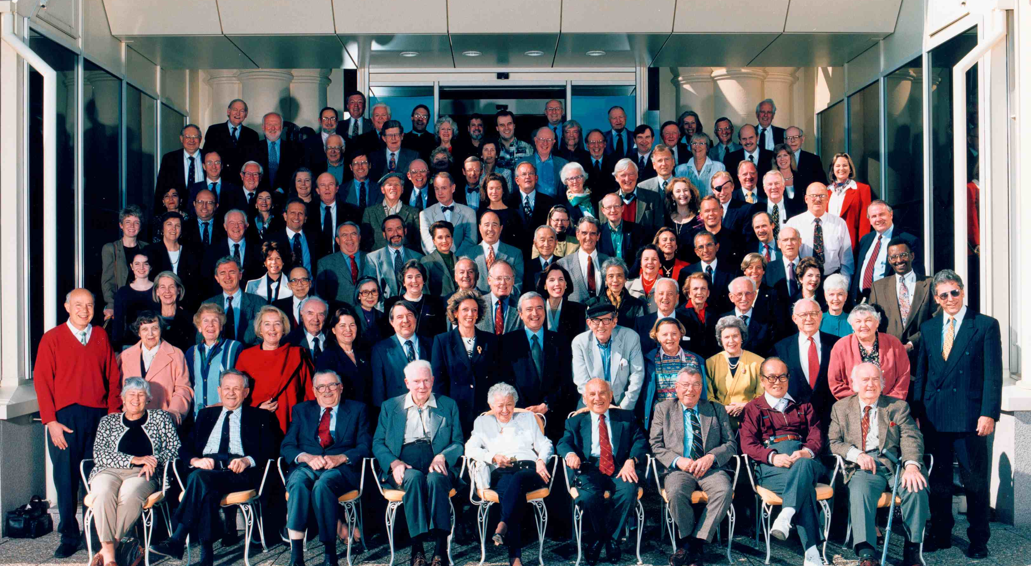
Montreaux 1997: 50 Years

Slide 47
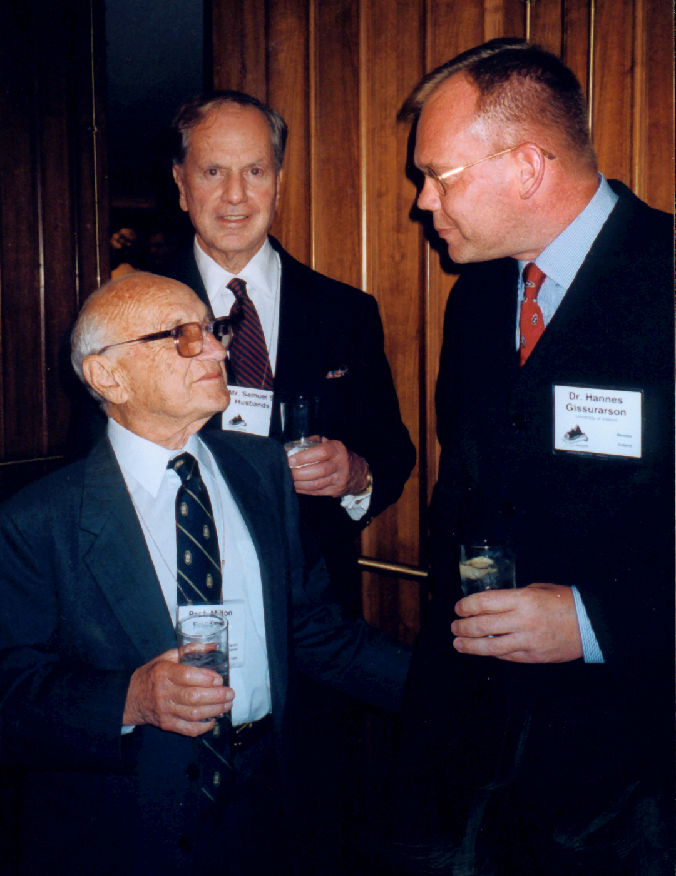
Vancouver 1999
With Sam Husbands, libertarian stockbroker
Last met Friedman at a barbecue at Ed Crane’s in 2002
Had received a medal same day from President Bush, discussed the father and son

Slide 48
Comparison
Hayek the most profound thinker: Dispersed knowledge demands dispersed power; overcoming individual ignorance by the market and by traditions
Popper’s insight: Concentrate on amending ills or evils, because we can identify them; we know unhappiness, not happiness
Friedman sharpest thinker, clearest in debate and the most eloquent, quick as lightning

