Slide 1
The Icesave Dispute International Courts and Domestic Politics
Professor Hannes H. Gissurarson
NOPSA-24, Gothenburg
12 August 2014, 13.30–14.30

Slide 2
Top Credit Ratings Created Bubble
Notes:
Source: Asgeir Jonsson, lecture 7 October 2013.

Slide 3
Icelandic Banks “oversized”?
Notes:
Norris, Floyd (2008). The World’s Banks Could Prove Too Big to Fail — or to Rescue, New York Times 10 October. His source is quoted as being Bridgewater Associates.

Slide 4
Online retail deposit accounts

Slide 5
Iceland Taken Down

Slide 6
Icesave, Haarde and Oddsson

Slide 7
Letter from Oddsson to Haarde

Slide 8
Landsbanki enslaving nation?

Slide 9
Fierce Debate
Notes:
Frettabladid 26 June 2009.

Slide 10
In Ten Years, 2019 …
Notes:
Drawing by Halldor Baldursson, July 2009.

Slide 11
Dilettantes Negotiating?

Slide 12
Over 50,000 signatures on petition

Slide 13
Old Rivals: Grimsson and Sigfusson

Slide 14
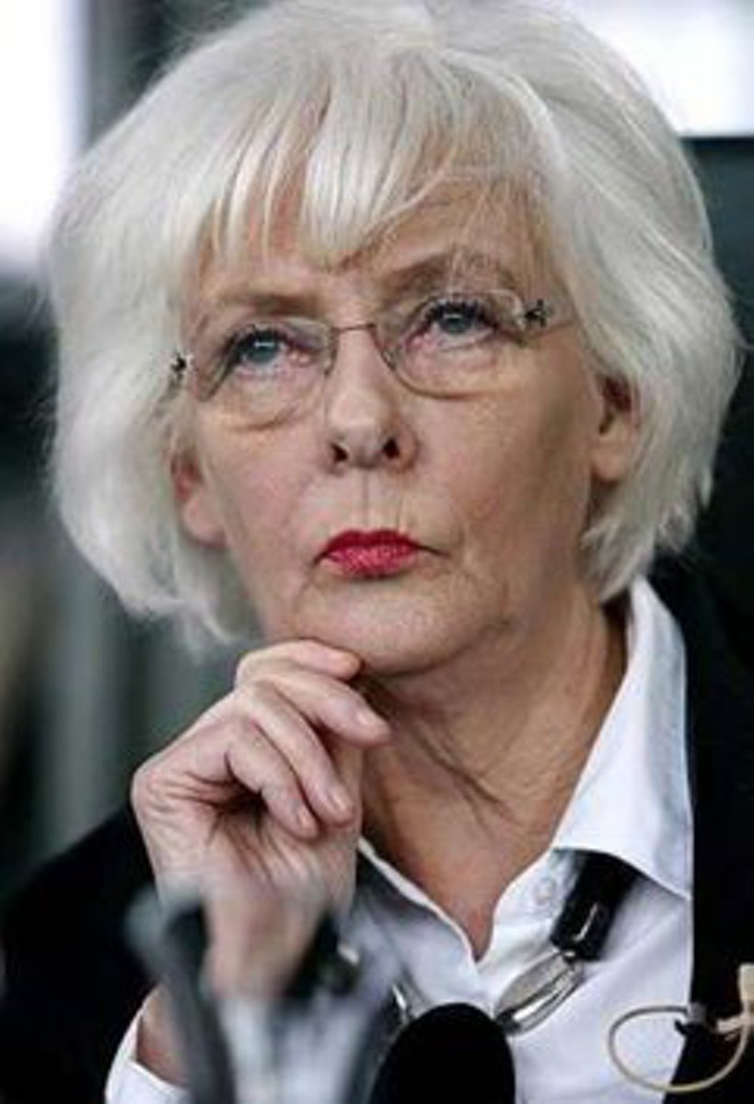
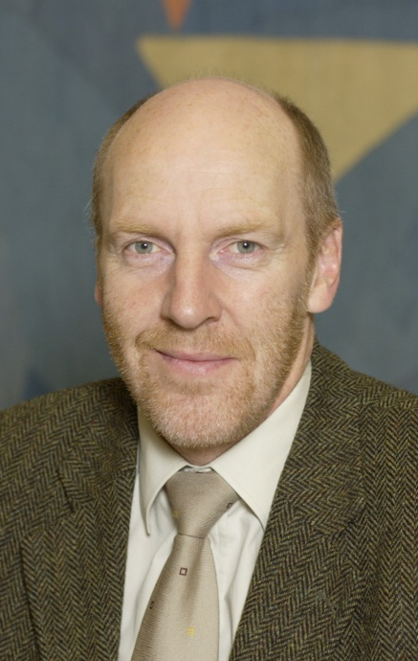
Popularity of Leading Ministers
Notes:
Callup polls 2009–2012. http://www.capacent.is/rannsoknir/thjodarpulsinn/

Slide 15
Voters’ Intention 2010–2013
Notes:
Callup polls 2009–2012. http://www.capacent.is/rannsoknir/thjodarpulsinn/

Slide 16
“Very Good Performance in Icesave”
Notes:
Data from Eva Heida Onnudottir, The Icelandic Election Research Project.

Slide 17
“Very Bad Performance in Icesave”
Notes:
Data from Eva Heida Onnudottir, The Icelandic Election Research Project.

