Slide 1

Iceland Left Out in the Cold?
International Political Theory
Professor Hannes H. Gissurarson
NOPSA-37, Gothenburg
14 August 2014, 8.45–9.45

Slide 2
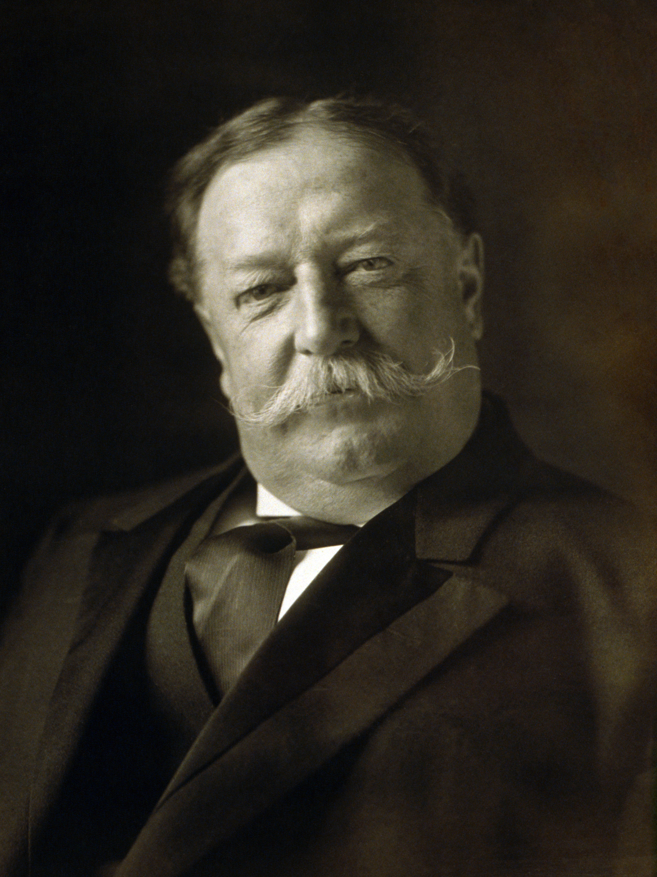
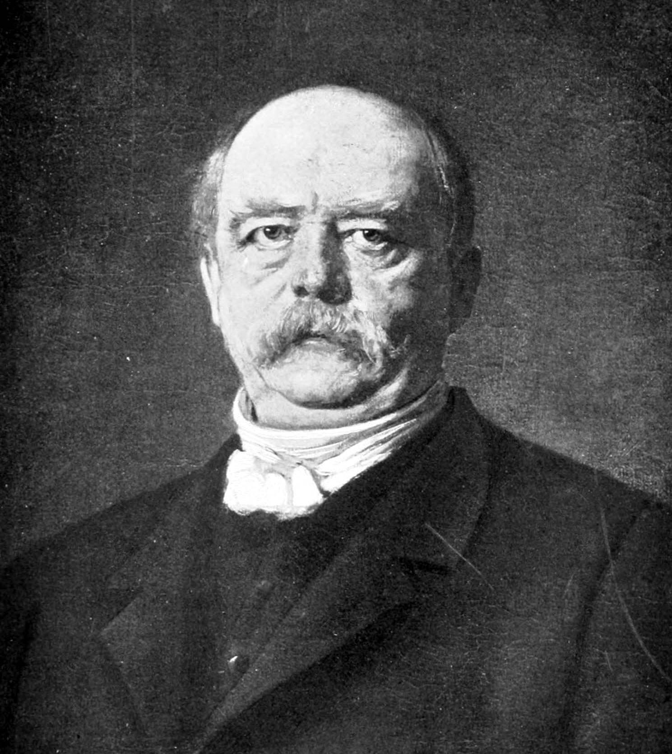
US v. Cuba, Prussia v. Denmark

Slide 3
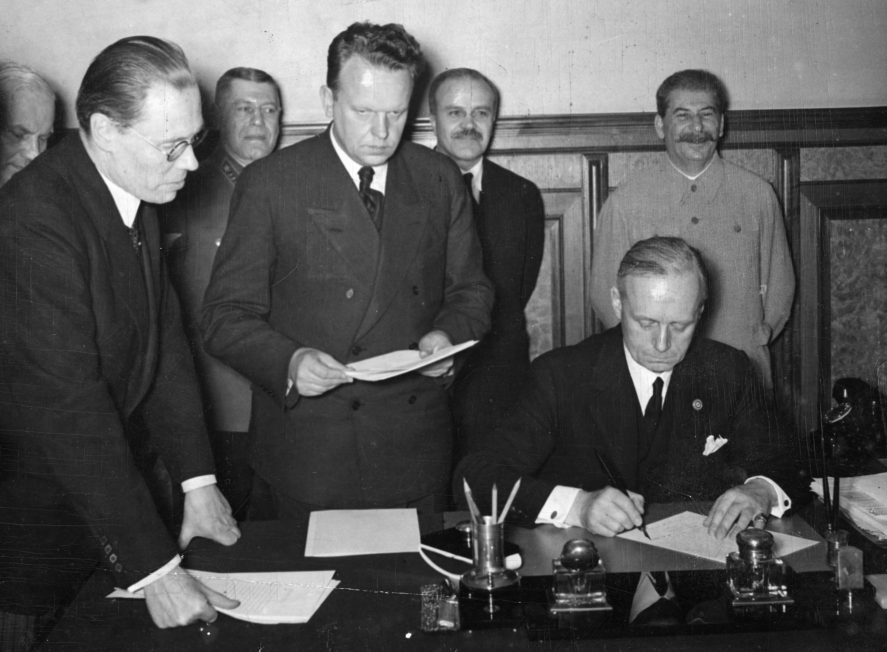
Division of Central Europe

Slide 4
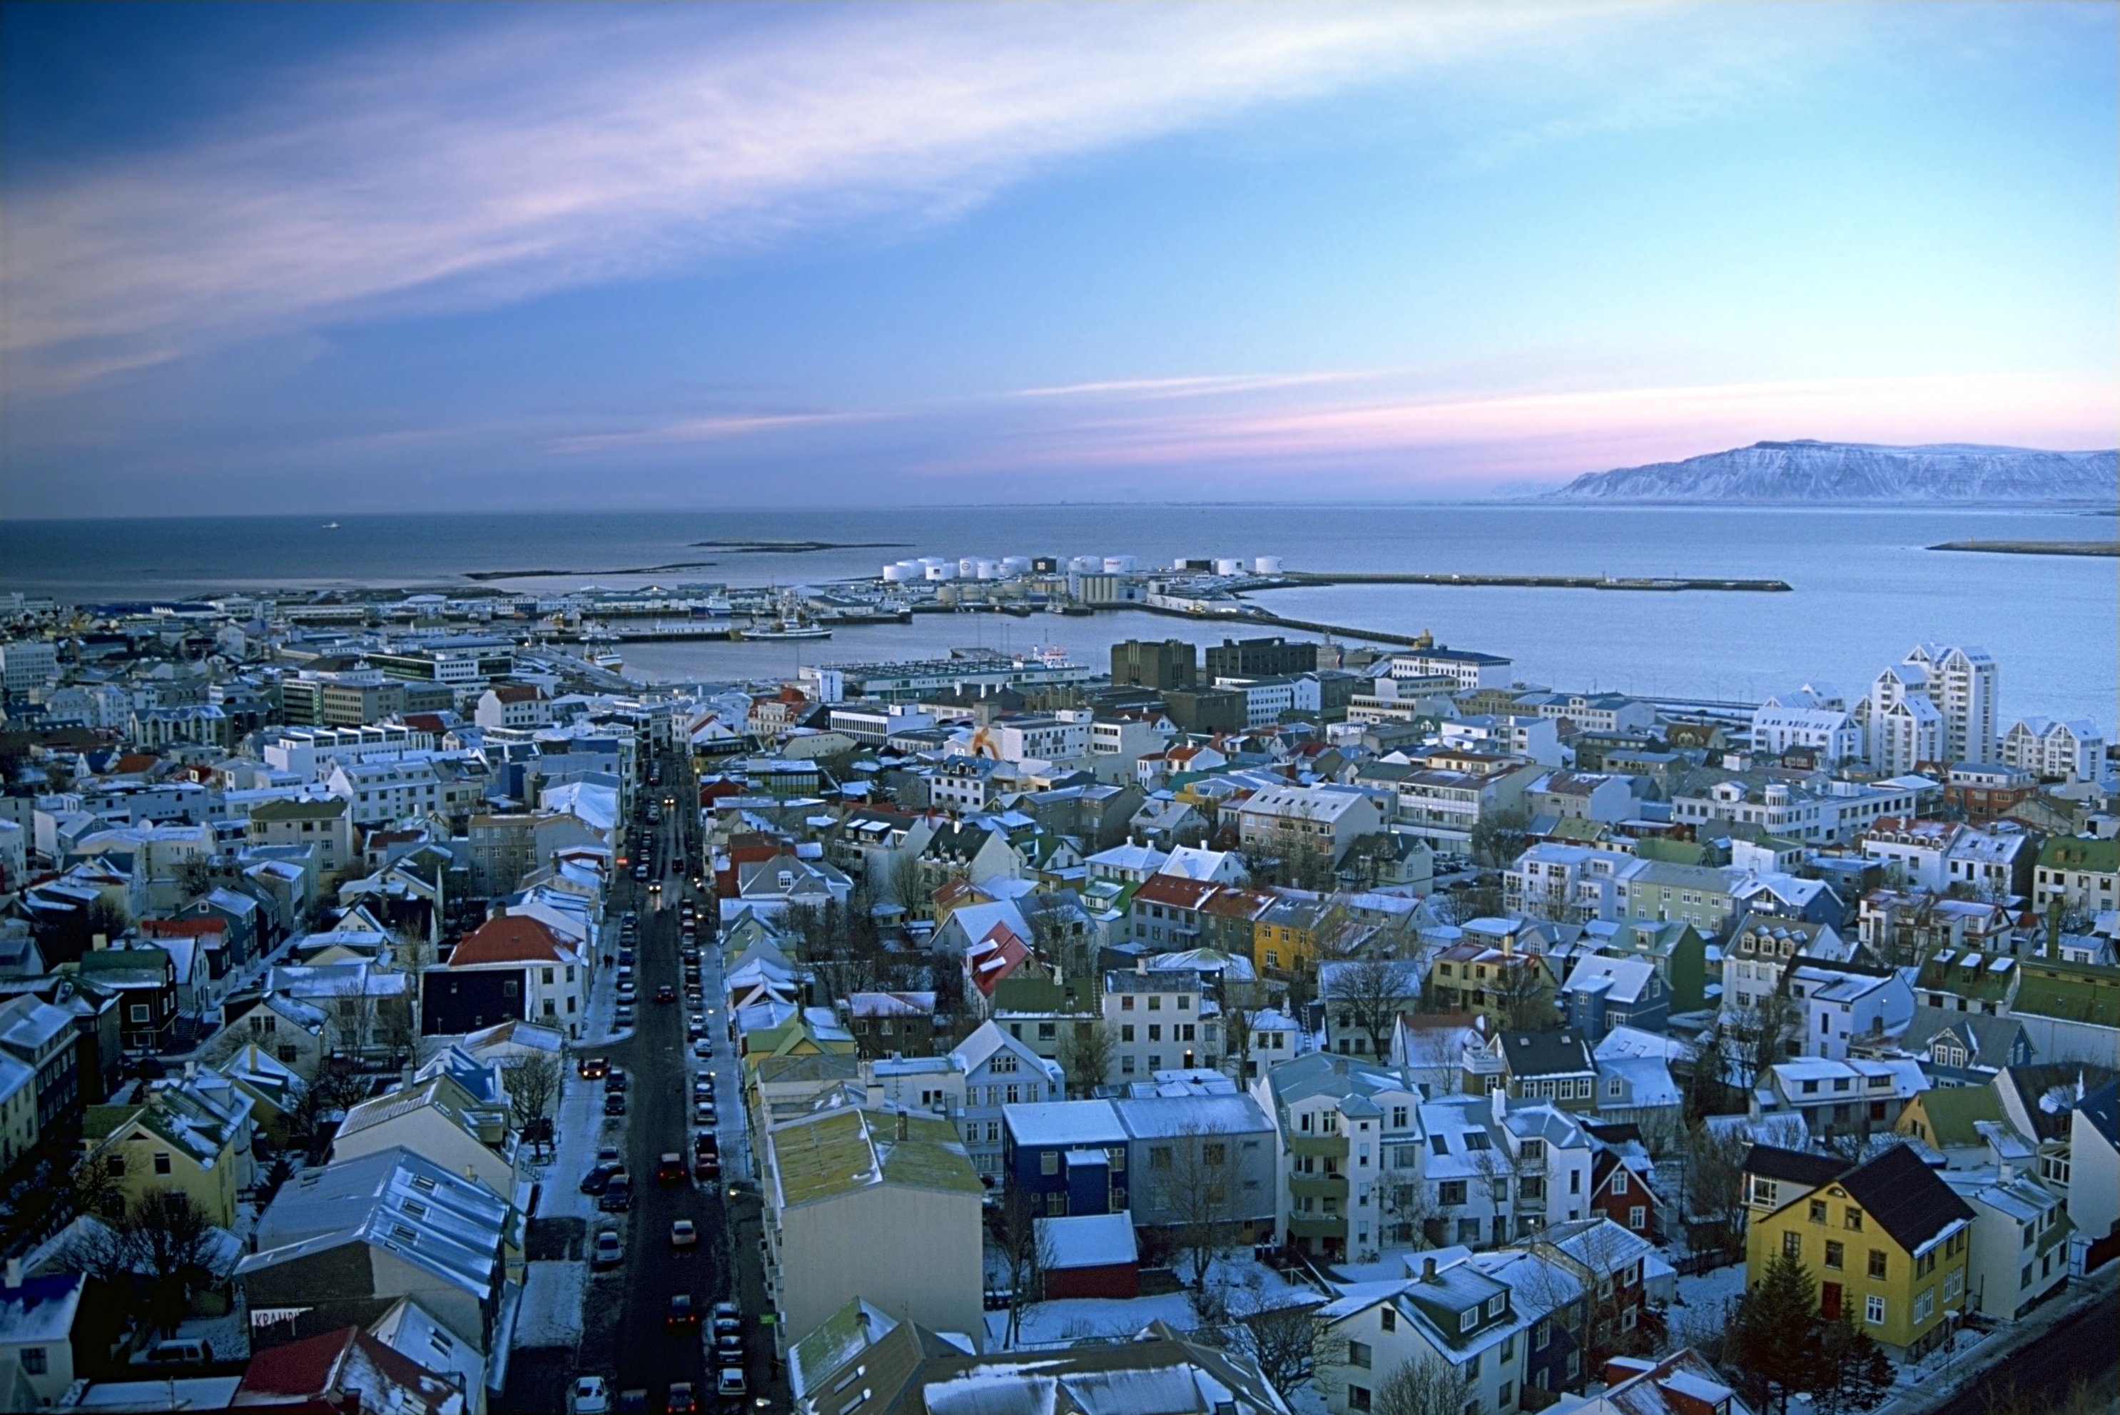
Iceland: 325,000 Without a Military

Slide 5
Top Credit Ratings Created Bubble
Notes:
Source: Asgeir Jonsson, lecture 7 October 2013.

Slide 6
External Debt: 2004 Crucial Year
Notes:
Source: Central Bank, Statistics: http://statistics.cb.is/data/set/1wsf/#!display=line&ds=1wsf!1yuk=6 [accessed 4 August 2013].

Slide 7
2004–8: Baugur Bubble
Notes:
Source: Special Investigation Commission, Report, 2010, Vol. 7, Ch. 21, supplementary data.

Slide 8
No more “Oversized” than others
Notes:
Norris, Floyd (2008). The World’s Banks Could Prove Too Big to Fail — or to Rescue, New York Times 10 October. His source is quoted as being Bridgewater Associates.

Slide 9
Size of Banking Sector, 1992–2007
Notes:
Sources: Thorvaldur Gylfason (2011); Union Bank of Switzerland.

Slide 10

Why Does Glass Break?

Slide 11
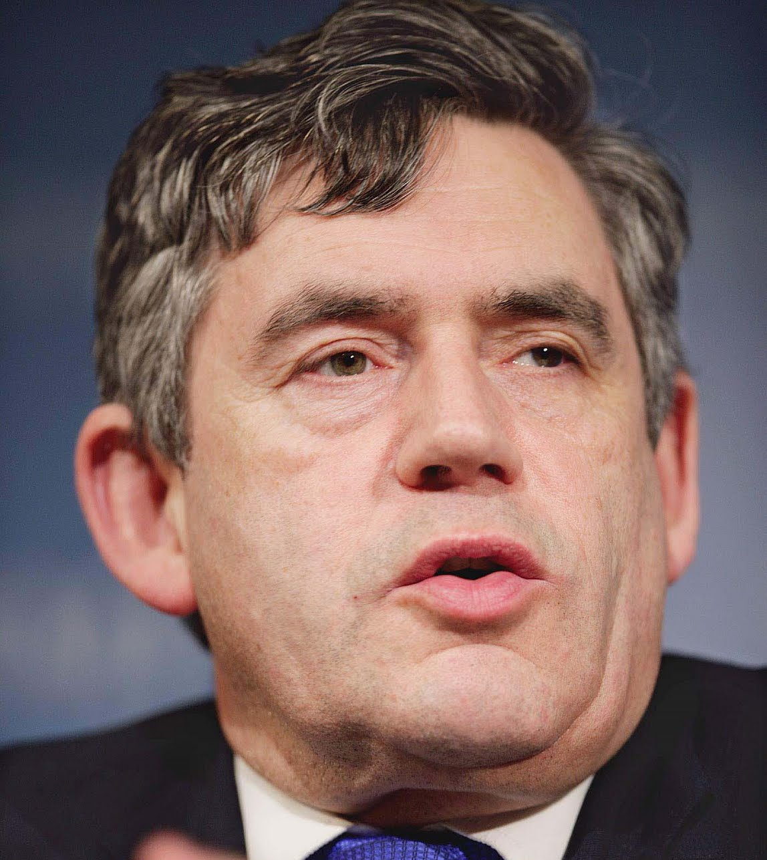
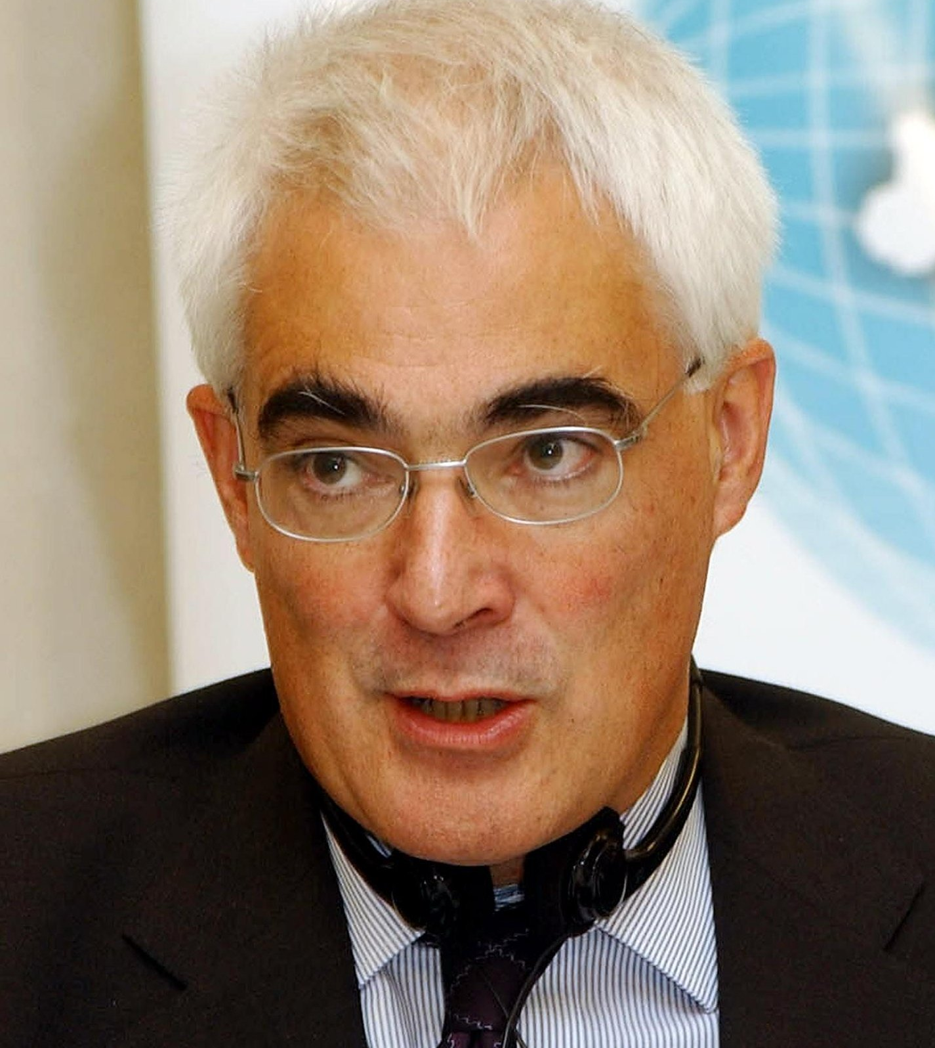
Crucial Announcements and Decisions

Slide 12
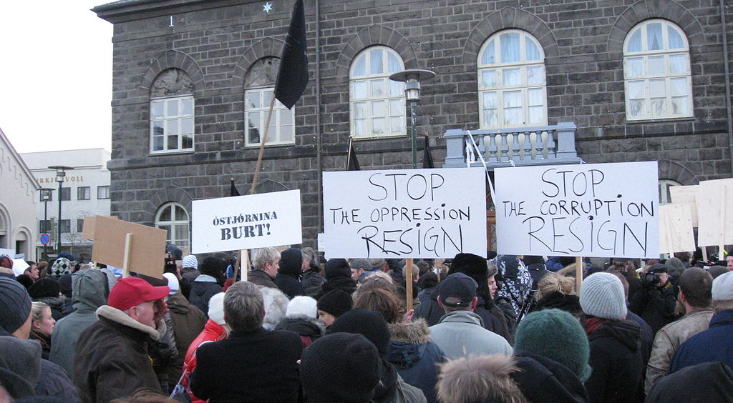
Loss of Social Capital

Slide 13
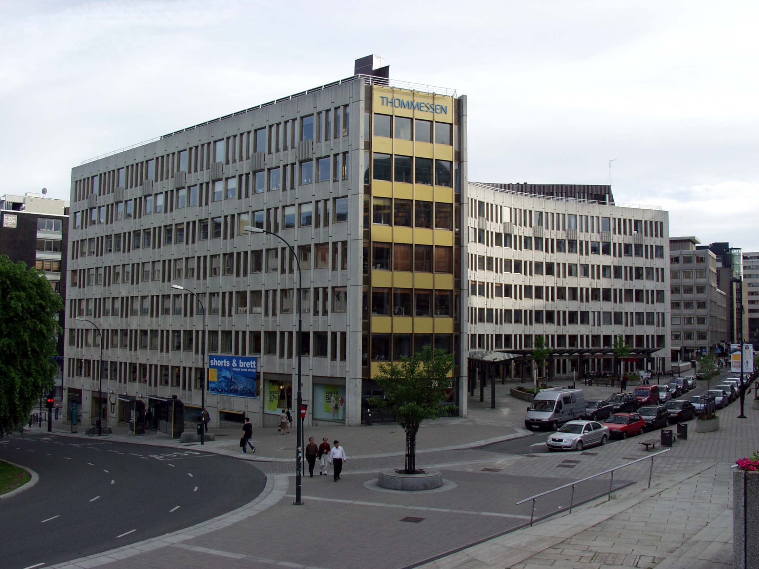
Haakon VII’s gate 10 in Oslo

Slide 14
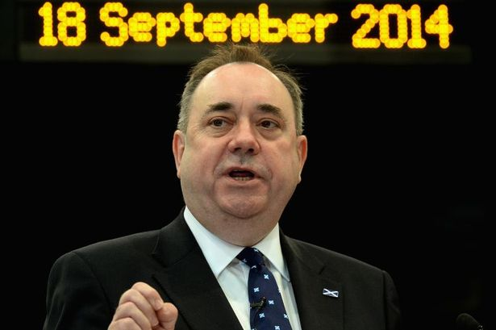
The Scottish Angle

Slide 15
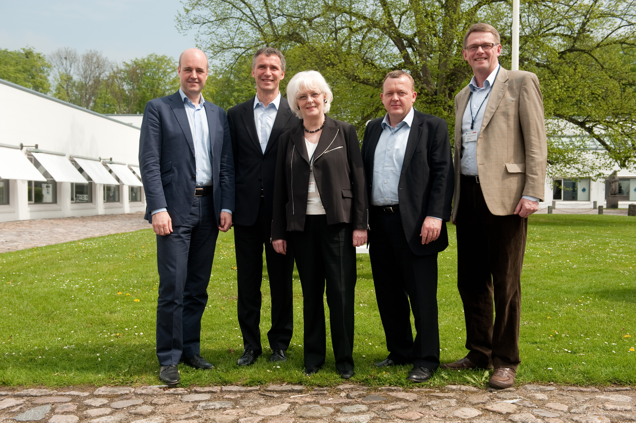
Friends in Need, Friends Indeed

Slide 16
