Slide 1

The Icelandic Welfare State:
Nordic or Anglo-Saxon?
Professor Hannes H. Gissurarson
NOPSA-36, Gothenburg
14 August 2014, 13–15

Slide 2
Lower Rate, More Revenue
Notes:
Source: Statistics Iceland. Suggested by Edward Prescott.

Slide 3
Stabilisation: Inflation fell
Notes:
Source: Icelandic Statistics. (Figures no longer available in this form, author’s calculations.)

Slide 4
Sustainable Strong Pension Funds
Notes:
Source: OECD, Pension Markets in Focus, 2006.

Slide 5
Public Expenditure in Iceland
Notes:
Source. Statistics Iceland. National accounts and public finance. Public finance. Central government main aggregates 1980–12013. Expenditure % of GDP. www.statice.is, accessed 3 May 2014.

Slide 6
Economic Freedom in the North
Notes:
Source: Economic Freedom of the World: 2012 Annual Report. freewtheworld.com, accessed 3 May 2014.

Slide 7
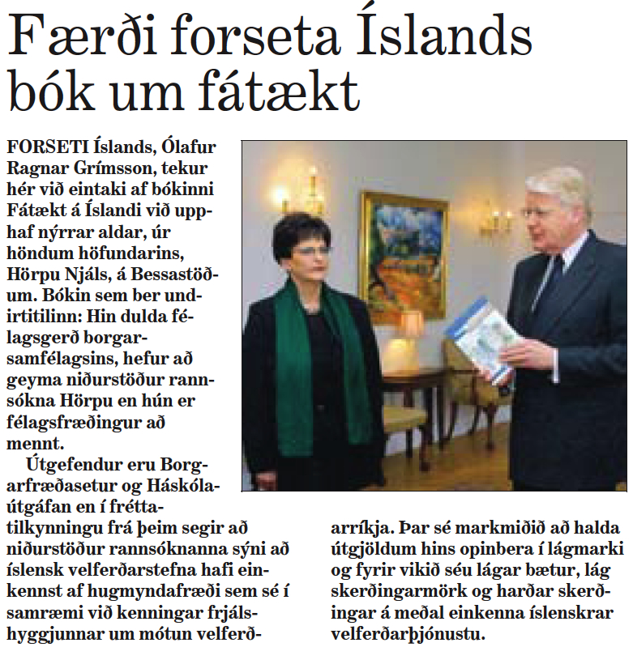
2003 Debate on “Hidden Poverty”

Slide 8
Eurostat on 2003–4 Poverty
Notes:
Source: Hagtíðindi 2007 (1). Lágtekjumörk og tekjudreifing 2003–2004. Table 13. Hagstofa Íslands (Statistics Iceland).

Slide 9
Olafsson’s Income Distribution

Slide 10
Eurostat Income Distribution
Notes:
Source: Hagtíðindi 2007 (1). Lágtekjumörk og tekjudreifing 2003–2004. Table 13. Hagstofa Íslands (Statistics Iceland). Estimate of Gini Coefficient 1995: Stefan Olafsson.

Slide 11
Gini Coefficients after 2004
Notes:
Note: Hagtíðindi, 2013 (9). Lágtekjumörk og tekjudreifing 2012. Reykjavik: Iceland Statistics. Eurostat refers to the survey year, or the year the survey was implemented. The income reference period is the previous year. For example, the Gini coefficient for 2011 (year of income) would be given by Eurostat for the year 2012 (year of calculation). See also: http://epp.eurostat.ec.europa.eu/tgm/table.do?tab=table&language=en&pcode=tessi190

Slide 12
Top Credit Ratings Created Bubble
Notes:
Source: Asgeir Jonsson, lecture 7 October 2013.

Slide 13
Bubble: 2004 Crucial Year
Notes:
Source: Central Bank, Statistics: http://statistics.cb.is/data/set/1wsf/#!display=line&ds=1wsf!1yuk=6 [accessed 4 August 2013].

Slide 14
2004–8: Baugur Bubble
Notes:
Source: Special Investigation Commission, Report, 2010, Vol. 7, Ch. 21, supplementary data.

Slide 15
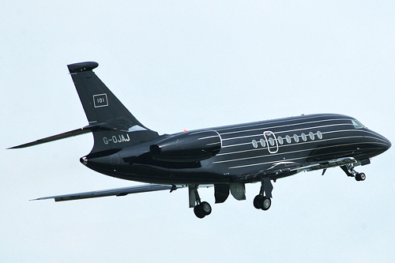
101: Baugur Group Private Jet

Slide 16

101: Baugur Group Private Yacht

Slide 17
Seven EU countries hit harder
Notes:
Source: Eurostat website. Real GDP growth, 2001–2010 (% change compared with the previous year; average 2001–2010).

Slide 18
All Income Groups Suffered
Notes:
Hagtíðindi 2013 (9). Lágtekjumörk og tekjudreifing 2012. Table 3. Reykjavik: Statistics Iceland.

Slide 19
Living standards relative to EU average
Notes:
Source: Eurostat, GDP per capita in PPS. Index (EU28 = 100) http://epp.eurostat.ec.europa.eu/tgm/table.do?tab=table&init=1&plugin=1&language=en&pcode=tec00114

Slide 20
