Slide 1
A SURPRISE ENCOUNTER The Jewess who became an Icelander and the Nazi who became a communist
Professor Hannes H. Gissurarson
28th Conference of Nordic Historians
Joensuu, Finland, 16 August 2014

Slide 2
Henny Goldstein-Ottosson
Born Berlin 28 March 1905, to Leo Lippmann and wife Minna, b. Glass
Two half-brothers from mother’s earlier marriage: Harry and Siegbert Meinhardt Rosenthal
Married Robert Goldstein, son Peter born 1927

Slide 3
Refugee in Iceland
Medellín, Colombia, divorced, returned 1930
Dressmaker in Berlin to 1934
Moved to Reykjavik, mother and son arriving later
When threatened in 1938, Hendrik Ottosson married her
Brother Harry joined in 1938 with his girlfriend
Siegbert stayed in Berlin with wife, expecting a child

Slide 4
Henny and her brothers Berlin 1936

Slide 5
The Rosenthal Couple

Slide 6
An Icelandic Family in 1939

Slide 7
Sisters-in-Law: Reykjavik and Berlin

Slide 8
Reykjavik in the 1930s

Slide 9
Bruno Kress
Born Seltz, Alsace, 11 February 1907, son of Karl Kress and Emma, b. Friedrichs
1919, Alsace French, family moved to Berlin
Studied philology Friedrich Wilhelms-Universität under Gustav Neckel, ardent nationalist
1932, moved to Iceland to study Icelandic, lodged with the Thoroddsens

Slide 10
The Thoroddsens

Slide 11
Party member no. 3.401.317
Became member in March 1934
Let his private students (sympathetic to Nazism) read Hitler’s speeches
Rude to Jews in Reykjavik, according to source
1935 complained to Berlin Nazi Party about German consul Dr. Timmermann being lax
1936 expelled from Nazi Party
1938 reinstated, after long investigation

Slide 12
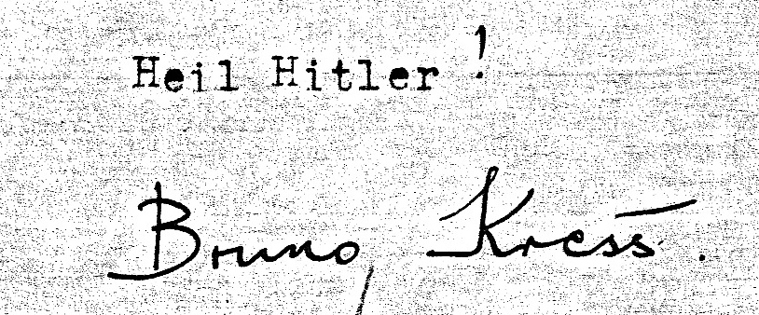
Grant from Ahnenerbe
Himmler’s Ahnenerbe interested in Iceland
Prepared expedition
1939 Kress got grant to write grammar, 100 Reichsmarks a month

Slide 13
Kress in the War Years
1940 arrested after British Occupation of Iceland
1940–44 held on Isle of Man
1942 Corresponded with Wolfram Sievers, Ahnenerbe director
1944 chose to leave in prisoners’ exchange
Schoolteacher in Mecklenburg
SS-Standartenführer Wolfram Sievers

Slide 14
Rosenthals in the War Years
March 1943 all three taken to Auschwitz
April 1943 Swedish Embassy tries contact
July 1943, Siegbert to Natzweiler
August 1943, killed in gas chambers
“Skeleton collection”
Siegbert and Danny Rosenthal in Berlin

Slide 15
Kress: Career in East Germany

Slide 16
Birthday Party 26 May 1958

Slide 17
Story in a North Schleswigian paper

Slide 18
Honorary Doctor Iceland 1986

Slide 19
One more Anti-Nazi gained

