Slide 1

Thomas Piketty’s Capital
A Critical Review
Professor Hannes H. Gissurarson
European Students for Liberty, Bergen
18 October 2014: 14–14.45

Slide 2
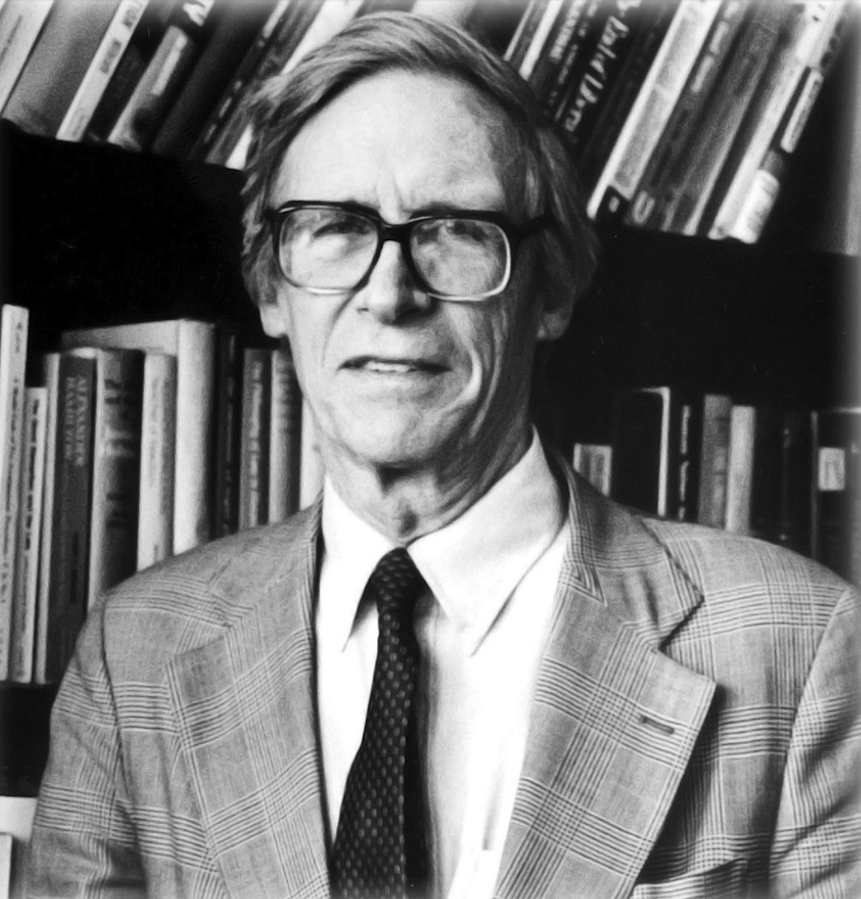
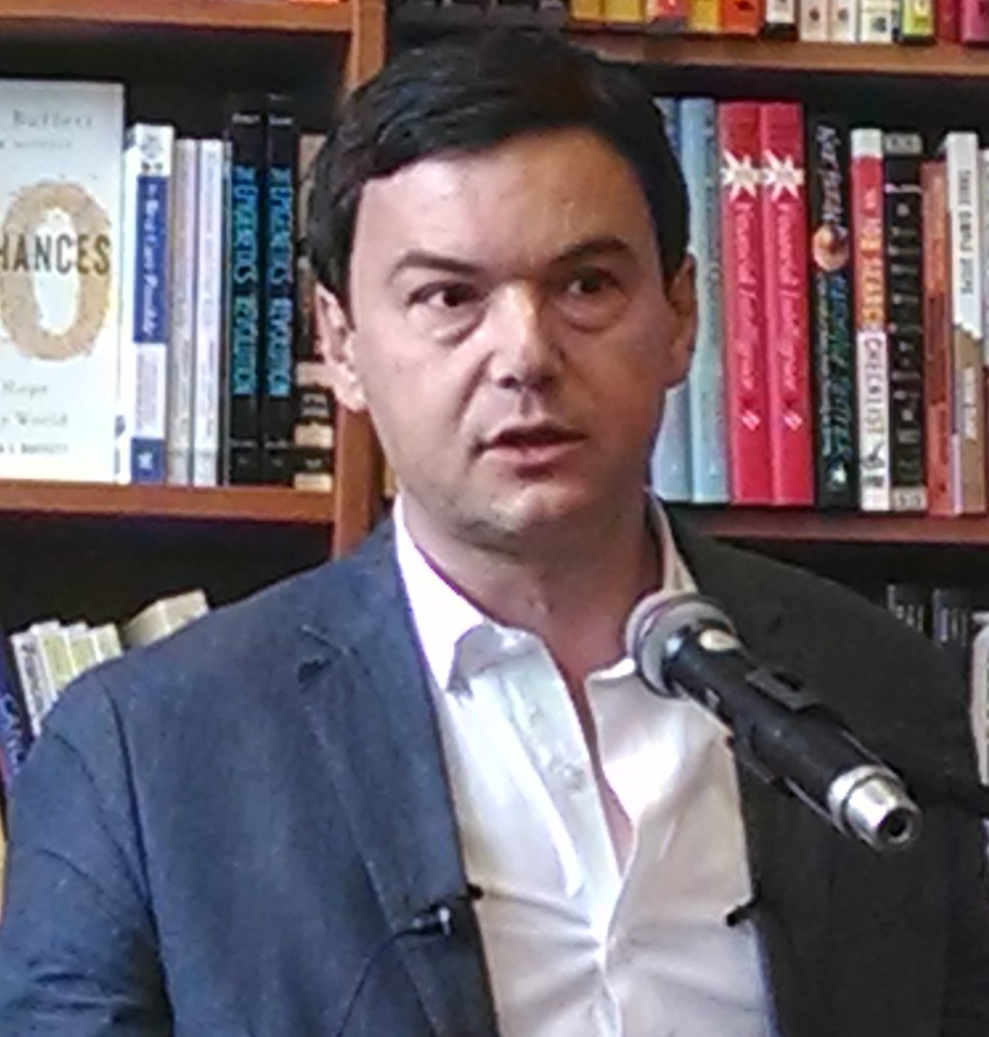
Piketty Replacing Rawls as Prophet

Slide 3
Rawls, and the Poor
Main proposition: Income distribution just if poor are as well off as they can be: maximum of minimum (maximin)
Let us look at Index of economic freedom, with data from long time and many places

Slide 4
Which Country Better, A or B?
Notes:
Source: John Rawls 1971. A Theory of Justice. Cambridge, Massachusetts: Harvard University Press.

Slide 5
Four Worlds of Freedom
Notes:
Source: Economic Freedom of the World: 2012 Annual Report. Website: freetheword.com

Slide 6
Lowest Incomes in Four Worlds
Notes:
Source: Economic Freedom of the World: 2012 Annual Report. Website: freetheword.com

Slide 7
Productive Power of Capitalism
Notes:
Source: Angus Maddison

Slide 8
Much Less Violence than in Past
Notes:
Source: Manuel Eisner, 2003. Long-Term Historical Trends in Violent Crime. Crime and Justice 30, 83-142. Table 2. Overall Homicide Rates in Europe, Thirteenth to Twentieth Centuries. Estimated average of non-state societies is a rate of almost 1,000; the Inuit and the Kung people have a rate of about 100.

Slide 9
Clean Water: Saving Lives
Notes:
Source: Historical Statistics of the United States, Millennial Edition On Line, edited by Susan B. Carter, Scott Sigmund Gartner, Michael R. Haines, Alan L. Olmstead, Richard Sutch, and Gavin Wright, © Cambridge University Press 2006. TABLE Bd448–4622-564 Series Bd448–462 Bd HEALTH
INCIDENCE OF DISEASE Richard H. Steckel.

Slide 10
The Green Revolution
Notes:
Source: FAO Statistics. http://faostat.fao.org/site/567/default.aspx#ancor (the hectars in FAO statistics turned into acres).

Slide 11
Escaping the Malthus Trap
Notes:
Source: United Nations Population Division. World Population Prospects: The 2012 Revision. http://esa.un.org/wpp/Excel-Data/population.htm

Slide 12
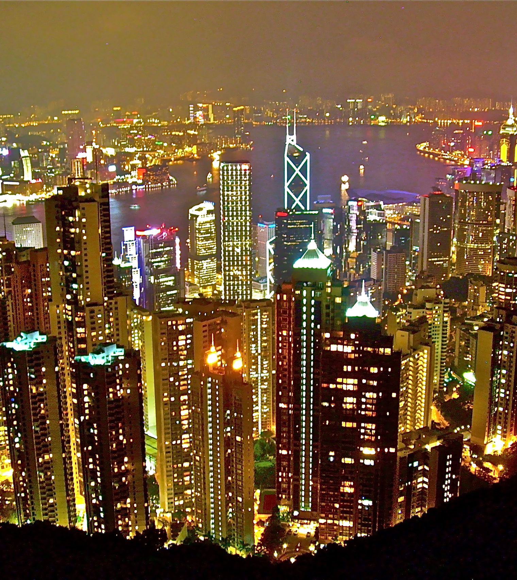
Similar Countries, Different Paths
Four Chinese economies: mainland China, Hong Kong, Taiwan, Singapore
Australia and Argentina, similar natural resources, European immigrants
Singapore and Jamaica, small tropical islands under British rule

Slide 13
Four Chinese Economies 2011
Notes:
Source: World Economic Outlook Database, October 2012. IMF website: www.imf.org

Slide 14
Parting Ways: Australia and Argentina
Notes:
Source: Bolt, J. and J. L. van Zanden (2013). The First Update of the Maddison Project; Re-Estimating Growth Before 1820. Maddison Project Working Paper 4. Website: http://www.ggdc.net/maddison/maddison-project/data.htm

Slide 15
Parting Ways: Jamaica and Singapore
Notes:
Source: Bolt, J. and J. L. van Zanden (2013). The First Update of the Maddison Project; Re-Estimating Growth Before 1820. Maddison Project Working Paper 4. Website: http://www.ggdc.net/maddison/maddison-project/data.htm

Slide 16
Seven Nordic economies 2010
Notes:
Sources: Canadian data (Table A.34 gross domestic product per capita, provinces and territories, in current dollars) from Canada Statistics for 2009–2010. The data are in C$ which was then almost equal to US$. See www.statcan.gc.ca Data on Nordic countries from CIA World Factbook (GDP per Capita, PPP, USD) 2010. Data on states in the US from Avery, J.E., Siebeneck, T.P., og Tate, R.P. 2011. Gross Domestic Product by State. Advance Statistics for 2010 and Revised Statistics for 2007–2009. Price level 2010. Bureau of Economic Analysis. See www.bea.gov

Slide 17
Swedes in Different Economies
Notes:
Sources: Data on the US and Sweden, OECD 2009. GDP per capita: US$, using current PPPs, in OECD in Figures. Paris: OECD Publishing. Data on Swedish-Americans, Sanandaj, Nima 2012. The surprising ingredients of Swedish success — free markets and social cohesion. London: Institute of Economic Affairs, 21.

Slide 18
Gini Coefficient and Lorenz Curve

Slide 19
Income Distribution in Four Countries
Notes:
Source: OECD

Slide 20

Country of Immigrants
US subject to waves of immigrants, first from Europe and Asia, now from Mexico and Central America
Brings down US averages, even if only temporarily
Creates a statistical illusion

Slide 21
Problem with Gini Coefficient
Compare two countries with same Gini C.
One then changes in two ways: more people get educated and more people live longer
Both changes increase Gini Coefficient because ranks of temporarily poor (students and pensioners) swell
Does not reflect increased income inequality between groups, only between periods in individual lives

Slide 22
Resurrection of the Dead?
Data should be critically evaluated
Example: World Bank accepted data on economic growth from Ceausescu’s Romania which would have had Romanians below starvation level, if extrapolated backwards
Example: ICP (International Comparison Program) 2005 data cut Chinese and Indian prices by 40%
Same error, if extrapolated backwards: below existence minimum in 1950

Slide 23

Piketty, and the Rich
Main proposition: poor do not gain from capitalism
Capital accumulated by rich, because r > g
Need for Confiscatory international taxes on wealth and top income

Slide 24
Piketty’s Income Share of 1% Top
Notes:
Source: Top Income Data Base.

Slide 25
Problems with Piketty’s Numbers
Financial Times: Errors in calculations of wealth distribution in the UK
French economists: inflated real estate prices cause overestimate of wealth
Neither criticism very relevant to Piketty’s income distribution
However: no correlation between the redistributive welfare state and income inequality

Slide 26
Problems with Piketty’s Method
Underestimates bottom income: uses income before transfers
Overestimates top income: ignores changes brought about by changed taxation, top income becoming more visible
Method suffers from same problems as Gini coefficient: relative share of top increases if more people study longer or live longer

Slide 27
Impact of Globalisation
Piketty possibly right that bottom income stagnant or even slightly decreasing
Competition from China and India: Massive migration into middle class
Global income distribution become more equal, while income distribution in West less equal
West only 1 of 7 billion people on earth

Slide 28
Income Share of 90% Bottom, China

Slide 29
Do Data Reflect Reality?
Data on bottom or average income in West show stagnation in equalised $
But living conditions of bottom group (and all groups) much better than before
Takes fewer hours to work for most goods, not only lightbulbs, vacuum cleaners and food, but also books

Slide 30
Why the Super-Rich?
People with special, non-replicable skills (i.e. earning rent from abilities), innovators, entrepreneurs, entertainers, athletes
By definition, supply (almost) fixed, while demand flexible
Suddenly find demand, the market for their services, going from 300 million people to perhaps 3 billion, impact of globalisation

Slide 31
What’s Wrong With Inequality?
Country with an income distribution D₁
Milton Friedman comes to give a lecture
1,000 attend, each paying $50
Friedman $50,000 richer, 1,000 people each $50 poorer: less equal distribution D₂
No problem: everybody is happy
Distribution by choice: from each as she chooses, to each as she is chosen

Slide 32
More Problems with Piketty’s Ideas
Rate of return of capital not always higher than economic growth
Capital not immobile and unbreakable
Capital not in hands of rentiers, landowners and bondholders, also innovators, entrepreneurs, investors, funds, third sector organisations
Dispersed by children, divorces, risks, uncertainties

Slide 33
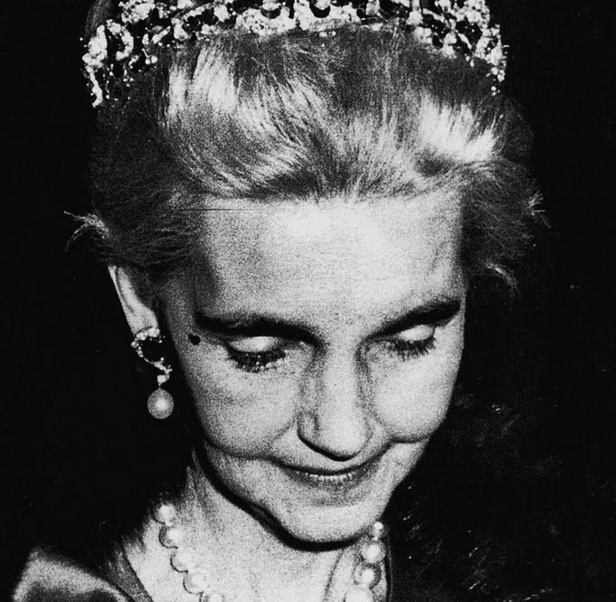

Challenge to Retain Wealth
Barbara Hutton
Charles Koch

Slide 34
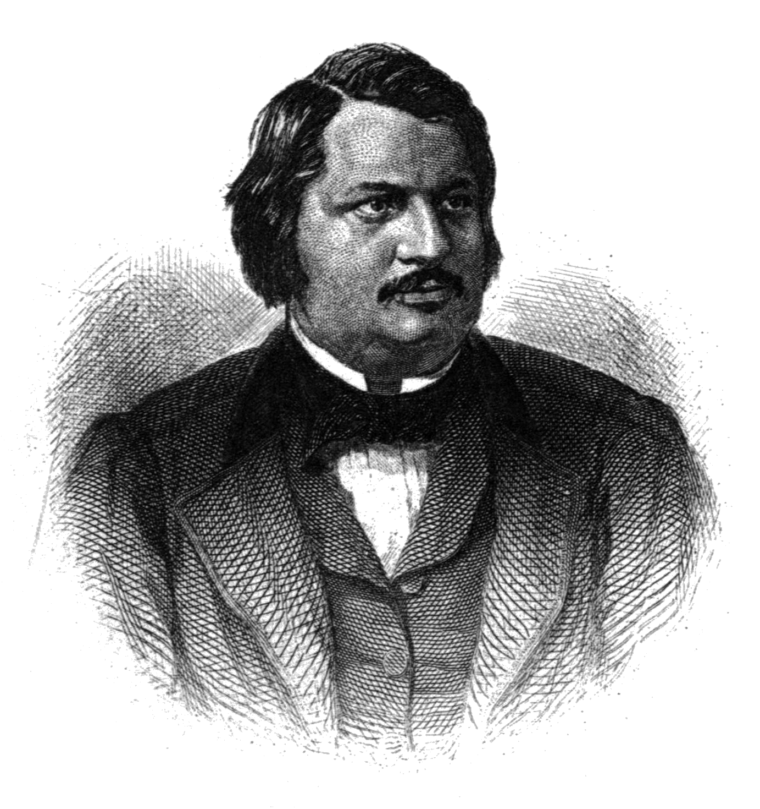
Reading Balzac
Piketty quotes Balzac, Old Goriot
Story of fragile wealth
Goriot penniless
Anastasie’s lover with gambling debts
Delphine’s husband failed speculations

Slide 35
Economic Growth
Piketty’s confiscatory taxes would become a self-fulfilling prophecy
Immense creative powers of capitalism
Almost unlimited possibilities of economic growth
Capitalism needs innovators, entrepreneurs and investors
Welfare state needs taxpayers

Slide 36
Sustaining the Welfare State
Notes:
Source: Department of the Treasury: Office of Tax Analysis Working Paper #85, "U.S. Treasury Distributional Methodology" by Julie-Anne Cronin (September 1999). See Tax Facts, http://www.taxpolicycenter.org from Brookings Institute.

Slide 37
Laffer Curve for Switzerland and Sweden
Notes:
Source: Revenue Statistics. OECD. 2011 Figures.

Slide 38

Rand’s Thought Experiment
The rich contribute most of tax revenue
What happens if they emigrate (as they sometimes do)?
What happens if they choose to disappear: Theme of Rand’s Atlas Shrugged

Slide 39

Further Benefits of the Rich
Pay for experimental process to turn luxuries into necessities
Provide risk capital; 1,000 experiments instead of 10
Have means to fight bureaucratic aggression and government oppression

Slide 40
The Challenge of the Red Queen
Notes:
Source: International Monetary Fund, Data and Statistics, World Economic Outlook Database, April 2014. Website: www.imf.org

Slide 41


