Slide 1

Hayek’s Spontaneous Evolution:
Three Icelandic Examples
Professor Hannes H. Gissurarson
Manhattanville College, NY
10 October 2014

Slide 2
Preliminary Remarks on Hayek
Section One

Slide 3
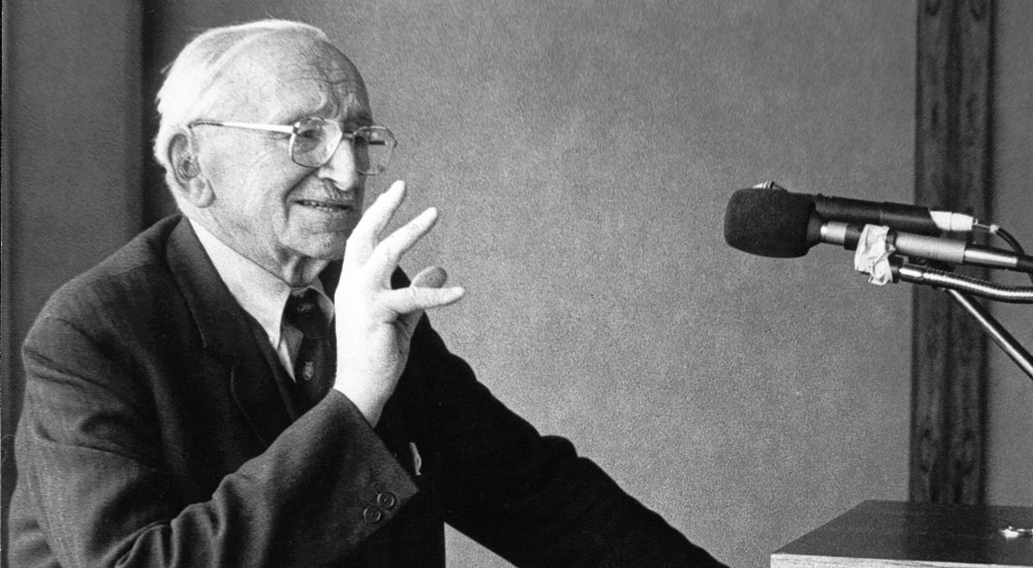
1980: Inspired by Hayek

Slide 4
1982: Mont Pelerin Society, Berlin

Slide 5
1984: Mont Pelerin Society, Paris

Slide 6
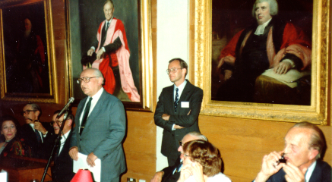
1984: Mont Pelerin Society, Cambridge

Slide 7
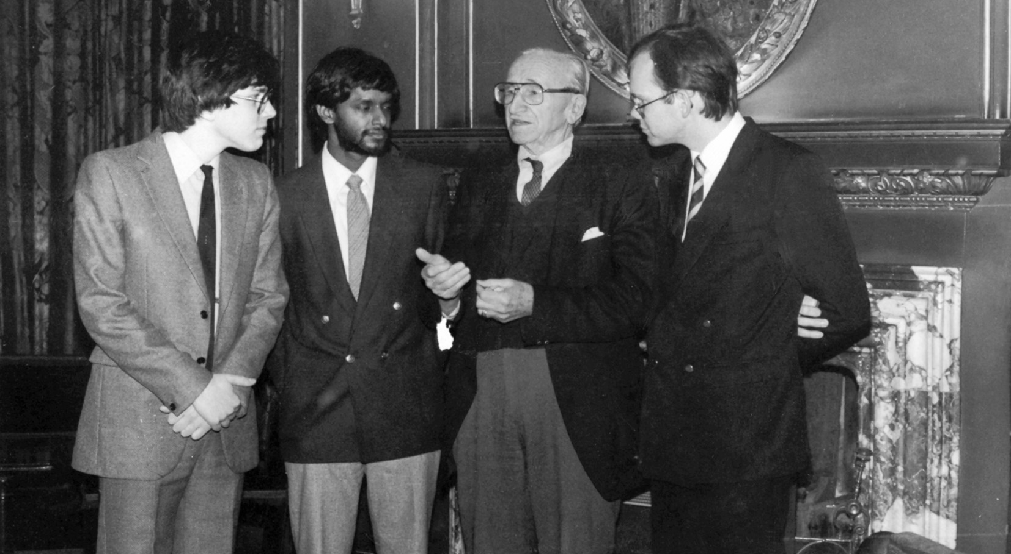
1985: Hayek Society, Oxford

Slide 8
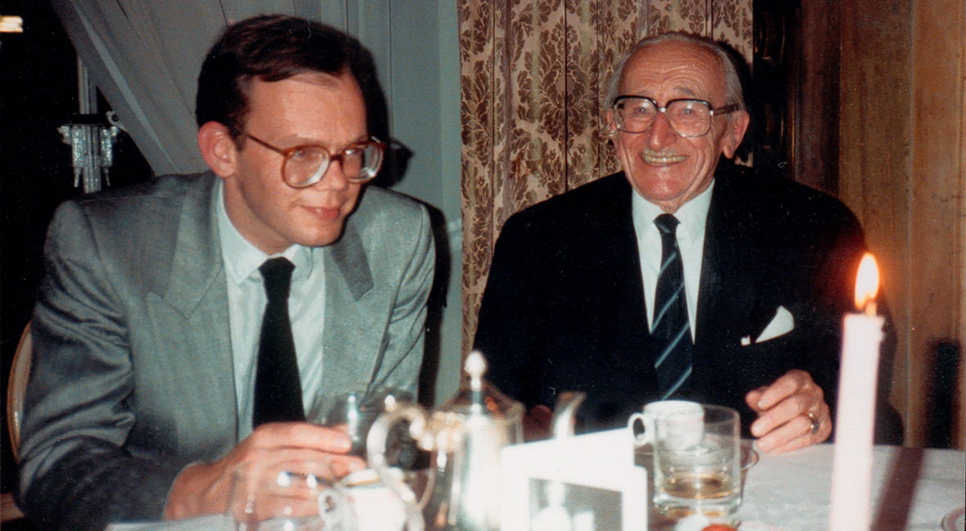
1985: Hayek Society, London

Slide 9
Three Familiar cases
Section Two

Slide 10
The Hayekian Insight
The individual, alone, is characterised by ignorance or at least limited knowledge
Acting with others, within the price system and under certain spontaneously evolved traditions and rules, enables him or her to attain a much higher level of civilization and to utilise much more knowledge than in isolation
Government, on the other hand, avails itself, by necessity, of a much smaller fund of knowledge
A market-based economy uses much more dispersed knowledge than a planned economy

Slide 11
The Tradition of Private Property
Private property precedes the state: It develops and exists to regulate utilisation of scarce resources
Good fences make good neighbours
Private property extends your time horizon and enables division of knowledge
When fencing and branding are cheap, e.g. for farmlands and cattle, evolution of private property rights easy
But what about public goods? Or “The Tragedy of the Commons”?

Slide 12

Pigou’s Two Roads
Pigou: Two roads of different quality implies digestion on better one
Suggestion: road toll
Knight: Not if roads are privately owned
Problem not open access, but lack of private property rights
Government failure
Notes:
A. C. Pigou, Economics of Welfare. London: Macmillan 1920. Frank H. Knight, Some Fallacies in the Interpretation of Social Cost, Quarterly Journal of Economics, 38, 1924, 582–606.

Slide 13
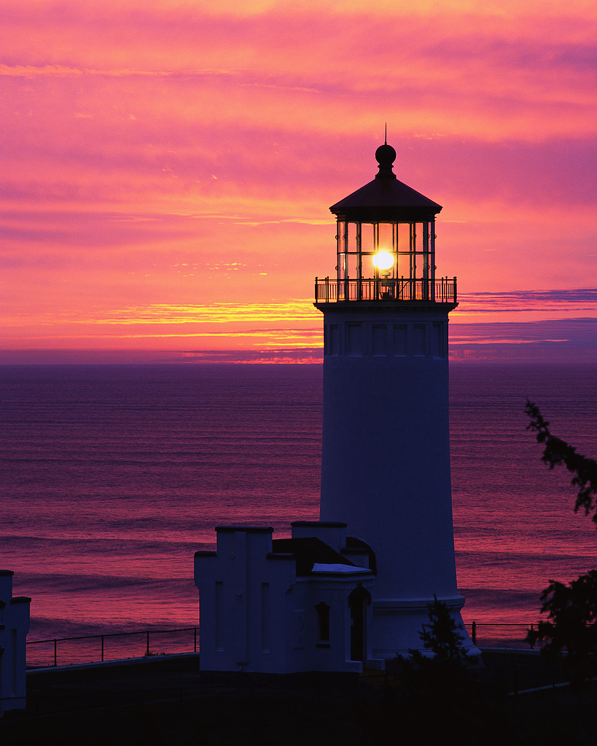
The Lighthouse in Economics
Samuelson: Textbook case of public goods, produced by government
Coase: Seafarers had previously solved problem by including service fees for lighthouses in port charges
Solution possible, perhaps not optimal except by law
Notes:
Ronald Coase, The Lighthouse in Economics. Journal of Law and Economics, 17 (2), 1974, 357–376.

Slide 14
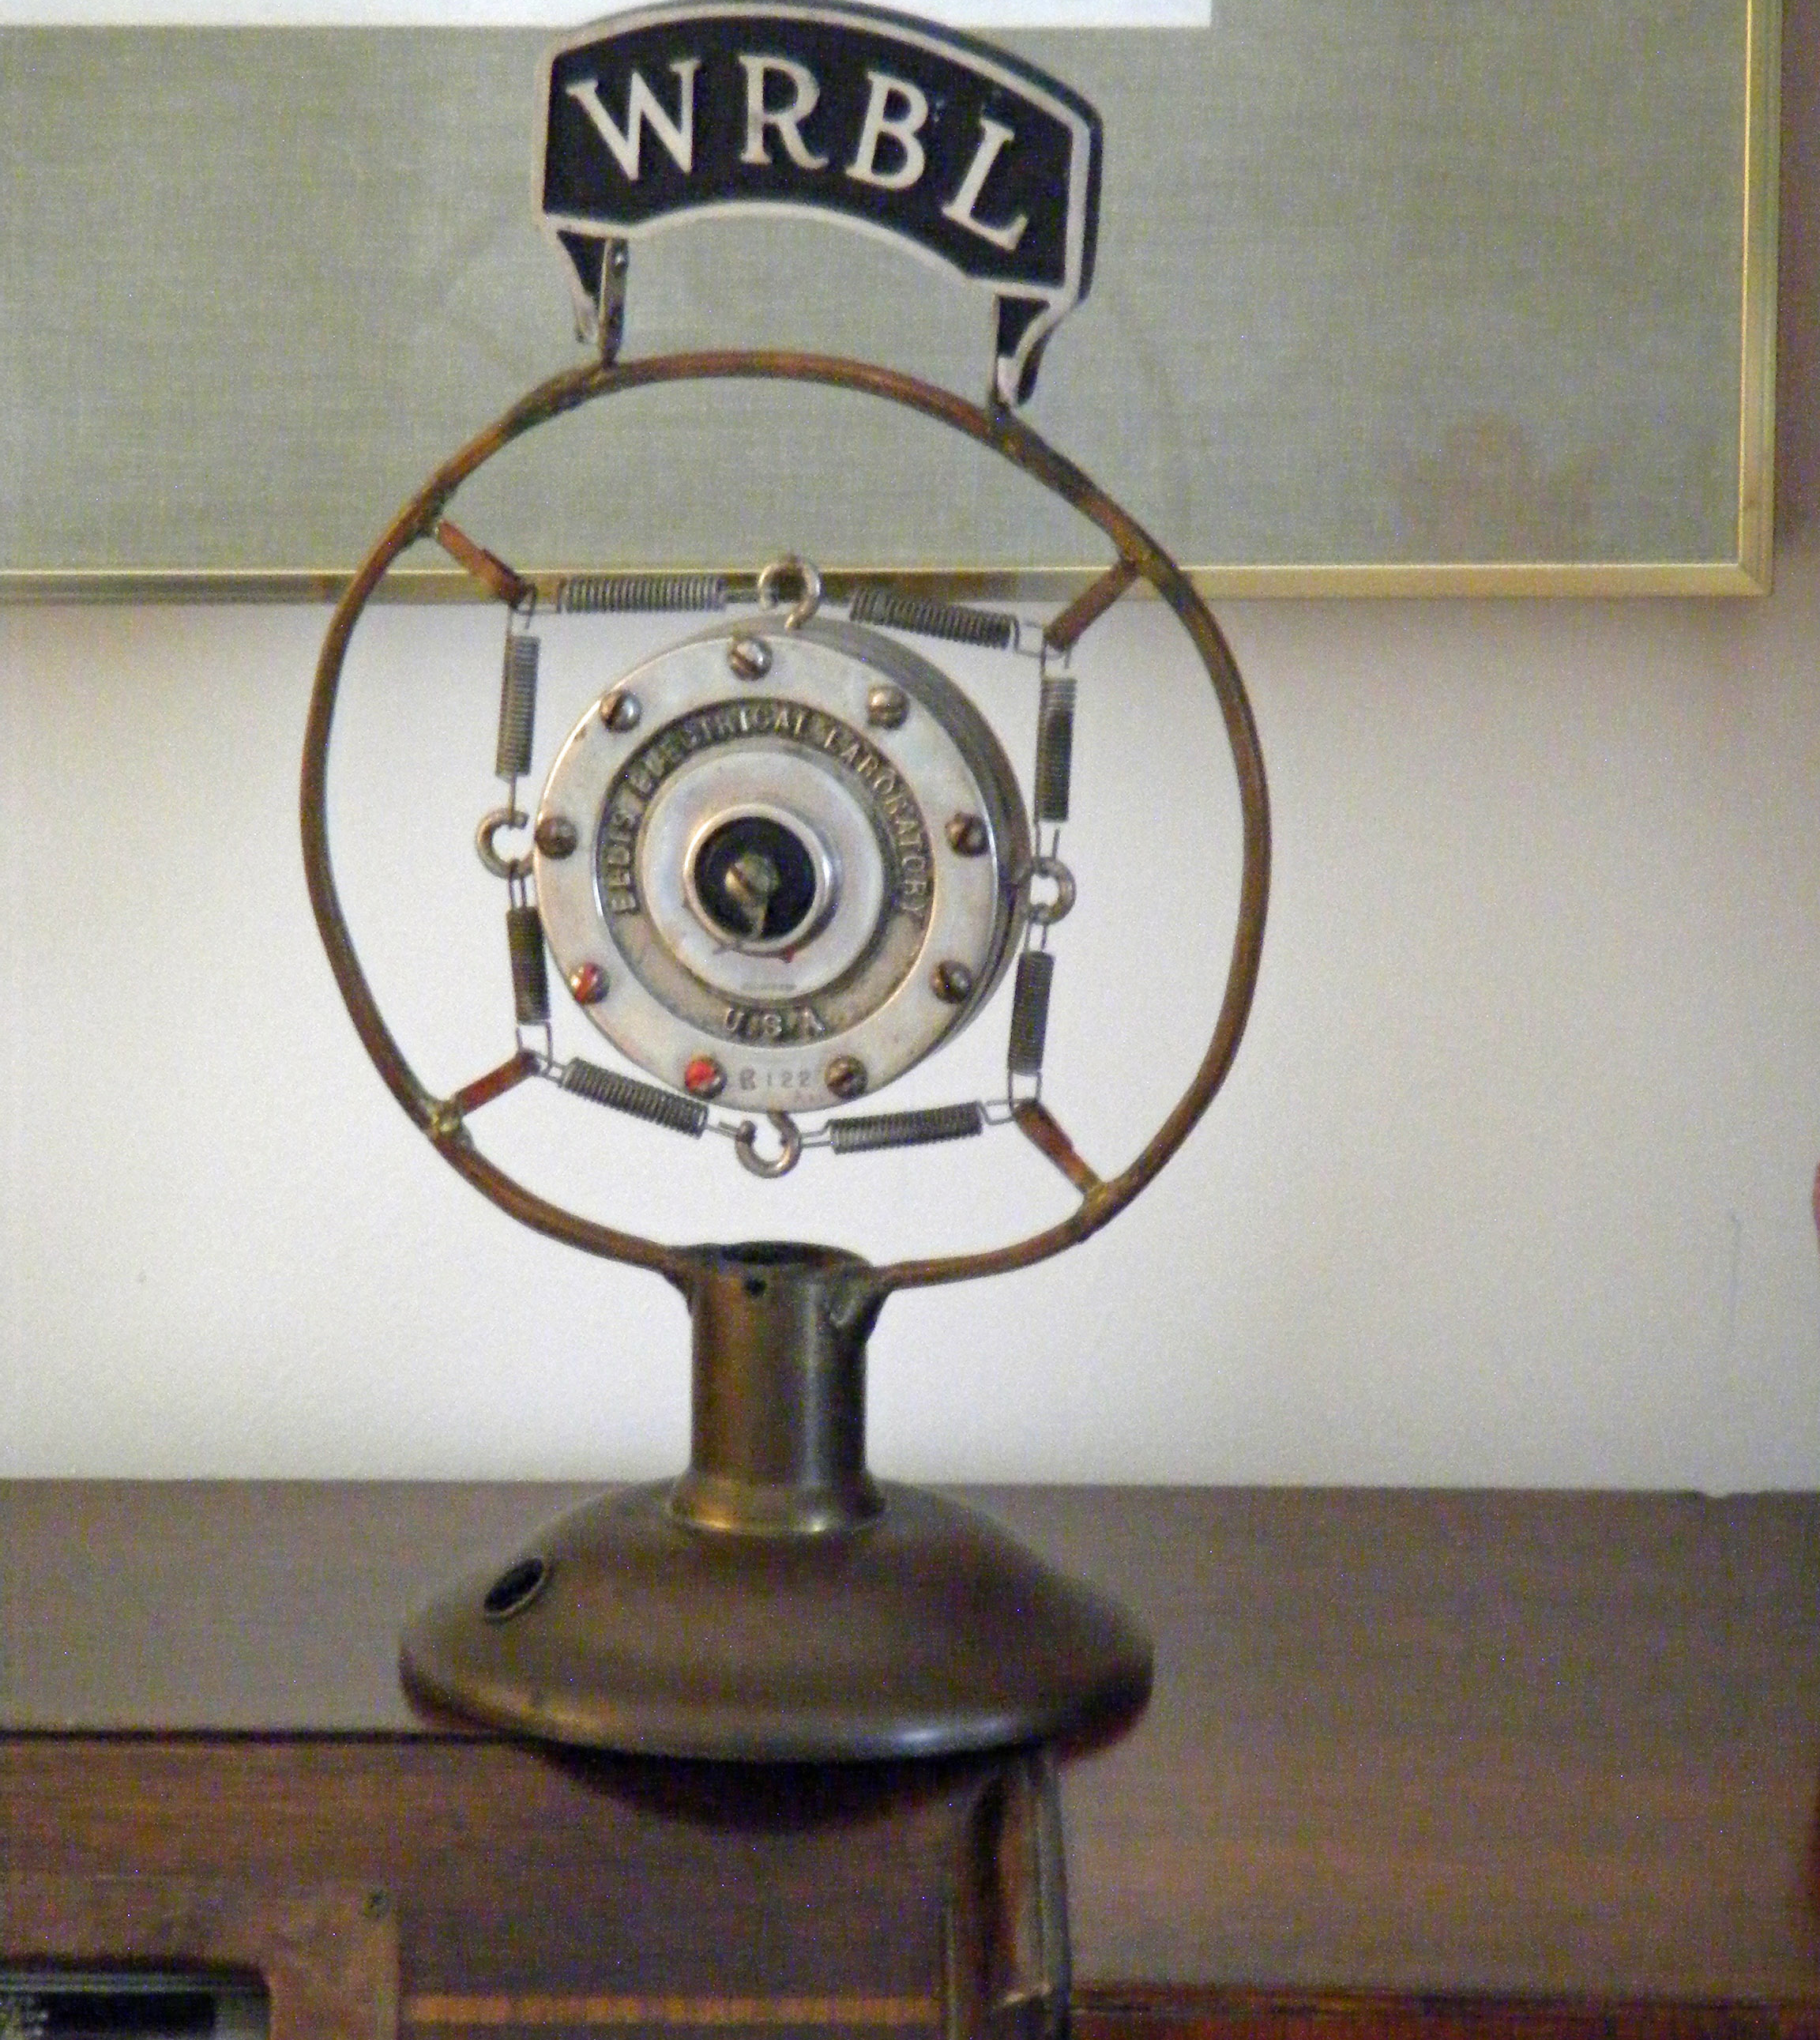
Radio Spectrum: Public or Private?
Coase: Allocate use rights of radio spectrum by pricing
Hazlett: In 1920s, radio channels already allocated in court cases
Congress stopped gradual evolution of private property rights in radio spectrum
Notes:
Thomas W. Hazlett, The Rationality of U.S. Regulation of the Broadcast Spectrum. Journal of Law and Economics, 33, April 1990, 133–177. Ronald Coase, The Federal Communications Commission. Journal of Law and Economics, 2, October 1959, 1–40.

Slide 15
ThRee Icelandic Cases
Section Three

Slide 16
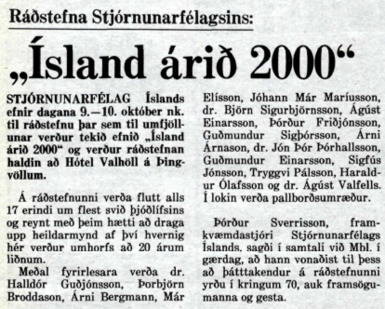
Hayek’s Ardent Disciple
9–10 October 1980, conference on “Iceland in 2000”
Speakers: Free Market cannot cope with over-fishing
I: Why not property rights?
Also: Discussion on perennial inflation over coffee
I: Why not adopt dollar?

Slide 17
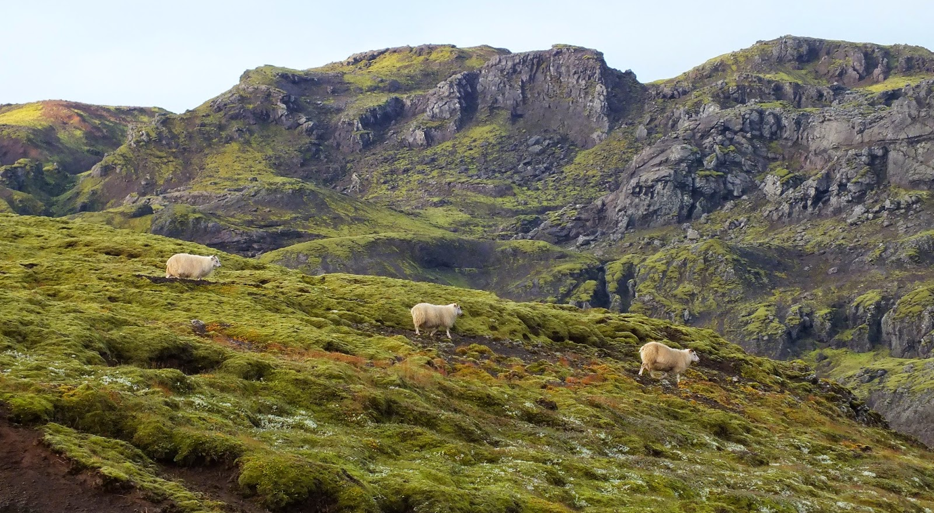
874–930: Settlement of Iceland
Notes:
Source: Thrainn Eggertsson, Analyzing Institutional Successes and Failures: A Millennium of Common Mountain Pastures in Iceland. International Review of Law and Economics (1992), 12, 423–437.

Slide 18
Society of Farmers
Settlers: Men from Western Norway and Women from Celtic countries (DNA research)
Iceland more inviting then because of warmer climate: Discovery of America
About 4-5 thousand farmers in many valleys, mostly rearing sheep
Winter: sheep fed in barns
Summer: sheep grazed in mountains
Farms private property, each valley formed an association
Notes:
Source: Thrainn Eggertsson, Analyzing Institutional Successes and Failures: A Millennium of Common Mountain Pastures in Iceland. International Review of Law and Economics (1992), 12, 423–437.

Slide 19
Grazing Rights in Pastures
Mountain pastures: held in common (by the geographical association, hreppur in each valley) because fencing and monitoring costs too high outside traditional farmland
Temptation for each farmer to keep too many sheep: benefit captured by him and cost imposed on all
Solution: Grazing rights or “quotas” (itala: counting in) defined to each farm
The old Icelandic Law Book (Gragas): Filling the pasture, with the sheep returning as fat as possible
Notes:
Source: Thrainn Eggertsson, Analyzing Institutional Successes and Failures: A Millennium of Common Mountain Pastures in Iceland. International Review of Law and Economics (1992), 12, 423–437.

Slide 20
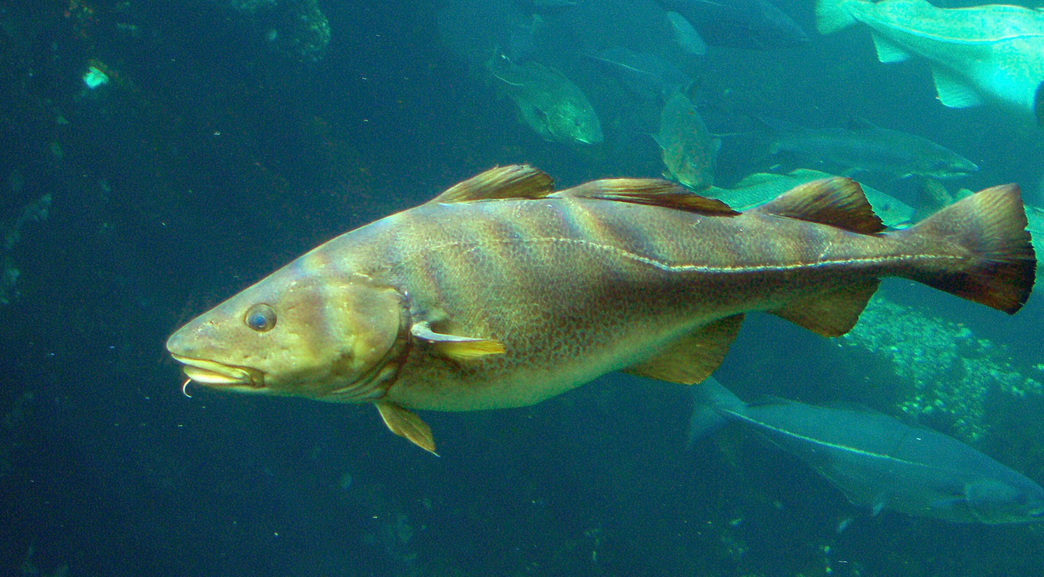
Fertile Fishing Grounds
Notes:
Cf. Mark Kurlansky, Cod: A Biography of the Fish that Changed the World. New York: Walker and Co. 1997. (Also in Icelandic translation.)

Slide 21
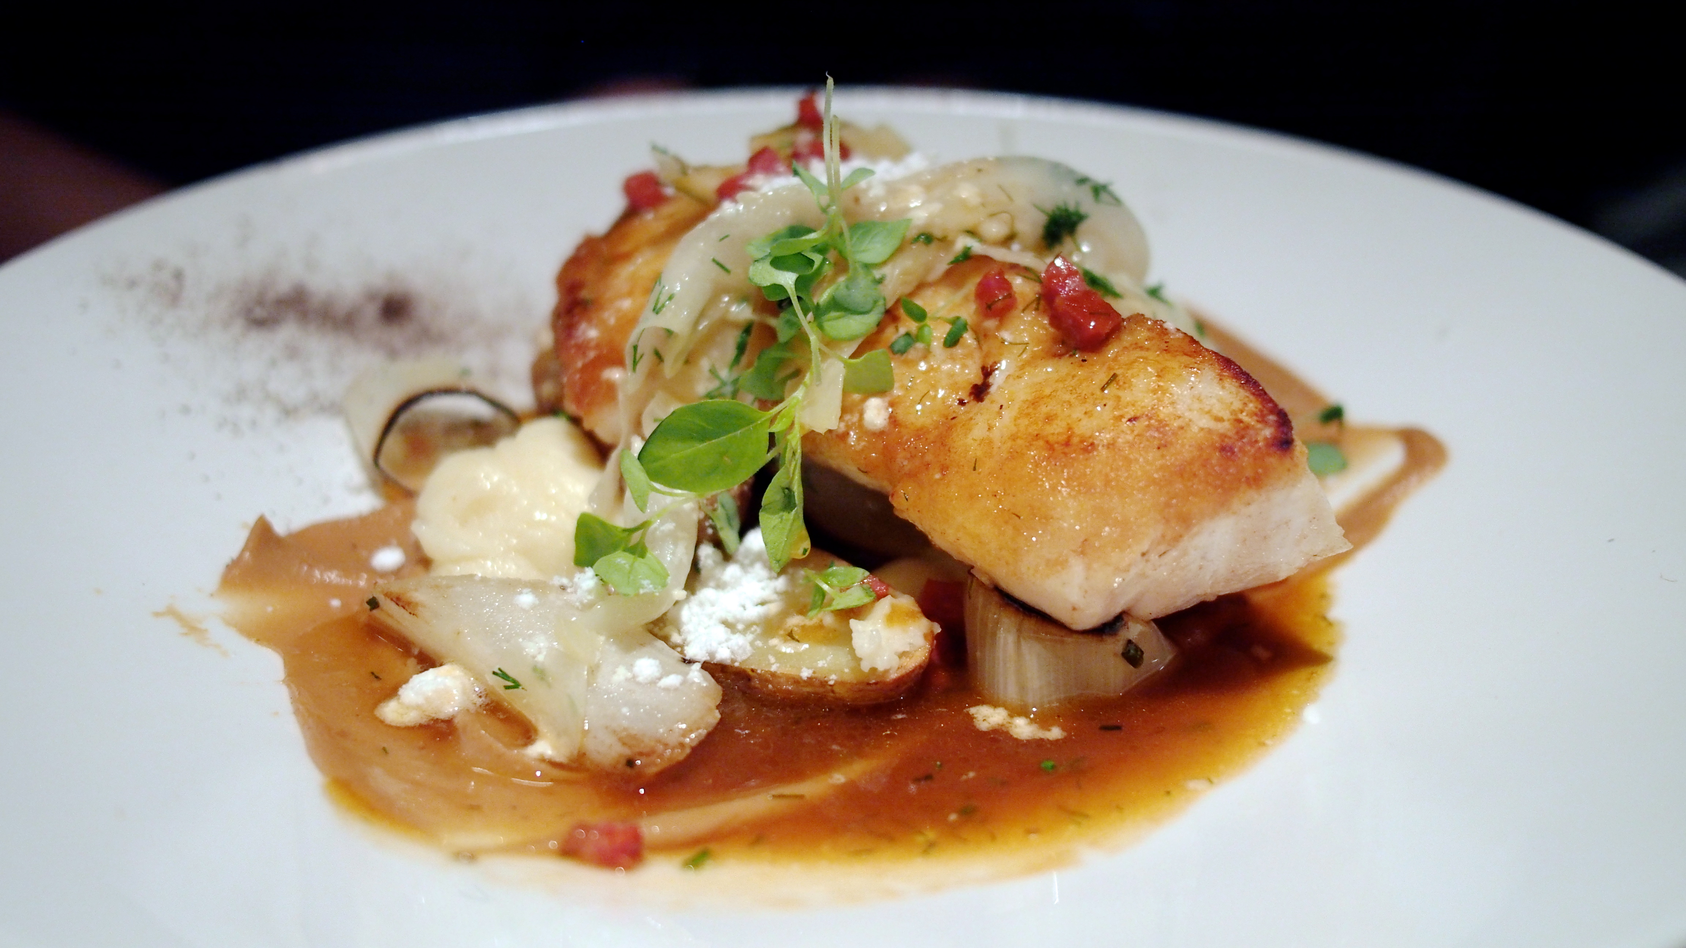
Delicious, Nutritious Food

Slide 22
Offshore Fisheries in Iceland
Fishing grounds difficult to fence off
Resource occurs on an immense scale
Some fish stocks (e.g. herring) fugitive
Biological overfishing: Herring stock collapsed in 1960s, and cod stock almost collapsed in 1970s
Economic overfishing: Too many boats chasing the fish
After capturing Icelandic waters in Cod Wars with UK, Iceland in sole control: Reduced transaction costs

Slide 23
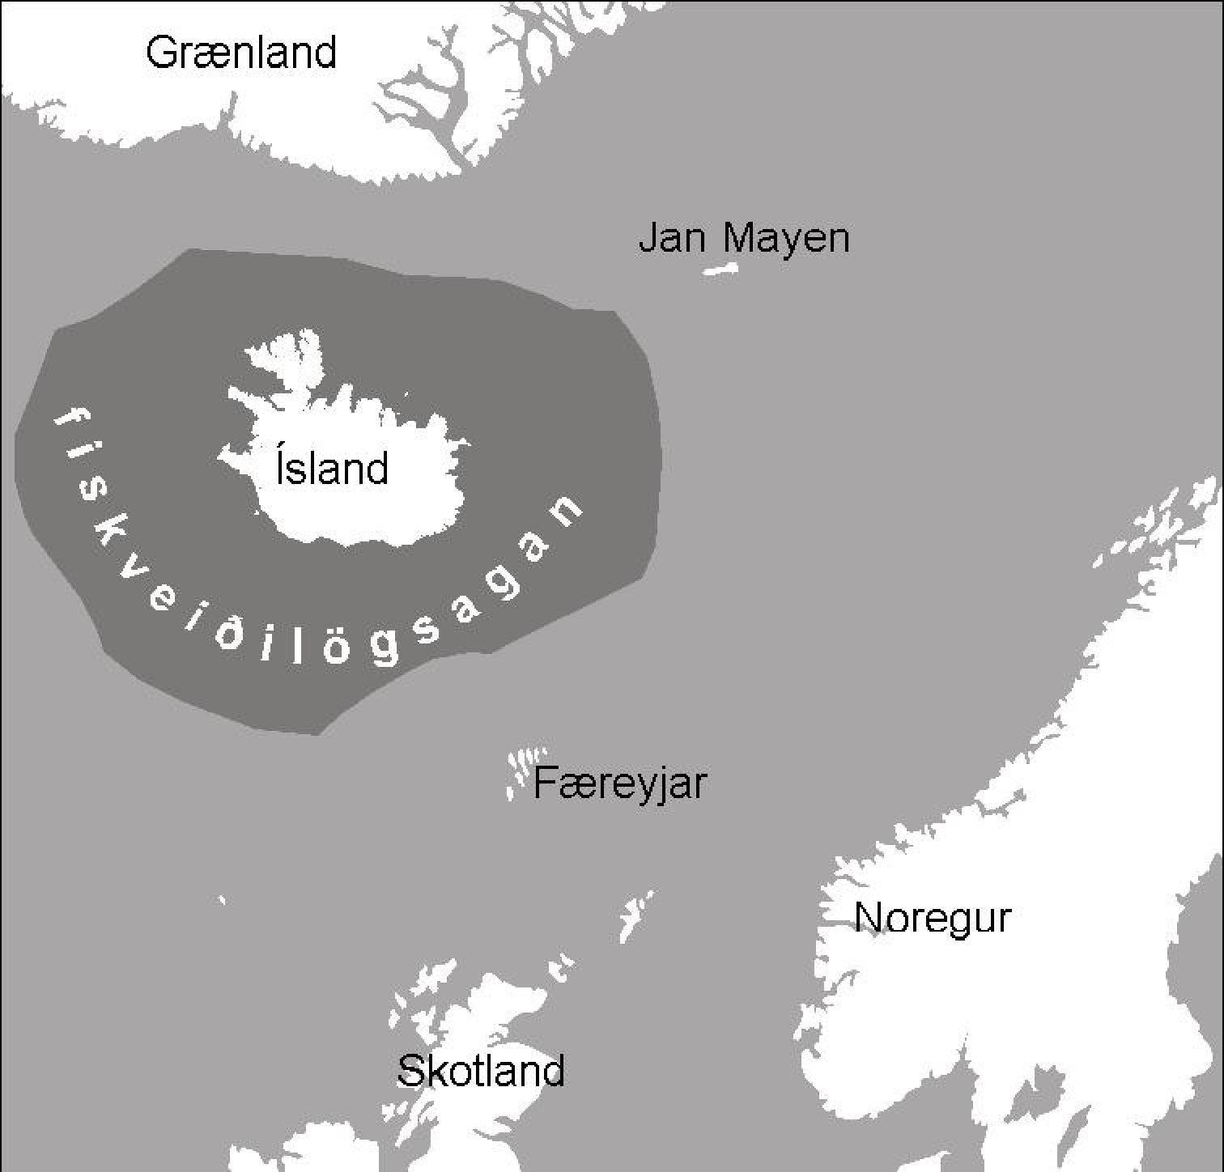
Icelandic EEZ Since 1975

Slide 24
Economic Overfishing: 16 Boats
Notes:
H. Scott Gordon,

Slide 25
Overfishing: From 8 to 16
When access to fishing grounds free, effort (number of boats) increases until revenue goes down to nothing (total revenue equals total cost)
Best to maximise profit (difference between revenue and cost), i.e. by 8 boats, not catch, i.e. by 10 boats
In effect, 16 boats harvest what 8 boats could harvest: Rent dissipated, zero profit
Task is to reduce the fishing fleet (and fishing effort) from 16 to 8 boats
Notes:
Hannes H. Gissurarson 2000. Overfishing: The Icelandic Solution. London: Institute of Economic Affairs.

Slide 26
Two Options Discussed
Public renting out of quotas
Allocation of free quotas
Government profits enormously
Some fishing vessel owners neither profit or lose
Other fishing vessel owners lose (their investment suddenly becomes worthless)
Public? Does it profit from a stronger state?
Government profits somewhat
Fishing vessel owners who sell quotas and leave fishery profit
Fishing vessel owners who stay, profit
The public benefits
Nobody loses

Slide 27
Same End Result: 8 Boats instead of 16
Notes:
H. Scott Gordon,

Slide 28
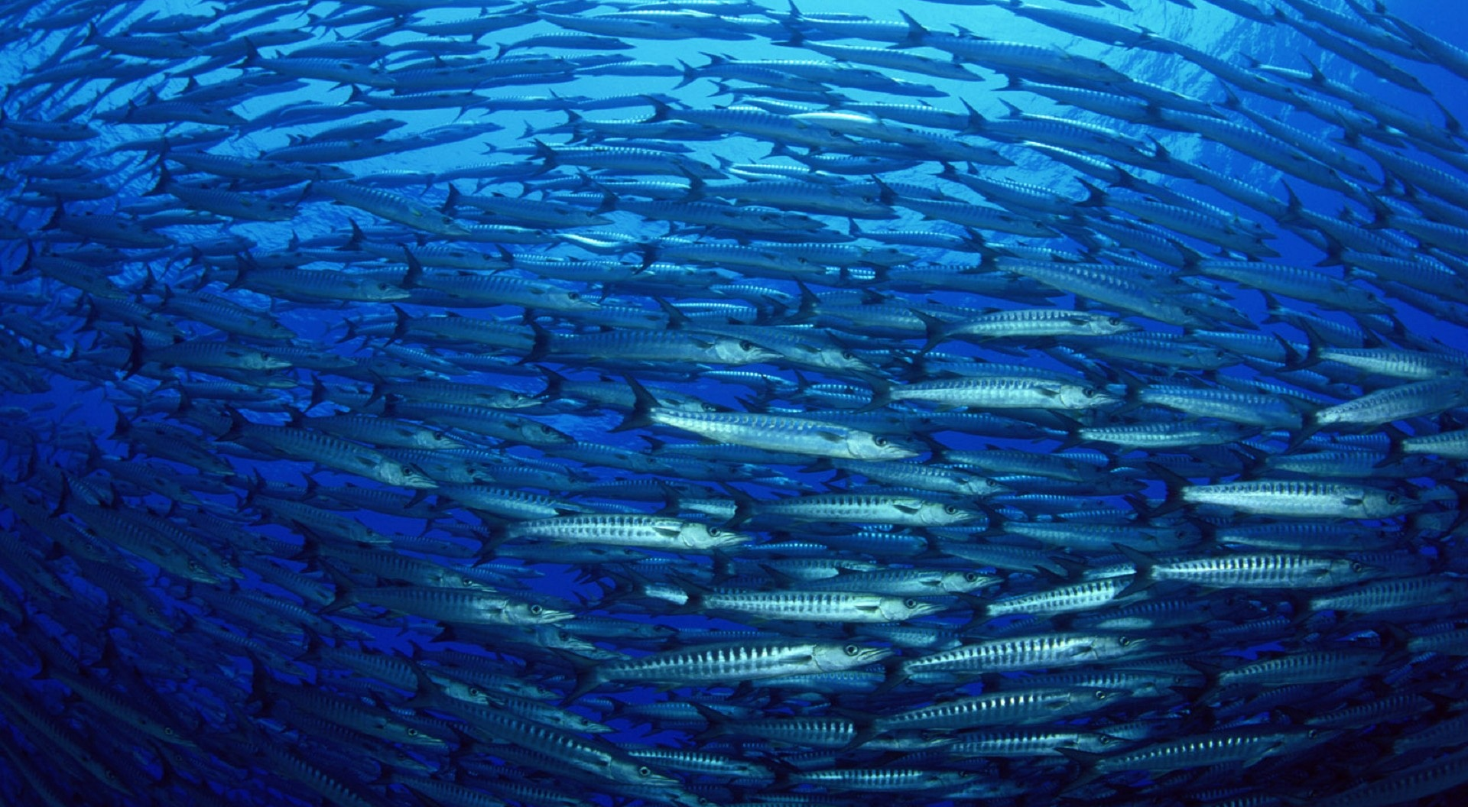
Pelagic fishery: Fugitive species

Slide 29
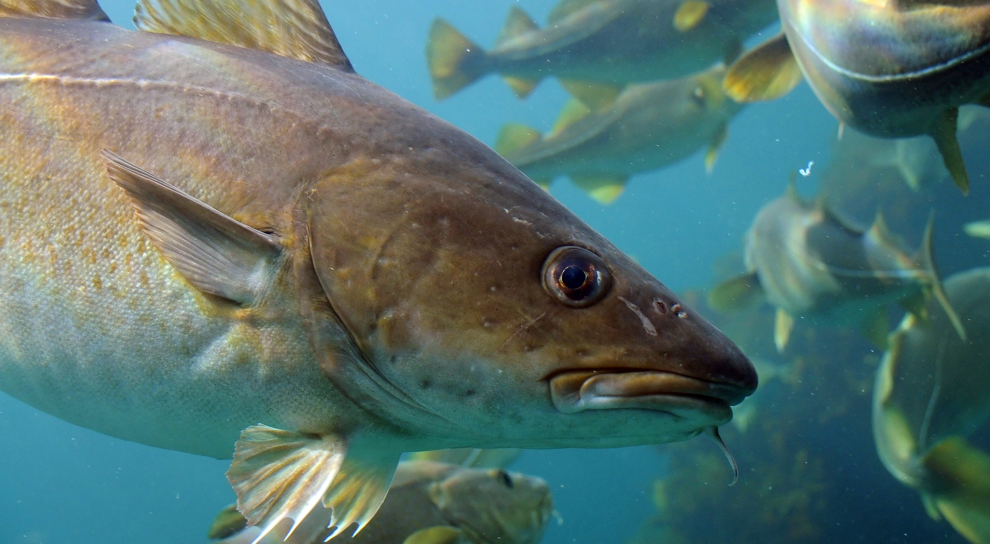
Demersal Fishery: More Local

Slide 30
Development of ITQ System
Catch quotas in pelagic fisheries (herring) introduced already in 1975, boats of similar size, low transaction costs
Effort quotas (allowable fishing days) in demersal fisheries introduced in 1977, high transaction costs
“Derby”: Costly race to capture as much as possible in allowable days
Catch quotas imposed in 1983, allocated on basis of catch history
Gradually became transferable, and system made comprehensive in 1990

Slide 31
How ITQ System Works
Ministry of Fisheries sets TAC, total allowable catch per season, in each fish stock
Owners of fishing vessels hold ITQs, individual transferable quotas, i.e. rights to harvest a given % of the TAC in a fish stock
Catches monitored at landing
Ideal change: More autonomy to Association of Fishing Vessel Owners, e.g. setting TACs
In reality: Political pressure to allow small boats to fish outside the system, and to impose special taxes on fishery, reducing its competitiveness

Slide 32
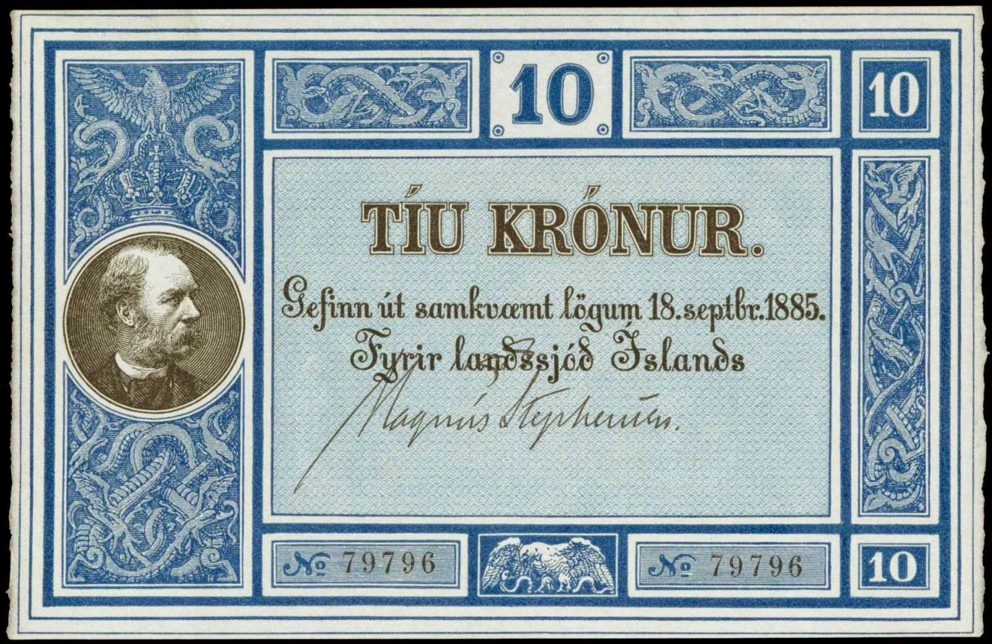
1885–1914: Gold Standard

Slide 33
Brief Monetary History of Iceland (1)
Iceland in Middle Ages poor subsistence economy, almost without money; fisheries outlawed as main industry
Danish dependency: Constitution 1874; first bank 1885–6; unofficial member of Nordic monetary union, based on gold standard, with Swedish kronor, Norwegian kroner and Danish kroner (and Icelandic kronur) freely circulating, and exchangeable
Off gold standard by emergency law in 1914
First quoted exchange rate of Danish kroner 1922

Slide 34
Brief Monetary History of Iceland (2)
Fixed exchange rate system 1925–1939, import and currency controls introduced in Great Depression
Devaluations in 1939, 1950 and 1960–61, import and currency controls abolished 1960
Inflation and great depreciation of krona: 1983 new kronur, 100 times more
1922–82, Icelandic krona down to 1/1000 of Danish krone, having been equal initially
In 1980s, I (almost) only person to advocate adoption of another currency

Slide 35
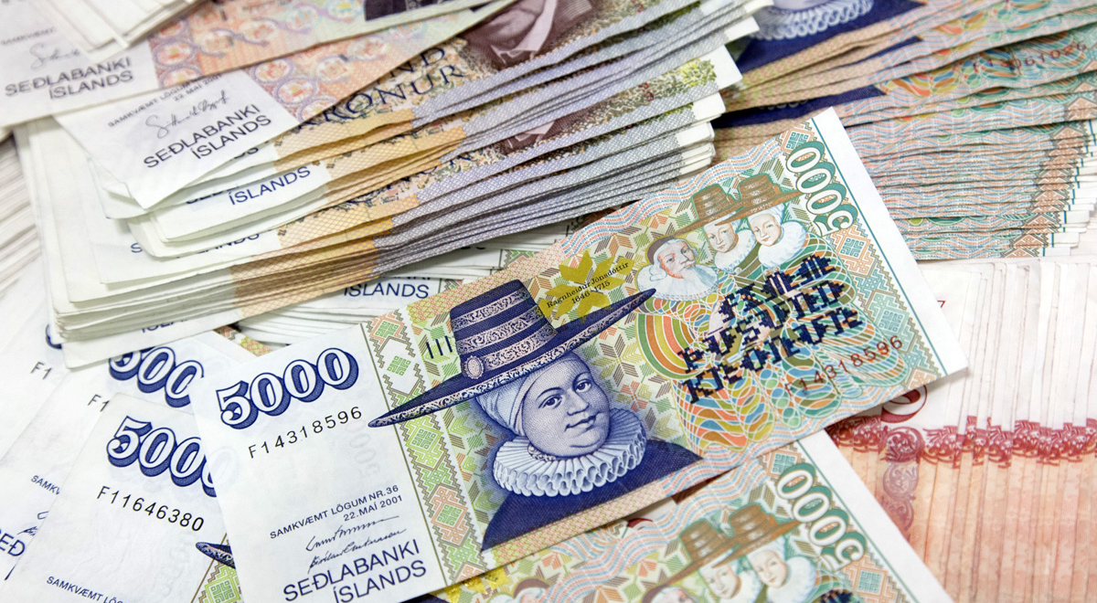
Unit of account? Store of Value?

Slide 36
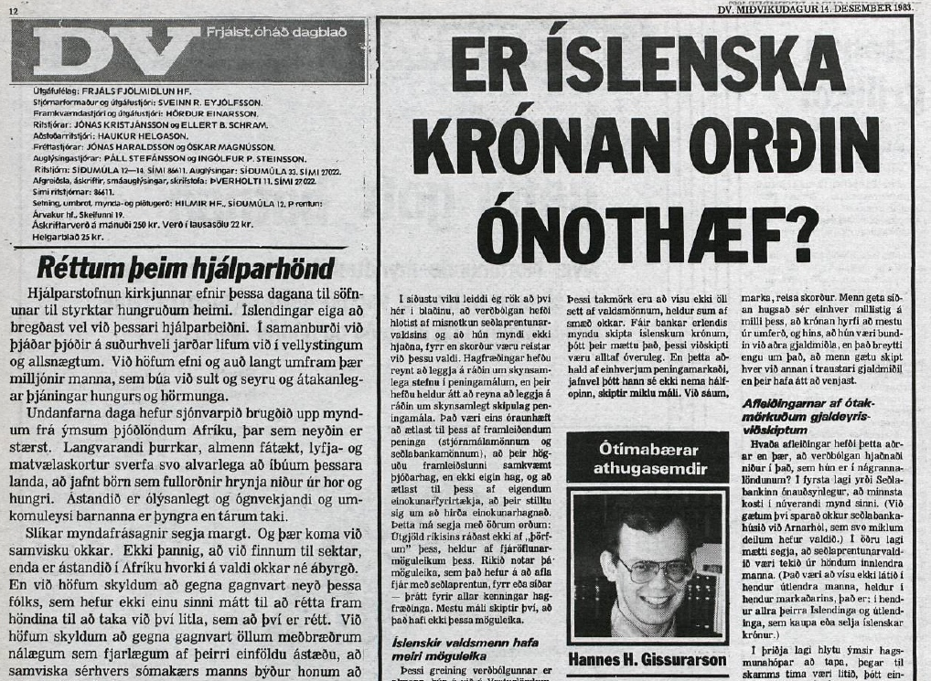
Choice in Currency? Or IS Dollar?

Slide 37
A Solution Did Already Exist
The ever depreciating Icelandic krona was usable as medium of exchange, but not as unit of account or store of value
Icelandic state strong enough to print money, but too weak to collect taxes for all its obligations
In 1979, law on indexed krona had been passed
In reality, two currencies, usual krona and indexed krona
Indexed krona hard currency, fulfilling roles as unit of account and store of value

Slide 38
Not a Perfect Solution
Possibly only applicable in the small, closed economy of yesteryear, breaks down under pressure
What then? Euro rather than Dollar?
Euro will become soft currency, for systemic reasons:
EU strong enough to print money, but too weak to collect taxes for its obligations
Labour unions stronger in eurozone than in US
Social mobility less than in US

Slide 39
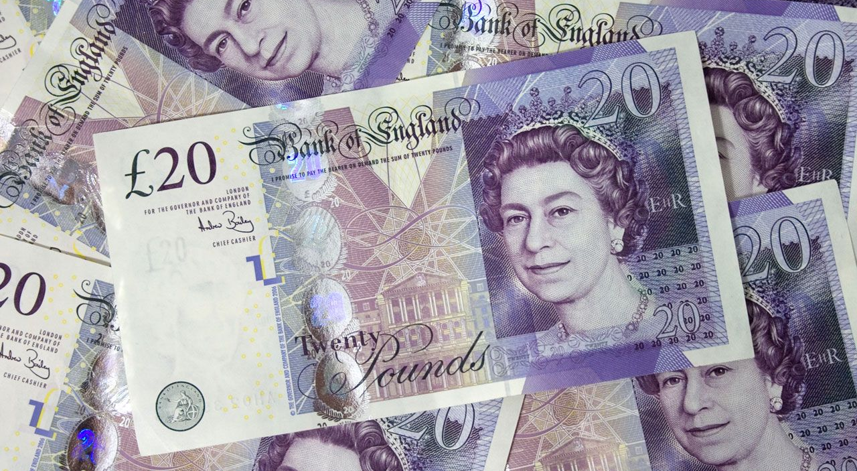
Currency Board with GB Pound?

Slide 40
