Slide 1

Europe of the Victims
RNH-AECR Project 2012–2014
Professor Hannes H. Gissurarson
Brussels 4 November 2014

Slide 2
Past Events Include:
Lecture 2012 by Prof. Bent Jensen and Prof. Niels Erik Rosenfeldt
International conference 2012, with Prof. Stéphane Courtois, Prof. Oystein Sorensen, etc.
Photo exhibition 2013 at National Library
Lectures 2013 by Dr. Mart Nutt, Dr. Pawel Ukielski and Dr. Andreja Zver
Publication 2013 of Rand’s We the Living and lecture by Dr. Yaron Brook
Lectures and articles 2012–2014 by Prof. Hannes H. Gissurarson

Slide 3
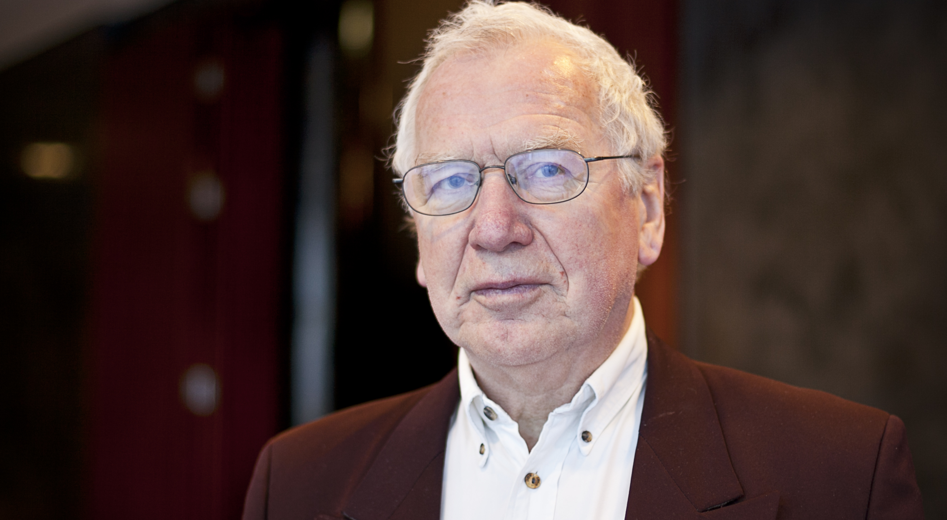
Prof. Jensen, February 2012

Slide 4
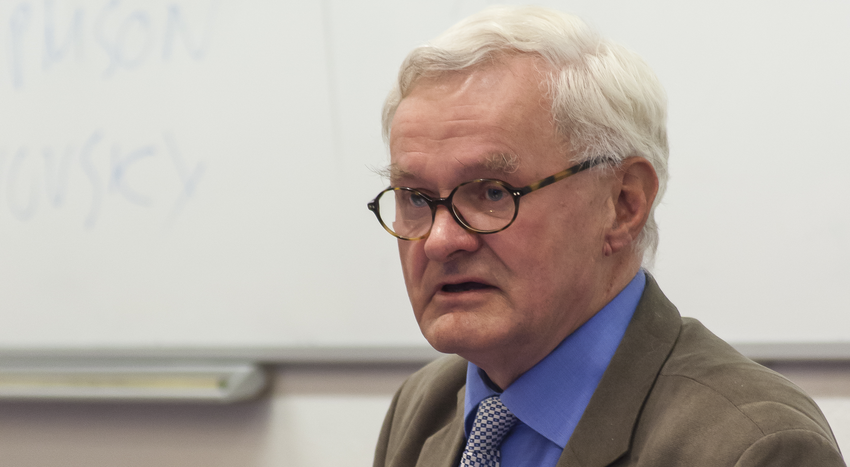
Prof. Rosenfeldt, September 2012

Slide 5
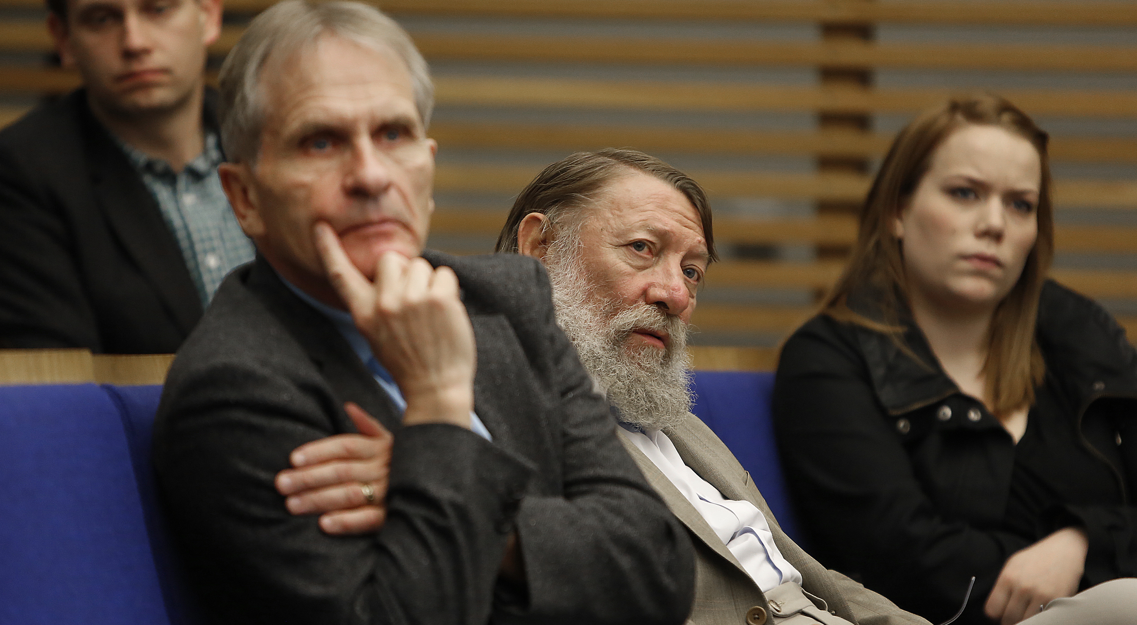
Prof. Courtois, September 2012

Slide 6
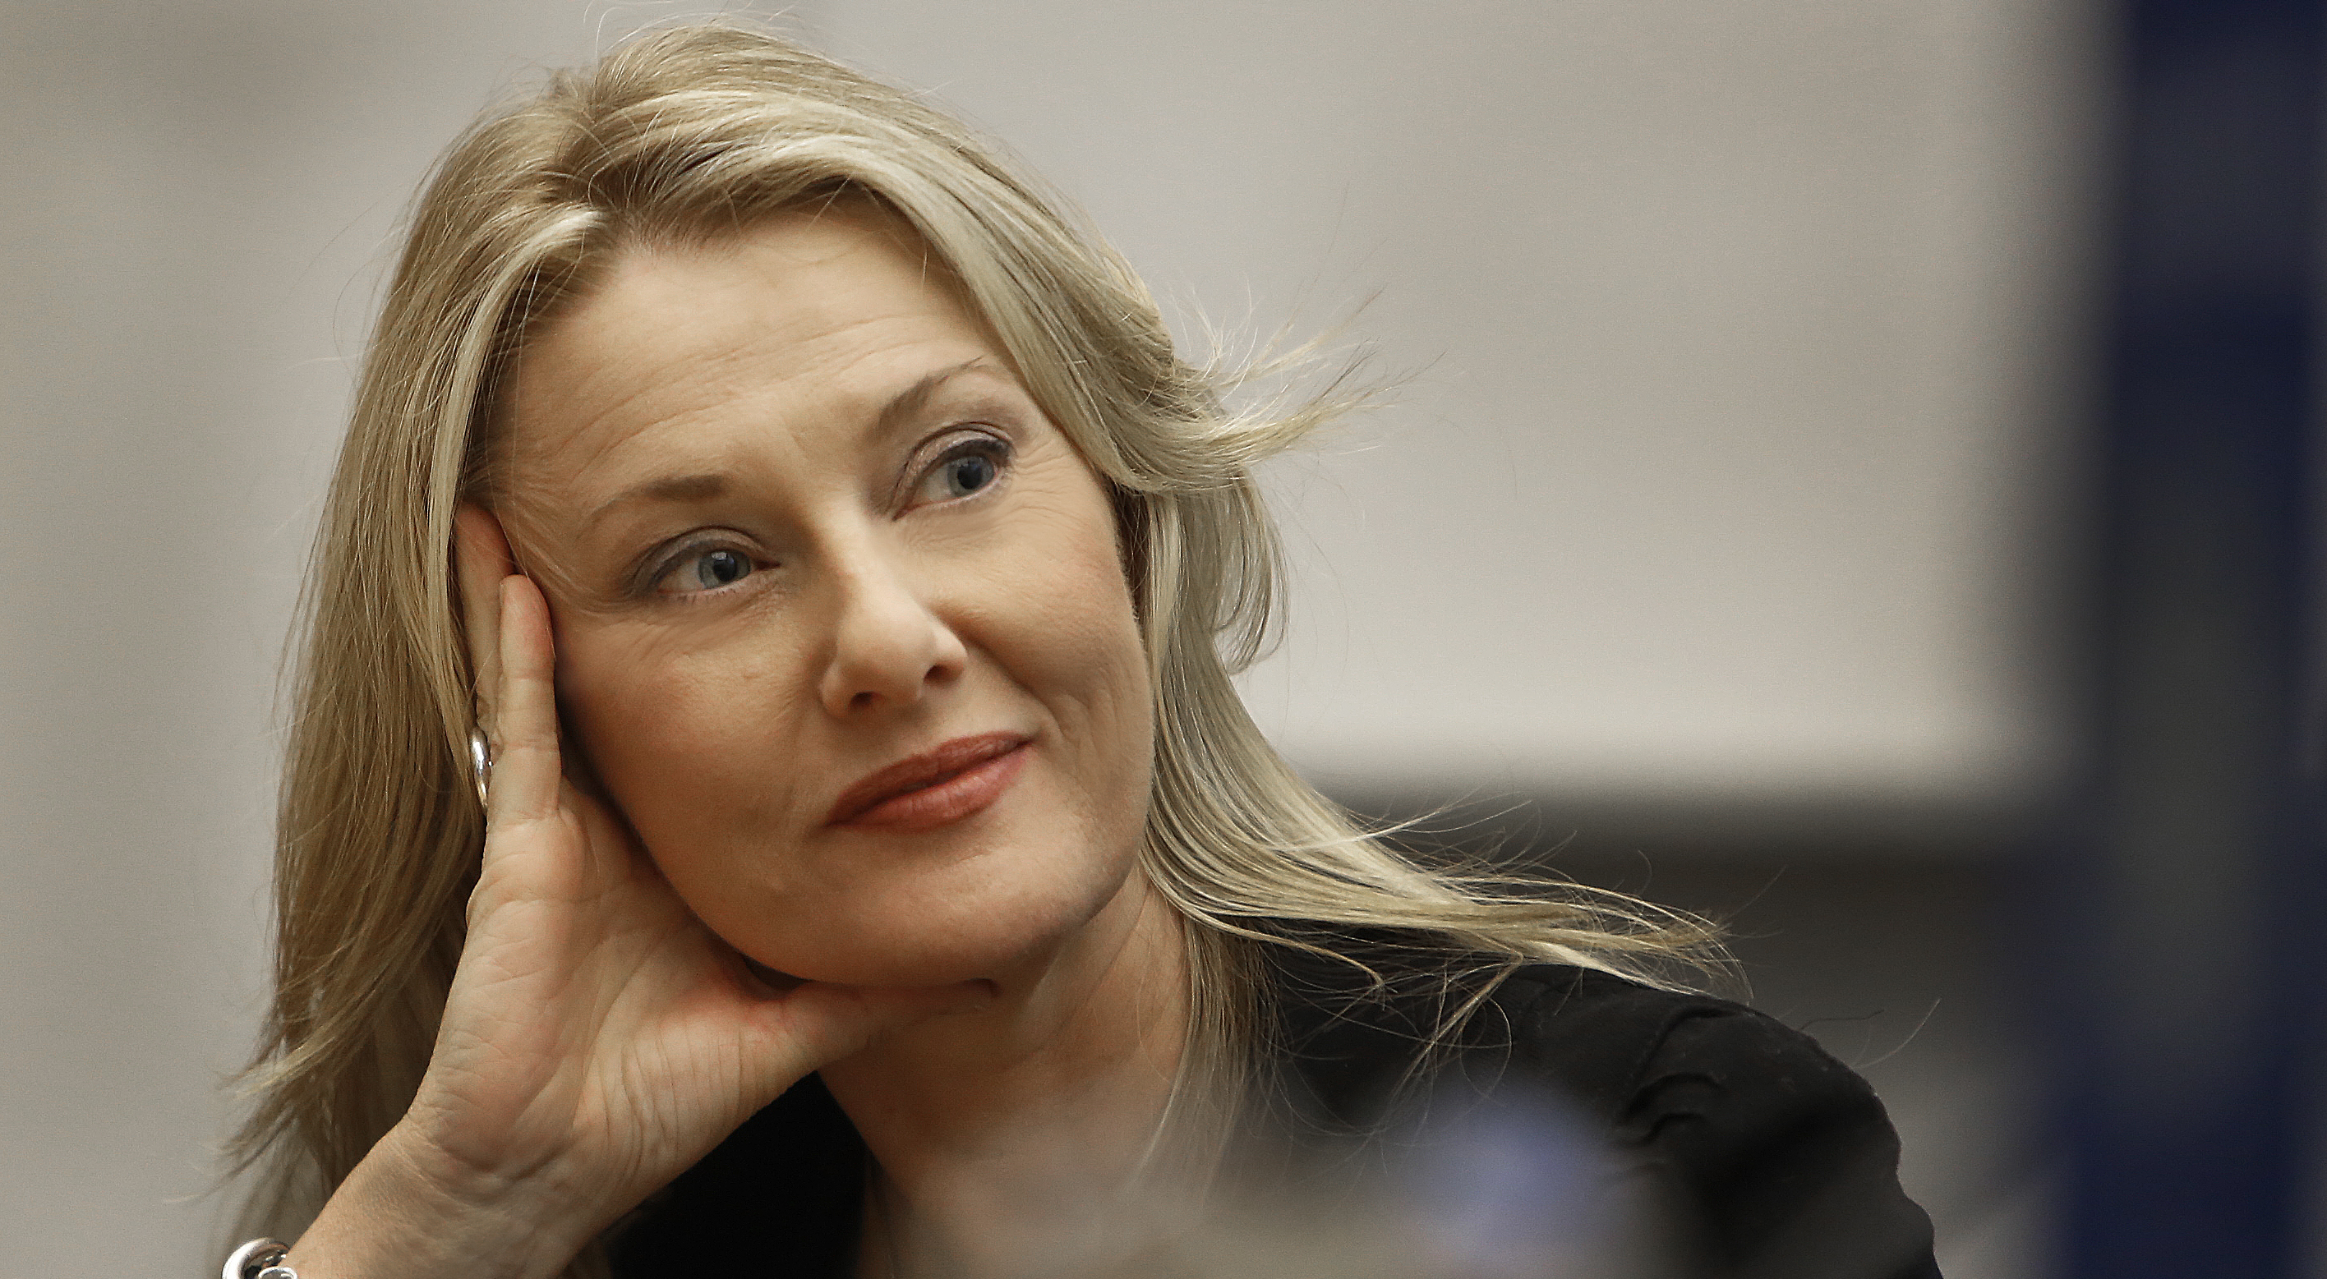
Anna Funder, September 2012

Slide 7
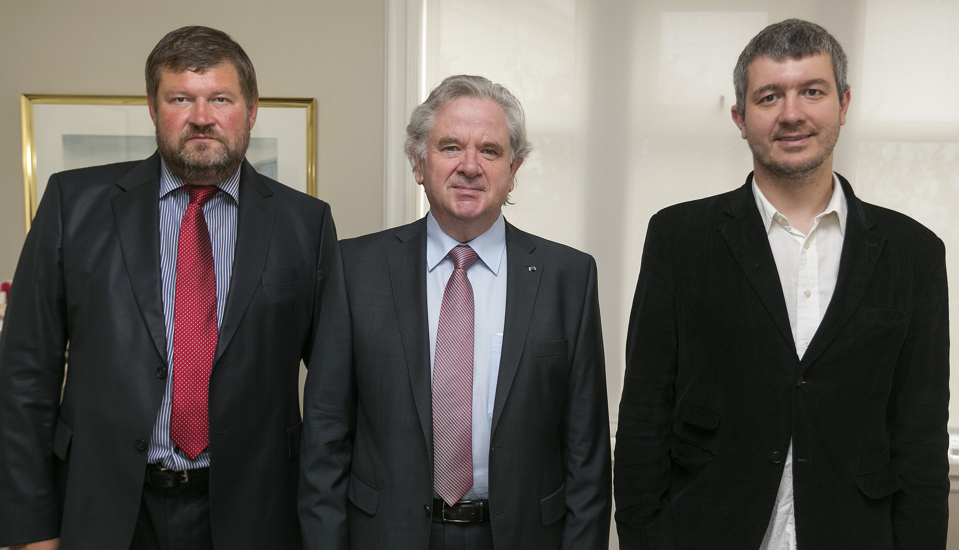
Nutt and Ukielski, August 2013

Slide 8
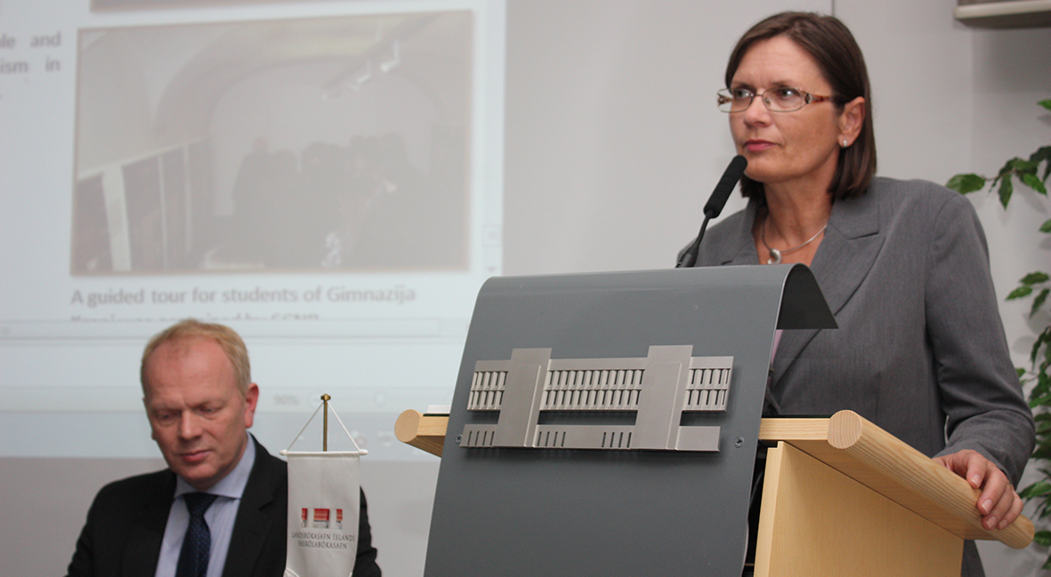
Zver, September 2013

Slide 9
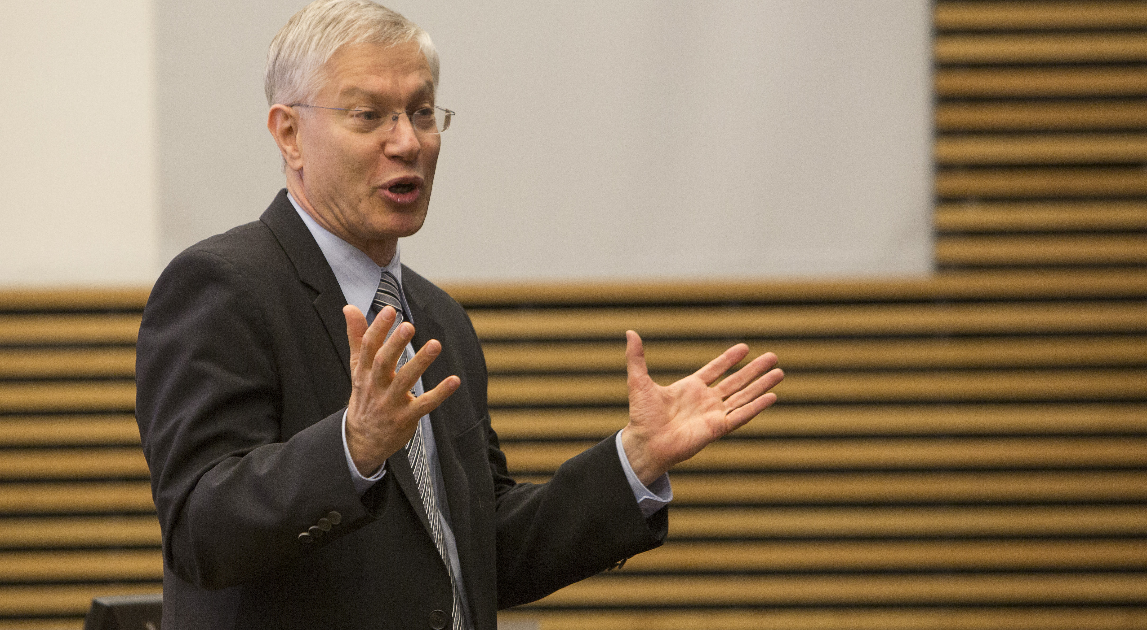
Brook, November 2013

Slide 10
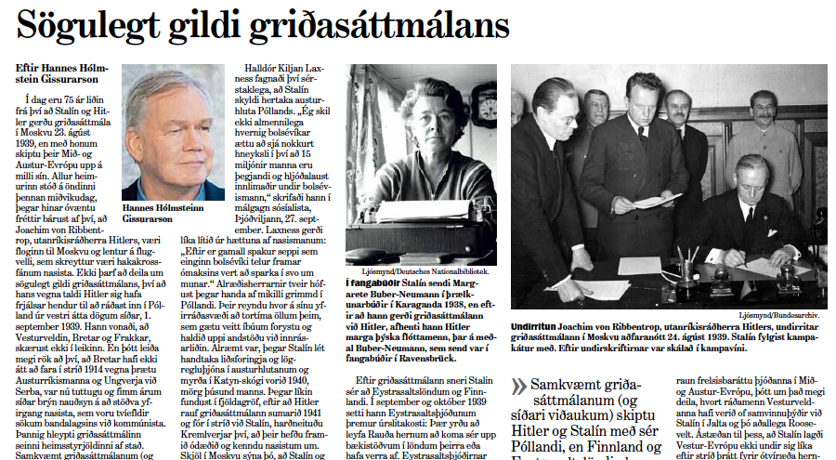
On Hitler-Stalin Pact

Slide 11
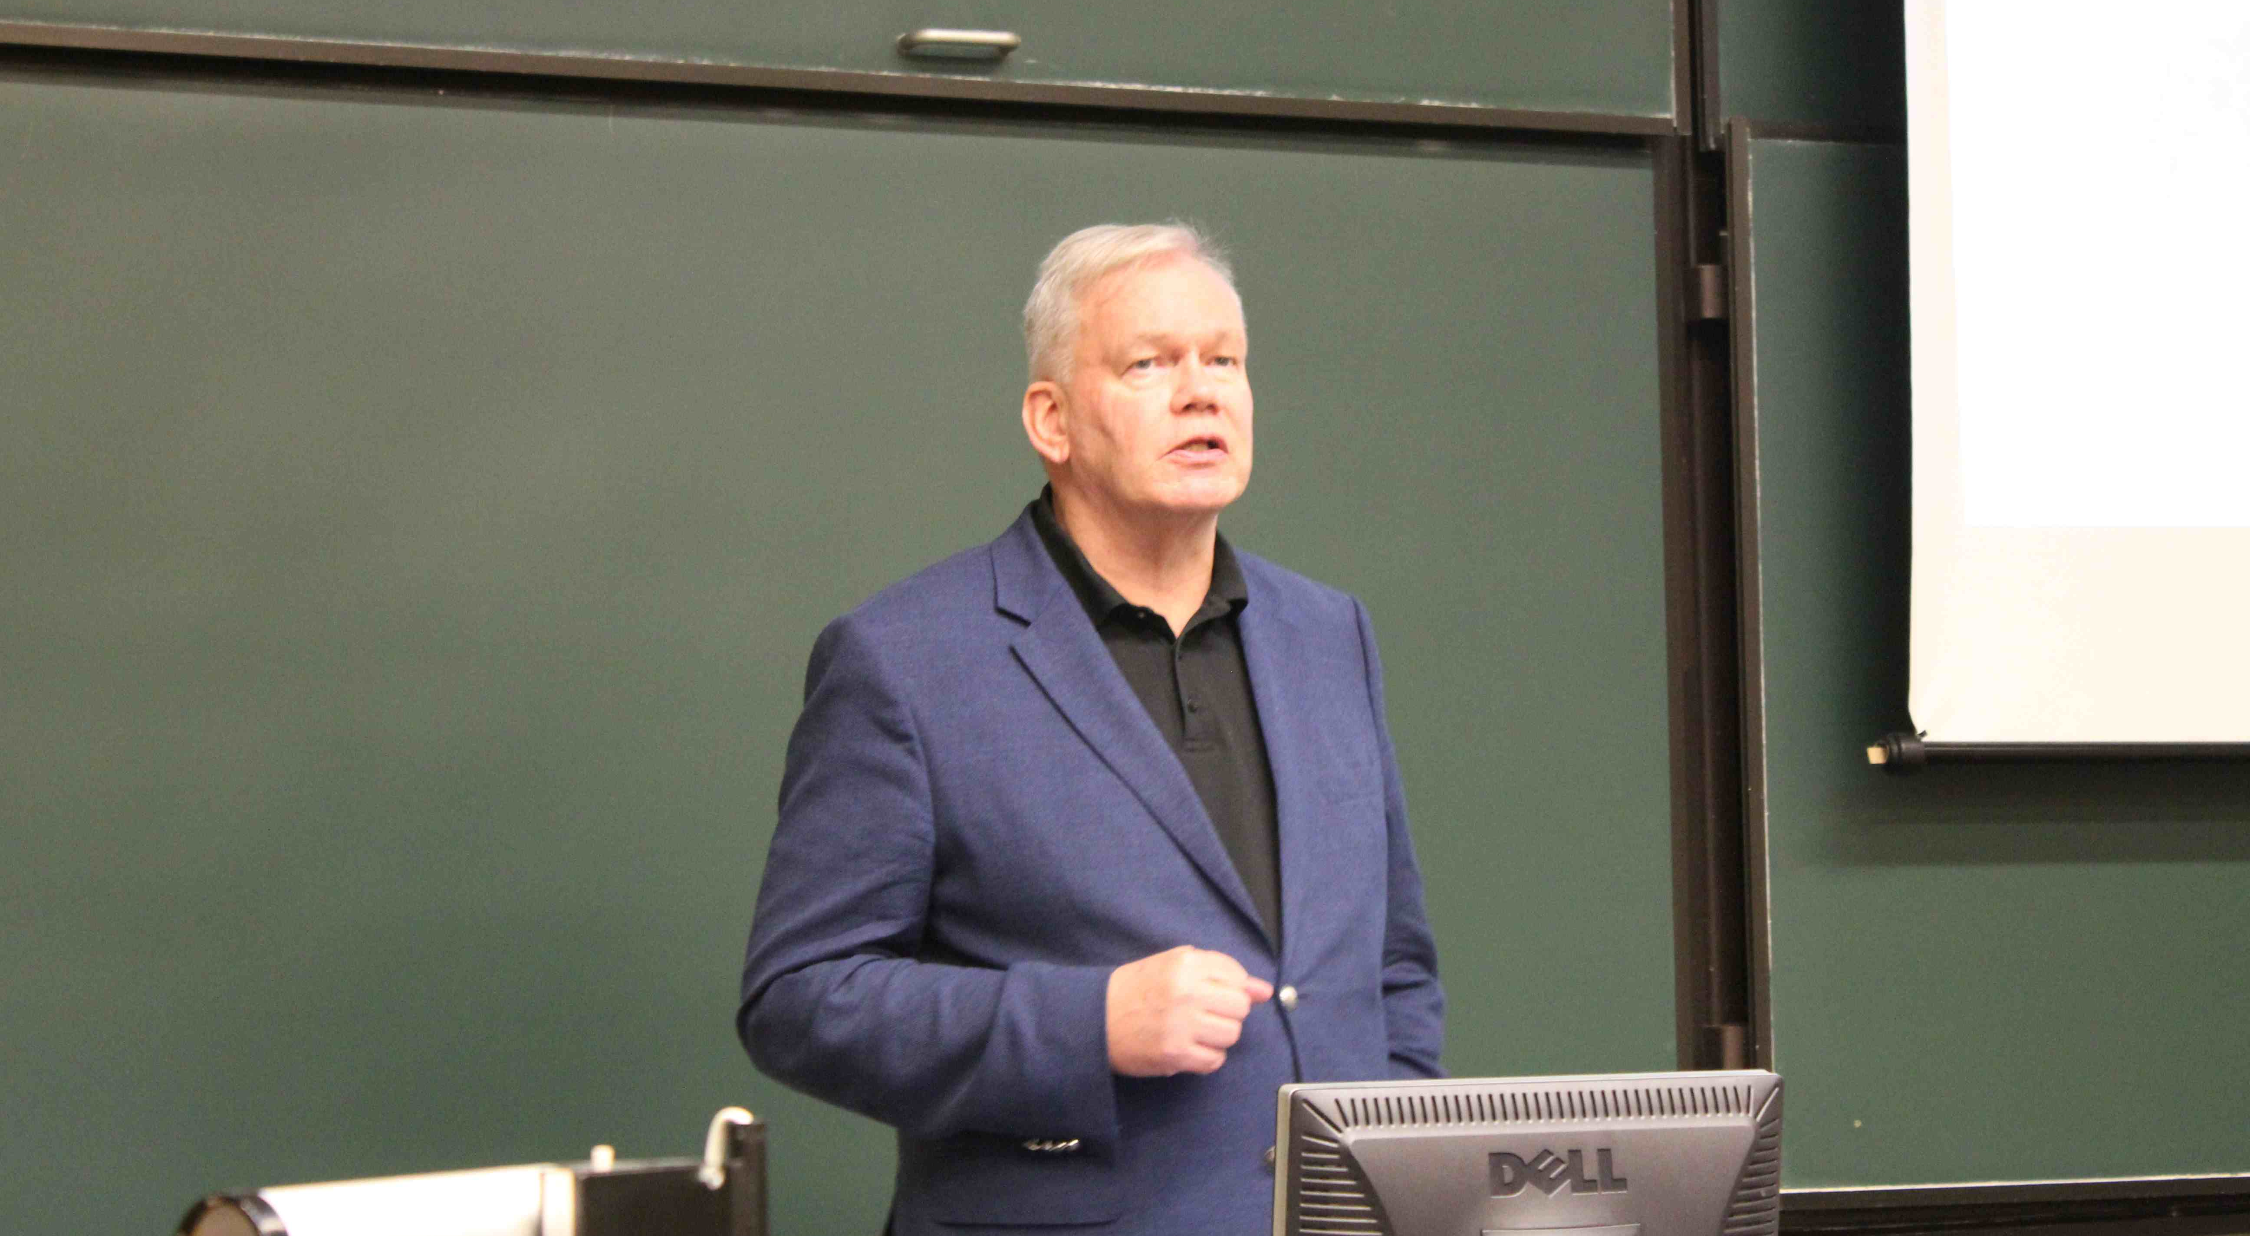
Prof. Gissurarson 2014

Slide 12
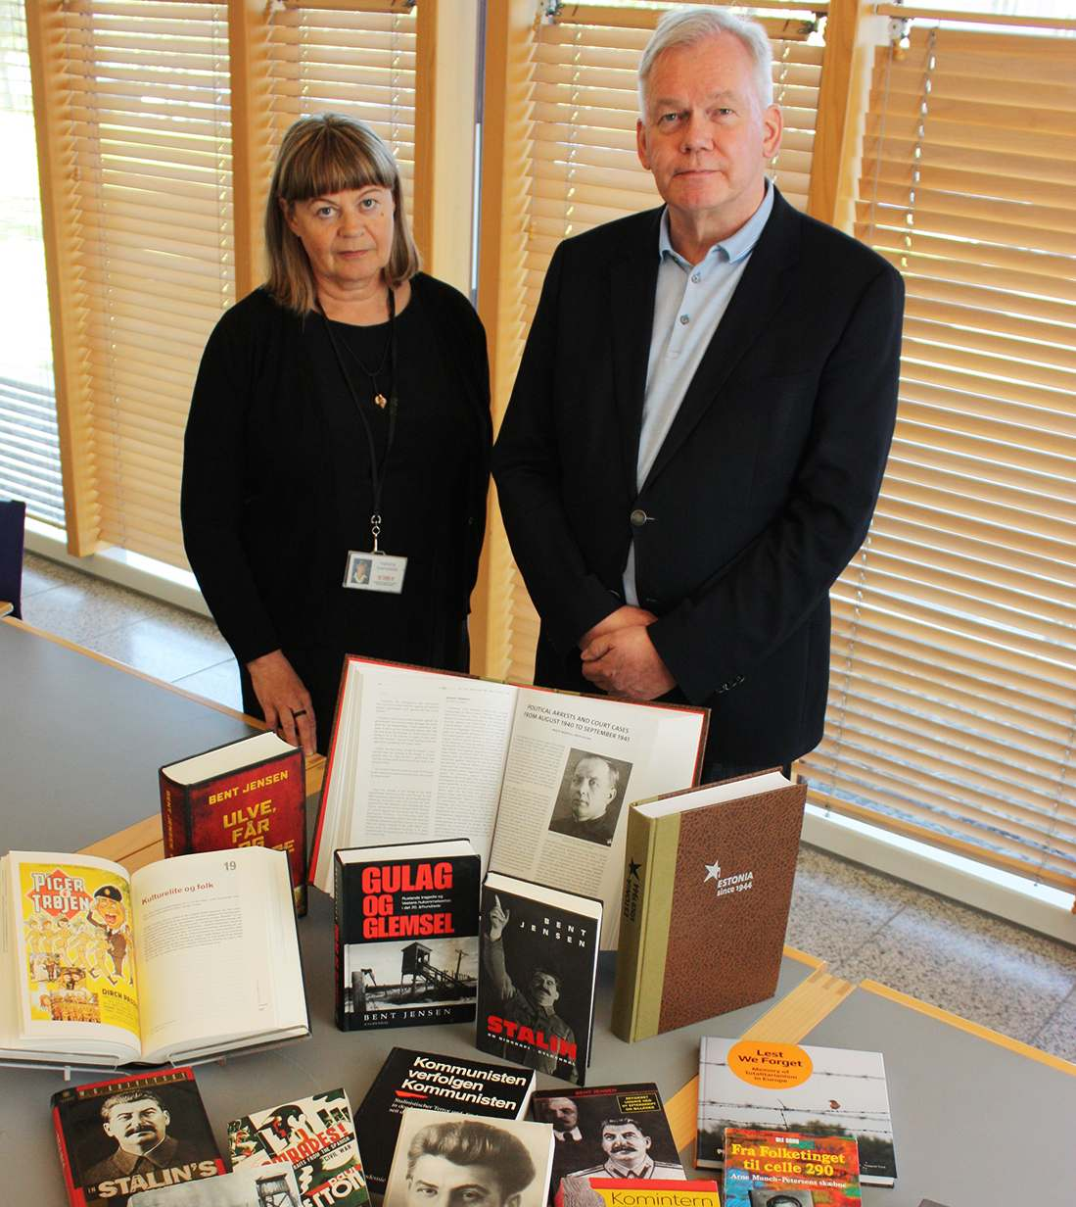
Other Activities
Gave Comintern documents to National Library 23 August 2013
Gave books on communism to National Library 23 August 2014
Edited books on communism, to be published online and by print-on-demand on paper

Slide 13

Aatami Kuortti, Escape
Kuortti Finnish priest serving in Soviet Karelia
Imprisoned by the GPU and put into the Gulag
Escaped to Finland
Icelandic translation in 1938
Book prohibited by Soviets in Finnish libraries after 1944
Republication scheduled in 2017, Finland’s 100th anniversary

Slide 14

Jan Valtin, Out of the Night
Jan Valtin, alias Richard Krebs, Comintern agent, posing as also working for Gestapo
Published in Icelandic 1941 and 1944
Caused a furore with the Icelandic communists
Fierce debate in newspapers
Krebs ambiguous individual

Slide 15

Victor Kravchenko, I Chose Freedom
Ukrainian defector
Published 1951 in Iceland
Celebrated court case in Paris 1949
Witnesses testifying about the Gulag
Icelandic communists attacked the author and claimed CIA financed the publication
Republication scheduled 7 November 2017, 100th anniversary of Bolshevik revolution

Slide 16

Erik Rostboll, Hungary 1956
Danish priest and journalist
Visited Budapest and refugee camps
Published in 1957 in Iceland, with a postscript by noted poet
No reaction from Icelandic communists
Republication scheduled 23 October 2016, 60th anniversary of Hungarian Uprising

Slide 17

Bertrand Russell, 1937–56
Icelandic newspapers published articles in Russell’s anti-communist phase
Nine articles collected in a small book, with a foreword and notes by Hannes H. Gissurarson
Include Scylla and Charybdis or Communism and Fascism and articles on Soviet threat
Republication scheduled 9 November 2014

Slide 18
Other Works Include …
The God That Failed by Arthur Koestler etc.
Darkness at Noon by Arthur Koestler
Nineteen Eighty Four by George Orwell
Prisoner of Stalin and Hitler by Margarete Buber-Neumann
Baltic Eclipse by Ants Oras
Estonia. Small Country Under Foreign Yoke by Anders Küng
El campesino by Valentin Gonzalez

Slide 19
Necessary Because …
Some intellectuals choose to ignore victims of communism (while all recognise the evils of nazism)
The historical journal of Iceland, Saga, published a negative review of Jung Chang’s Mao (by a person earlier supported and later employed by Chinese government), before it was even published in Icelandic
Sigrun Palsdottir, editor of Saga, refused to review the Black Book of Communism, on ground that translations were not reviewed!
Professor Stefan Olafsson blogged in 2012, wondering about “conferences and tea parties about communist crimes committed 70–100 years ago”

Slide 20
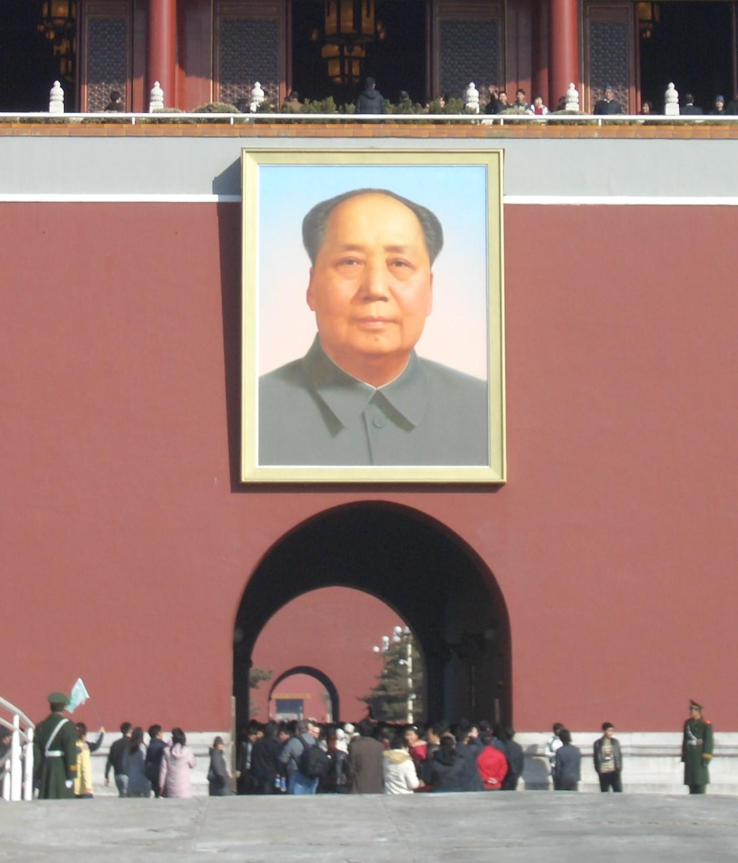
Spectre of Communism …
… no longer haunting Europe, but certainly still around in North Korea and Cuba and partly in China, Vietnam, etc.
Communism needs to be recognised and discredited as morally evil, just as nazism is

Slide 21


