Slide 1

A Latter-Day Jacobin With Data
Reflections on Piketty’s Capital
Professor Hannes H. Gissurarson
European Students for Liberty, Reykjavik
15 November 2014: 16.15–17.00

Slide 2
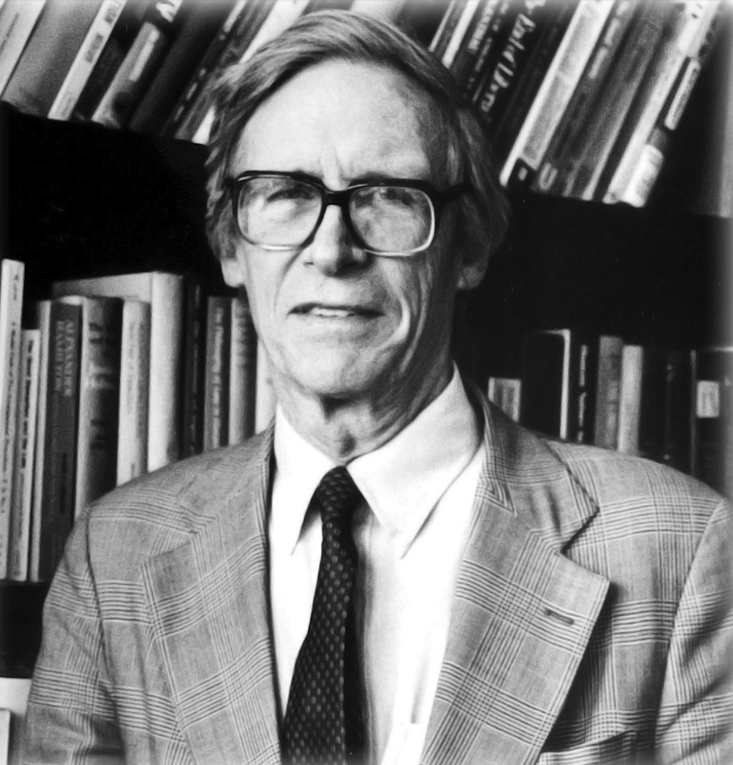
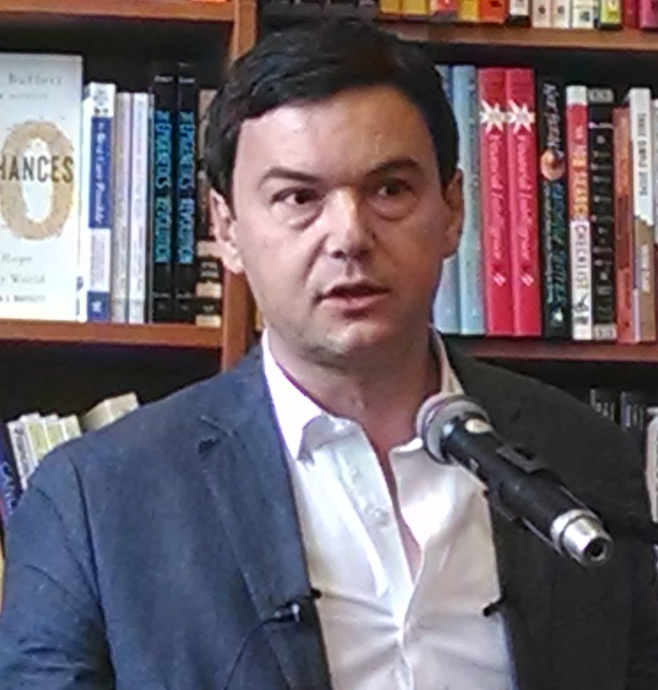
Piketty Replacing Rawls as Prophet

Slide 3
Rawls, and the Poor
Main proposition: Income distribution just if poor are as well off as they can be: maximum of minimum (maximin)
Let us look at Index of economic freedom, with data from long time and many places

Slide 4
Four Worlds of Freedom
Notes:
Source: Economic Freedom of the World: 2012 Annual Report. Website: freetheword.com

Slide 5
Lowest Incomes in Four Worlds
Notes:
Source: Economic Freedom of the World: 2012 Annual Report. Website: freetheword.com

Slide 6
Parting Ways: Australia and Argentina
Notes:
Source: Bolt, J. and J. L. van Zanden (2013). The First Update of the Maddison Project; Re-Estimating Growth Before 1820. Maddison Project Working Paper 4. Website: http://www.ggdc.net/maddison/maddison-project/data.htm

Slide 7
Parting Ways: Jamaica and Singapore
Notes:
Source: Bolt, J. and J. L. van Zanden (2013). The First Update of the Maddison Project; Re-Estimating Growth Before 1820. Maddison Project Working Paper 4. Website: http://www.ggdc.net/maddison/maddison-project/data.htm

Slide 8
Seven Nordic economies 2010
Notes:
Sources: Canadian data (Table A.34 gross domestic product per capita, provinces and territories, in current dollars) from Canada Statistics for 2009–2010. The data are in C$ which was then almost equal to US$. See www.statcan.gc.ca Data on Nordic countries from CIA World Factbook (GDP per Capita, PPP, USD) 2010. Data on states in the US from Avery, J.E., Siebeneck, T.P., og Tate, R.P. 2011. Gross Domestic Product by State. Advance Statistics for 2010 and Revised Statistics for 2007–2009. Price level 2010. Bureau of Economic Analysis. See www.bea.gov

Slide 9
Swedes in Different Economies
Notes:
Sources: Data on the US and Sweden, OECD 2009. GDP per capita: US$, using current PPPs, in OECD in Figures. Paris: OECD Publishing. Data on Swedish-Americans, Sanandaj, Nima 2012. The surprising ingredients of Swedish success — free markets and social cohesion. London: Institute of Economic Affairs, 21.

Slide 10

Piketty, and the Rich
Main proposition: inequality rising, poor do not gain from capitalism
Capital accumulated by rich, because r > g
Need for confiscatory international taxes on wealth and top income

Slide 11
Piketty’s Income Share of 1% Top
Notes:
Source: Top Income Data Base.

Slide 12

US: Country of Immigrants
US subject to waves of immigrants, first from Europe and Asia, now from Mexico and Central America
Brings down US averages, even if only temporarily
Creates a statistical illusion

Slide 13
Problems with Piketty’s Numbers
Financial Times: Errors in calculations of wealth distribution in the UK
French economists: inflated real estate prices cause overestimate of wealth
Neither criticism very relevant to Piketty’s income distribution
However: no correlation between the redistributive welfare state and income inequality

Slide 14
Problems with Piketty’s Method
Underestimates bottom income: uses income before transfers
Overestimates top income: ignores changes brought about by changed taxation, top income becoming more visible
Method suffers from same problems as Gini coefficient as measurement of inequality: relative share of top increases if more people study longer or live longer

Slide 15
Impact of Globalisation
Piketty possibly right that bottom income stagnant or even slightly decreasing
Competition from China and India: Massive migration into middle class
Global income distribution become more equal, while income distribution in West less equal
West only 1 of 7 billion people on earth

Slide 16
Income Share of 90% Bottom, China

Slide 17
Why the Super-Rich?
People with special, non-replicable skills (i.e. earning rent from abilities), innovators, entrepreneurs, entertainers, athletes
By definition, supply (almost) fixed, while demand flexible
Suddenly find demand, the market for their services, going from 300 million people to perhaps 3 billion, impact of globalisation

Slide 18
What’s Wrong With Inequality?
Country with an income distribution D₁
Milton Friedman comes to give a lecture
1,000 attend, each paying $50
Friedman $50,000 richer, 1,000 people each $50 poorer: less equal distribution D₂
No problem: everybody is happy
Distribution by choice: from each as she chooses, to each as she is chosen

Slide 19
More Problems with Piketty’s Ideas
Rate of return of capital not always higher than economic growth
Capital not immobile and unbreakable
Capital not in hands of rentiers, landowners and bondholders, also innovators, entrepreneurs, investors, funds, third sector organisations
Dispersed by children, divorces, risks, uncertainties

Slide 20
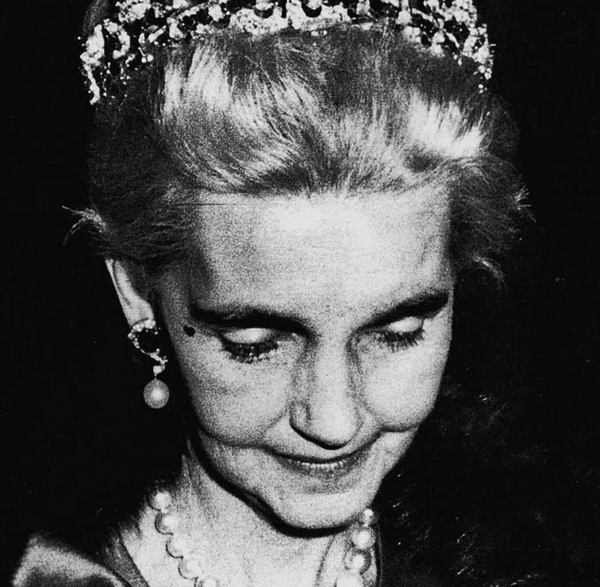

Challenge to Retain Wealth
Barbara Hutton
Charles Koch

Slide 21
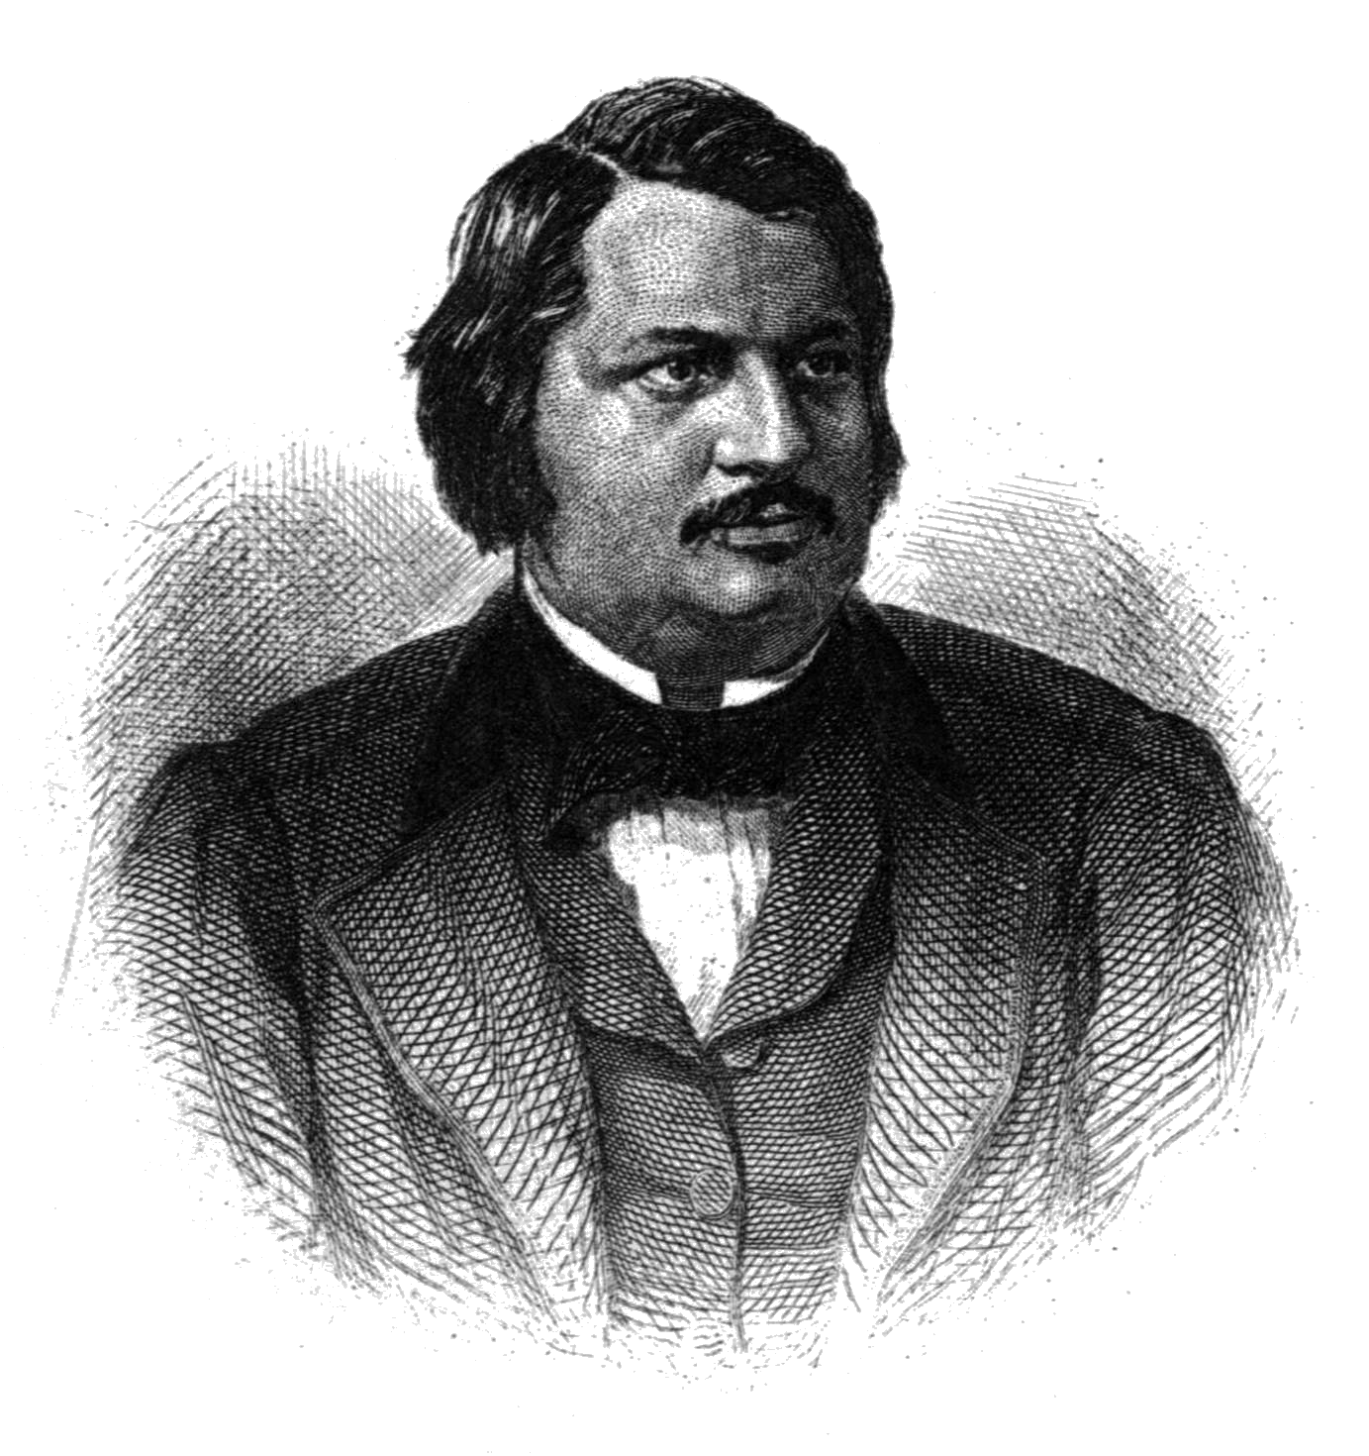
Reading Balzac
Piketty quotes Balzac, Old Goriot
Story of fragile wealth
Goriot penniless
Anastasie’s lover with gambling debts
Delphine’s husband failed speculations

Slide 22
Economic Growth
Piketty’s confiscatory taxes would become a self-fulfilling prophecy
Immense creative powers of capitalism
Almost unlimited possibilities of economic growth
Capitalism needs innovators, entrepreneurs and investors
Welfare state needs taxpayers

Slide 23
Sustaining the Welfare State
Notes:
Source: Department of the Treasury: Office of Tax Analysis Working Paper #85, "U.S. Treasury Distributional Methodology" by Julie-Anne Cronin (September 1999). See Tax Facts, http://www.taxpolicycenter.org from Brookings Institute.

Slide 24
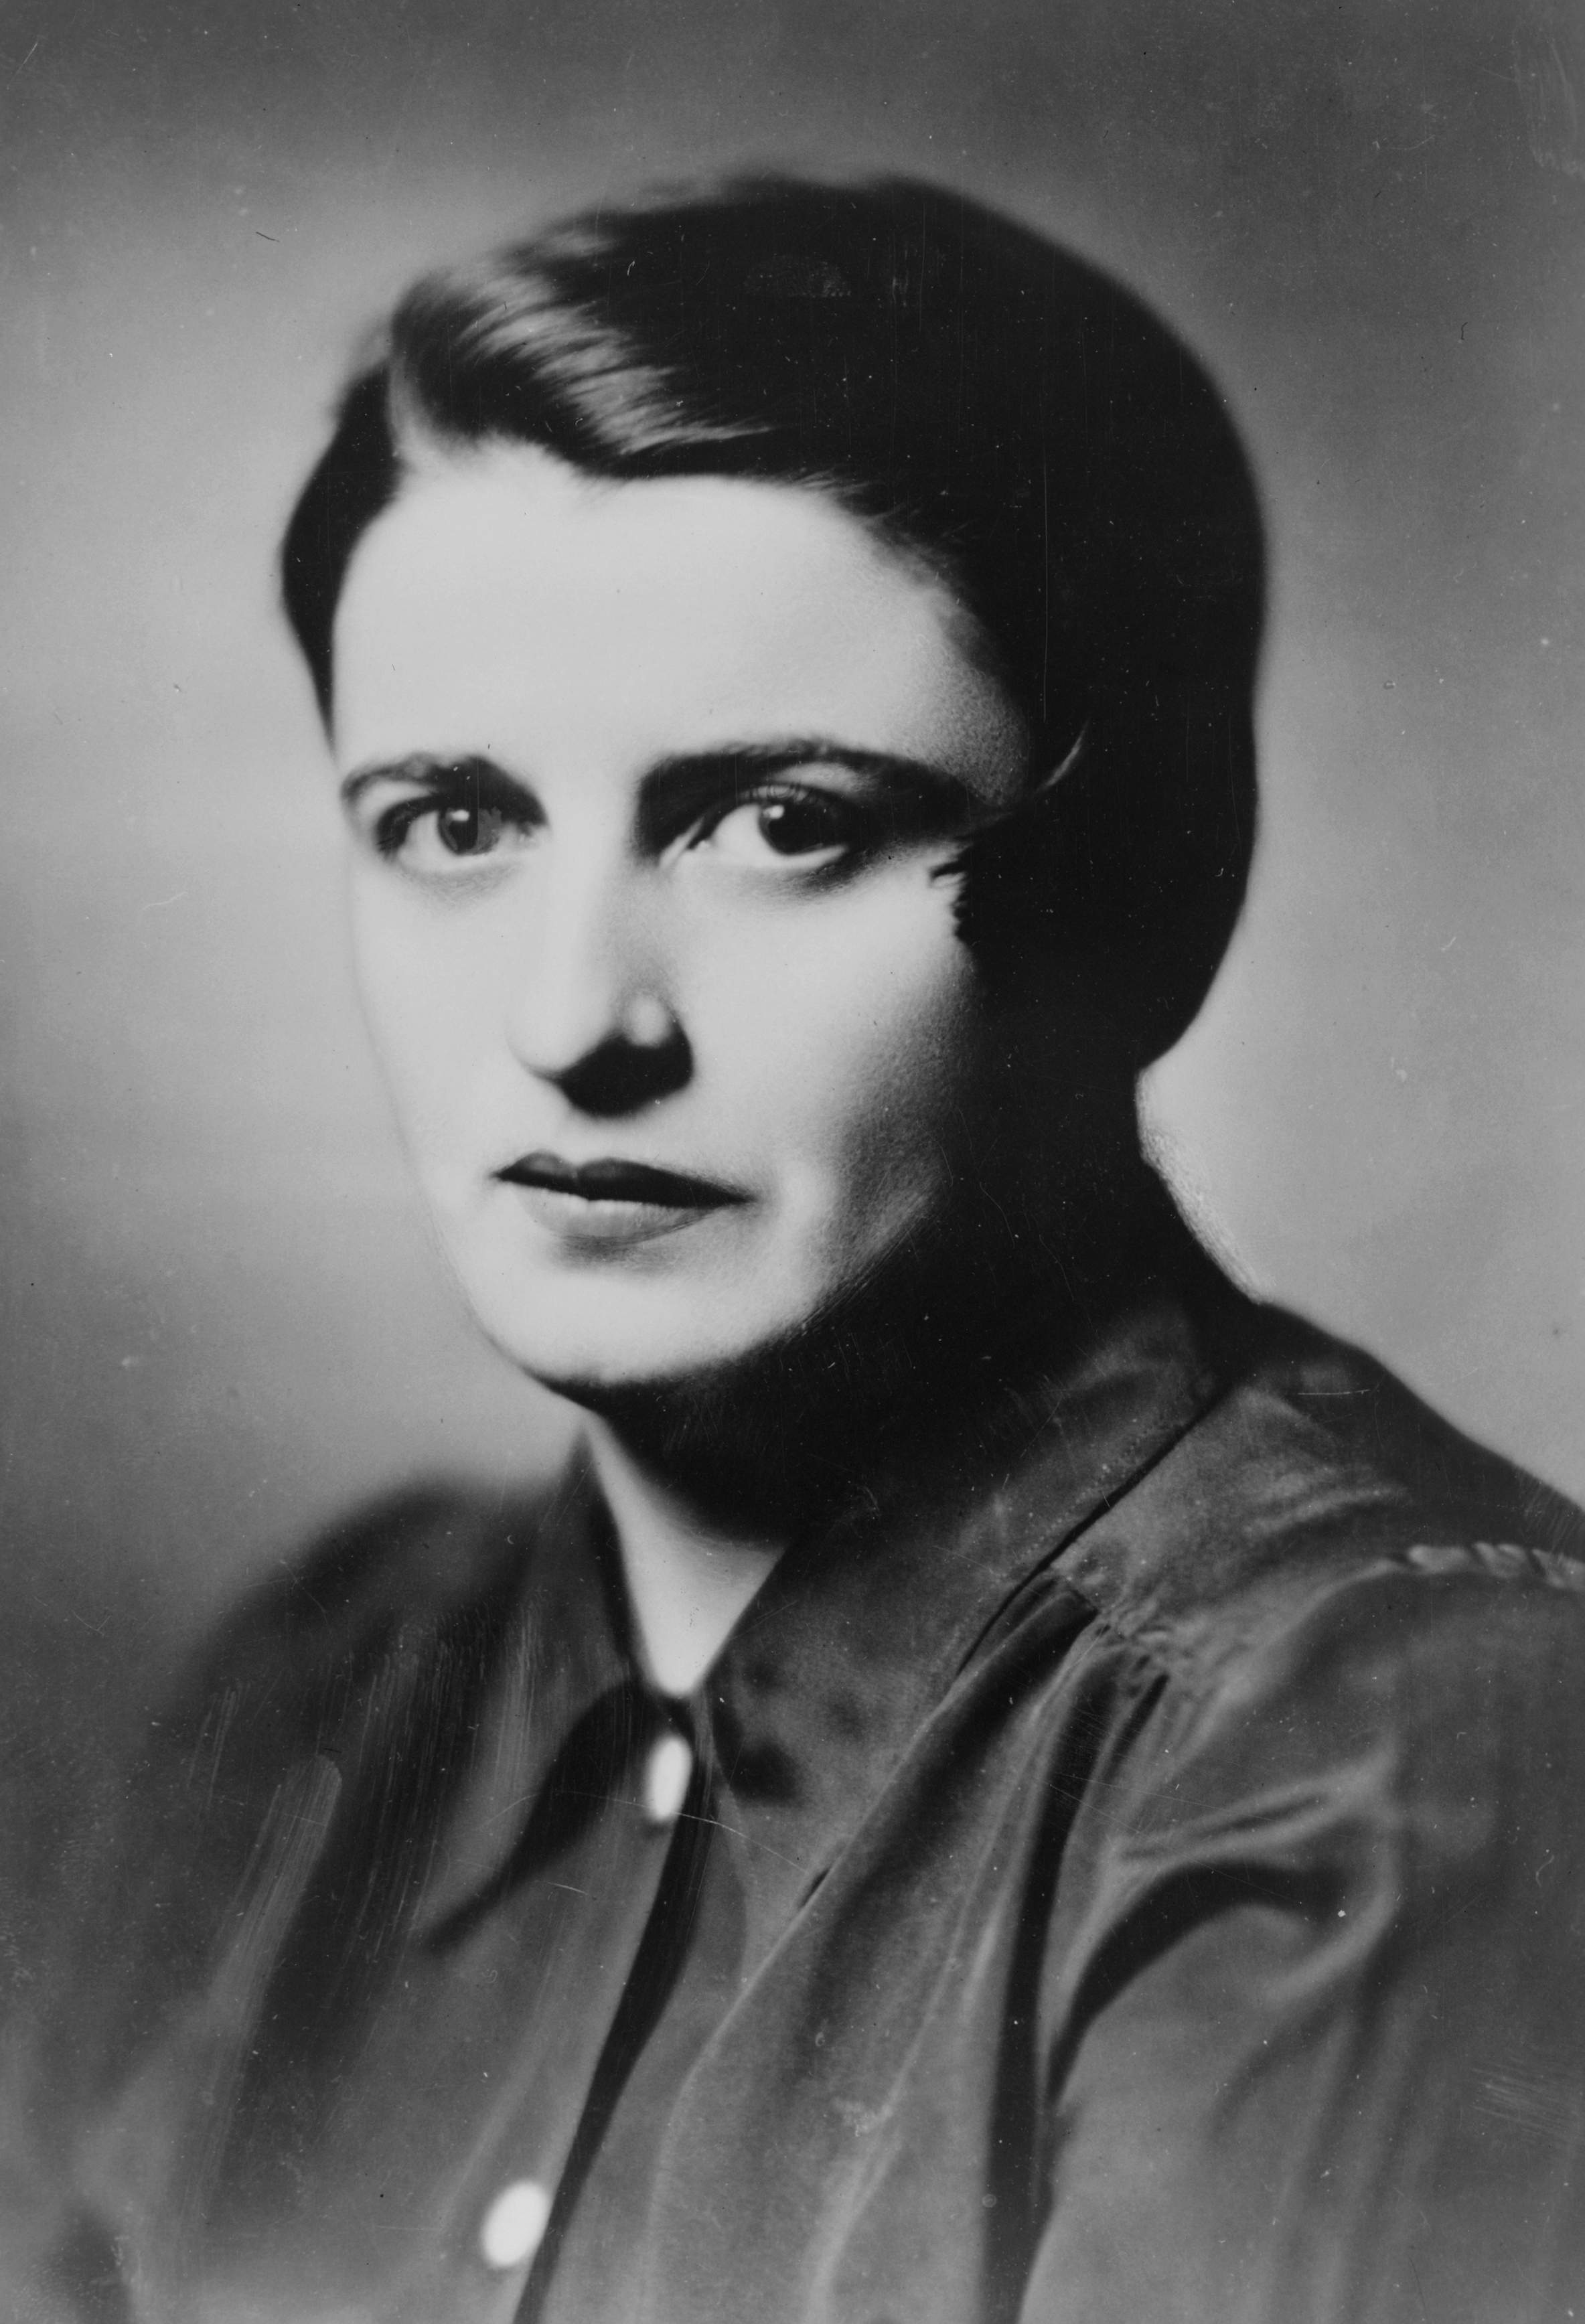
Rand’s Thought Experiment
The rich contribute most of tax revenue
What happens if they emigrate (as they sometimes do)?
What happens if they choose to disappear: Theme of Rand’s Atlas Shrugged

Slide 25

Further Benefits of the Rich
Pay for experimental process to turn luxuries into necessities
Provide risk capital; 1,000 experiments instead of 10
Have means to fight bureaucratic aggression and government oppression

Slide 26
The Challenge of the Red Queen
Notes:
Source: International Monetary Fund, Data and Statistics, World Economic Outlook Database, April 2014. Website: www.imf.org

Slide 27
