Slide 1

In Defence of Small States:
Reflections after the 2008 Icelandic Bank Collapse
Professor Hannes H. Gissurarson
NOPSA: Nordic Political Science Association
Odense, 10 August 15:15

Slide 2
The Sibert-Thorhallsson Thesis
2008 bank collapse showed Iceland was too small
She has to join the EU to get “shelter”
Small economies more volatile
Economies of scale in providing public goods
Small countries more vulnerable to disasters
Lack of professionalism in small states
Political favouritism in small states
Iceland’s historical “shelters”: Norway, Denmark, UK, and US

Slide 3
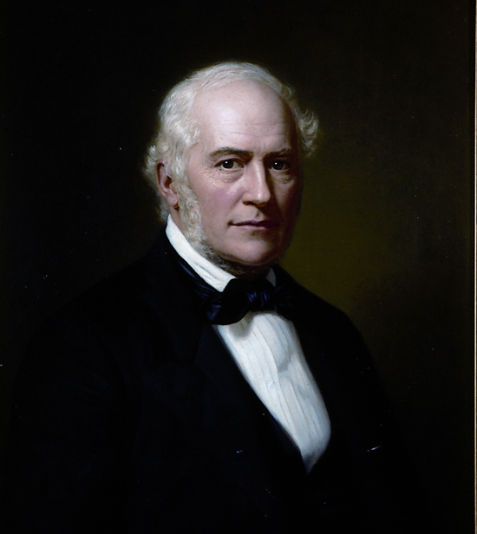
Was Jon Sigurdsson Wrong in 1848?
Icelanders have from outset been independent, sovereign
A distinct nation with her own language and culture
They know better than foreign bureaucrats what is right for them
Iceland should trade with all, not only with one
University of Iceland established on his 100th birthday 1911

Slide 4
Proliferation of Small States
No: History shows that Jon Sigurdsson was not wrong
76 independent states in 1946; 195 in 2016
Main causes:
Disintegration of empires (Russia, Habsburg and Ottoman dominions, British Empire)
Nationalism (Secessions of Norway, Iceland, Slovakia, etc.)
Triumph of democracy, less resistance to secession
Most important: increased economic integration making smallness less costly

Slide 5
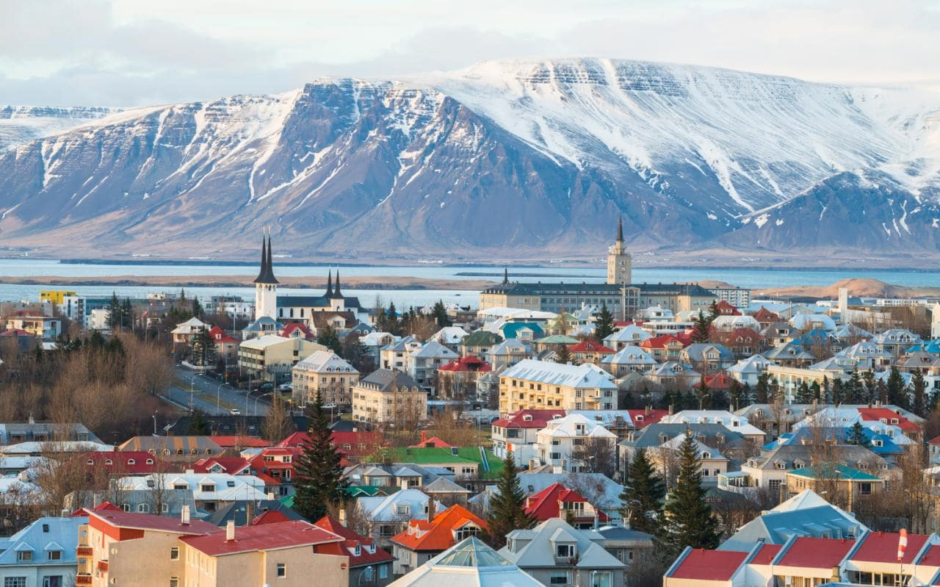
More Economic Integration Makes Less Political Integration Possible

Slide 6
Small States More Wealthy
Maintain open economies, enjoy benefits of free trade
Alesina: Of 10 richest countries, only 4 with populations over 1 million: US, Switzerland, Norway, Singapore
Large countries not rich: China, India, Indonesia and Brazil (only exception US)
Becker: Less systemic exploitation; monopoly not subsidised; homogeneous populations

Slide 7
Small States Volatile and Vulnerable?
Volatile? True, but not very relevant because:
Found ways to cope with volatility, flexibility and consensus politics (Katzenstein)
large states volatile, Great Depression in the US and Germany, Nazism
Vulnerable? True, but not the whole story:
homogeneity means more solidarity
Self-insurance can stretch over time no less than space

Slide 8
Economies or Diseconomies of Scale?
Outlays to produce public goods as a proportion of GDP in 2006 (OECD)
Country | Public Services | Defence | Public Order | Total
Sweden | 7.7 | 1.7 | 1.3 | 10.7
Denmark | 6.0 | 1.6 | 1.0 | 8.6
Iceland | 4.8 | 0.1 | 1.4 | 6.3
The UK | 4.9 | 4.9 | 2.6 | 10.0
The US | 4.8 | 4.8 | 2.1 | 11.2

Slide 9
Less Costly to be Small
Costs of statehood, e.g. foreign service, negligible fraction of GDP
The more cohesive, or homogeneous a state, the less the cost of maintaining public order and reach consensus
Small states not aggressive like large ones (less militarism)
Complexity also has its costs (e.g. multi-layered and non-transparent bureaucracy)

Slide 10
Less Professionalism?
Smaller talent pool, yes. But professionalism depends more on civic culture than size of population (Brazil, India, China, Indonesia all corrupt countries, with little professionalism)
Civic culture strong in some small countries because of strong collective identity, solidarity, cohesion, trust, transparency
Little “hard corruption” in small Nordic countries, perhaps some “soft corruption”

Slide 11
Where is the Evidence?
Sibert and Thorhallsson both allege that political patronage is prevalent in Iceland
It was prevalent in Nordic countries during Social Democratic Era (Seip’s ettpartistat), whereas Iceland had a system of coalition governments
Only one study quoted: 17 experts pronounced on 111 appointments in 2001–5
68% professional, 57% bureaucratic, 41% both
44% political, 16% only political
Several problems with study

Slide 12
A More Relevant 2008 Study
Comparative survey of party patronage in 15 European countries
Iceland one of five with least party patronage (Netherlands, Danmark, the UK, and Norway)
Little corruption according to Transparency International index
To be expected: cohesive, transparent, homogeneous, strong civic culture
Major reforms in the 1991–2004 era; opportunities for corruption reduced by transferring decisions from political to private realm

Slide 13
The “Shelter” was a Trap
In 1262, Iceland yielded to Norwegian king against her will, afraid of isolation and under sway of local chieftains
Norwegian, later Danish, Crown isolated Iceland, but did not defend her adequately (English raids in 1400s and 1500s, ‘Turkish Raid’ in 1627, English takeover in 1809)
Crown extracted as much as possible and allied itself with landowners, hindered development of fisheries, preferred low taxes to danger of losing control
Iceland was in a poverty trap

Slide 14
Core of Truth in “Shelter” Theory
In a wide sense, implausible; in a narrow sense, trivial
Wrong to speak of cultural shelter: aim is fruitful, cultural exchanges
Wrong to speak of economic shelter: aim is trade to mutual benefit
But small states lack military power and therefore need allies or protectors
Iceland was protected by Royal Navy in 1810–1941 and by US in 1941–2006
In the financial crisis, it was left out in the cold

Slide 15
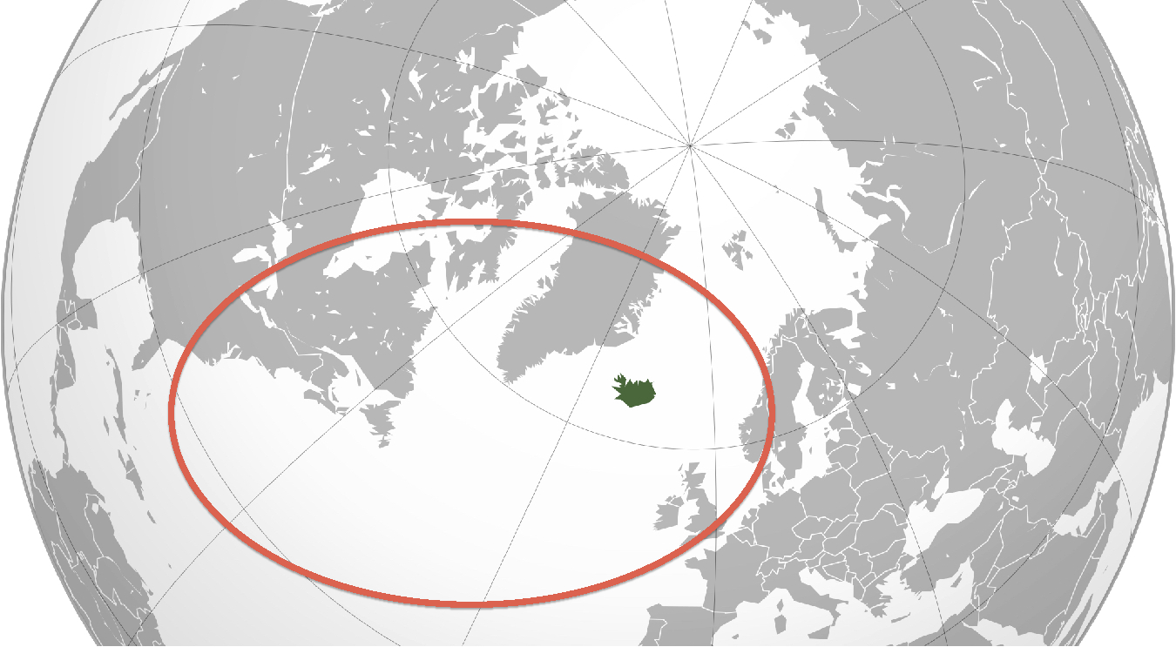
Atlantic or Continental Option?

Slide 16
