Slide 1

How Offshore Fisheries Can Be
Both Sustainable and Profitable
Professor Hannes H. Gissurarson
The Blue Economy
Gdansk, 22 March 2019, 13:45–14:30

Slide 2
Economic Overfishing: 16 Boats Instead of 8
Notes:
H. Scott Gordon,

Slide 3
Solution of Overfishing: From 16 to 8
When access to fishing grounds free, effort (number of boats) increases until revenue goes down to nothing (total revenue equals total cost)
Best to maximise profit (difference between revenue and cost), i.e. by 8 boats, not catch, i.e. by 10 boats
In effect, 16 boats harvest what 8 boats could harvest: Rent dissipated, zero profit
Task is to reduce the fishing fleet (and fishing effort) from 16 to 8 boats
Notes:
Hannes H. Gissurarson 2000. Overfishing: The Icelandic Solution. London: Institute of Economic Affairs.

Slide 4
Two Options Discussed in Iceland in 1980s
Public renting out of quotas
Allocation of free quotas
Government profits enormously
Some fishing vessel owners neither profit or lose
Other fishing vessel owners lose (their investment suddenly becomes worthless)
Public? Does it profit from a stronger state?
Government profits somewhat
Fishing vessel owners who sell quotas and leave fishery profit
Fishing vessel owners who stay, profit
The public benefits
Nobody loses

Slide 5
Same End Result: 8 Boats instead of 16
Notes:
H. Scott Gordon,

Slide 6
ITQ System in Iceland (and NZ) Efficient
Individual: Each bears responsibility for his own operations
Permanent: Fishermen have long-term interest in profitability of resource
Transferable: The 8 more efficient buy out the 8 less efficient
Rent, previously dissipated in excessive harvesting costs, now captured
Icelandic fisheries very profitable

Slide 7
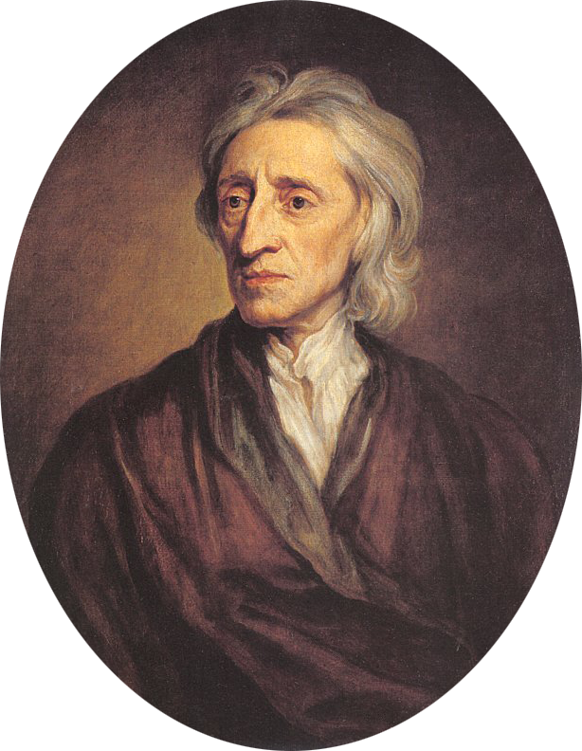
ITQ System Just (in Locke’s Sense)
How can people come to have rights to exclude others from use of goods?
Locke’s proviso: Because those others are not made worse off (indeed much better)
Nobody made worse-off because the right to fish of which others are deprived is the right to harvest at zero profit, and that is a worthless right

Slide 8
Change to ITQ System Pareto-Optimal
Social change Pareto-Optimal, if no-one worse off, and some or all better off
Initial allocation by government auction not Pareto-optimal
Initial allocation on basis of catch history (“grandfathering”) Pareto-optimal: Fishermen bought out, not driven out
Therefore the only feasible political solution, as well as the only economically efficient one
Environmental protection need real-life protectors whose self-interest coincides with the public interest

Slide 9
