Slide 1

Nordic Liberalism
Professor Hannes H. Gissurarson
APEE, Bahamas: Classical Liberalism in Europe
5 April 2019, 8:00–9:15 [2.A.3]

Slide 2
Selected Writings in 2016–18
Icelandic Liberalism, three papers for Econ Journal Watch
The Nordic Models (Brussels: New Direction, 2016)
In Defence of Small States (New Direction, 2016)
Green Capitalism: How to Protect the Environment by Defining Private Property Rights (New Direction, 2017)
Voices of the Victims: Notes Towards a Historiography of Anti-Communist Literature (New Direction, 2017)
Totalitarianism in Europe: Three Studies (Brussels: ACRE, 2018)
Why Conservatives Should Support the Free Market (New Direction, 2018)
Spending Other People’s Money: A Critique of Rawls and Piketty (New Direction, 2018)
Foreign Factors in 2008 Icelandic Bank Collapse (Reykjavik: Ministry of Finance, 2018)

Slide 3
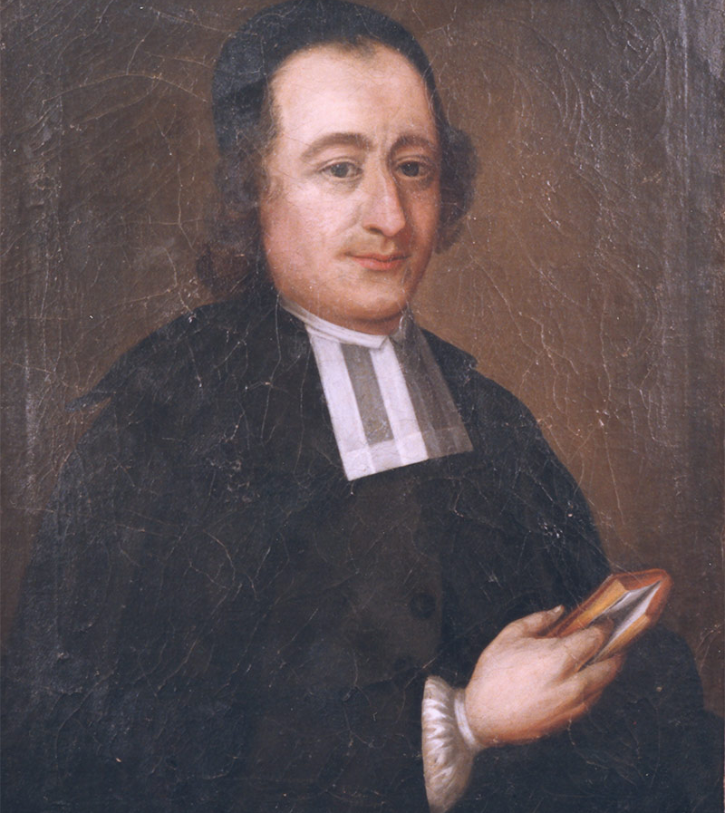
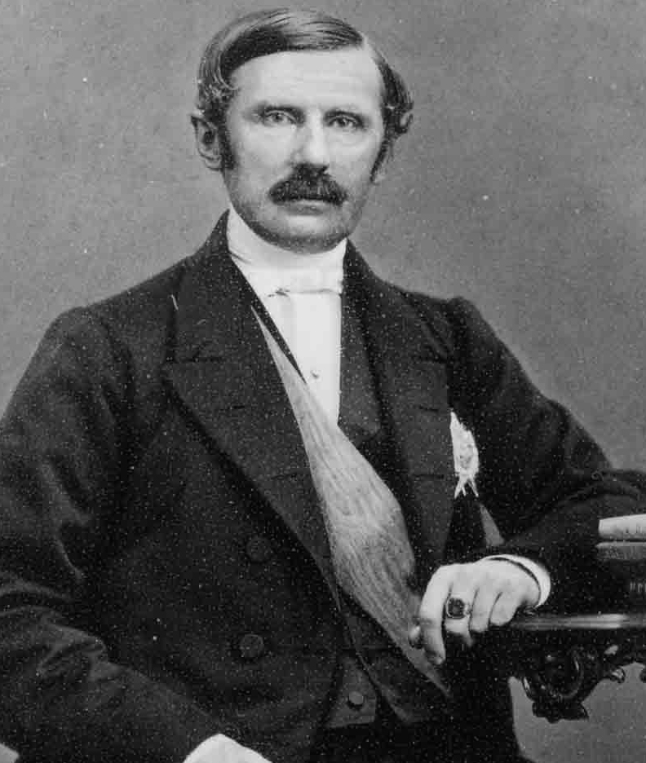
Strong Swedish Liberal Tradition …
Anders Chydenius
Johan August Gripenstedt
Notes:
Johan Norberg, Den svenska liberalismens historia (Stockholm: Timbro, 1998).

Slide 4
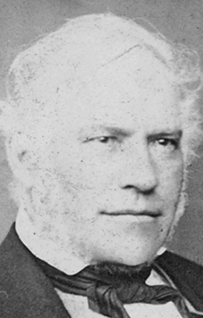
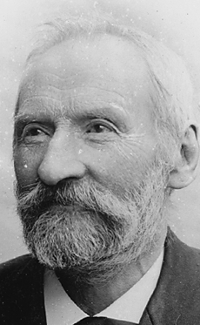
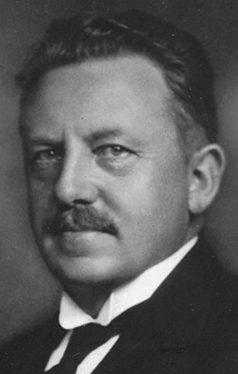
Even Liberals in Little Iceland …
Jon Sigurdsson
Arnljotur Olafsson
Jon Thorlaksson

Slide 5
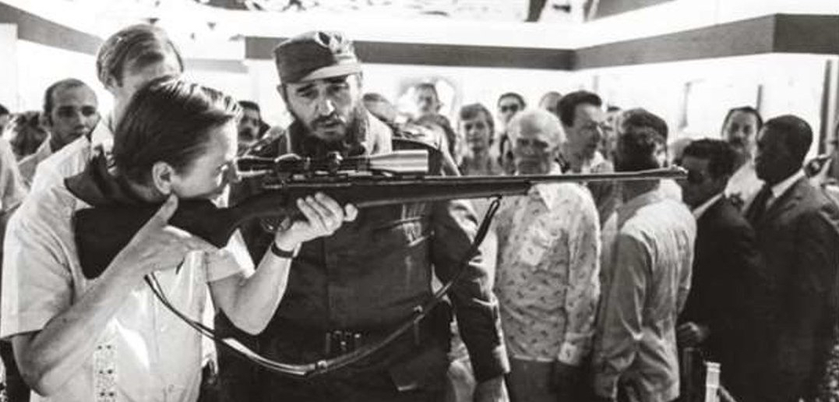
2nd Swedish Model 1970–90:
Radical Redistributionism

Slide 6
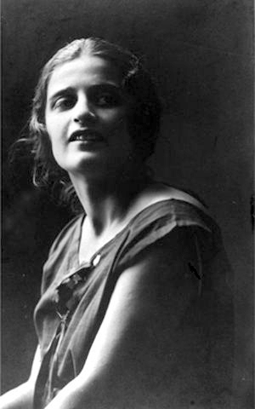
Atlas Shrugged: Sweden 1970–90
In 1870–1970 many entrepreneurs, large companies
1970–1990, capitalists and entrepreneurs, Kamprad (IKEA), Rausing (Tetrapak), etc., left Sweden
Entrepreneurship diminished
Value erosion: worth ethic declined, shirking increased
Almost like a Randian nightmare

Slide 7
Sweden’s Fall and (Partial) Rise
Notes:
Purchasing Power Parity Converted GDP Per Capita Relative to the United States, G-K method, at current prices for Sweden. Heimild: Federal Reserve Bank of St. Louis, Economic Research, heimasíða. Frumheimild: University of Pennsylvania.

Slide 8
Culture Matters: Swedes
Notes:
Sources: Data on the US and Sweden, OECD 2009. GDP per capita: US$, using current PPPs, in OECD in Figures. Paris: OECD Publishing. Data on Swedish-Americans, Sanandaj, Nima 2012. The surprising ingredients of Swedish success — free markets and social cohesion. London: Institute of Economic Affairs, 21.

Slide 9
Comparison of Northern Countries
Notes:
Heimildir: Tölur frá Kanada (Table A.34 gross domestic product per capita, provinces and territories, in current dollars) eru frá Canada Statistics og fyrir árin 2009–2010. Þær eru í Kanadadal, en hann var þá nánast jafngildur Bandaríkjadal. Heimasíða www.statcan.gc.ca Tölur um Norðurlönd eru úr CIA World Factbook (GDP per Capita, PPP, USD) fyrir 2010. Tölur um ríki í BNA eru úr Avery, J.E., Siebeneck, T.P., og Tate, R.P. 2011. Gross Domestic Product by State. Advance Statistics for 2010 and Revised Statistics for 2007–2009. (Breytt hér úr 2005 verðlagi í 2010 verðlag með því að margfalda með 1,10993.) Bureau of Economic Analysis. Heimasíða www.bea.gov

Slide 10
A Few Comments on Little Iceland
In Iceland, (classical) liberals gained intellectual hegemony in the 1980s, reinforced by collapse of communism in the 1990s
Comprehensive and successful liberal reforms implemented in 1991–2004 under leadership of David Oddsson: tax cuts, privatisation, strengthening of pension funds and quota system in fisheries, public administration reform, transparency, free trade and free capital movements with EEA membership

Slide 11
Lower tax rate: Increased revenue
Notes:
Source: OECD Revenue Statistics.

Slide 12
Icelandic Discoveries or Innovations
Icelandic Commonwealth 930–1262: restitution, crimes compensated; private enforcement of law; choice between ‘protective agencies’ or chieftains
America discovered in 1000! And lost again.
Quota system in fisheries since 1975 (comprehensive since 1991): permanent, transferable rights to harvest a given amount of total allowable catch, creating incentive to minimise cost
If depositors get priority claims, then government guarantees of banks unnecessary (moral hazard)

Slide 13
Conclusions
Nordic countries successful despite, not because of redistribution
Main factors: Free trade, rule of law, social cohesion, moral values (hard work, thriftiness, honesty)
Nordic people even more successful in North America than in Europe
Liberal reforms in Iceland 1991–2004 quite successful
Best evidence: Rapid recovery of Iceland after bank collapse!

Slide 14
