Slide 1
ITQs, other Rights Based fisheries management schemes, and the new frontier
Gordon Munro
Vancouver School of Economics, University of British Columbia, Canada
Conference in Honour of Professor Ragnar Arnason
Reykjavik, Iceland 14 June 2019

Slide 2
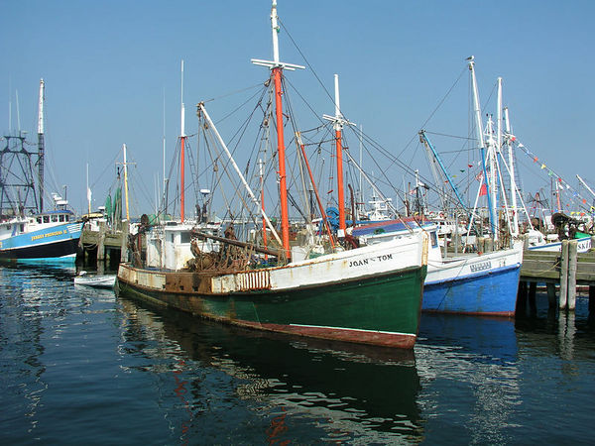
Introduction
A dominate feature of Professor Ragnar Arnason’s extensive and productive career has been his world wide championship of rights based fisheries management – ITQs in particular- extending back to the early 1980s
Since the early ‘80s, rights based fisheries management schemes, with ITQs in the fore, have made great strides, with the ongoing advance seemingly inexorable.
So what then do we mean by a New Frontier?

Slide 3
The New Frontier
Professor Arnason and I are agreed that an ITQ scheme will realize its full potential, if and only if, there is effective cooperation among the ITQ holders. By definition, other rights based fisheries management schemes – fisher cooperatives/TURFs - will be successful, if and only if, there is effective cooperation among the members
The need for such cooperation implies a strategic interaction between/among ITQ holders; between/among cooperative members.
From this it follows, I would argue, that economists, when analysing rights based fisheries management schemes, have no choice but to bring to bear the theory of strategic interaction- theory of games.
Herein lies the New Frontier.

Slide 4
New Frontier cont.
A book soon to appear, Grønbæk et al., Game Theory and Fisheries Management: Theory and Applications, maintains that:
  application of game theory to analysis of economic management of international fisheries - extensive and well developed,
  application of game theory to analysis of economic management of intra-EEZ fisheries - at a primitive level – thus the New Frontier
Will review application of game theory to intra-EEZ fisheries, as far as it has gone
  in so doing comment on contentious issue of the extent to which cooperation among ITQ holders is in fact feasible
Then, with your indulgence, we will draw upon an intra-EEZ case study from my region of Canada- which holds lessons for fisheries far beyond Canada
    how does the case study relate to Icelandic fisheries?

Slide 5
The Kronbak - Lindroos Model
The starting point for our review of game theory and intra-EEZ fisheries is the 2006 model of Kronbak and Lindroos.
It is a static stage game model, in which the resource manager plays a leader-follower game with the fishers, and makes the first move. The fishers respond, and in so doing may play competitively, or engage in cooperation - partial or full.
  provides an important framework – link between resource manager explicit; allow for possibility of fisher cooperation in response to resource manager’s policies.
  assumed ,by the way, that resource manager has only one instrument- control over fishing effort

Slide 6
The K&L Three Stage Game
Stage 1
Resource Manager Chooses
Control of Fishing Effort Level
Stage 2
Fishers Choose Coalition Structure; Full Competition; Partial Cooperation; Grand Coalition
Stage 3
Fishers Choose Optimal Fishing
Effort Level
Source: Kronbak and Lindroos, 2006.

Slide 7
More on the Kronbak and Lindroos (K&L) Model
K&L investigate the consequences for the resource manager of the possible different coalition structures among the fishers. No surprise. Best outcome for resource manager- stable fisher Grand Coalition.
Analysis of fisher cooperation – have to turn to coalition game theory. K&L apply a class of coalition games – partition function games - which brings in the positive externalities created by cooperation for “free riders”. Invoke the concept of Grand Coalition “internal stability”, or the lack thereof
  partition function games used extensively in analysis of management of international fisheries – e.g. RFMOs

Slide 8
K&L Framework Model - Comments
K&L model only allows resource manager one instrument; will in reality have a portfolio of instruments, including rights based management – choose those instruments, which maximize fishers’ opportunities for cooperation
If fisher cooperative game has to be self-enforcing, partition function games predict “internal stability” achievable, only if number of players is small.
  let us note here: the issue of the extent to which cooperation among fishers, particularly under ITQ schemes, is feasible is a highly contentious one – economists have tended to be pessimistic, e.g. one notable claim that stable cooperation among ITQ holders not achievable, if number of “players” exceeds 15.
Two responses

Slide 9
Two Responses
I. The first response regarding scope for fisher cooperation is that partition function games (P games) do not really consider opportunities for cooperating players to punish defectors, with obvious consequences for free rider payoffs.
  repeated games with “trigger strategies” (e.g. Hannesson 1997)
  a new approach by Grønbæk and Lindroos – advanced P games- repeated coalition games with so called “club” goods . A “club” good is a benefit arising from cooperation that is available to those cooperating, but unavailable to defectors –definition broadened to include sanctions, e.g. peer pressure.
II. The second response is that, intra-EEZ fisher games, unlike international fishery games, do not have to be self-enforcing. There exists an obvious potential third party to help suppress free riding in the form of domestic government- resource manager.

Slide 10
More Comments of K&L Model
K&L model static. In a dynamic context have to allow for learning over time – as case study will reveal. Repeated games, to which we have referred, are dynamic by definition, but do they allow for learning? Not at all clear. The Game Theory and Fisheries Management authors turn to evolutionary games, first developed by evolutionary biologists. Some attempts to apply evolutionary games to economics, but none so far to fisheries economics.
As part of the evolutionary process, relationship between resource manager and fishers may change, with the leader-follower game ceasing to be valid. Resource manager-fisher game may evolve into a cooperative one – again as illustrated by the case study, to which we now turn.

Slide 11
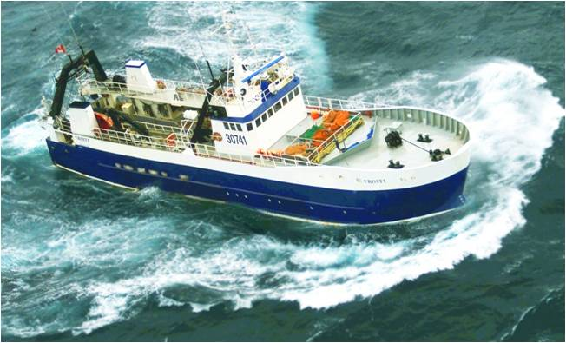
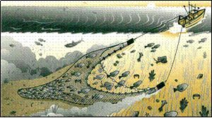
Case Study - British Columbia Groundfish Trawl Fishery
complex multi-species fishery – 60 stocks - operating along entire B.C. coast – bottom and mid-water trawls – currently 55 active vessels
fishery put under management in late 1970’s –standard limited entry with Olympics style TACs
problems emerged, with which we economists are now so well acquainted; came to a head in 1995
Photo credit: Brian Mose
Notes:
11

Slide 12
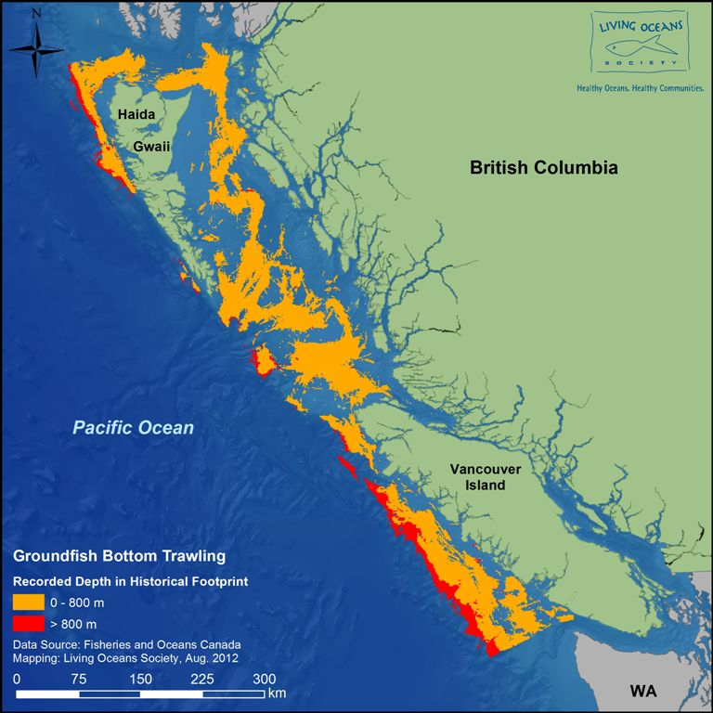
Bottom area trawled between 1997-2011
~41,000 km²
Notes:
Despite some excellent species and catch management, there were virtually no habitat rules in this entire area
~4000km2 in waters greater than 800m
12

Slide 13
State of Affairs in 1995
In terms of K&L model, fisher game in1995 highly competitive; fisher-resource manager (gov’t of Canada), of course competitive – poisonously so.
  evidence of gross overcapitalization
Resource manager shut fishery down in1995- re-opened over 1996-97; greatly enhanced surveillance/enforcement, with full cost imposed on industry; ITQ scheme forced upon industry. Each vessel owner issued a portfolio of quotas and invited to become a portfolio manager. This they did, most successfully.
    received wisdom among fishery economists of the time – ITQ schemes infeasible in multi-species fisheries –too complicated.

Slide 14
State of Affairs in Early 2000s
Clear signs that stable fisher cooperative game had emerged, for reasons that we do not fully understand
  there was an industry association- Canadian Groundfish Research and Conservation Society (CGRCS) –but an association only, with no power over members – 80 members.
  vessel ownership relations complex, but can state that number of independent “players” not fewer than 30 – large cooperative game.
By early 2000s, industry (through CGRCS) had established a research fund , based on strictly voluntary member contributions, to supplement resource manager’s stock assessments
In addition, had successfully pressured resource manager to slash TAC on a key fishery resource and engage in a multi-year resource rebuilding program.
    this process was to be repeated a few years later.

Slide 15
B.C. Groundfish Trawl Habitat Conservation Collaboration Agreement
In mid-200s industry under attack by NGOs for habitat destruction- coral and sponge. Attack had market consequences.
Resource manager unable to address problem. Industry on its own (through CGRCS) negotiated an agreement with NGO consortium (with blessing of resource manager).
Under agreement, industry allowed an annual global coral/sponge catch of 4,500 kg.– Agreement came into effect – 4/2012. First year actual catch 500 kg. Since then, actual catches below 500kg. – 2018/2019 catch – 340 kg.
  industry co-recipient of Conservation Action award from Vancouver Aquarium in 2016.

Slide 16
Gwaii Haanas (Beautiful Islands)
Sensitive issue in Canadian fisheries – indigenous communities – First Nations- important First Nation in B.C. Haida Nation. Area includes Haida Gwaii (Haida Islands) – see slide 12
Lower part Gwaii Haanas –put under protection for cultural and ecological reasons- managed jointly by gov’t of Canada and Haida Nation. Plan put forward in late 2017 that would close 49% of surrounding waters to commercial fishing, affecting 19 separate fisheries – responses invited; conflict seemed inevitable
BUT B.C. groundfish trawl fishery, drawing upon its earlier experience, established multi-sector fishing industry cooperative game. Response that minimized impact of closures on industry put forward- accepted with gratitude and incorporated in Gwaii Haanas Management Plan - 11/2018.

Slide 17
Case Study Summary
Through ITQs, competitive fisher game transformed into a stable cooperative one, which has dealt with competing users of the marine resources with great success.
Number of fisher “players” relatively large. Why has the game not been undermined by free riding? Existence of “club” goods, certainly, but importantly, the game does not have to be self enforcing. Official surveillance/enforcement crucial.
There has been an evolutionary process, which we do not begin to understand, with one result being that the original leader-follower game has gone, replaced by a resource manager- fisher cooperative game – multi- level cooperation
  de facto co-management

Slide 18
A Few Conclusions
In the economic management of intra-EEZ offshore(and inshore) fisheries, rights based fisheries management schemes certain to play an increasingly important role.
It is now argued that such schemes will achieve maximum efficiency, only when there is stable cooperation among the fishers, and between fishers and resource managers. How is this to be achieved?
Strategic interaction, among fishers, between fishers and resource managers, key to the answer.
BUT, the theory of strategic interaction (game theory) required to analyse the issue at a very early stage- the New Frontier, a new frontier holding promise of decades of research for fisheries economists- the young Ragnar Arnasons of the future.

Slide 19
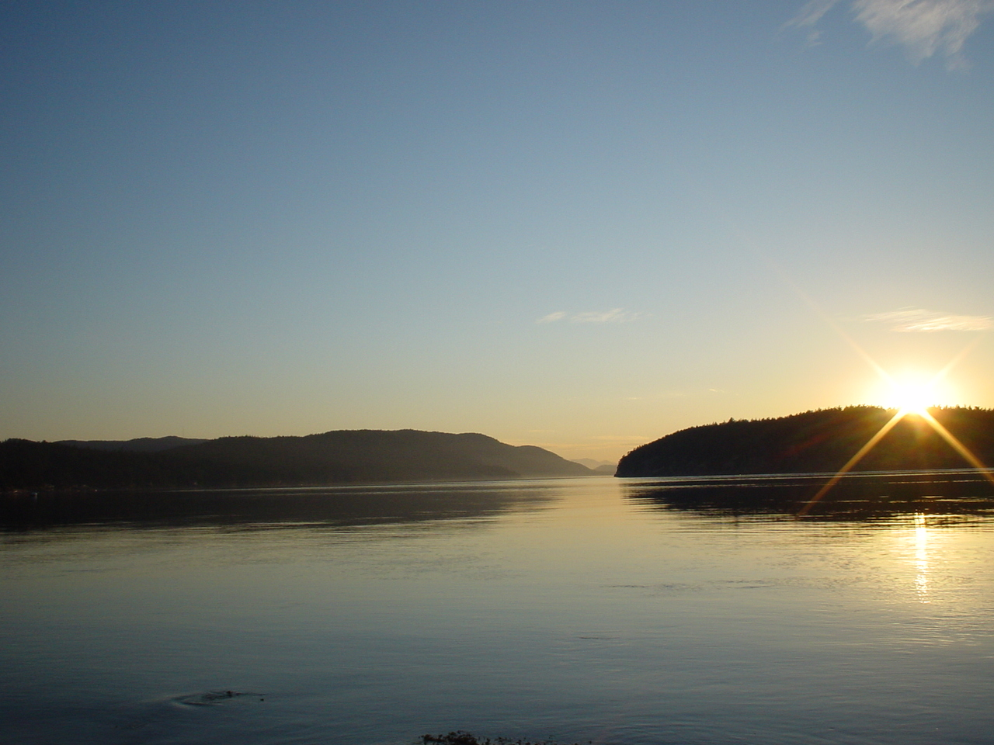


Thank you for your attention

Slide 20
