Slide 1

Green Capitalism
Sustainable and Profitable Use of Resources
Professor Hannes H. Gissurarson
Freedomfest, Las Vegas 17 July 2019

Slide 2
Two Kinds of Environmentalism
Wise Use Environmentalism: Resources (including seemingly non-economic ones such as pleasure from watching wildlife) should be used in a sustainable and profitable way
Ecofundamentalism: ‘Nature’ has intrinsic value, trumping human rights, the goal being preservation rather than conservation
Essentially a secular and atavistic religion, with sacred cows and implausible arguments

Slide 3
Pricing is Not Enough
Pigou proposed pricing, government taxes or tolls, to ‘correct’ externalities, harmful effects for others of economic activities
Knight and Coase answered that individuals could perhaps correct externalities in their transactions, if transaction costs were low
For this, clearly defined property rights necessary
Property rights: resources taken into custody, custodians apppointed: protection needs protectors

Slide 4
Who Pays for Preservation?
Ecofundamentalists demand ban on certain economic activities (use of DDT, whaling, ivory trade, etc.)
Wise use environmentalists: the conflict not between nature and man; it is between two groups of people one of which speaks in the name of nature
Examples: Wolves in the Alps killing sheep; Icelandic sea eagle threatening eider duck that produces valuable eiderdown for coastal farmers
Two uses, sometimes incompatible, of same resource: sheep to feed wolves or to feed and clothe man? Eider to feed eagles or to produce eiderdown?

Slide 5

Silent Spring, DDT and Malaria

Slide 6
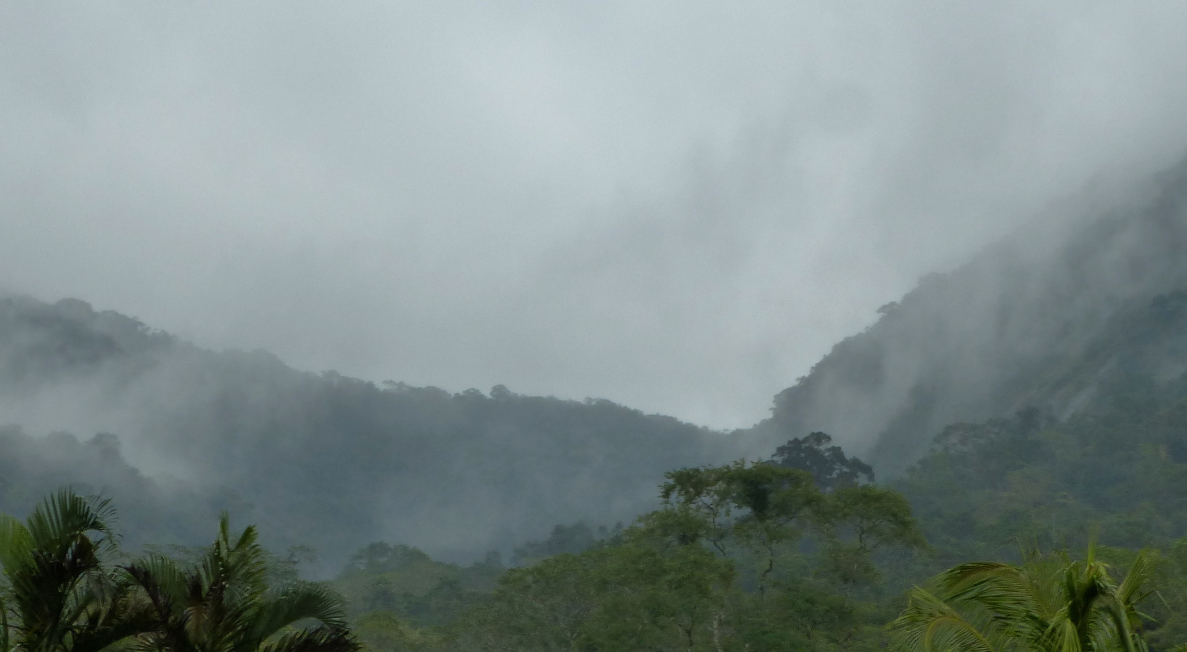
Rain Forests, Biodiversity and Oxygen

Slide 7
Overfishing: ‘Tragedy of Commons’
Overfishing (in an economic sense) is caused by unlimited access to limited resource
Under open access effort increases up to the point where no more profit is to be had; not to the point where profit is maximised
In 1980s, Iceland (and New Zealand) developed a way of dealing with the problem: Individual Transferable Quotas in fisheries
A move from open to restricted access, definition of private use rights, enclosure of oceans

Slide 8
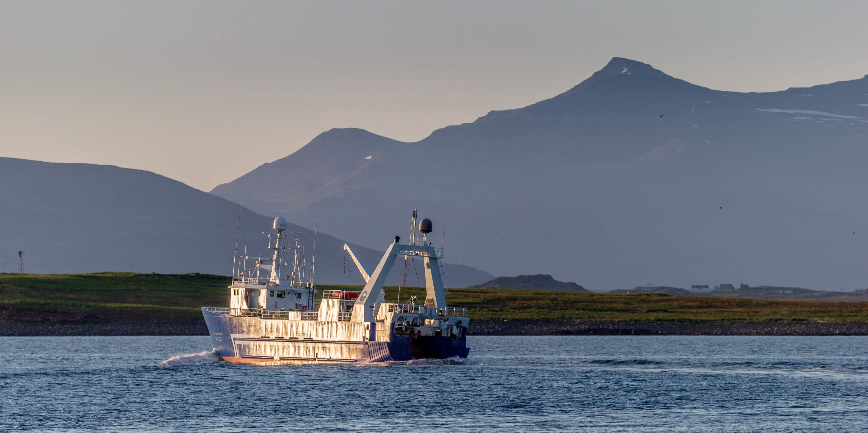
Fisheries: Sustainable and Profitable

Slide 9
The Whale: Ban or Use?
In past, whales overexploited, but today, some whale stocks robust, e.g. the two stocks Icelanders harvest (minke and fin whales)
Ecofundamentalists demand total ban on whaling, assigning special role to whales
Whales in Icelandic waters eat 6 million tonnes of seafood, while Iceland harvests 1 million tonne
Who should feed the whales to be preserved?
A similar problem: Mackarel in Icelandic waters

Slide 10
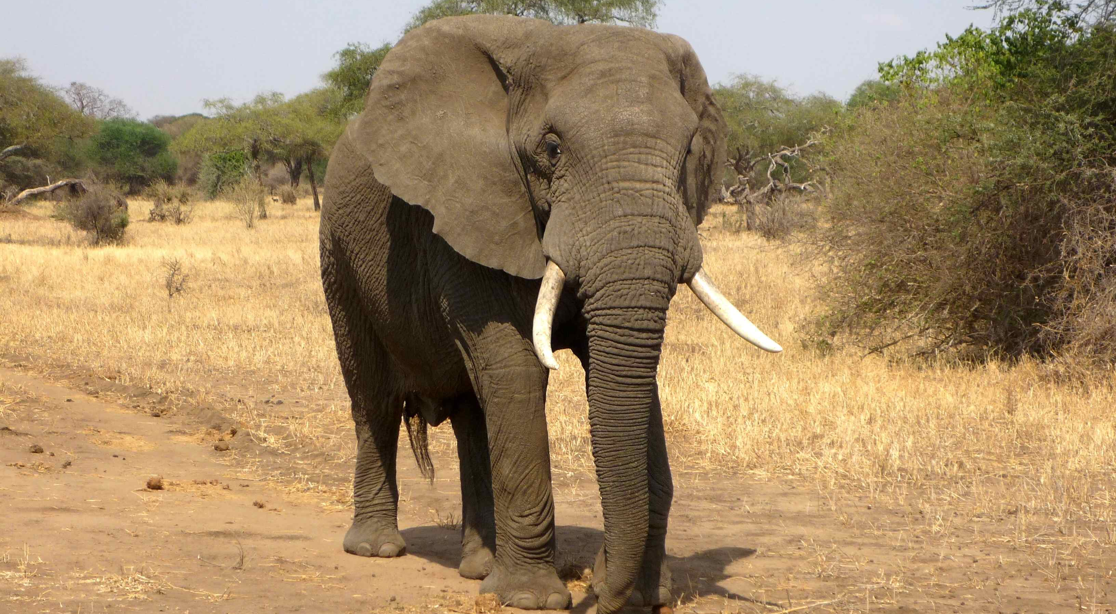
The Elephant: Ban or Use?

Slide 11


