Slide 1



Entrepreneurship as Key Engine of Economic Growth
October 4, 2025
Dr. Siri Terjesen
Florida Atlantic University
Norwegian School of Economics

Slide 2
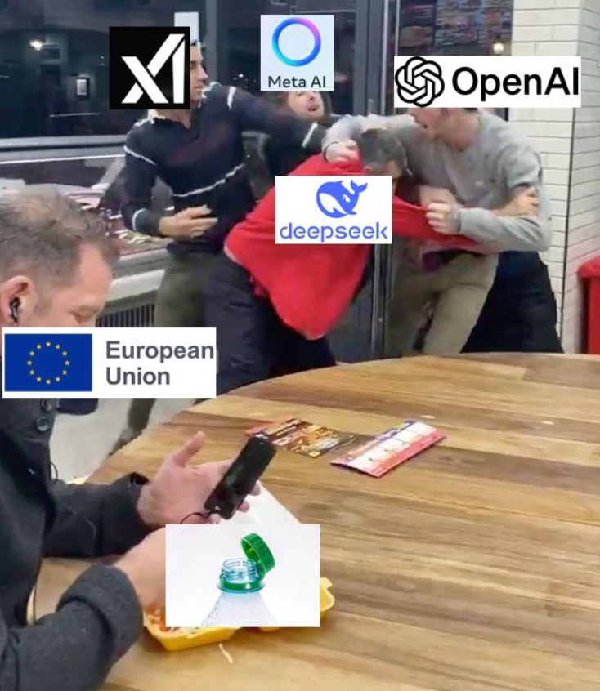
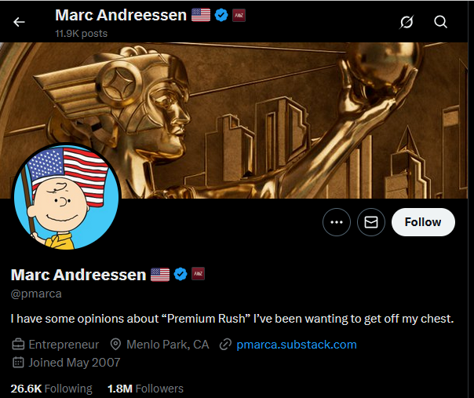

Slide 3
What is Entrepreneurship?
“Any type of start-up entrepreneurial initiative, including self-employment”

Slide 4
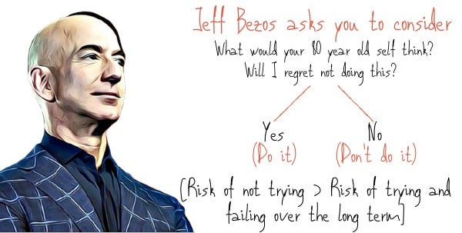
Regret Minimization Framework: Jeff Bezos

Slide 5
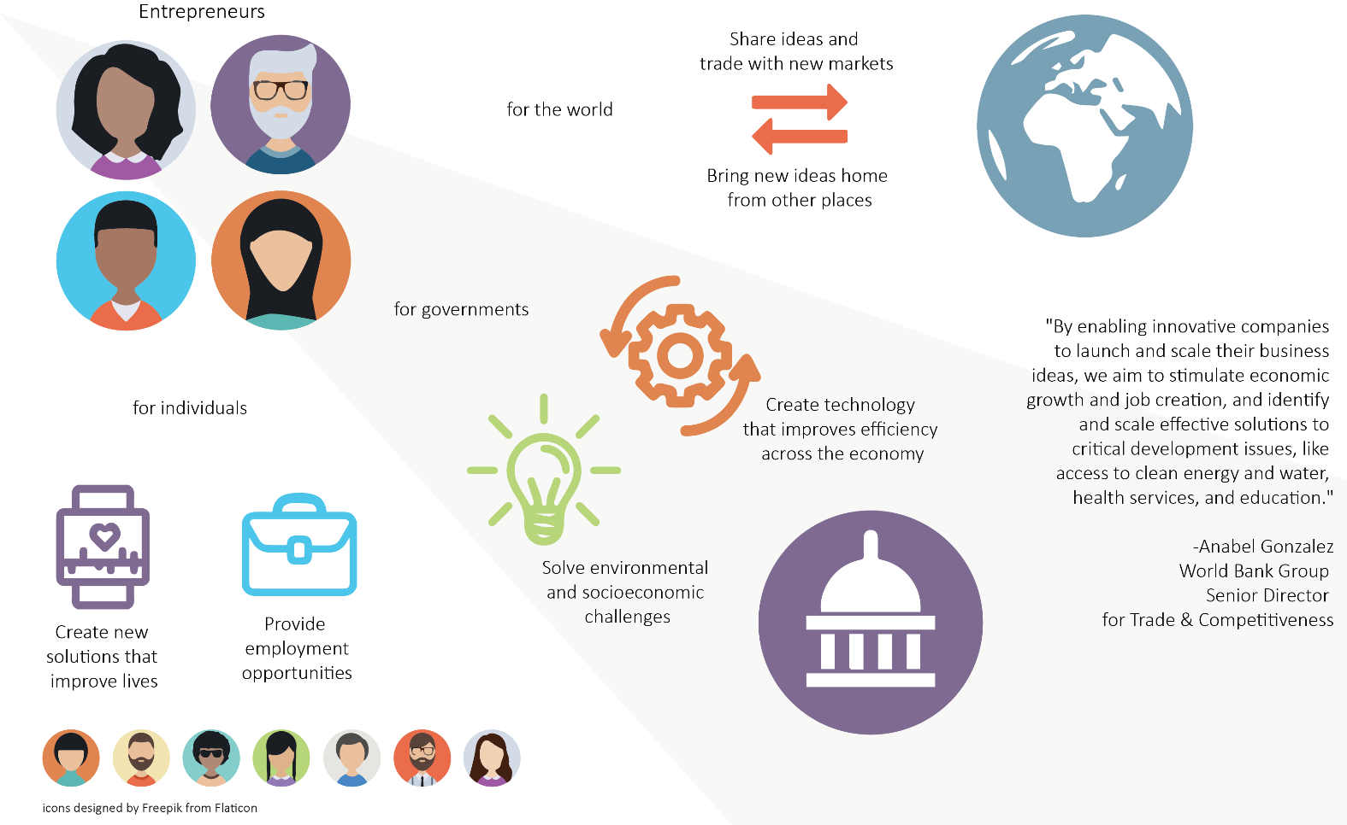

Entrepreneurs
Share ideas and trade with new markets
for
the world
Bring new ideas home from other places
for governments
for
individuals
Create technology that improves efficiency across the economy
Solve government failures
Solve environmental and socioeconomic challenges
Create new solutions that improve lives
Provide employment options

Slide 6



Entrepreneurs…
Are the happiest people on the planet, and
Take the best care of their parents in older age.

Slide 7
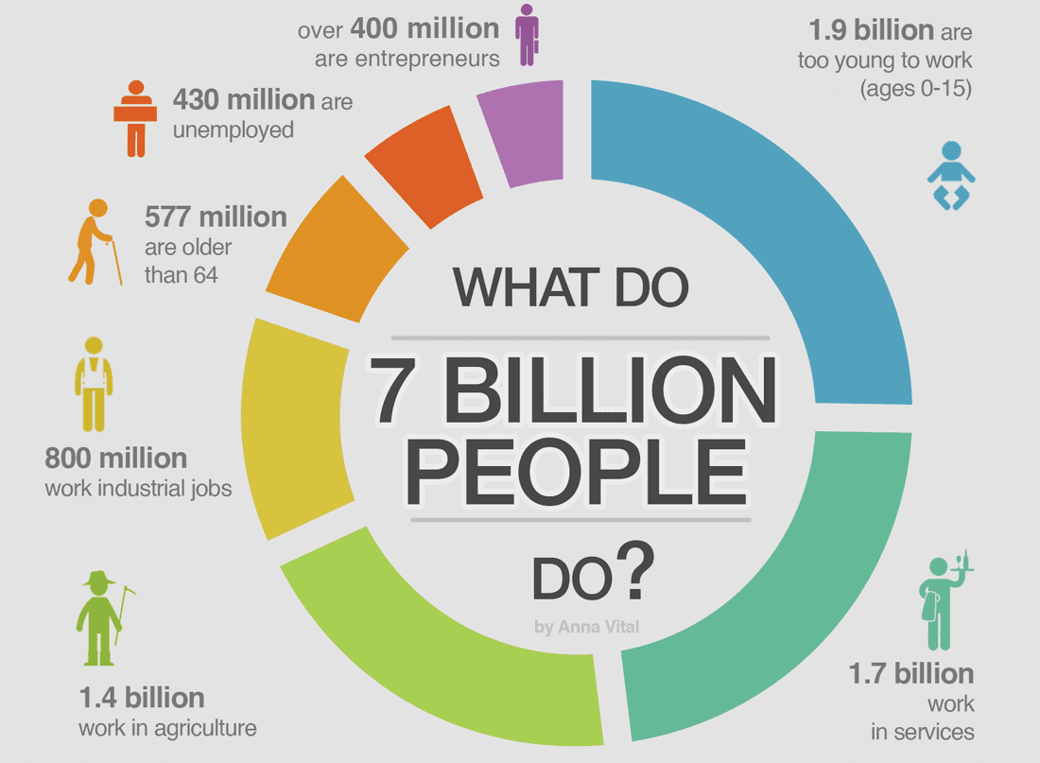
Source: https://www.lunarmobiscuit.com/wp-content/uploads/2018/05/How-many-Entrepreneurs.png; based on GEM, CIA, etc.

Slide 8


Each year GEM research teams survey over 180,000 people in more than 60 countries

Slide 9
Europe
Slovakia
Slovenia
Spain
Sweden
Switzerland
Turkey UK
North America
Belgium
Bulgaria
Croatia
Estonia
Finland
Germany
Greece
Hungary
Ireland
Italy
Latvia Luxembourg
Macedonia
Netherlands
Norway
Poland
Portugal
Romania
Canada
United States
Africa
Asia & Oceania
Latin America & Caribbean
Botswana
Burkina Faso
Cameroon
Egypt
Morocco
Senegal
South Africa
Tunisia
Australia
China
India
Indonesia
Iran
Israel
Japan
Kazakhstan Lebanon
Malaysia
Philippines Rep. of Korea
Taiwan
Thailand
Turkey
Vietnam
Argentina
Barbados
Brazil
Chile
Colombia
Ecuador
Guatemala
Mexico
Panama
Peru
Puerto Rico Uruguay

Slide 10
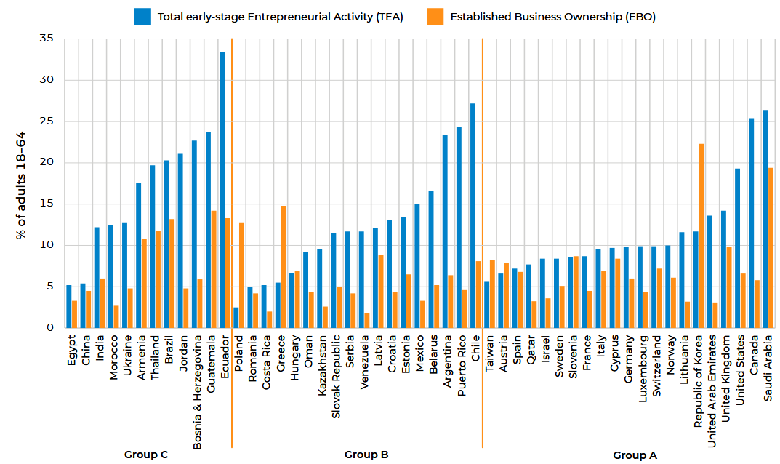

Source: https://www.gemconsortium.org/reports/latest-global-report

Slide 11
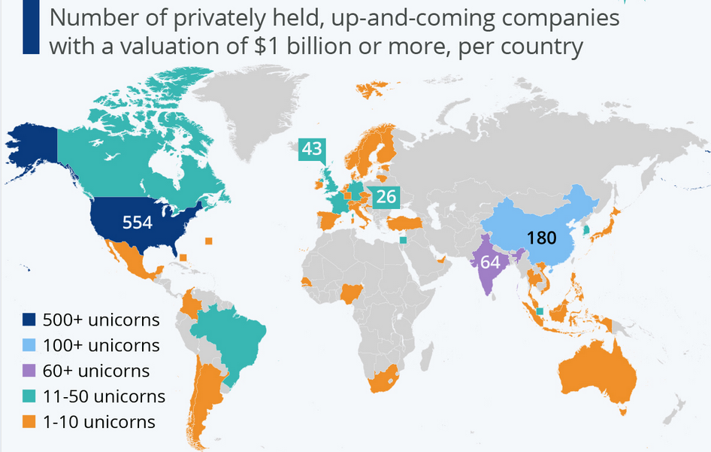

1
53
21
26
30
656
168
14
25
71
17

Slide 12
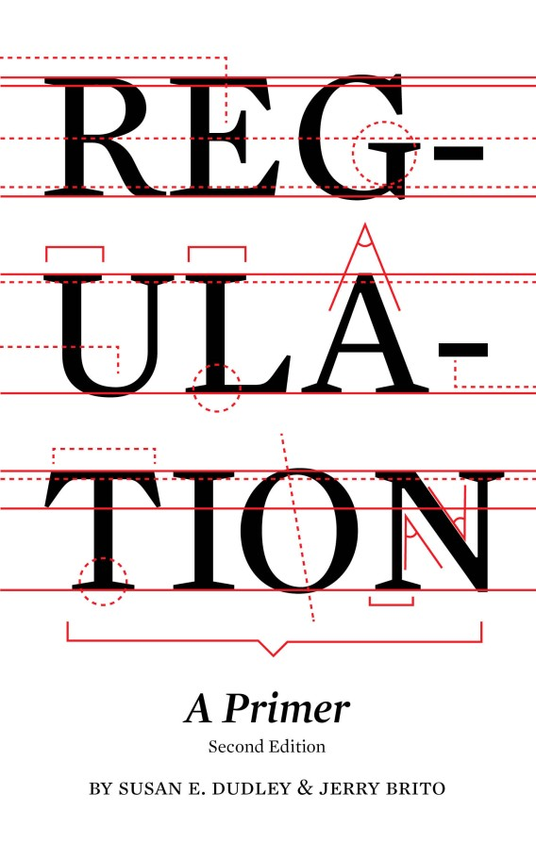
What is Regulation?
Regulations, also called administrative laws or rules, are the primary vehicles by which the federal government implements laws and agency objectives. They are specific standards or instructions concerning what individuals, businesses, and other organizations can or cannot do. Market economies need clear rules to function efficiently.”
https://www.mercatus.org/research/books/regulation-primer

Slide 13









Slide 14
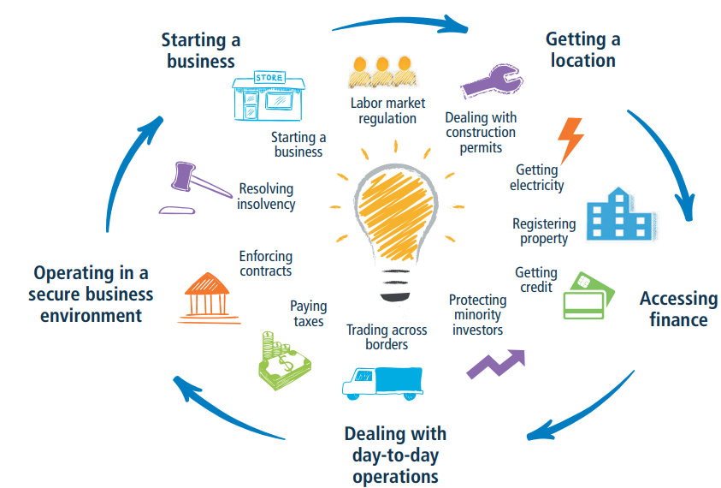

Slide 15
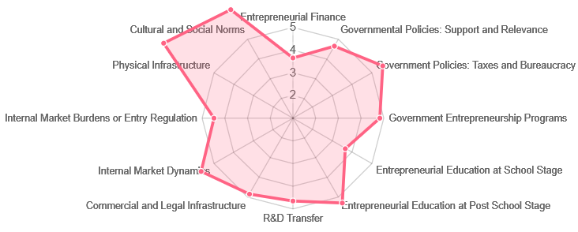
Iceland: Entrepreneurial Framework Conditions

Slide 16


Slide 17
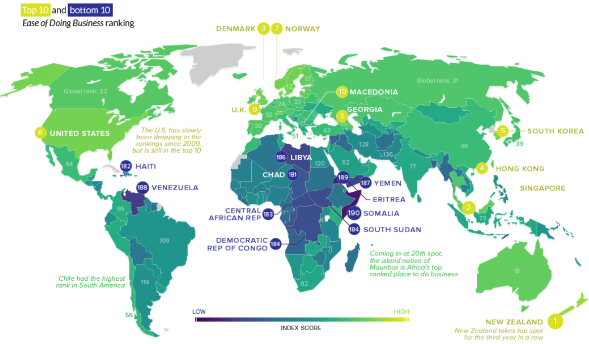

Iceland 26

Slide 18
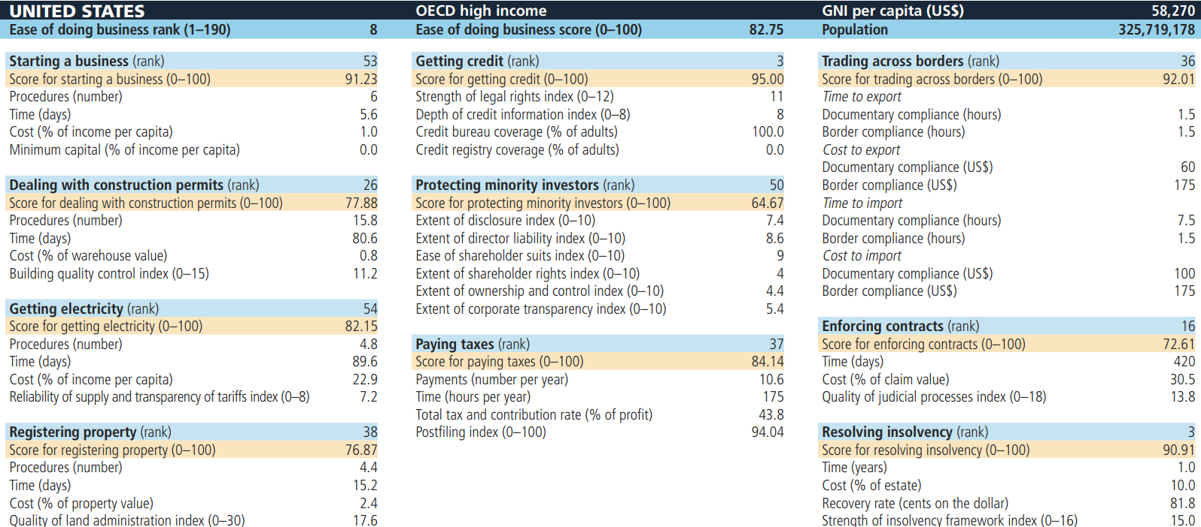

Ease of Doing Business: United States

Slide 19
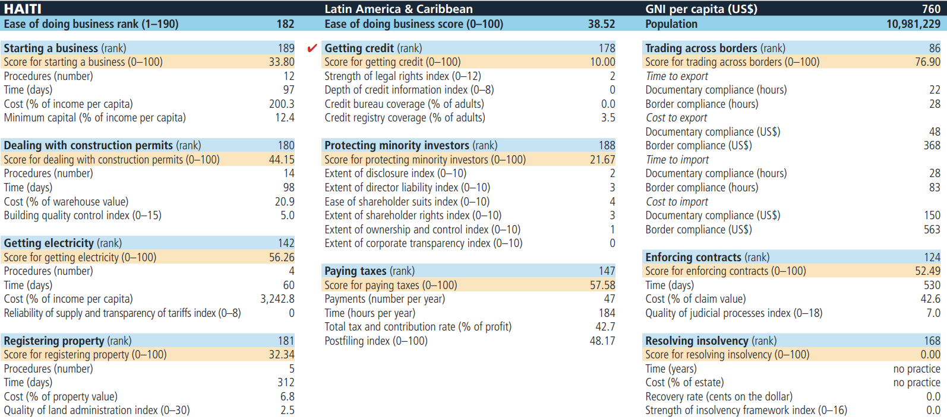

Ease of Doing Business: Haiti

Slide 20
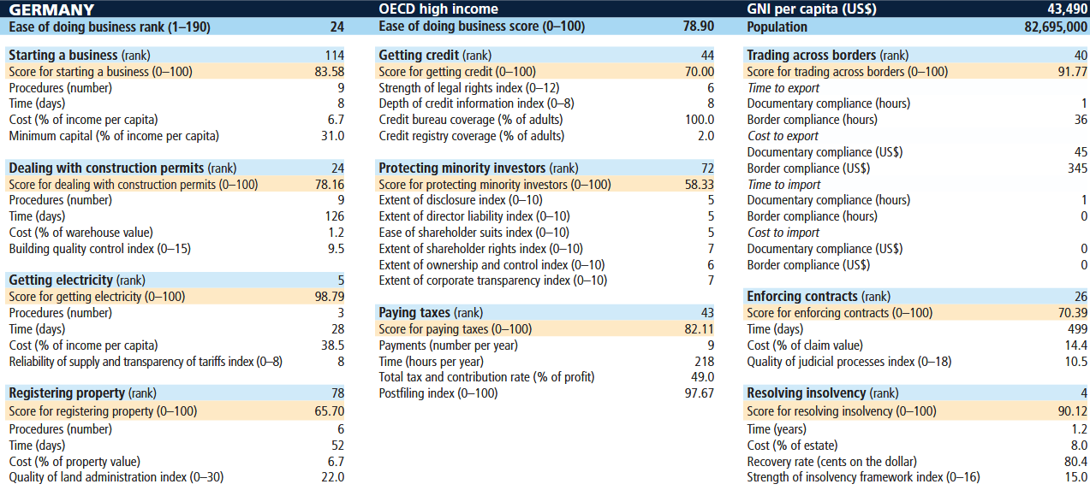

Ease of Doing Business: Germany

Slide 21
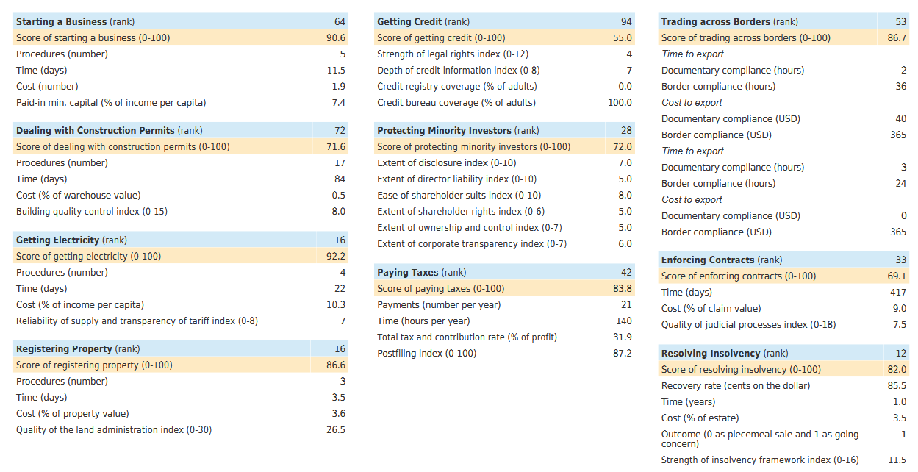

Slide 22

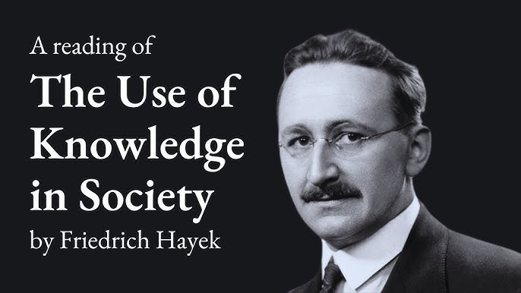

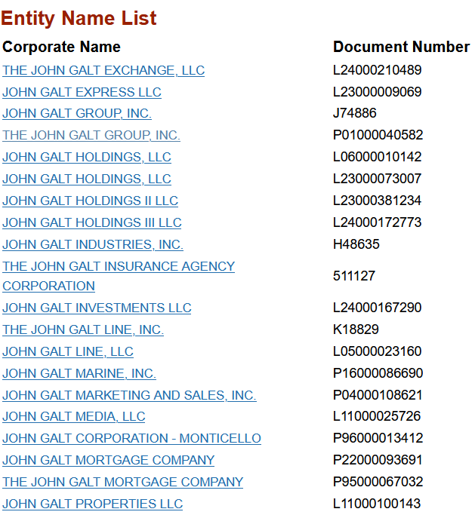



Classical Liberalism: Inspiration for Entrepreneurs

Slide 23

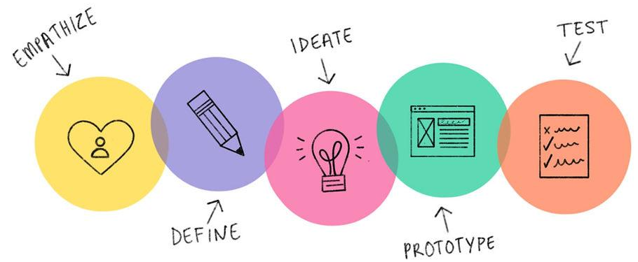
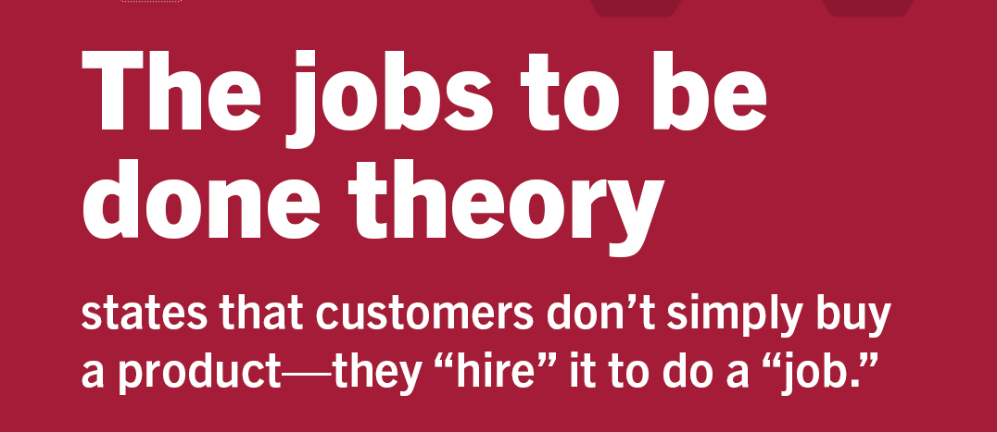


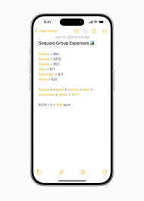
Take some Steps to Pursuing Entrepreneurship

Slide 24
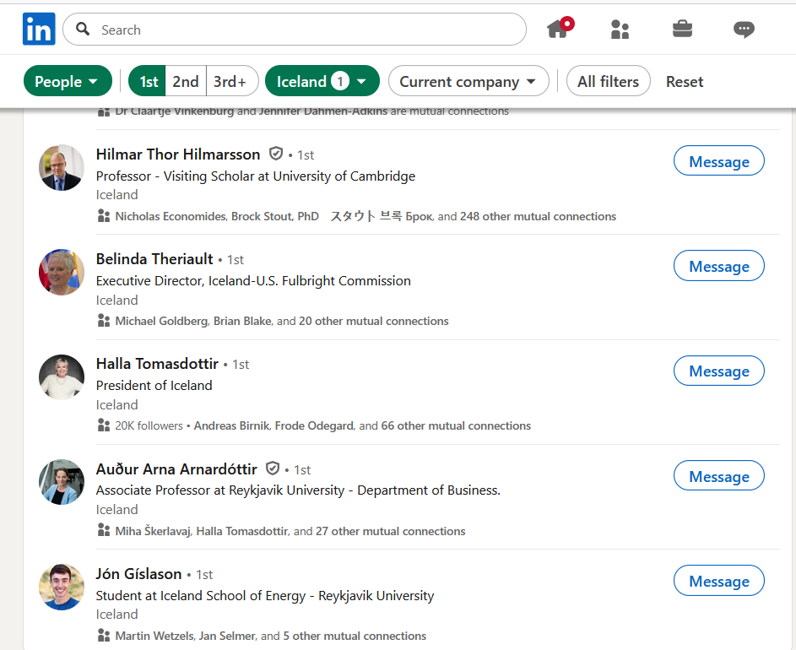
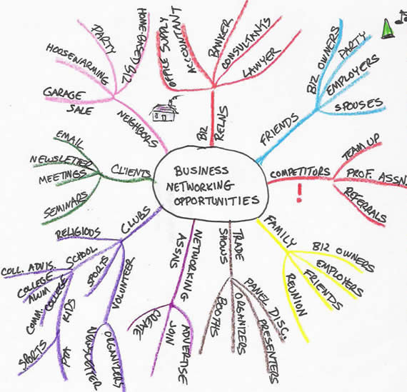
Build your Network

Slide 25
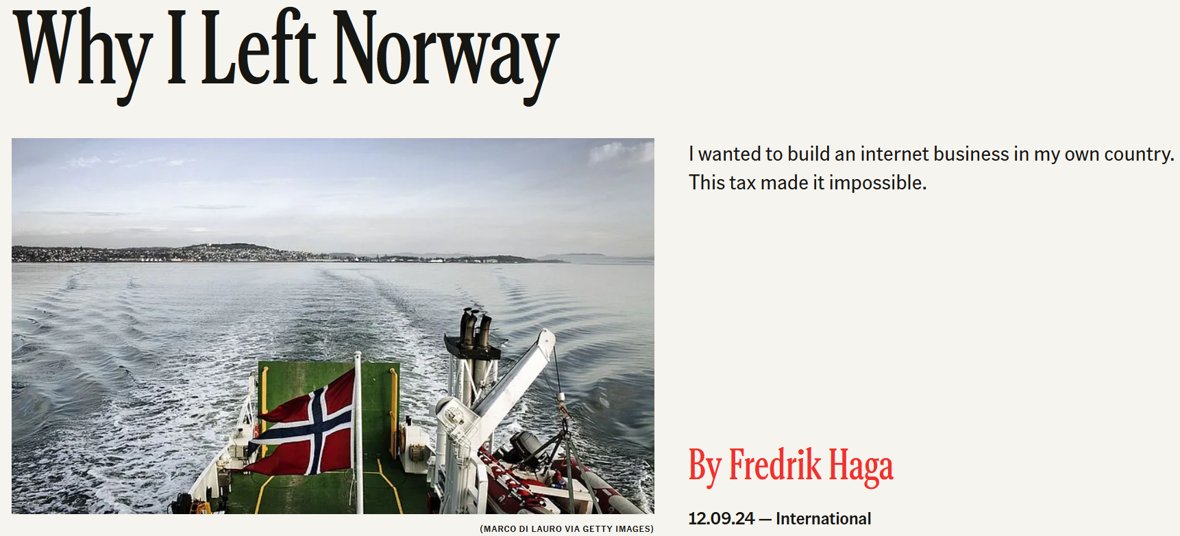

Source: https://www.thefp.com/p/why-i-left-norway-unrealized-gains-tax

Slide 26
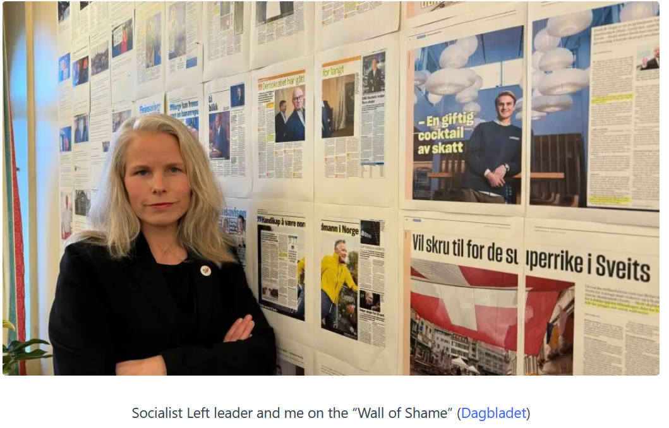

Slide 27

Thank you!
Dr. Siri Terjesen
sterjesen@fau.edu
Notes:
Thank you for this opportunity to speak with you about my research.

Slide 28


Slide 29
A few statistics about Germany last year
Over 1 billion work hours on state-mandated bureaucratic tasks
Costs German businesses €146 billion
Economic, financial & tax legislation doubled since 2009

Slide 30
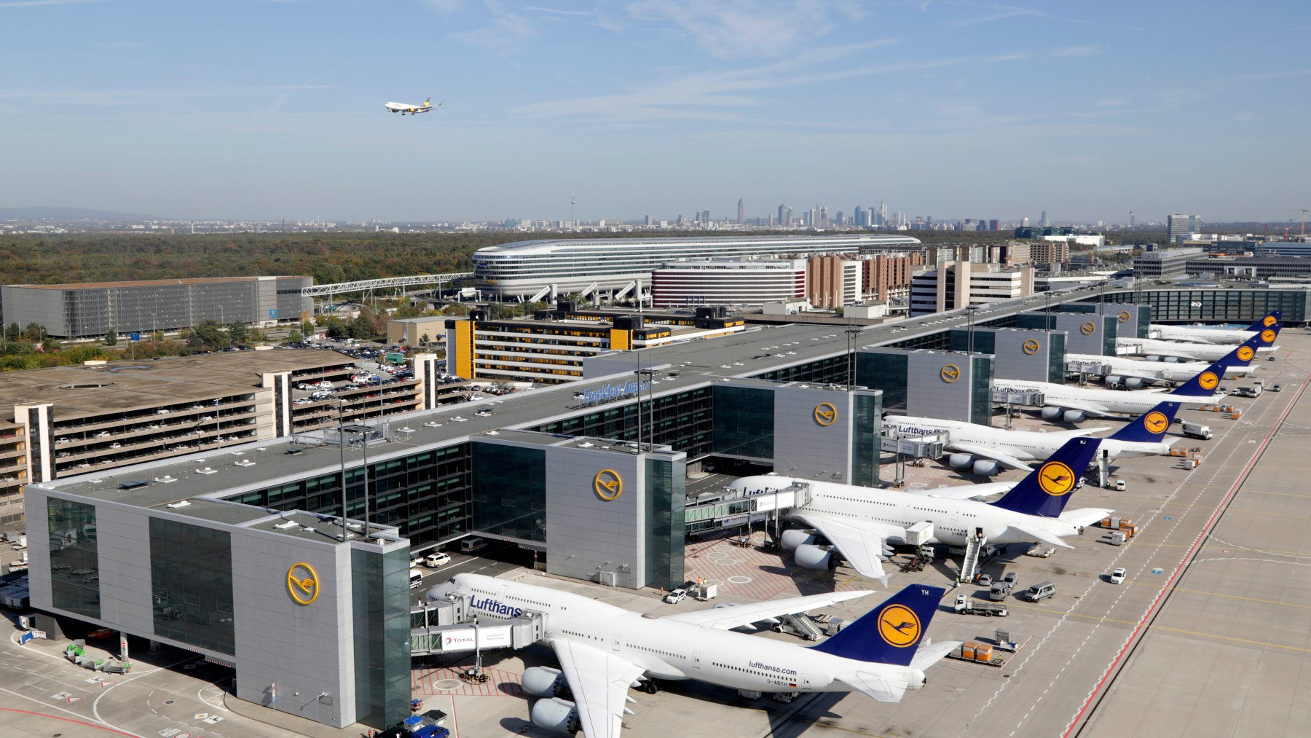

Slide 31



Slide 32


Slide 33


Slide 34
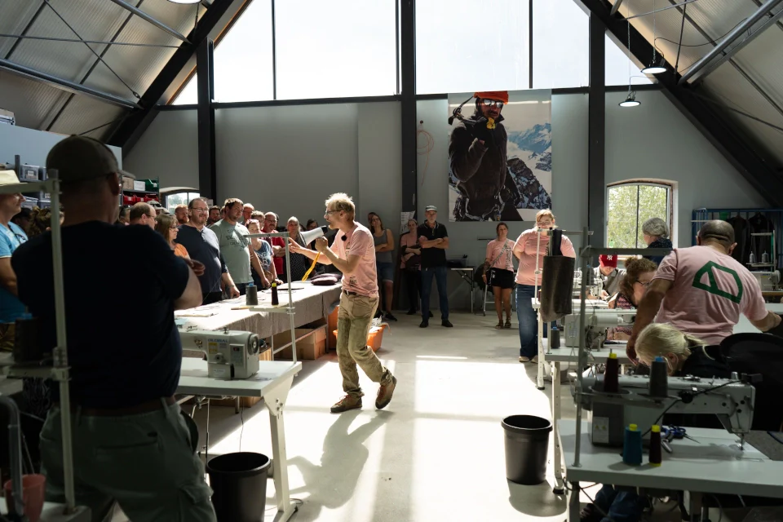

Slide 35


Slide 36
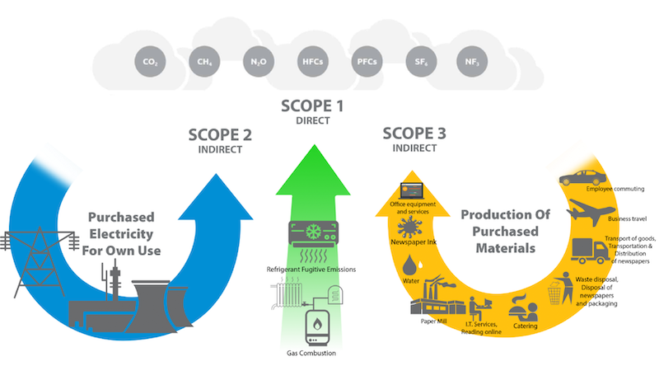
Scope 1 & 2 Emissions

Slide 37
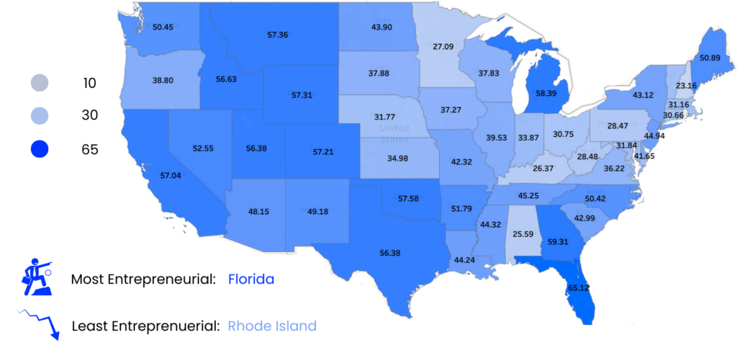
Entrepreneurial states by % population starting business, active start-ups, small businesses per 100,000 people & growth rate of new business applications

Slide 38
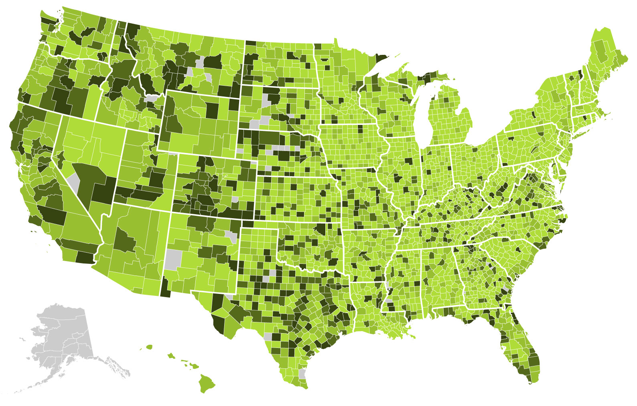
Number of net new jobs created at firms aged 0-1 years old per 1,000 people
Source: https://indicators.kauffman.org/

Slide 39
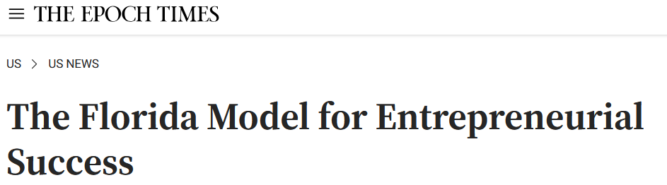
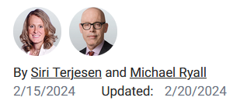
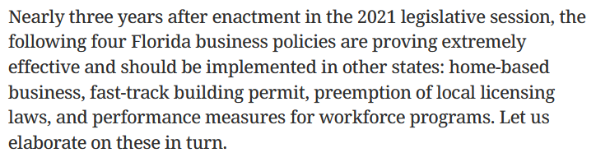

Slide 40




Home-based businesses
Many firms start at home
Create 64% of new jobs
Enable financial independence

Slide 41
Other Florida legislature entr-friendly regulations
Fast-track business permits
Pre-emption of local licensing (occupational licensing is a 3-16% tax on consumers)
Performance measures for workforce programs

Slide 42
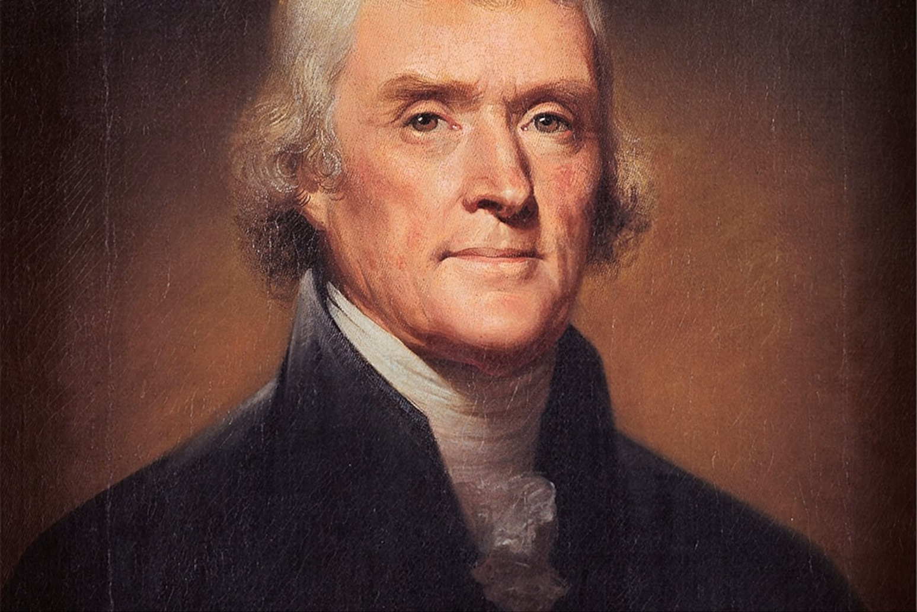
Founding fathers understood states to be key sources of policy innovation
“The way to have good and safe government, is not to trust it all to one, but to divide it among the many, distributing to every one exactly the functions he is competent to.”
– Thomas Jefferson

Slide 43
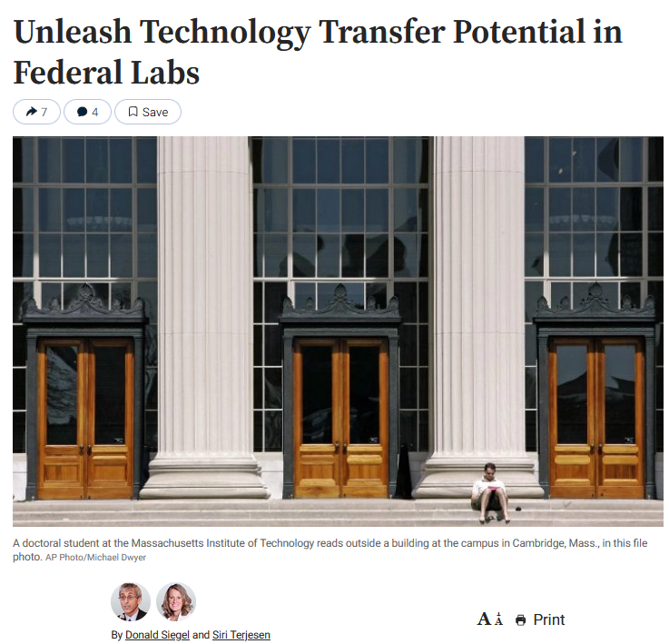
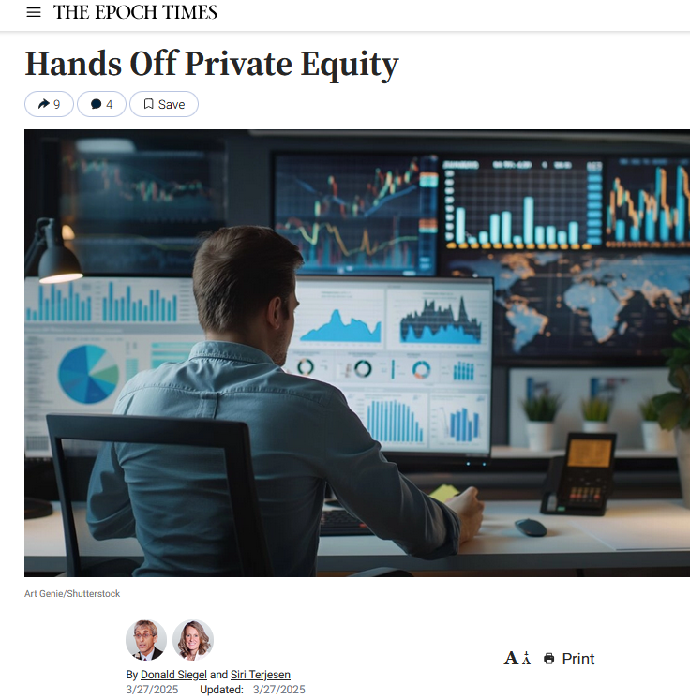
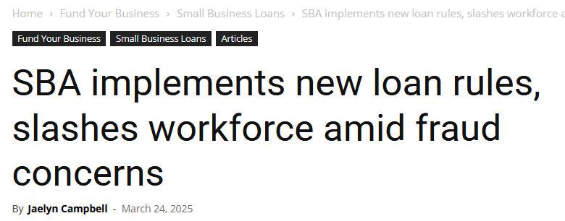
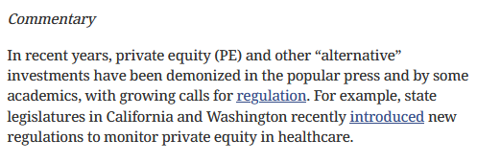
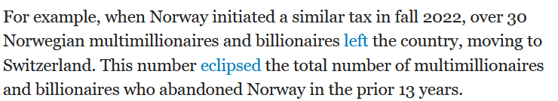
Proposed 25% tax on Unrealized Gains (Sept 2024):

Slide 44
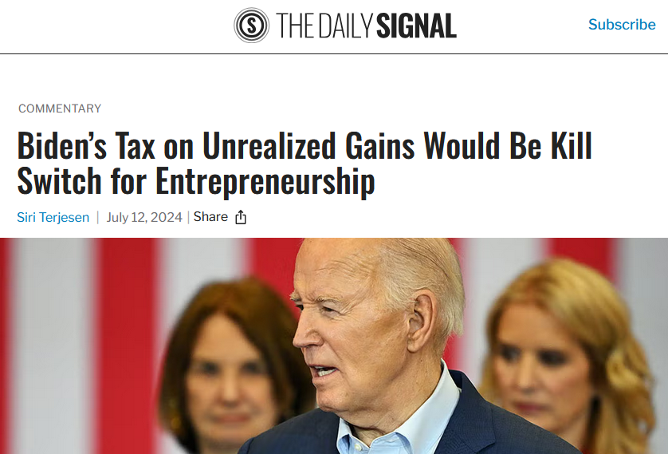
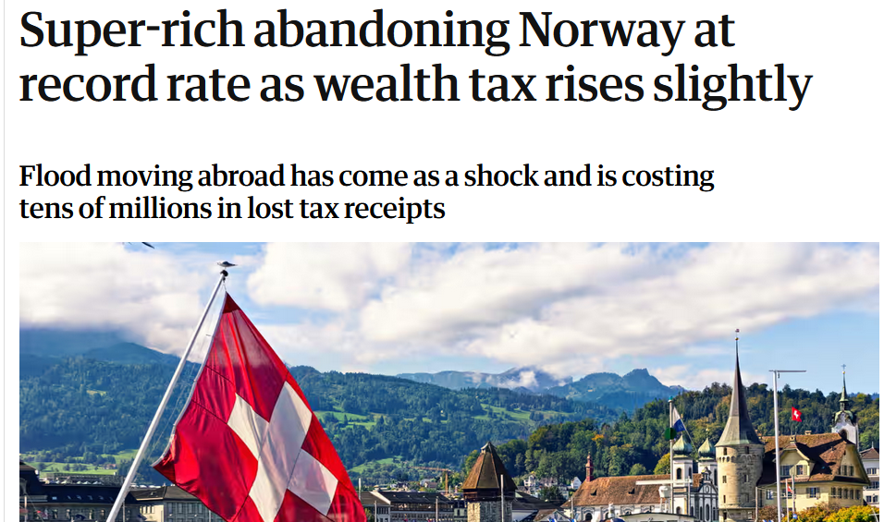
Proposed Legislation: Tax on Unrealized Gains

Slide 45
A Framework of the Effect of Government Policy on Entrepreneurship
Enabling Policies
Funding
Taxes and incentives
Labor market
Economic freedom
Ecosystem support
Entrepreneurial activity
Entrepreneurial outcomes
Survival
Growth
Innovation
Profitability
Constraining Policies
Regulatory burden
Regulatory uncertainty
Government institution policy
Government social policy

Slide 46
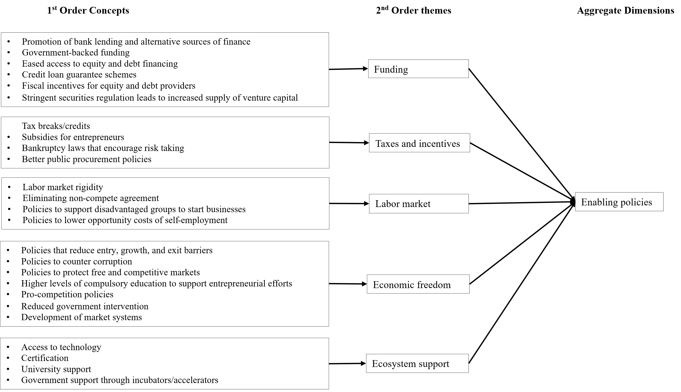

Slide 47
