Slide 1
Why has the EU Stagnated in Comparison with the US?
Iceland, 2025

Slide 2
Basic Message
The EU is poorer
The EU is growing slower
The EU has a statist orientation
The EU is a sinking ship

Slide 3
The U.S. vs. European Union
The good news is that both the U.S. and the E.U. are comparatively rich.
Both the U.S. and E.U. have comparatively high-quality governance.
But…
  Economic freedom score for the U.S. is 8.1
  Economic freedom score for the E.U. is 7.5 (7.7 if measuring pre-expansion members)

Slide 4
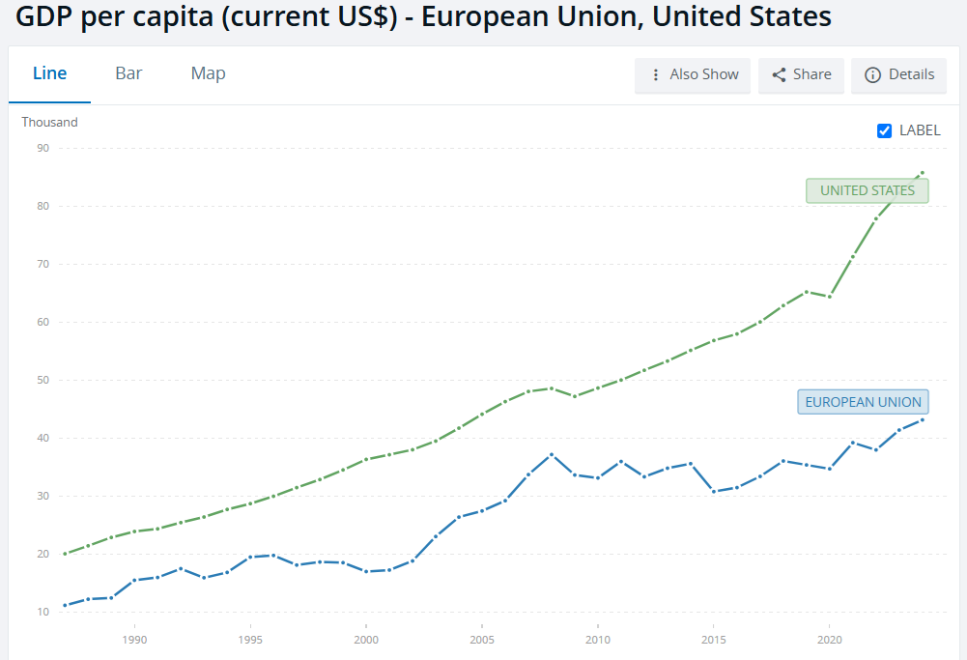
Part I: The U.S. Is Richer

Slide 5
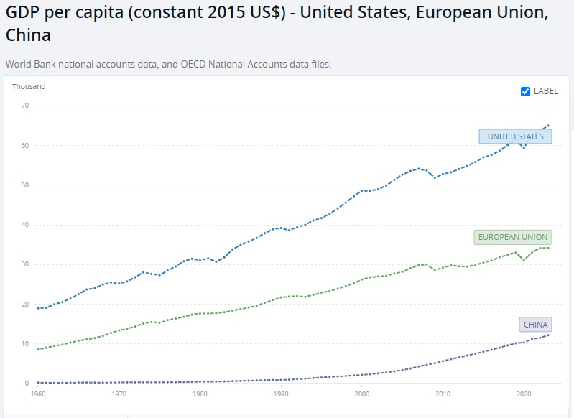

Slide 6
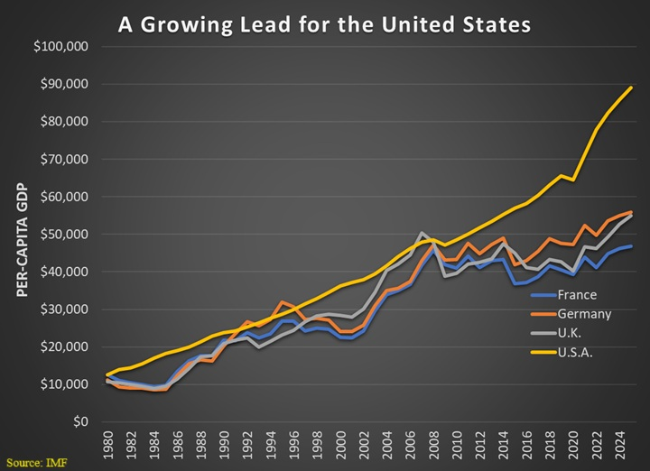

Slide 7
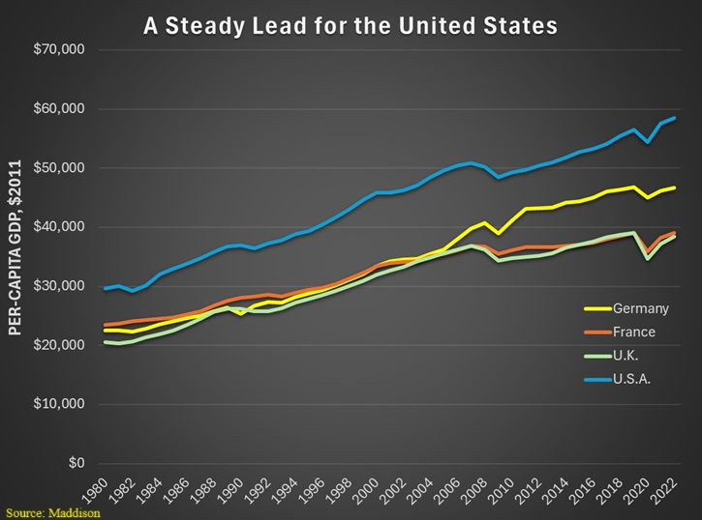

Slide 8
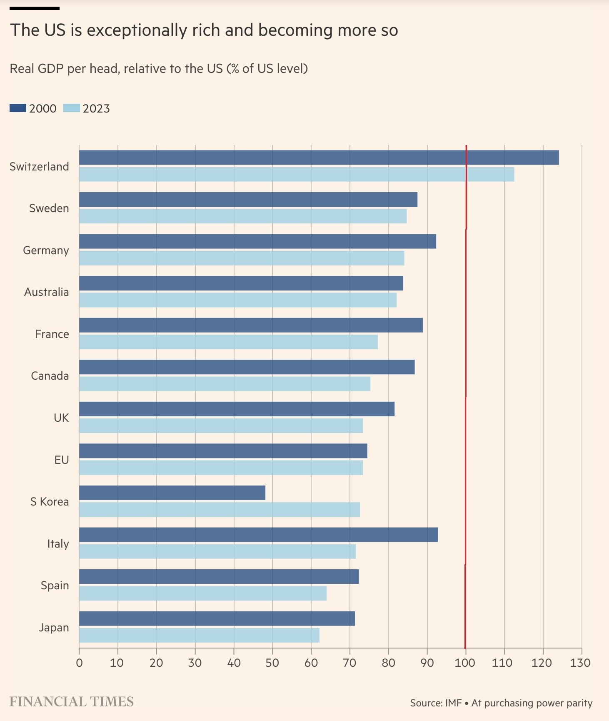

Slide 9
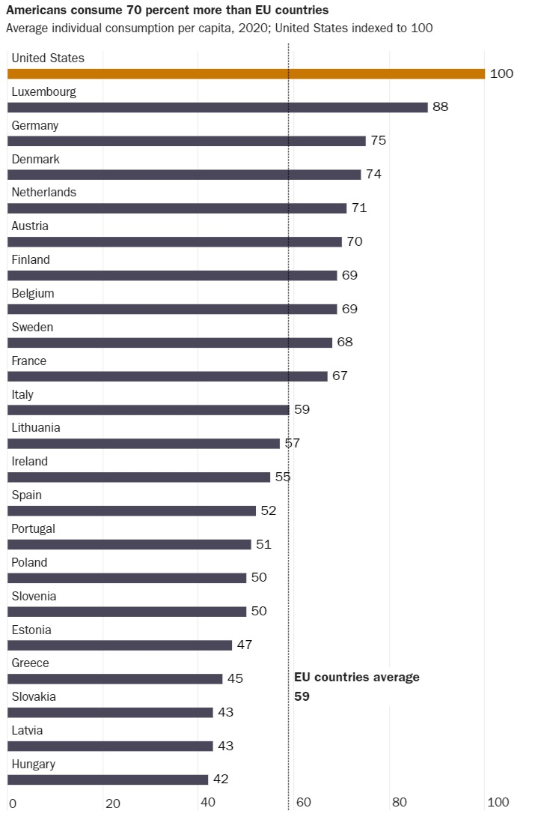

Slide 10
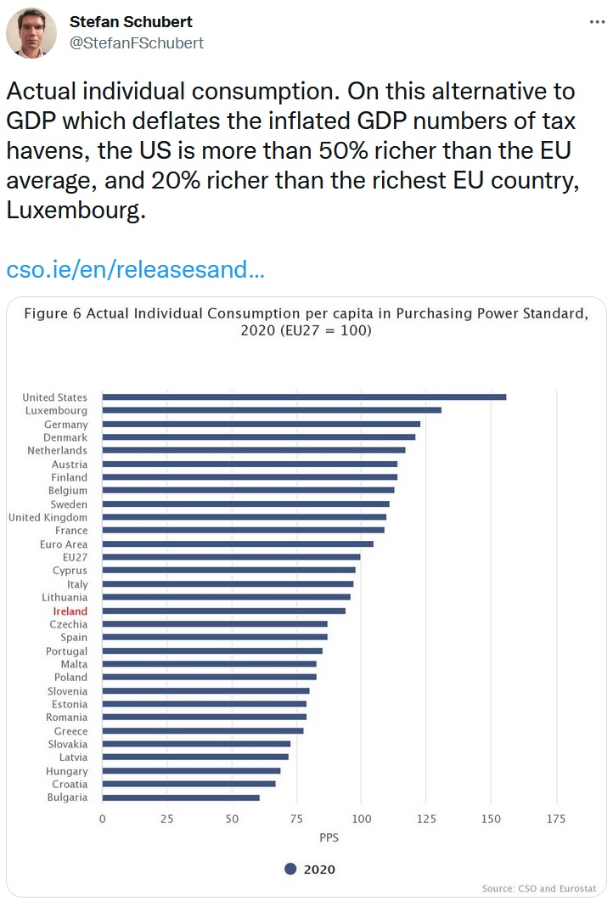

Slide 11
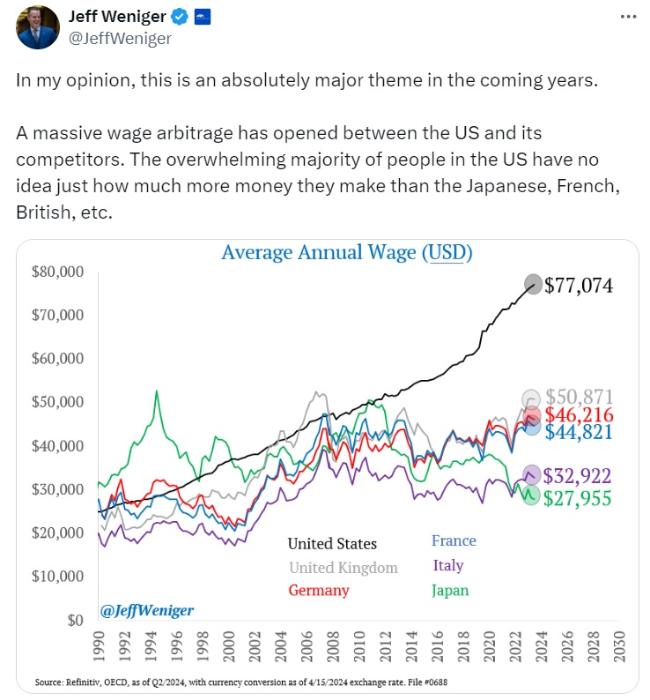

Slide 12
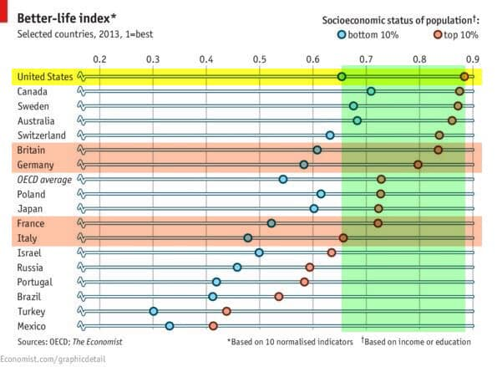

Slide 13
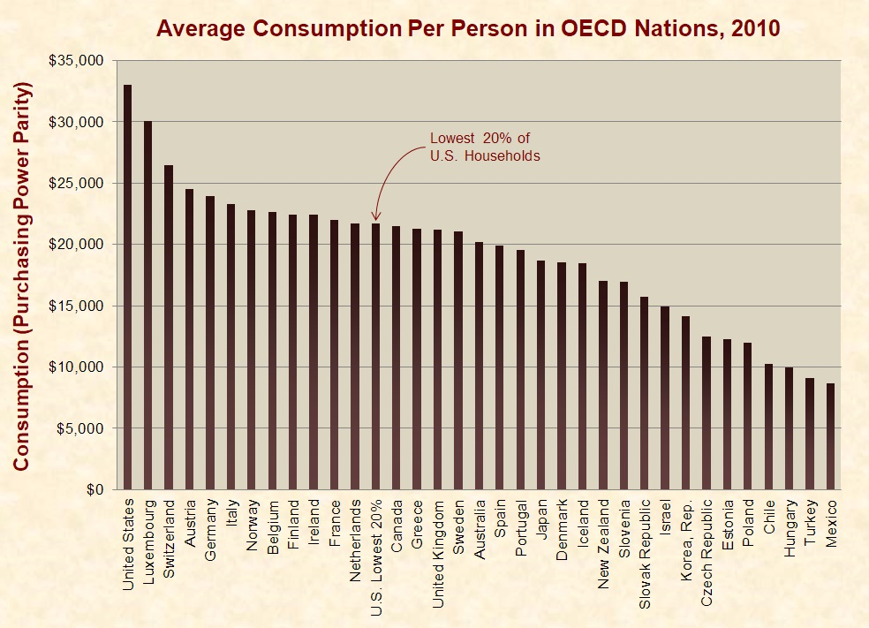

Slide 14
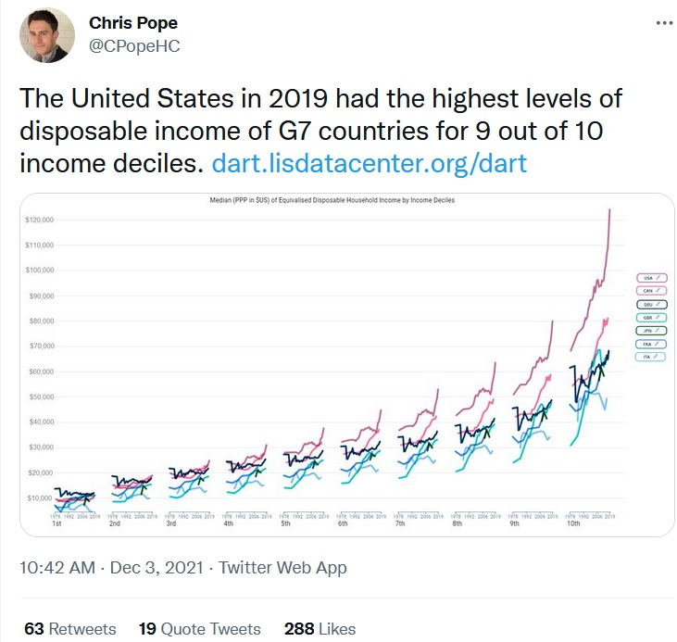

Slide 15
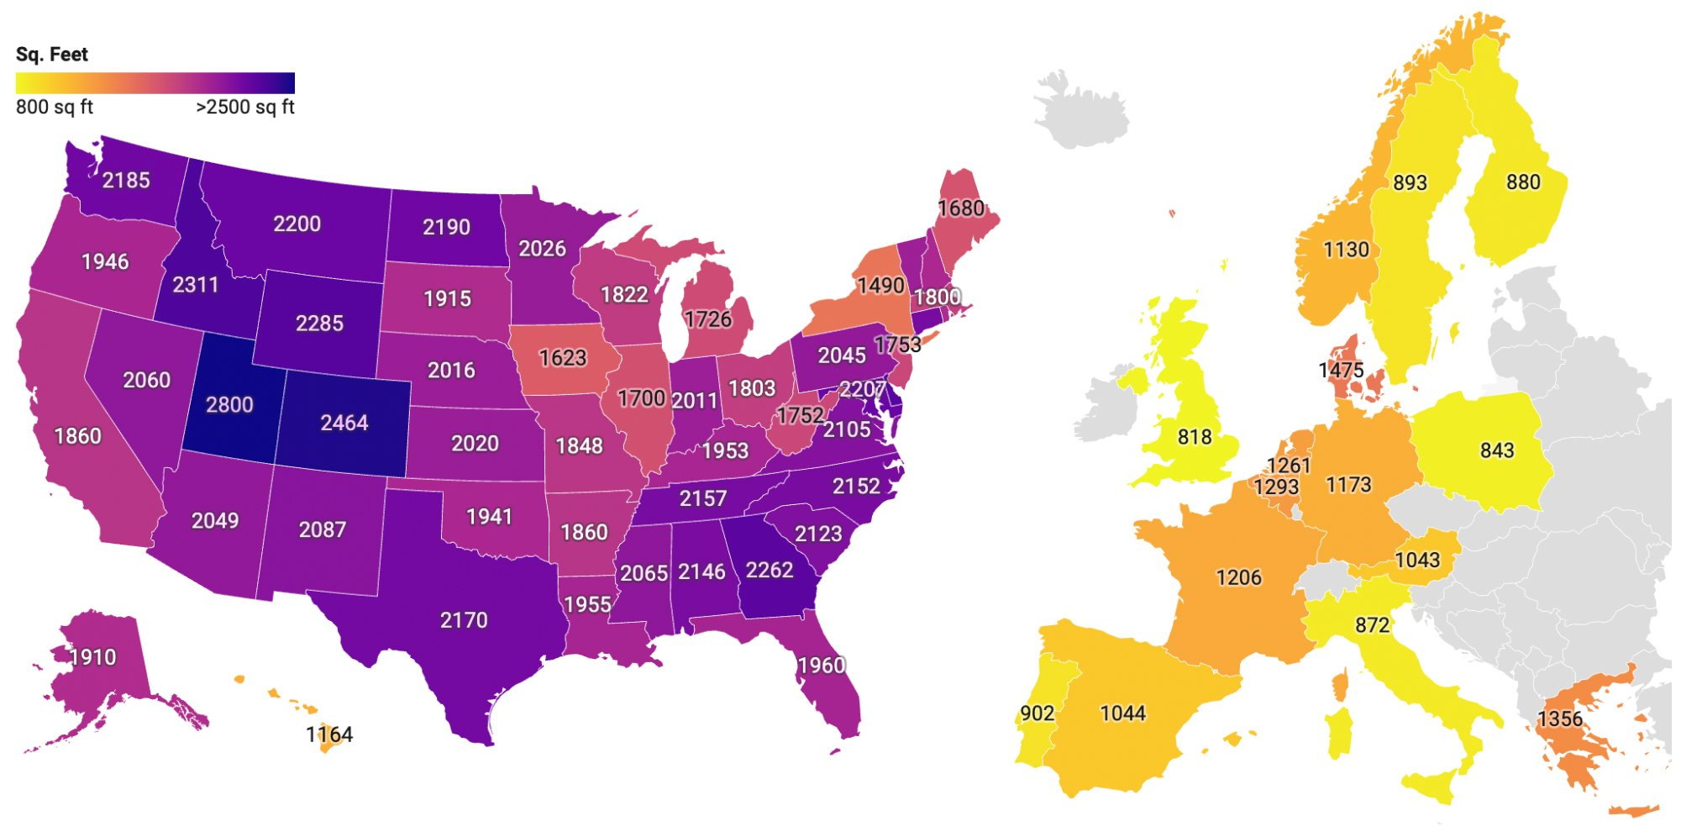

Slide 16
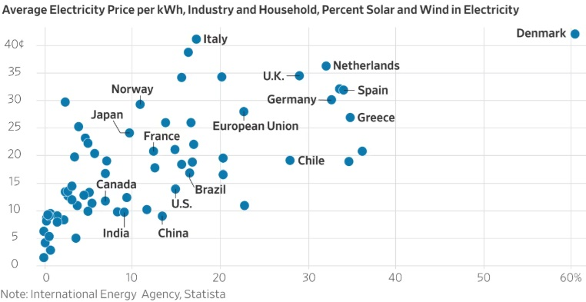

Slide 17
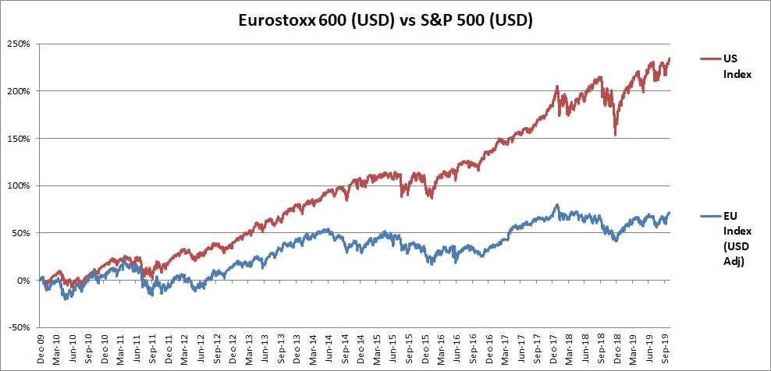

Slide 18
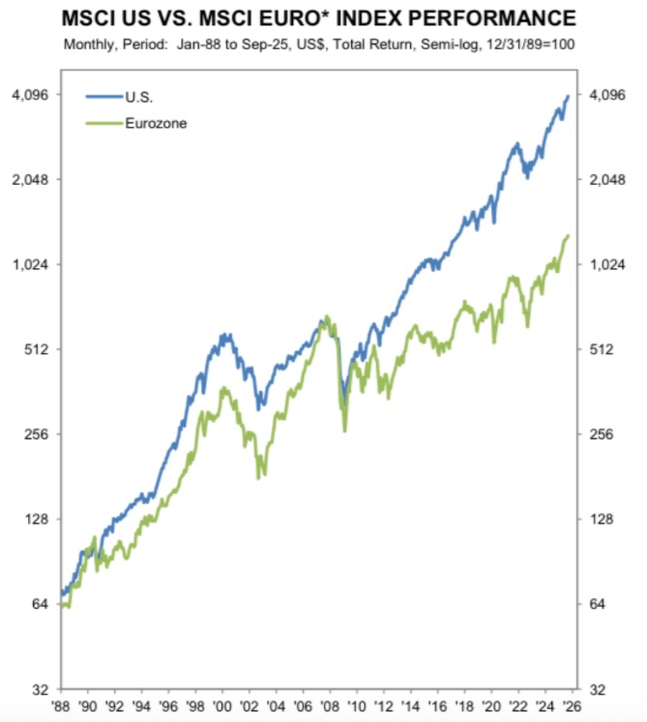

Slide 19
Part II: The U.S. Is Growing Faster
According to “convergence theory,” poorer nations should grow faster than richer nations.
Generally accurate description of how the world works.
But there are exceptions when nations have significant policy differences.

Slide 20
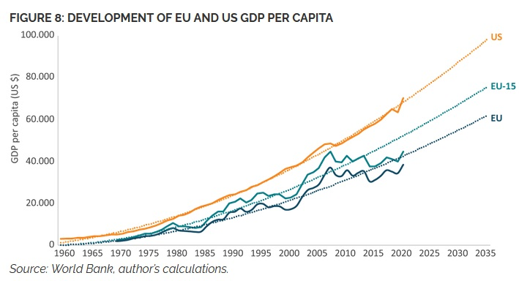

Slide 21
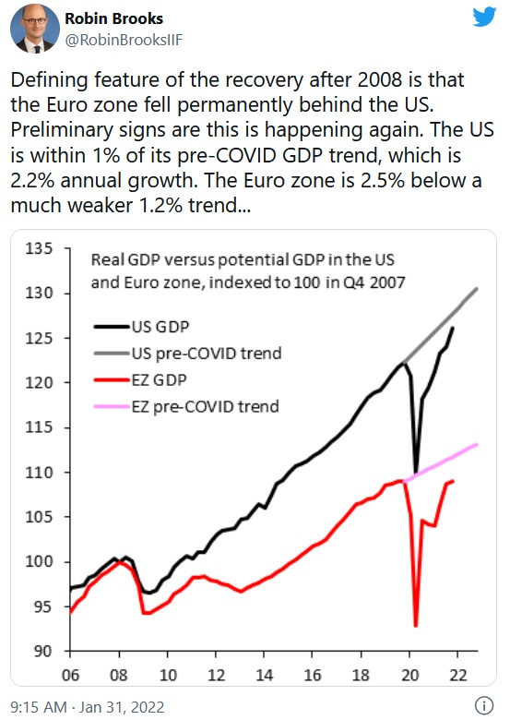

Slide 22
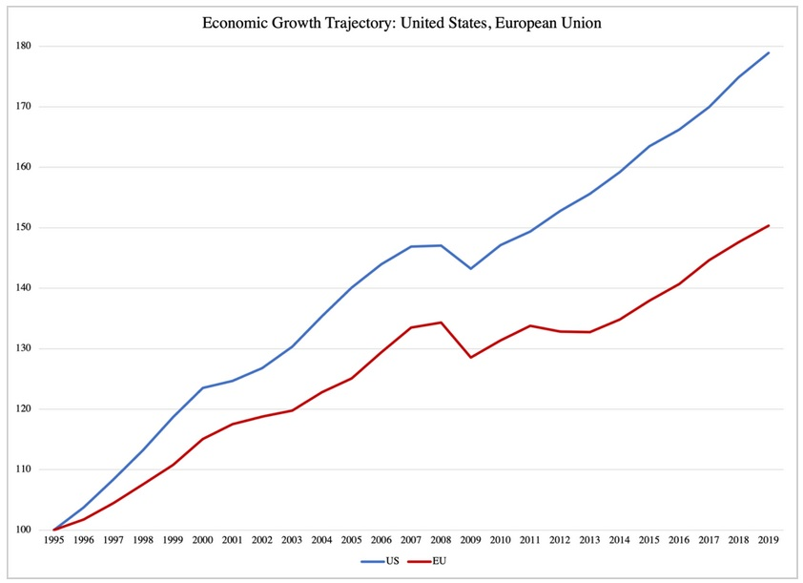

Slide 23
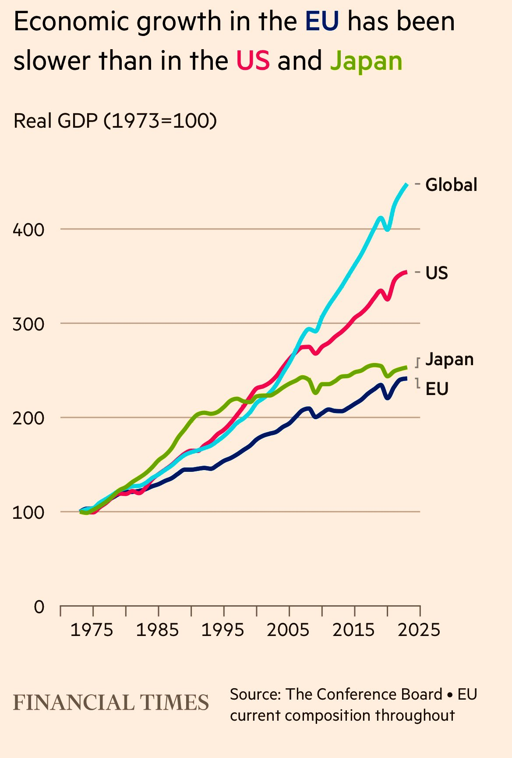

Slide 24
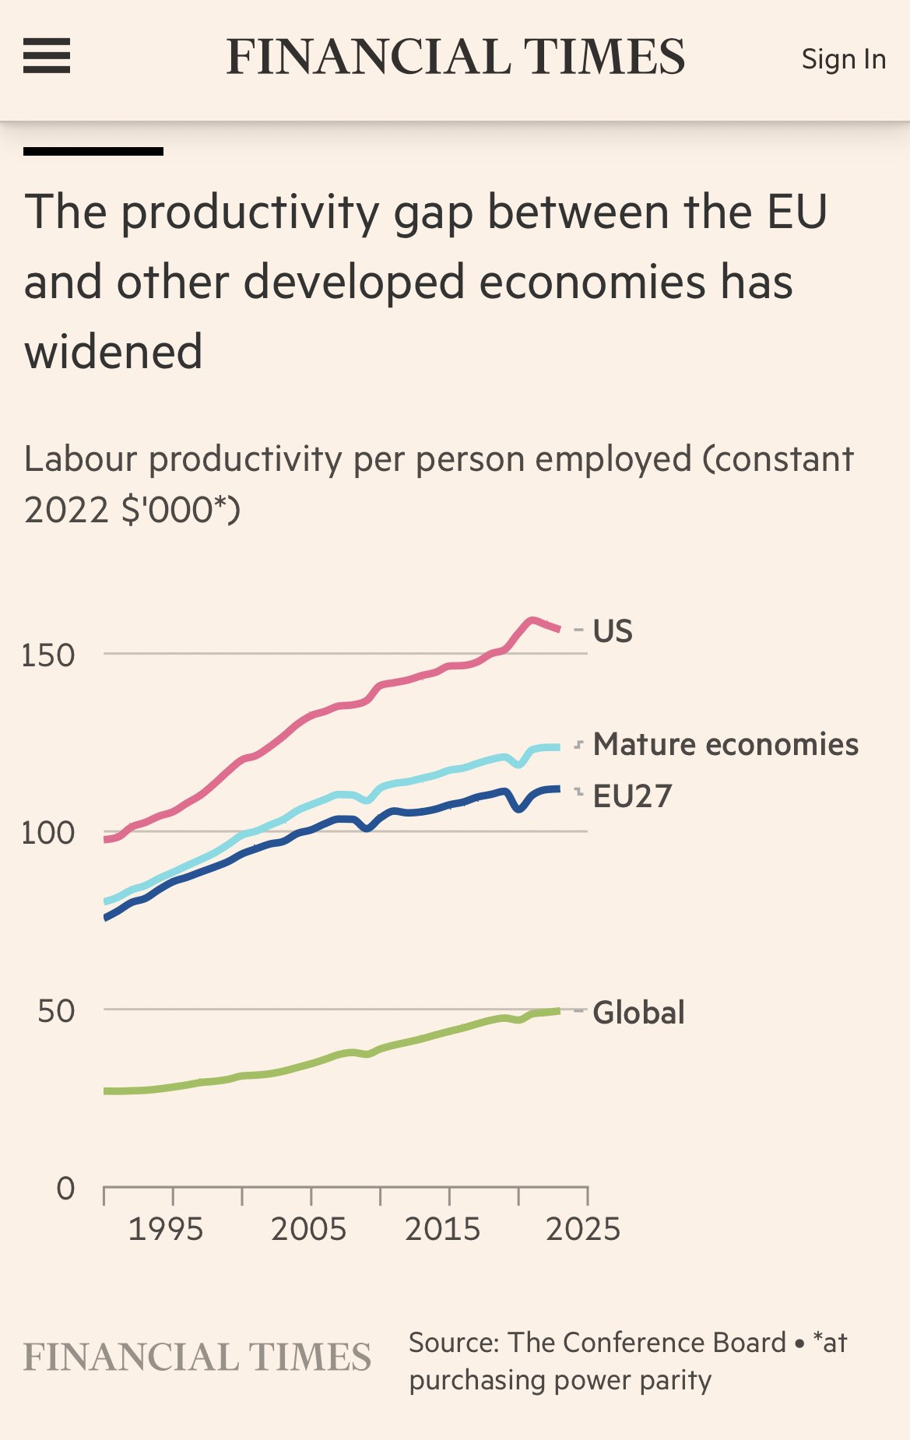

Slide 25
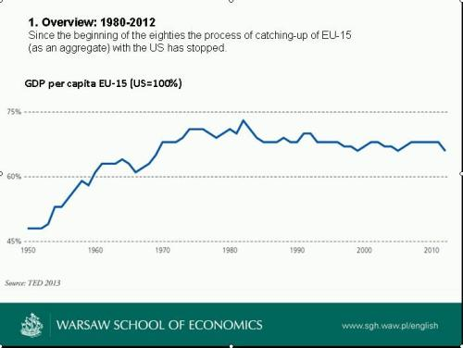

Slide 26
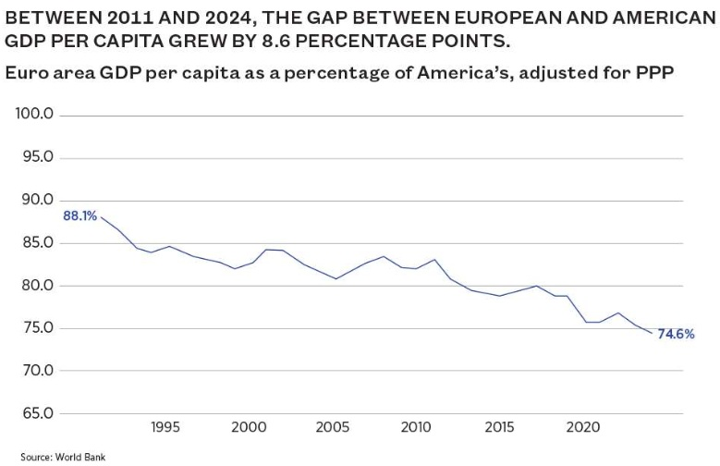

Slide 27
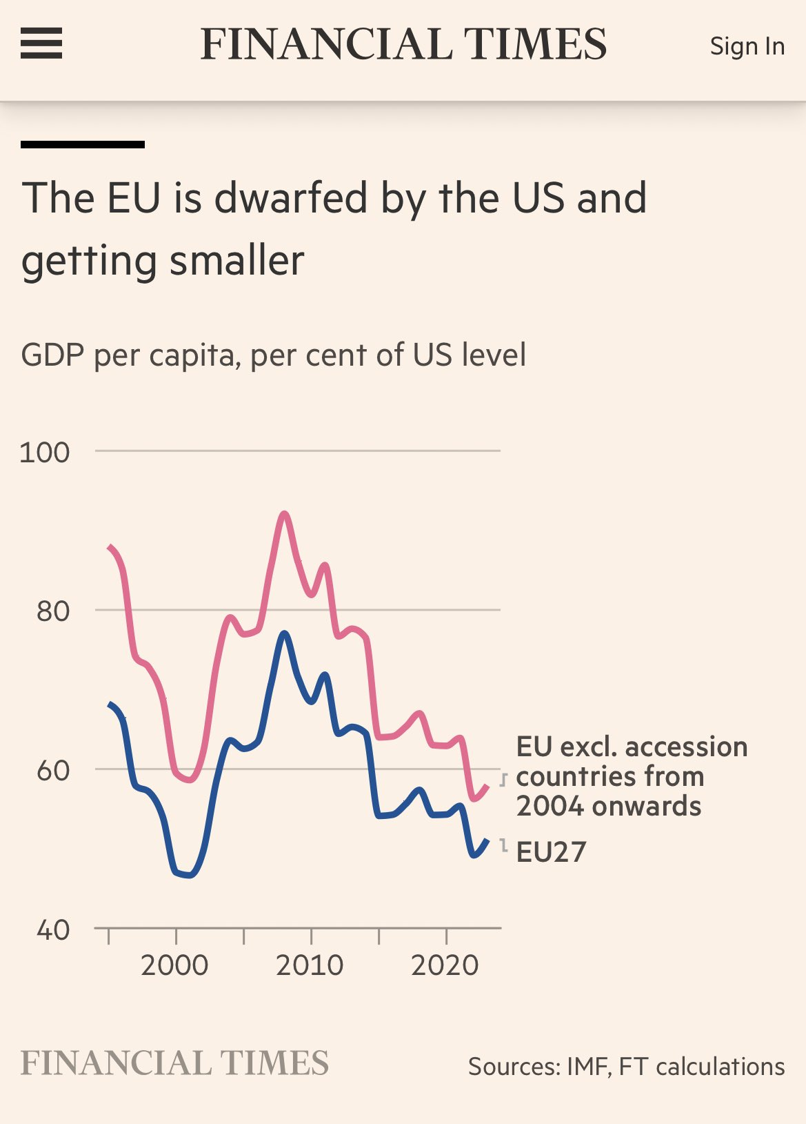

Slide 28
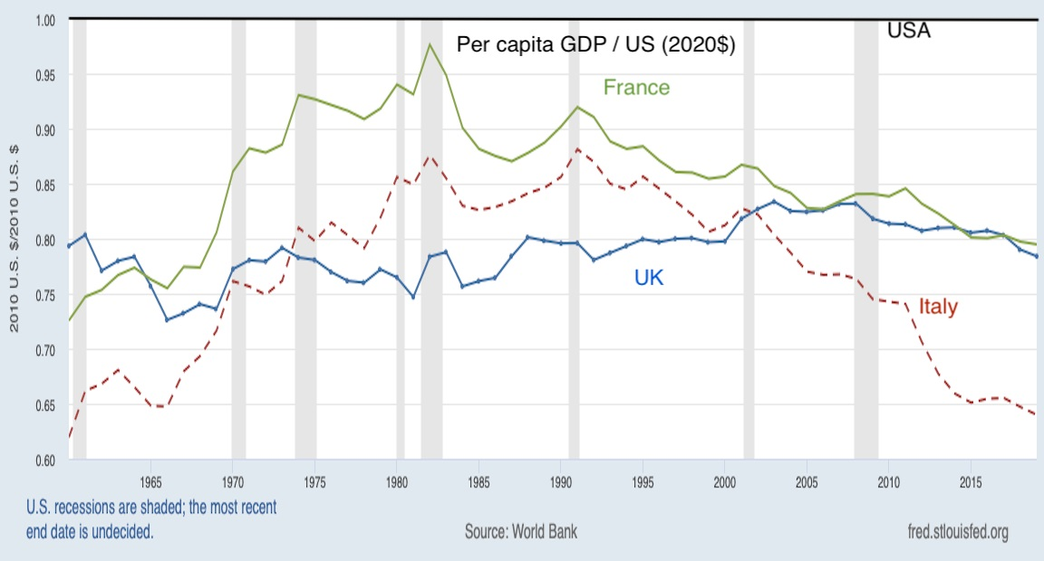

Slide 29
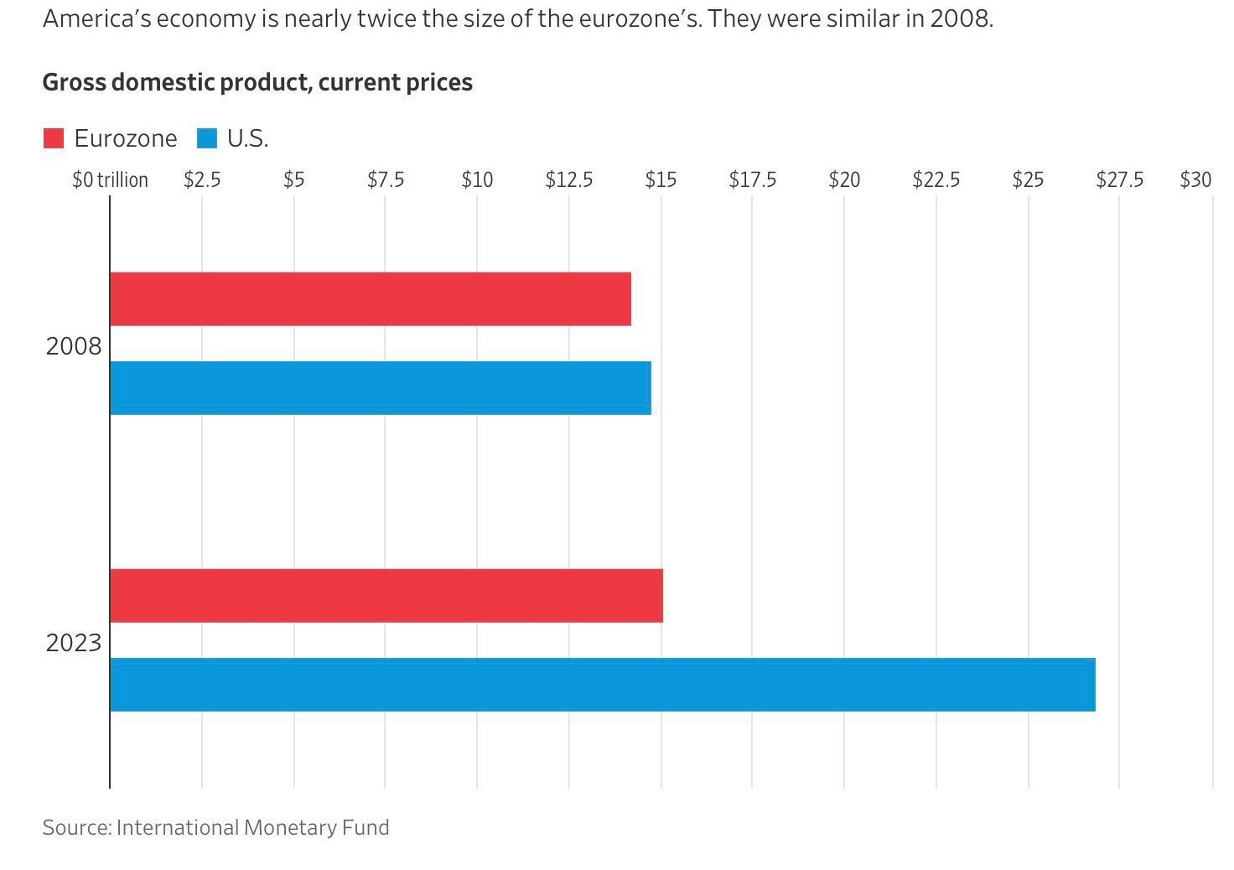

Slide 30
Part III: The E.U. Is Statist
Pushing for tax harmonization
Abandoning “mutual recognition” and embracing regulatory harmonization.
Pushing “net zero” policies.
Favors redistribution (CAP, etc).
Seeking “own resources”
“Mutualization” of debt

Slide 31
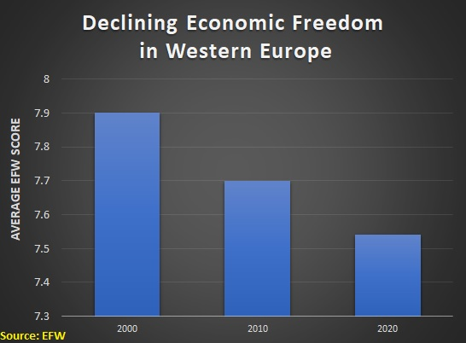

Slide 32
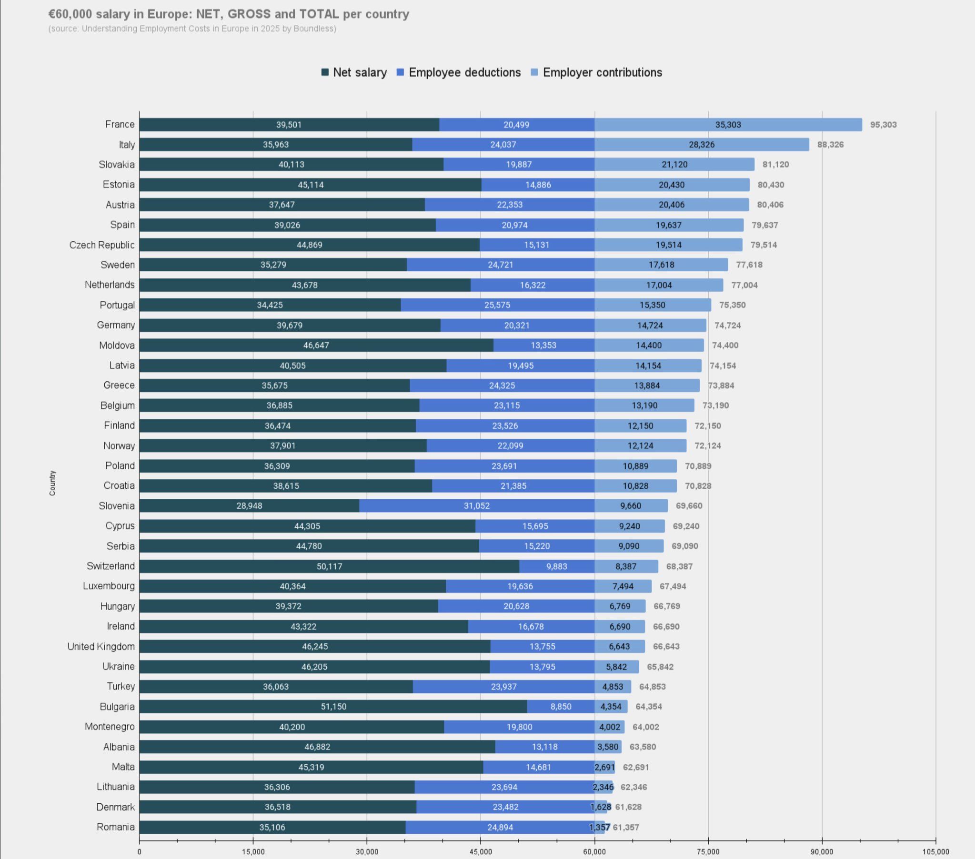

Slide 33
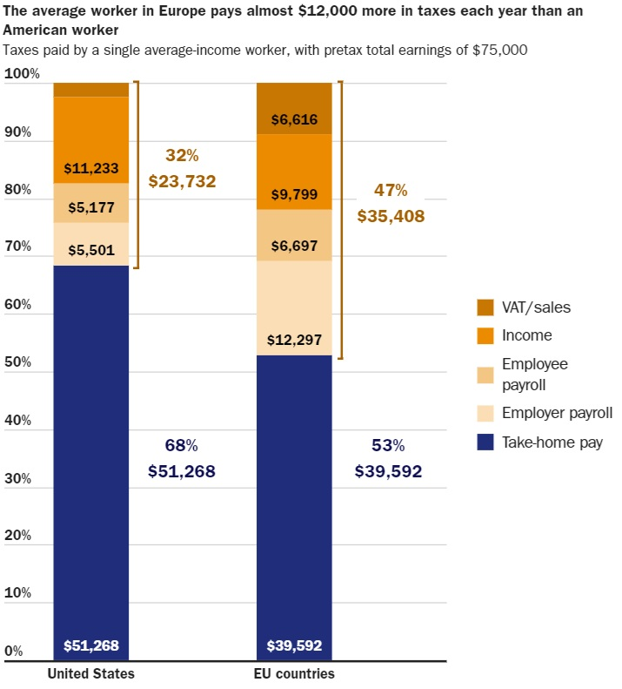

Slide 34
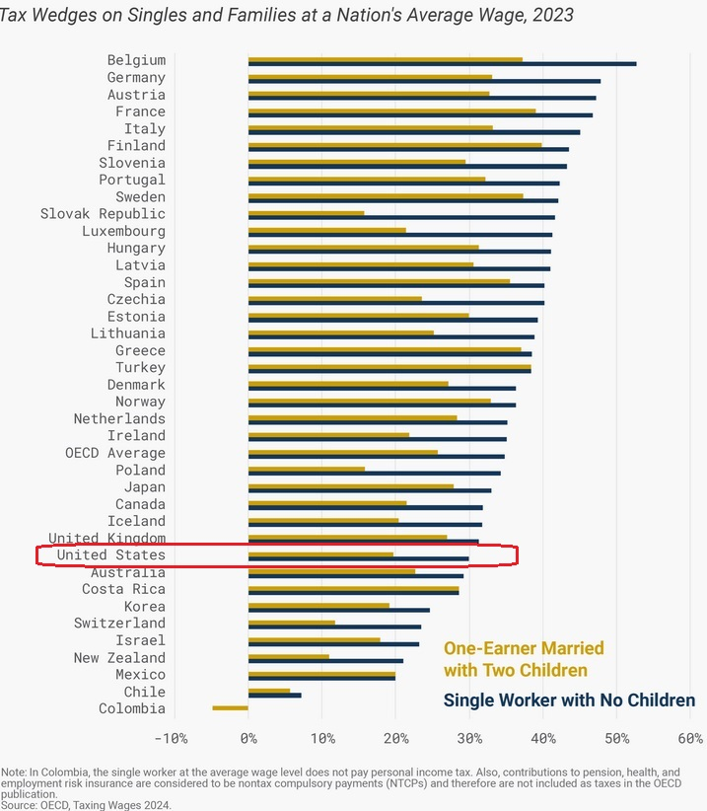

Slide 35
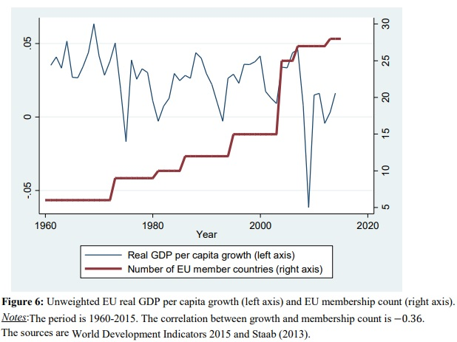

Slide 36
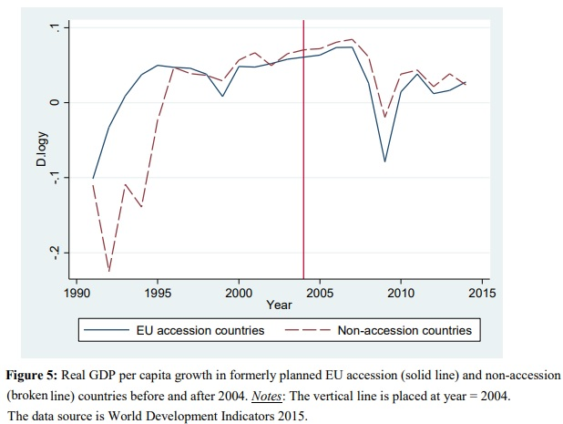

Slide 37
Part IV: The E.U. Is a Sinking Ship
The problem goes beyond economic anemia and dirigiste policy.
When demographics are added to the equation, the E.U.’s outlook is grim.
Over time, fewer taxpayers and more tax consumers.
Responsible nations (perhaps including Iceland) will finance bailouts.

Slide 38
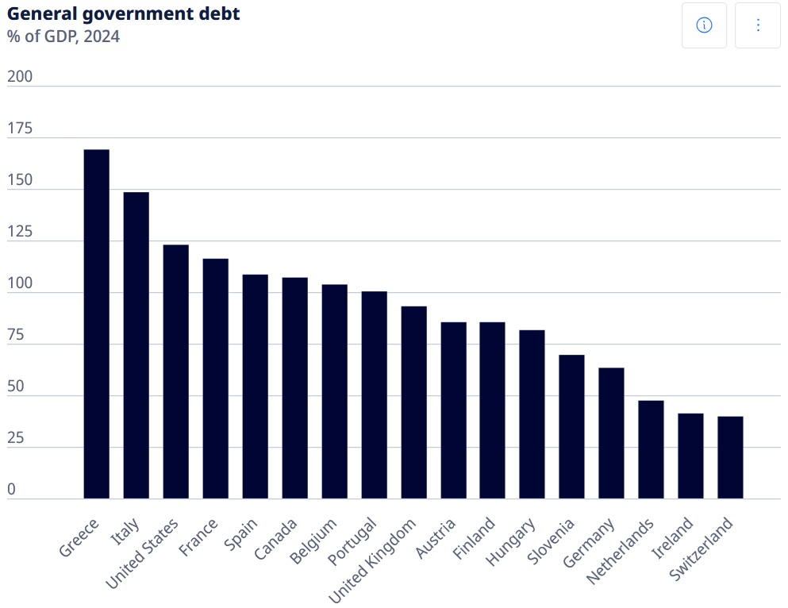

Slide 39
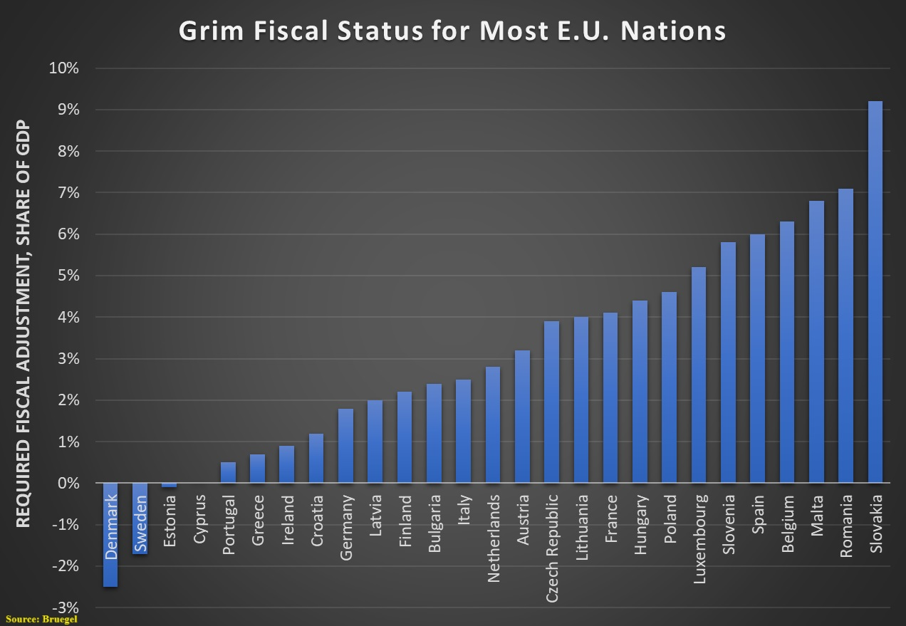

Slide 40
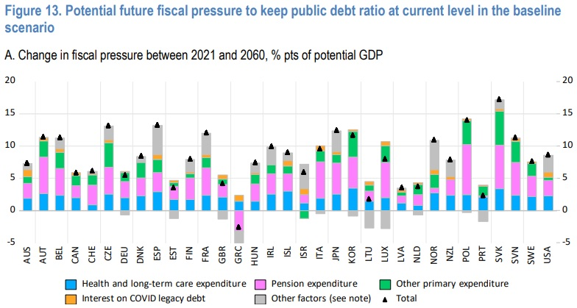

Slide 41
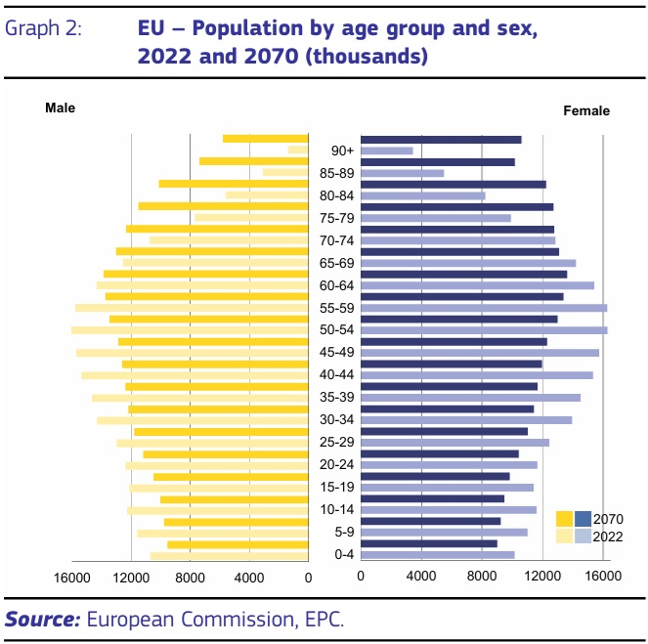

Slide 42
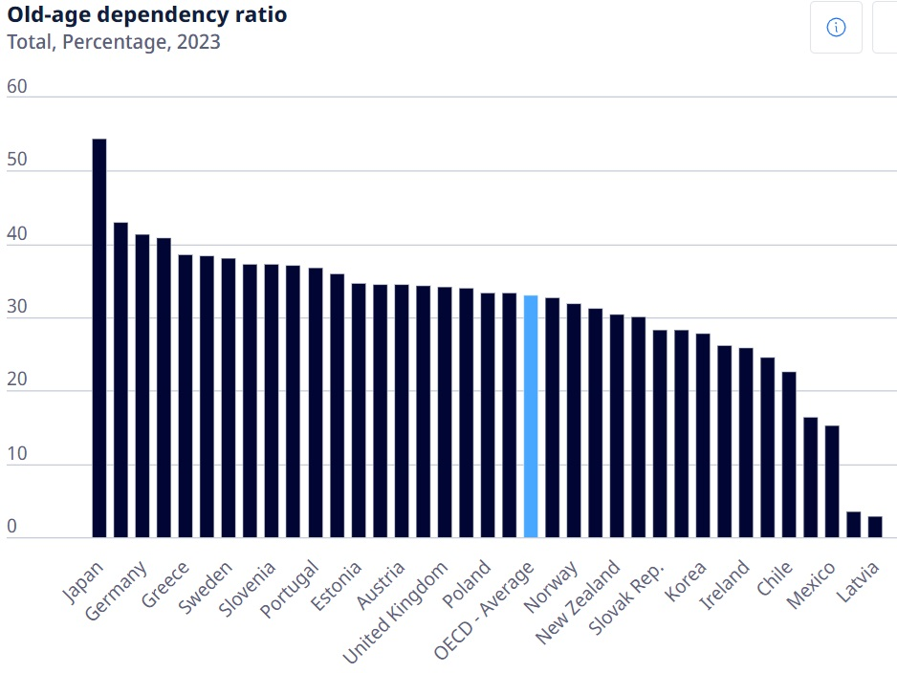

Slide 43
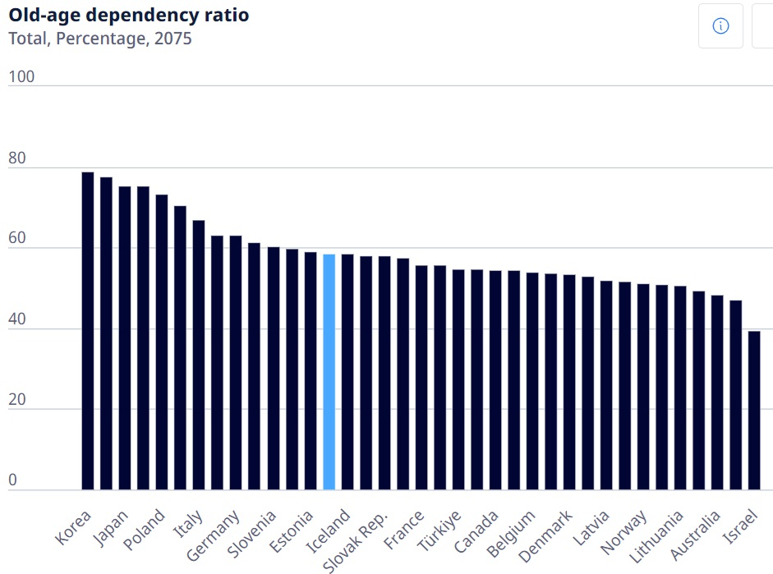

Slide 44
Main Takeaway
E.U. membership makes sense for a poor and backward nation (Albania?)
  Better rule of law (albeit too much law)
  Perhaps less cronyism/corruption
  Handouts from Brussels
Doesn’t make sense for Iceland
  Would create pressure for more statism
  Iceland would be a (growing) net payer

Slide 45
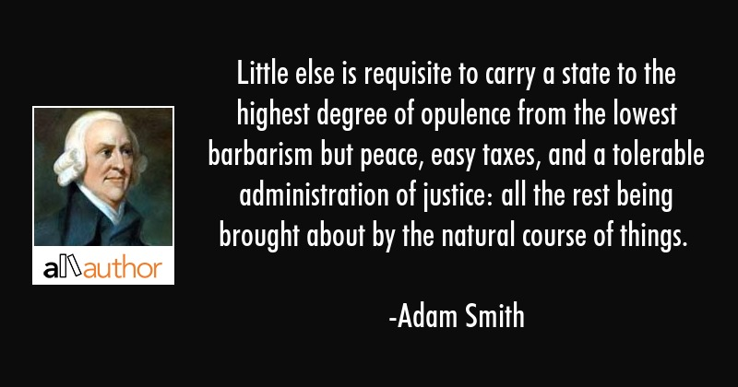
What Iceland Should do…

Slide 46
Conclusion
Site: www.danieljmitchell.wordpress.com
Twitter: @danieljmitchell
Website: www.freedomandprosperity.org
E-Mail: mitchell@freedomandprosperity.org

Slide 47
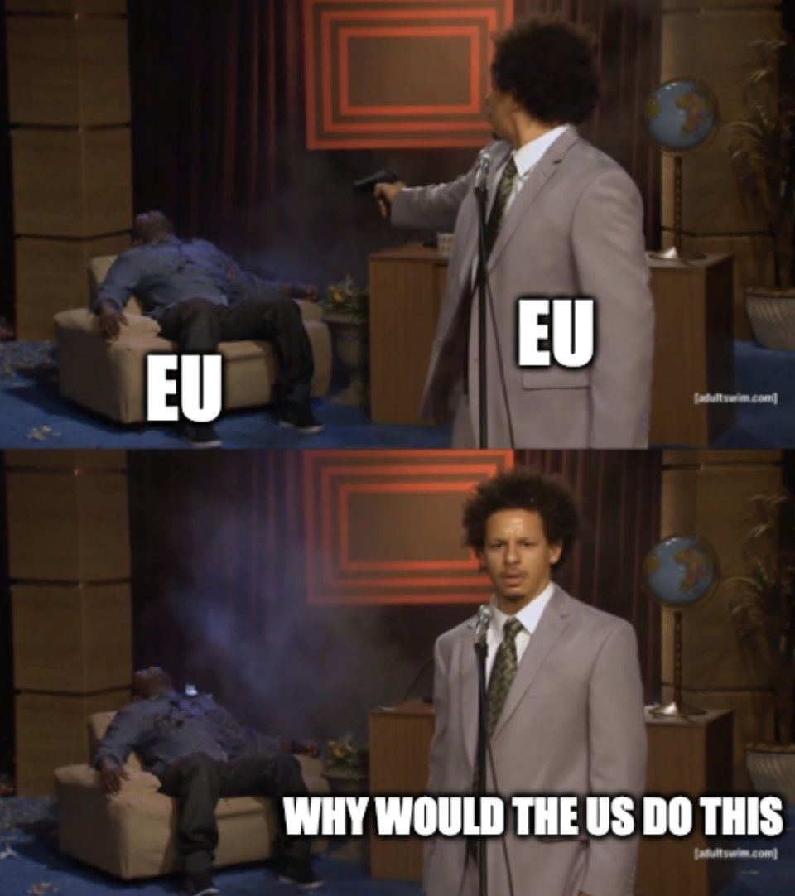

Slide 48
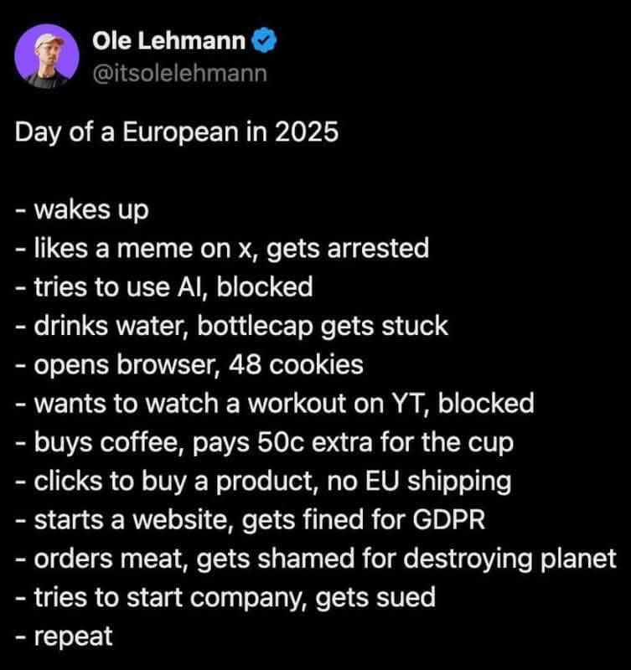

Slide 49
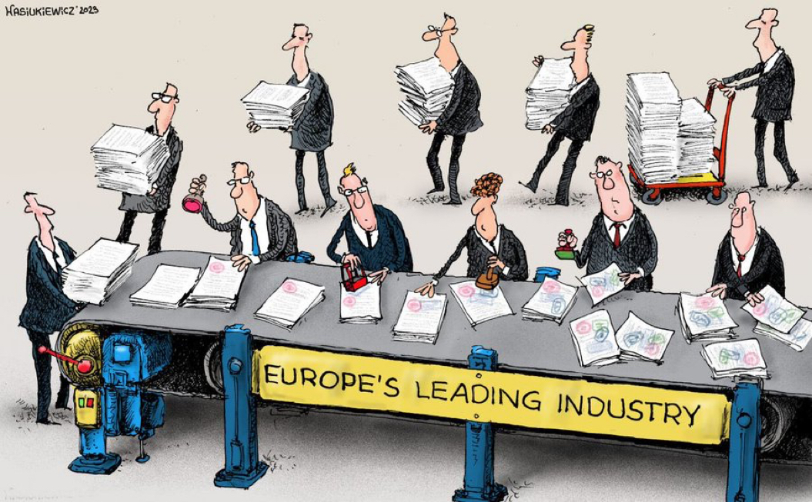

Slide 50
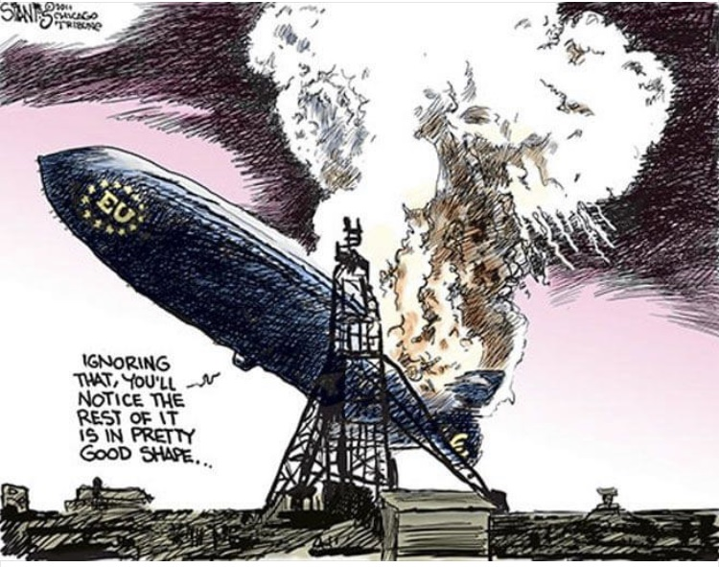

Slide 51


Slide 52
