Slide 1

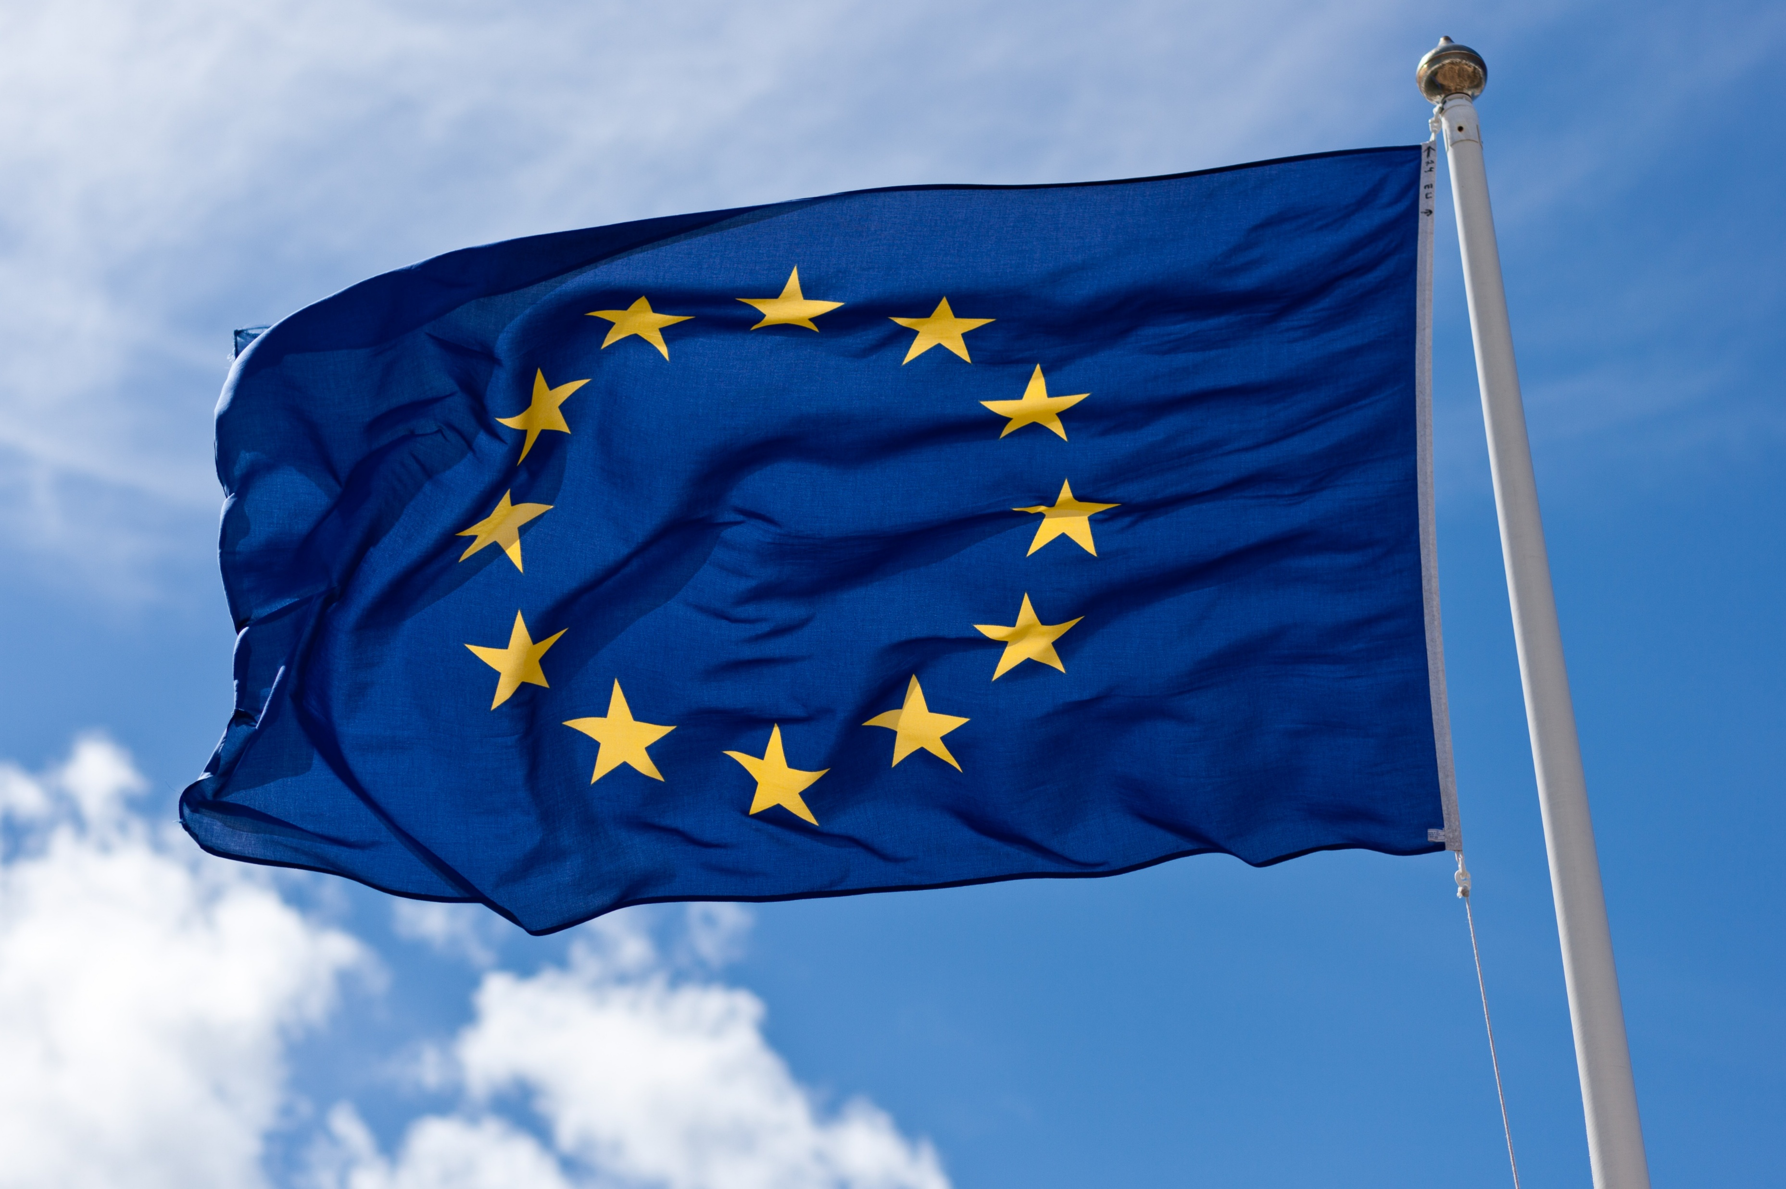
Ragnar Arnason
Iceland and the EU:
Does it make sense for Iceland to join?
Students for Liberty
Meeting in Reykjavik
4. Oct. 2025
Notes:
Considerable political pressure to drag Iceland into the EU (from the EU and certain political parties in Iceland).
Here try to consider the costs and benefits objectively

Slide 2
Self-evident truth (?)
One joins an association if one expects to benefit
…. and the risk (of a mistake) is not too great

Slide 3
Joining the EU: What are the potential benefits for Iceland?
Economic benefits (income, economic growth etc.)
Social benefits (more individual freedom, improved social security, stronger human rights etc.)
More national security (national independence, absence of foreign encroachment, wars etc.)
Notes:
Usually, the analysis stops with economic benefits.
Here, however, consider also other issues

Slide 4
Economic benefits?
Iceland is richer than the EU (GDP/cap ≈ 24% higher)
Iceland has higher economic growth than the EU (0.2-0.6% per annum)
EUs economic future is bleak (M. Draghi’s & E. Letta’s reports in 2024)
Iceland already has largely unhindered access to EU markets
(…..which are diminishing in global economic significance anyway)
Iceland has large untapped natural resources, the EU few
Net annual payment of Iceland for membership ≥1% of GDP
Economic loss (much) more likely than gain!

Slide 5
Increased national security?
Membership of the EU gives up part of national independence!
Is there less risk of national encroachment by other nations?
By Russia? No (Already have US-Icelandic defense treaty; NATO)
By China? No. (China very distant. Also the US-Icelandic defense treaty & NATO)
By the US? Possibly (…. but consider Greenland)
Which nations have violated or threatened Icelandic independence in the past?
UK, Denmark, Norway, Germany, the US (… not Russia or China)
More national security? Hardly!

Slide 6
Other social benefits?
More individual freedom?
National independence↓
Disposable income↓
Ability to travel, seek work, education etc. (↓)
More social security/welfare supports?
Iceland already has more than the EU
More protection of individual rights?
Possibly
Unlikely to be significantly positive!

Slide 7
To summarize:
The expected net benefits for Iceland
of joining the EU
seem to be negative!

Slide 8
There is an important additional consideration:
The option value of postponing decision
The outcome of joining the EU is not certain.
Joining may turn out to be a mistake.
Postponing the decision (to join) is an option.
This option has a value (because of the risk of a mistake).
This valuable option is lost if Iceland joins.
∴ The expected value of joining must exceed the option value!
The usual expected benefits rule is erroneous!

Slide 9
Ignoring the option value (Illustration of the potential error*)
* Assumptions:
Expected benefits >0
Rate of disc. 5%
The expected
PV-rule
Join
Option value rule
Join
Notes:
Realizing the option value makes the attractiveness of joining much smaller

Slide 10
Conclusion:
It doesn’t appear to make sense
for Iceland to join the EU
Even if the expected net benefits were positive, option value theory suggests postponing!

Slide 11

End

Slide 12
GDP/capita 2023 (USD. Purchasing power parity (PPP). Price level 2021) (Source: World Bank)
Iceland - EU: +24%
Iceland – Euro-zone: +19%
Notes:
Ísland 24% hærra en ESB og 19% hærra en Evrulönd.
Ísland stendur sig vel án ESB (hlýtur að vera að gera eitthvað betur en ESB)
Ef Ísland gengur inn í ESB eru líkur á að Ísland dragist niður í meðaltal ESB

Slide 13
Economic growth (Annual growth GDP/capita 2000-23. PPP measure) (Source: World Bank)
Iceland vs. Euro-zone
Difference in annual growth: 0.57%
=> GDP after 10 years ≈ +6%
=> GDP after 25 years ≈ +15%

